Slide 1
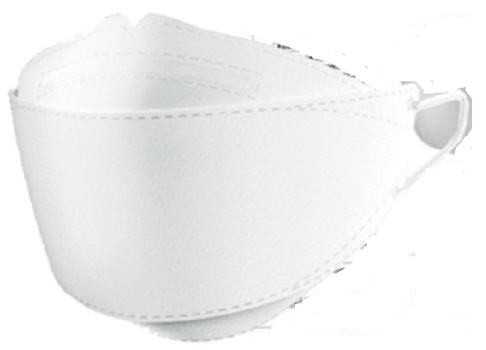
Project : Face Mask Logo + Sub Logo
Brand Name : PROMAK
PRO (Professional/Protective) MAK (Mask)
Sub Brand Logo : PROMAK SALT (3D, COMFORT, PRO) - Using salt filter
PROMAK MB - Using Melt-Blown Filter
Notes : No limitation of colors
Logos bear symbolization of mask and Salt

