Slide 1
Ram:
Extending Its Strategic Capabilities
A Partnership Overview with Alden Advisors

Slide 2
ALDEN ADVISORS OVERVIEW

Slide 3
Alden Advisors Overview
A leading financial advisory firm for the middle market serving companies that:
  Possess niche intellectual property and/or product/service experiences
  Have created value by specializing and offering unique products or services
Our team of Operational Deal Makers leverages decades of experience owning, operating, and advising middle market companies and management teams
  We partner with our clients to identify growth partners possessing debt and equity capital and strategic or synergistic offerings
Our points of differentiation:
  Broad industry, operational, and financial experience
  Experience in intellectual property management and technology
  Operational vs. Financial Deal Makers who see and articulate value beyond financial engineering metrics
  Complex transaction structuring expertise
  Committed partners from “Go to Close” providing hands-on support through due diligence and the completion of all legal documents
  Relationships with an array of financial sponsors and capital providers across the U.S., Europe, and Asia

Slide 4

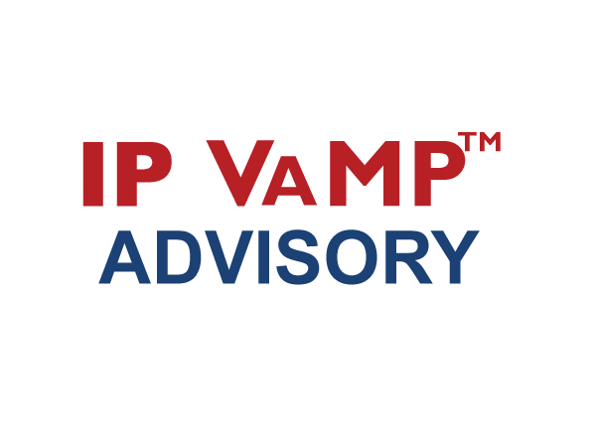
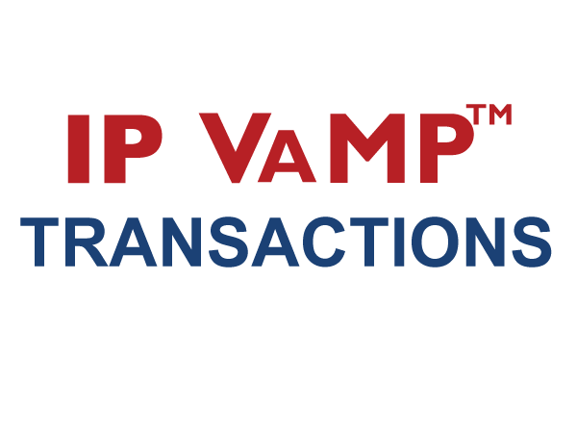
Our Unique Process
IP VAMP™ or the IP Value Maximization Process, is our unique and proprietary process that maximizes value by focusing on our client’s Core IP Experience™

Slide 5
Our Team of
Operational Dealmakers

Slide 6
Your Alden Advisors Team
Derrick Reagins
Derrick Reagins is the founder and Managing Partner at Alden Advisors. He has 15 years of industry experience in information technology, investment banking and private equity. Mr. Reagins has a broad background in mergers and acquisitions, corporate business development, strategic marketing and technology.
Prior to founding the firm, Mr. Reagins provided growth advisory services to middle-market companies in the technology, consumer products and manufacturing industries through acquisition, capital raising and operational strategies. Prior to this, Mr. Reagins worked with Texas Instruments in the mobile device processor group where he led the P&L planning and developed the global marketing strategies for emerging technologies. Additionally, Mr. Reagins was an integral member of the Business Objects’ (now SAP) corporate business development team, where he developed and executed corporate strategy through M&A, intellectual property management, equity investments and strategic alliance activities. He also identified, evaluated and invested in early-, mid- and late-stage private equity investments throughout Western Europe for the Paris, France-based Partech International. Mr. Reagins has diverse operational experience ranging from business development and product management activities in Asia to the management of a software development team in France.
Mr. Reagins holds an MBA specializing in M&A and Intellectual Property Management from the University of California, Berkeley, CA, a MSEE degree from Georgia Tech, a MSEE degree from École Supérieure de l’Électricité (a renowned French engineering university), and a BSEE from Purdue University, West Lafayette, IN. Mr. Reagins holds Series 63, Series 79, and Series 82 licenses and is bilingual in English and French.

