Slide 1
ALDEN ADVISORS OVERVIEW

Slide 2
TEXT HERE

Slide 3
Alden Advisors Overview
A leading financial advisory firm for the middle market serving companies that:
  Possess niche intellectual property and/or product/service experiences
  Have created value by specializing and offering unique products or services
Our team of Operational Deal Makers leverages decades of experience owning, operating, and advising middle market companies and management board
  We partner with our clients to identify growth partners possessing debt and equity capital and strategic or synergistic offerings
Our points of differentiation:
  Involve two ‘senior’ partners with solid business & financial network actively on each deal from start to closing
  Relatively Strong technical + business operations & deal experience in Tech including understanding emerging tech value chain
  Quantify strategic synergies, value prop, Unlock value of Patents & IP and overall business ROI a lot better
  Motivate Corp/BU sponsors well before warming the corp dev to lock value where it matters the most
  Deliver best in class IM that becomes an 'asset' and most often cuts the closure time/DD by half. Broad industry, operational and financial experience

Slide 4
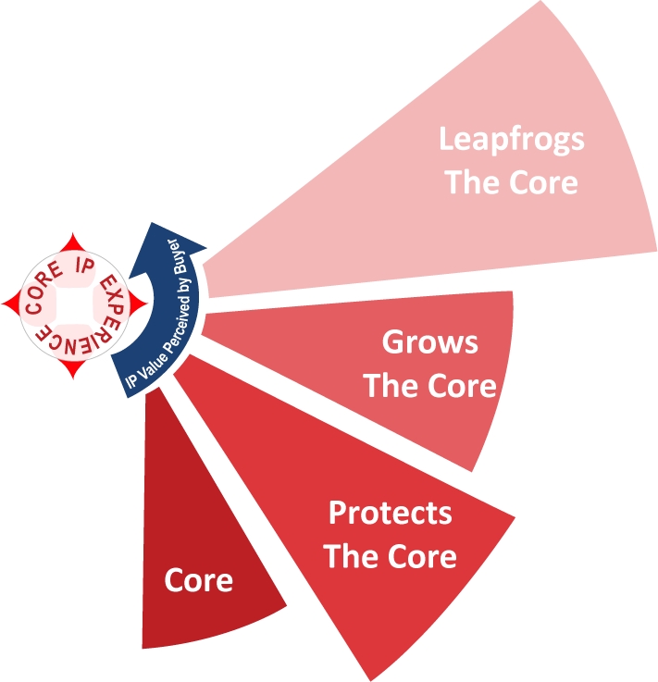
IP Engineering: Aligning Value With A Buyer’s Rationale
Alden Advisors creates a unique thesis for each buyer that emphasizes our client’s Core IP Experience™
Core Business
A buyer’s principal business activities
Protects the Core Business
IP assets or experiences which strengthen or protect the Core Business by 1) providing access to key enabling technologies 2) extending R&D activities and/or 3) hedging against disruptive technologies
Grows the Core Business
Logical extensions of the Core Business which 1) provide access to new products, markets, and customers and/or 2) give the buyer an unfair advantage against its competitors
Leapfrogs the Core Business
IP asset, which, if successful and subsequently leveraged, may permit a buyer early access to redefine its Core Business

Slide 5
Merger and Acquisition Services (Cont’d)
Due Diligence Support – Complete support and coordination of the due diligence process through gathering of all information necessary for financial, operating, and legal review of target companies, including all regulatory reviews
Financial Analysis and Modeling – Review and analysis of target company financial statements and gathering of additional management input to validate operating and financial performance
Acquisition Valuation – Development of an acquisition valuation based on analysis of financial statements, industry research, and review of completed industry transactions
Acquisition Financing (Capital Raising) – Raising, Structuring, and Negotiating the terms and conditions of investment capital required to acquire and capitalize our client in accordance with investor expectations and regulatory guidelines
Corporate Governance (Board of Directors & Management Recruiting) – Working with our affiliate, Brockman Owens Executive Search, we assist our clients in attracting and retaining executive management in all disciplines
Confidential Information

Slide 6
Target Identification Screening Criteria
We will conduct qualification interviews with CEOs and CFOs to share our client’s strategy, learn about the target company and its operations and to determine their interest in being acquired. The following subjects will be conversed:
Company Overview -- a general description of the company, staff, its formal and informal intellectual property and services offered
Revenue and Net Income Information -- the previous year, year-to-date, recurring revenue and annual projections
Ownership Structure --- percentage of all owners both active and passive, management team function and tenure
Transaction Needs and Interests – ownership goals, how they value the firm and their vision of a perfect transaction
Transaction Timeline -- has ownership discussed how long it will take to meet their M&A goals/needs
Company/Market Strengths – culture, backlog, partnerships, trends
Company/Market Challenges – market competition, operational challenges, customer concentration
Future Strategic Business Plans and Opportunities -- opportunities that will affect company projections positively
Confidential Information

Slide 7
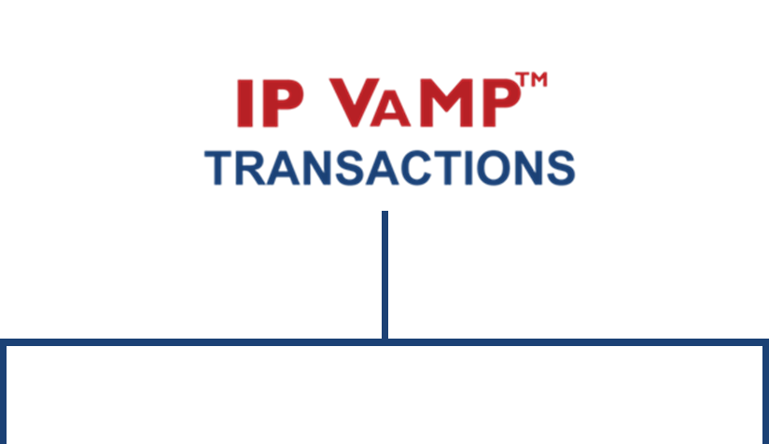

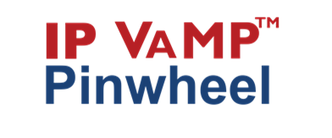

IP VAMP™ Pinwheel Buy-Side Process: A Complete Summary
Acquisition Criteria Development
Industry Analysis and Market Research
Target Company List Development
Target Company Research
Target Company Approach
Acquisition Lead Presentation and Reports
Due Diligence Services
Financial Analysis and Modeling
Acquisition Valuation
Acquisition Financing (Capital Raising)
Acquisition Closing Consultation
Corporate Governance (Board of Directors & Management Recruiting)
Acquisition Criteria Development
Industry Analysis and Market Research
Target Company List Development
Target Company Research
Target Company Approach
Acquisition Lead Presentation and Reports
Confidential Information

Slide 8
Select Transactions

Slide 9
2880 Zankar Road
Suite 203, San Jose CA 95134
+1.469.269.6460 x106 Office
+1.650.334.6366 Cell
sunil@AldenAdvisors.com

