Slide 1
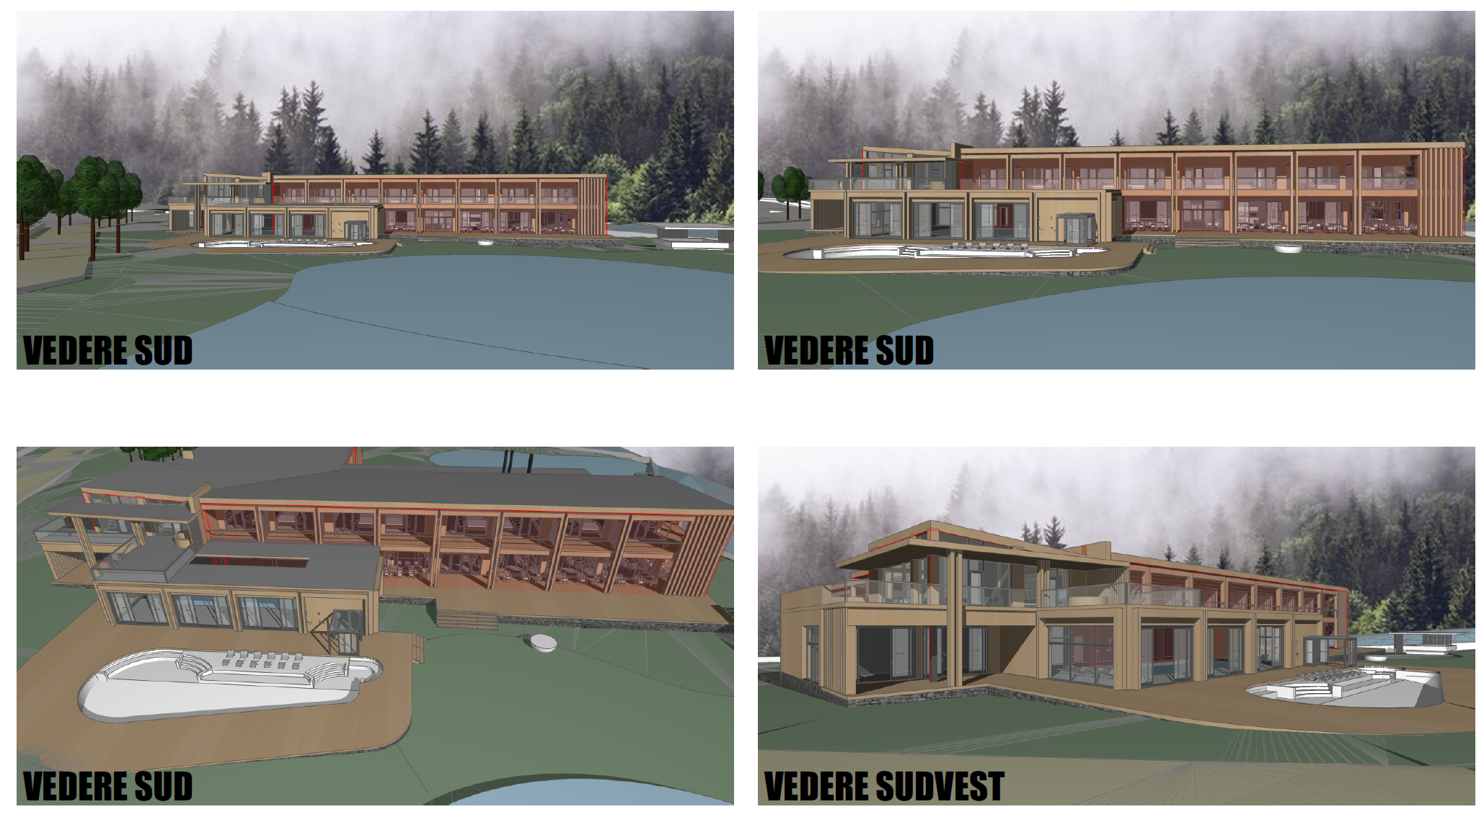
BERIVOI
NATURA
VILLAGE
Our resort will be built in a minimalist modern design with lots of wood, standing out in the wild surrounding nature. In the same time a classic style which has passed the test of time.
We should be inspired from the great classics, modern or rennaissance.

Slide 2
BERIVOI
NATURA
VILLAGE
Archetypes of our place:
Sage + Lover + Ruler
We believe the Queen is an embodiement of all 3, but we would like to explore variant where Sage, or Lover or Ruler take the front seat.

