Slide 1
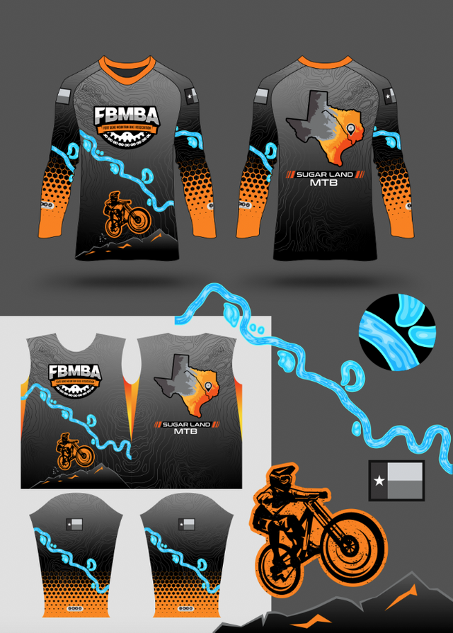
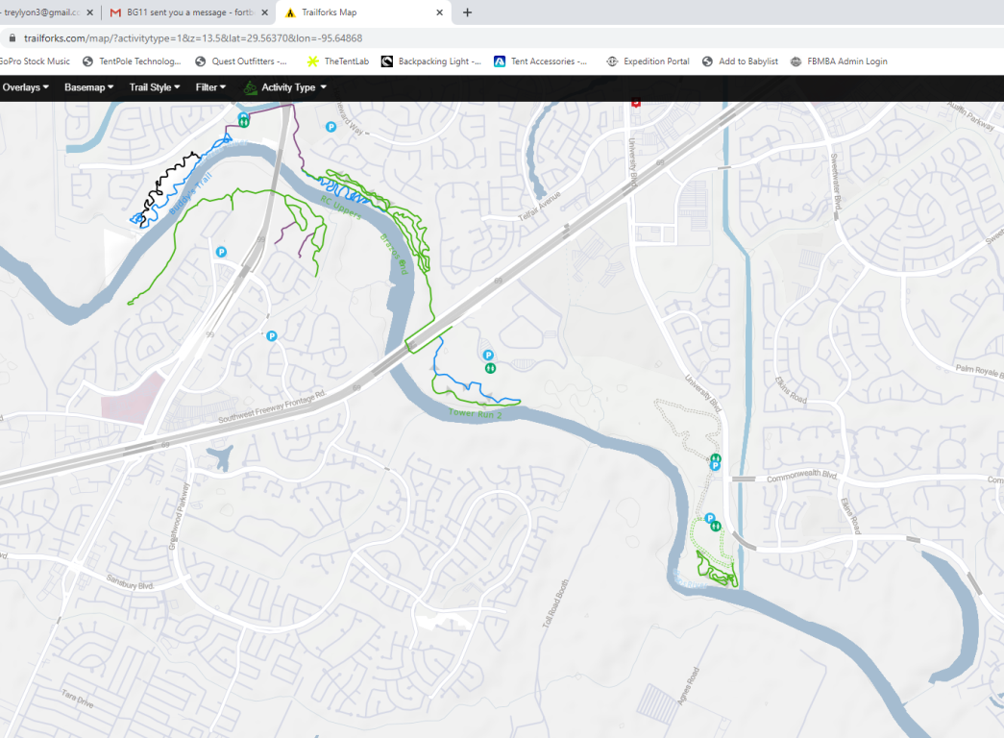
1. Use this part of the river on the chest
2. Could we see what it looks like with the trails overlain? The trace doesn’t need to be exact to each and every single curve, just the general shape of the trail. Only the green, blue, and black lines need to be traced. I’m just curious if this would look good or not. Interactive map location:
https://www.trailforks.com/map/?activitytype=1&z=13.3&lat=29.56758&lon=-95.64742

Slide 2
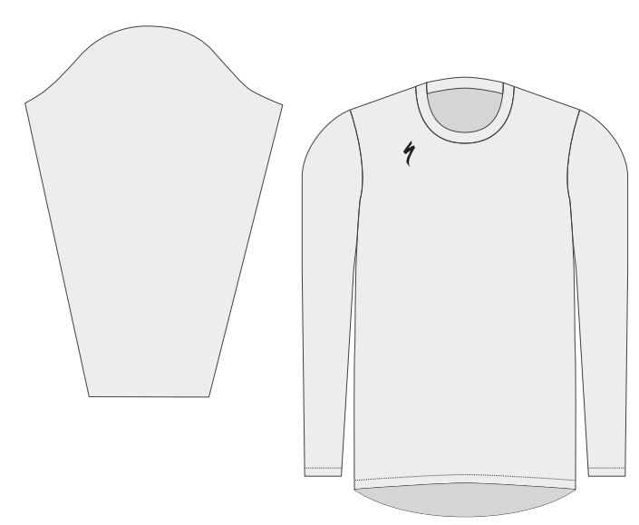

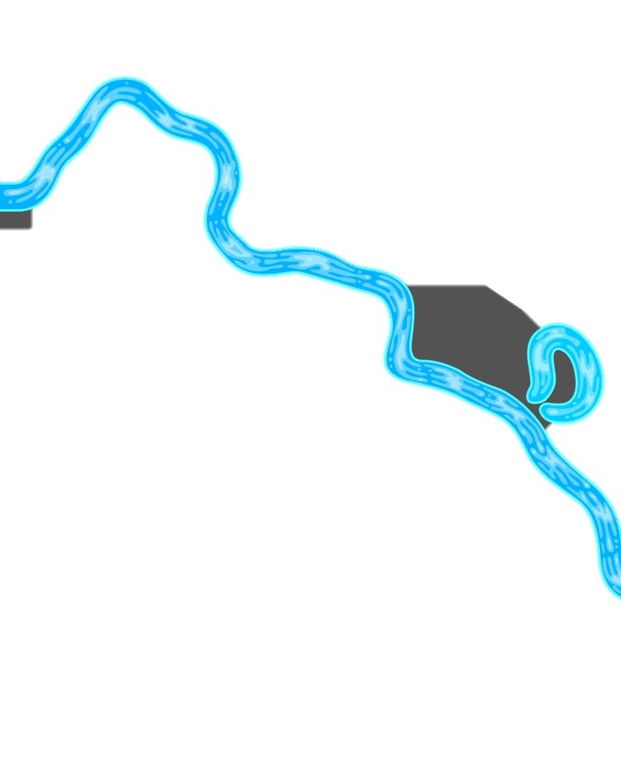

Use this section for the river for the chest so that all the trails can fit on the chest. No trails should be on the sleeve. Let’s outline the trails in the same orange color
Just make it a continuation of the river w/ the same texture. Doesn’t really matter how accurate it is. It’s not an important section. It should look like the river flows from the chest to across the arm, but only the chest will have trail outlined.
Just an idea because it’s from our existing logo. I don’t care either way. Your call if you think it might look better.

Slide 4
