Slide 1
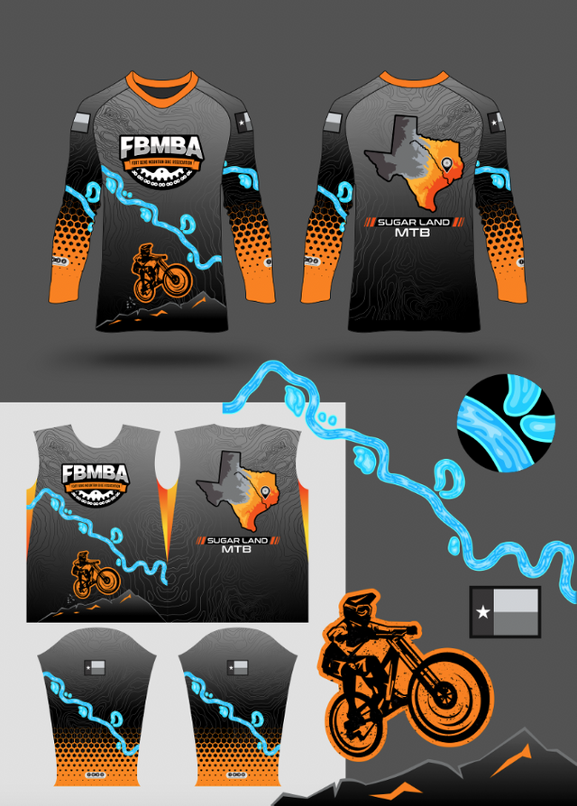
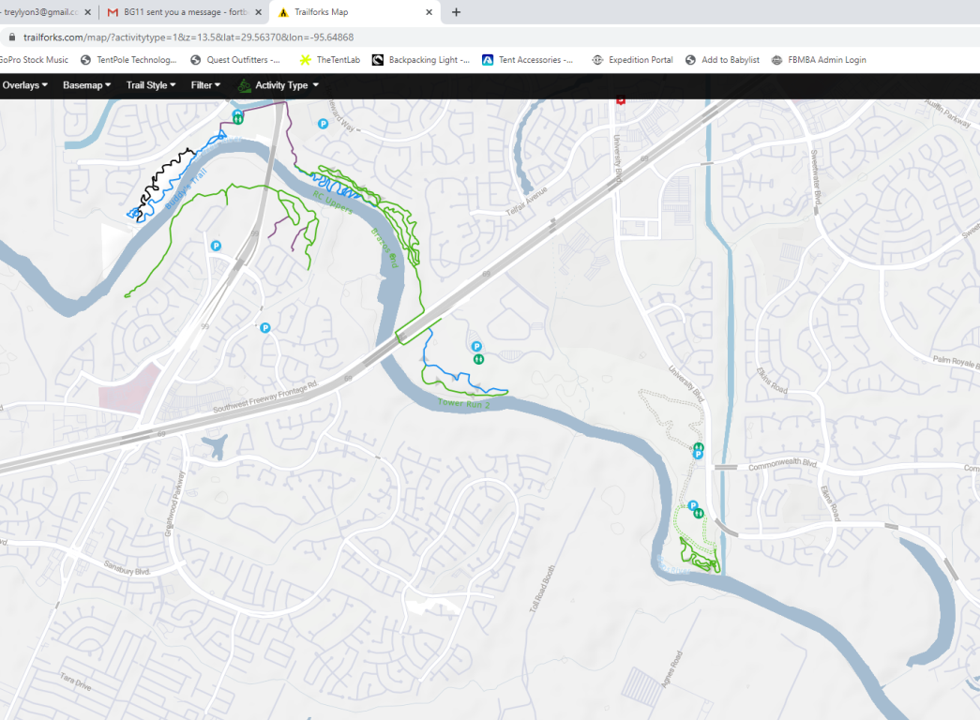
1. Use this part of the river on the chest
2. Could we see what it looks like with the trails overlain? The trace doesn’t need to be exact to each and every single curve, just the general shape of the trail. Only the green, blue, and black lines need to be traced. I’m just curious if this would look good or not. Interactive map location:
https://www.trailforks.com/map/?activitytype=1&z=13.3&lat=29.56758&lon=-95.64742

