Slide 1

This one is simple and integrates the company name into a design symbolic of the nature of the company.

Slide 2

This one is simple and you can tell just by looking at it what type of industry or sector they are involved in.

Slide 3

This one is simple and clean, and the design that speaks to their type of work (what looks like the tent) is subtle.

Slide 4

I like the simple design that integrates their values and product.

Slide 5

This one is great too – it integrates the key concept or brand into a creative design with simple shapes.

Slide 6
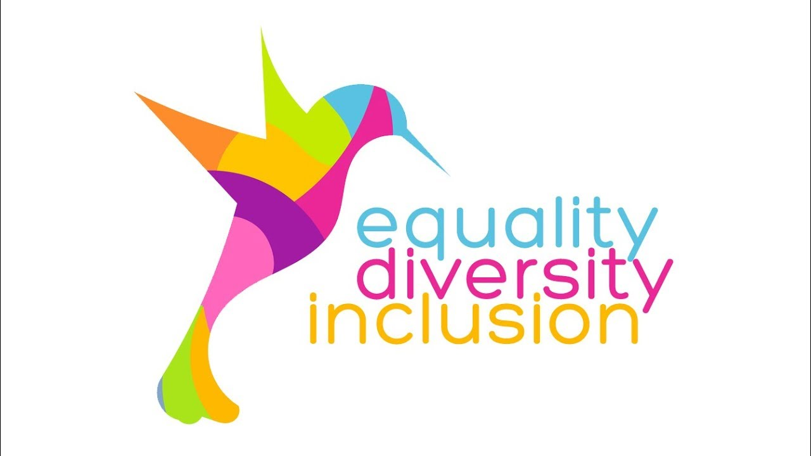


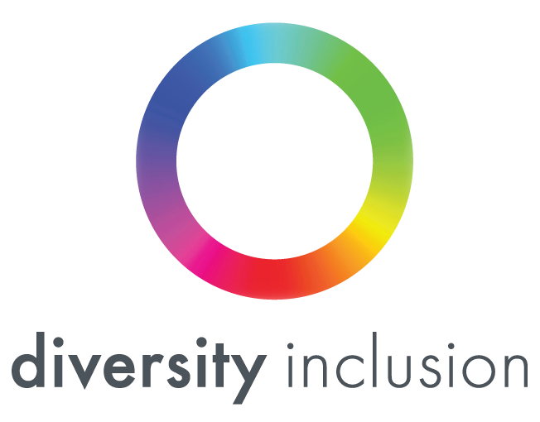
What we do NOT want
We don’t want logos that use the “rainbow” of colors. These are quite common for initiatives and organizations that do Diversity related work. We want to stand out more and not be seen as “just another company” that does diversity type work.

