Slide 2
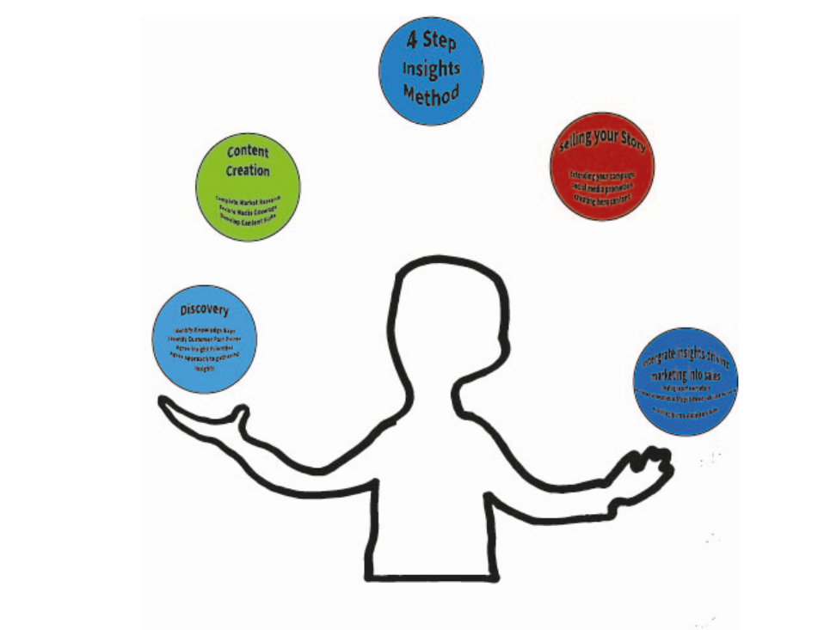
Personal brand building
Brand Personality:
Personable
Passionate
Thoughtful
Results orientated
Creative
Brand Style Guide:
Colours:
Red – AF180C
Blues – 0466C8, 1982C4, 00A6FB
Green – 8AC926
Fonts:
Anton (Vernon Adams) – for headlines
Taviraj (Cadson Denmark) – for sub headings and other text

