Slide 1


DAMMAM (KSA) KUWAIT (HO) RIYAD (KSA)

Slide 2
1
Our Vision, Mission and Goal
2
Our Journey
3
Our Services
4
Our Major Client ‘s
5
Company Future
Our Facilities
6
Certifications & Appreciations

Slide 3

1
Our Vision, Mission and Goal
To become the leading solution provider in GCC for Industrial Electronic Services, Automation and Energy Efficiency Services
Develop new solutions to mitigate market challenges in Industrial Sector
Offer A One Stop Shop - cost effective solutions for all industrial sector in Controls, Automation and Energy Efficiency Field

Slide 4


2
OUR JOURNEY
TSL is a Kuwait National Fund supported company, till date provided services to 30,000 Industrial electronic equipment's and supported 2,000 clients in Kuwait and Saudi.
2018
Smart Control Solutions
2017
Energy Monitoring Solutions
2015
Dammam (KSA) Established
2014
Riyadh (KSA) Established
2013
Automation Solutions
Field Maintenance - AMC
2012
History
Repairing Industrial Electronics

Slide 5

3
Our Services
ENERGY EFFICIENCY
SERVICES
INDUSTRIAL
REPAIR
INDUSTRIAL
AUTOMATION
TSL
SERVICES
EMERGENCY
SERVICES
INDUSTRIAL ANNUAL
MAINTENANCE

Slide 6
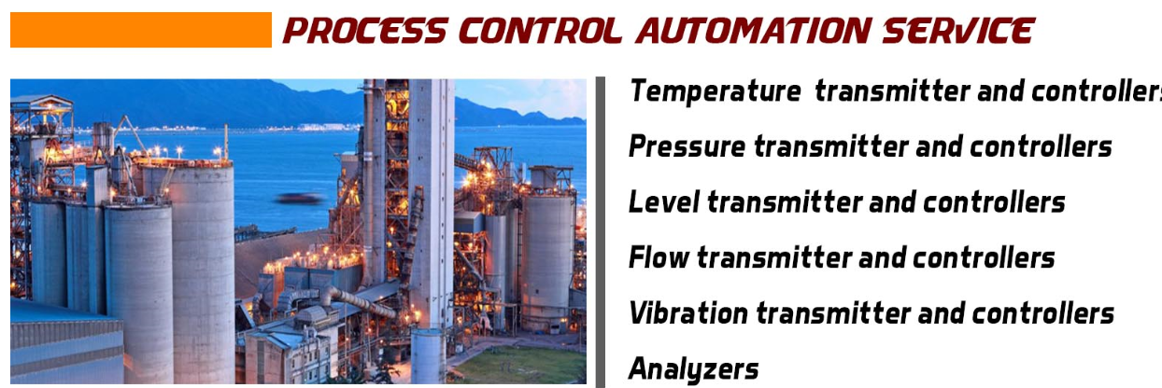
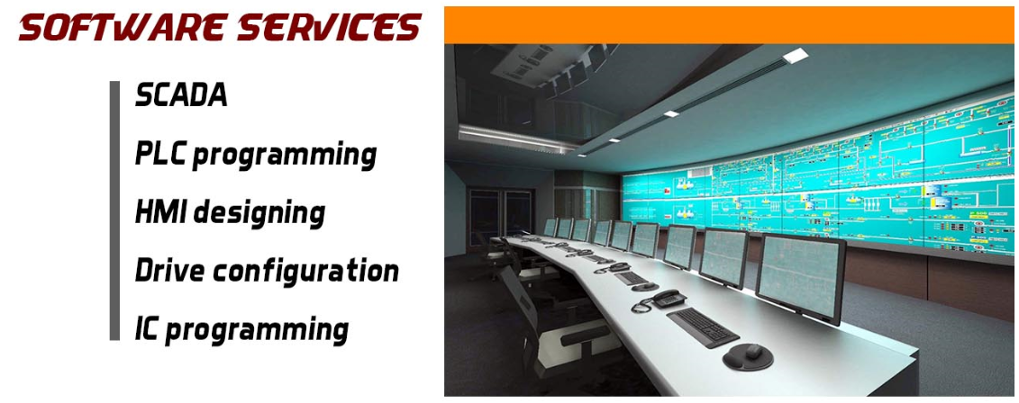
3
Our Services (Cont.)

Slide 7
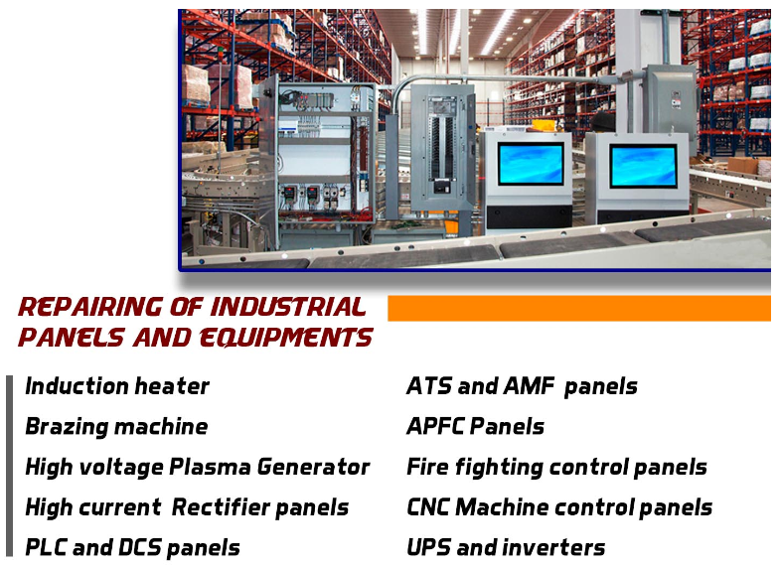
3
Our Services (Cont.)

Slide 8
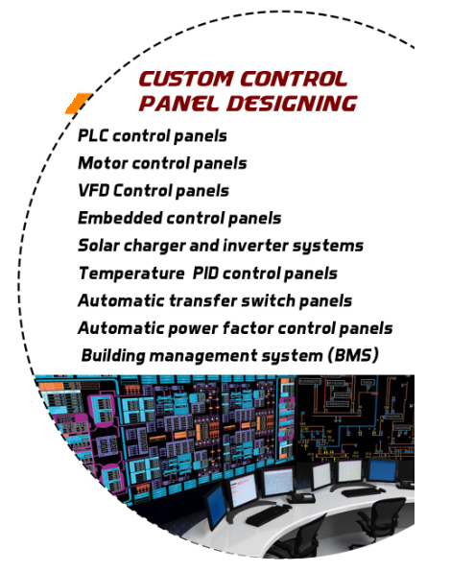

3
Our Services (Cont.)

Slide 9
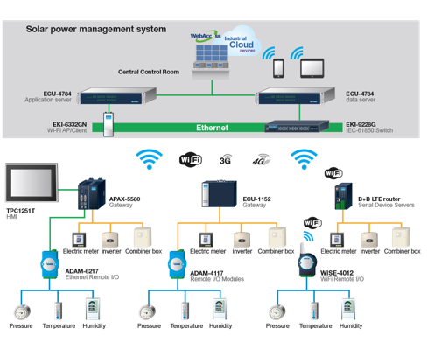
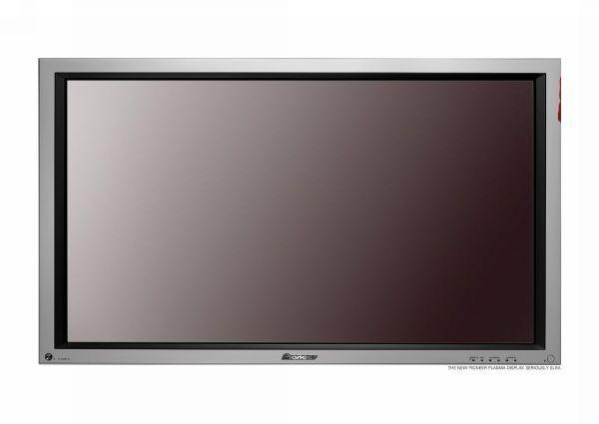
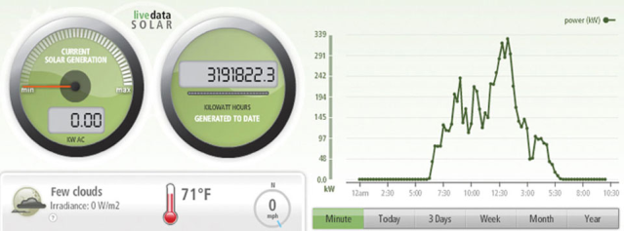
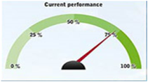
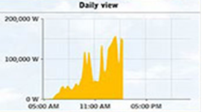
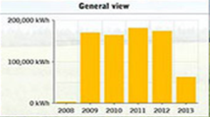
3
Our Services (Cont.)
ENERGY EFFICIENCY SERVICES (Monitoring & Controlling)
Industries
Office Buildings
Commercial Buildings
Schools
Universities

Slide 10
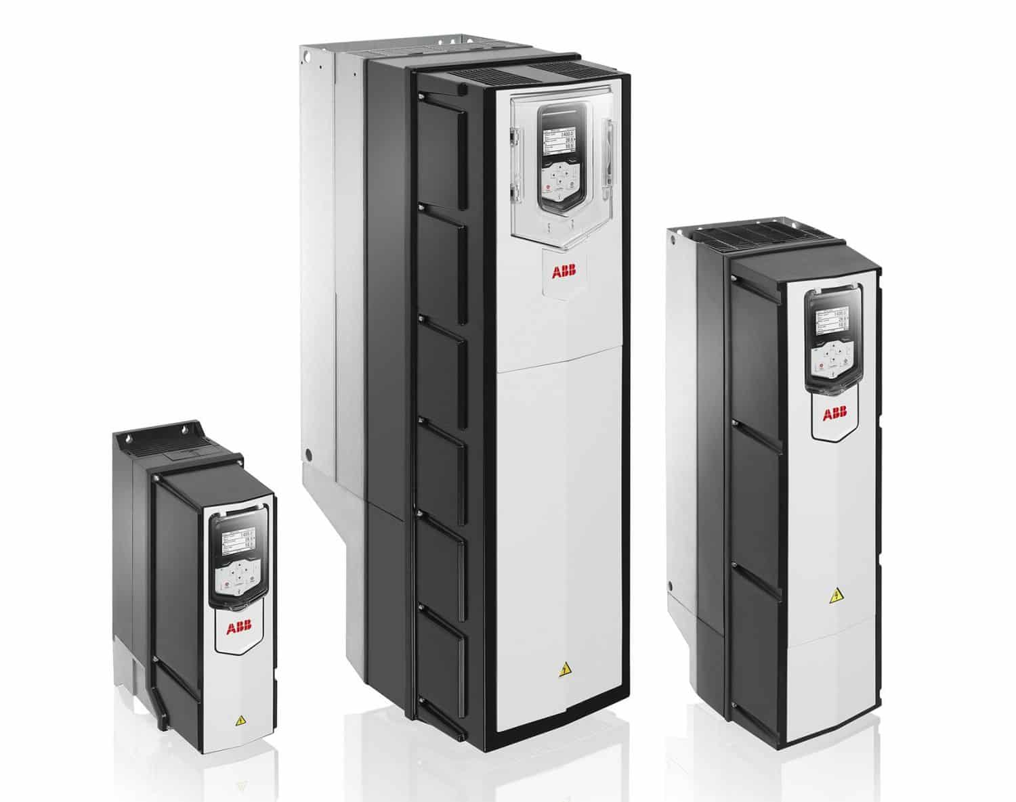
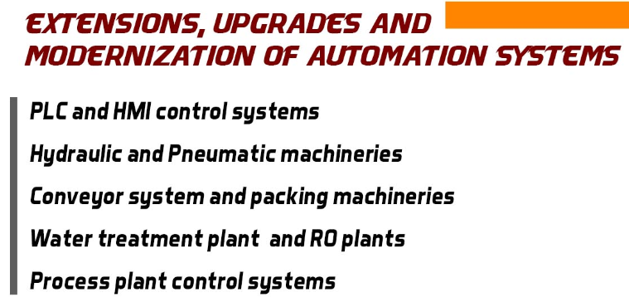
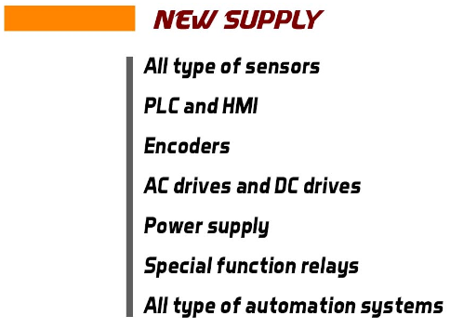
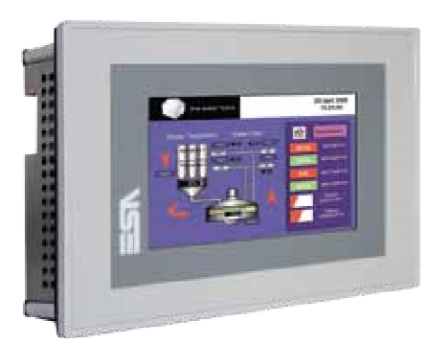
3
Our Services (Cont.)

Slide 11














4
Our Major Clients – Kuwait Oil Sector

Slide 12
4
Our Clients – Kuwait Industrial Sector
MEW | PEPSI | MPW | Gulf Cable & Electrical Co. | Kharafi National
United Foodstuff Industries Group Co. K.S.C.C | ABC Arabian Beverage Co. | Ashraf & Co. Ltd wll | Hassan Abul Marble Factory | Genoa Plastic Industries
Petra Food Manufacturing Company | AL-Sayer Soft Drinks Factory | The Trading & Industrial Equipment Co. wll | Kuwait Pipe Industries & Oil Services Co. | Mediator Industries & Com. Co.
Khazan Conserved FoodStuffs Distributing Co. W.L.L | Food Industries Co. (FICO) | Al Essa Medical & Scientific Equipment Co. wll | Wataniya Fiberglass Plastic Factory | United Neama Group Gen. Trad. & Cont. Co.
Kuwait Industrial Food Co. W.L.L. (KIFCO) | Rawdatain Natural Mineral Water | Gulf Paper Manufacturing Co. K.S.C | Refrigeration Industries | Mohamed Abdulrahman Al-Bahar
KITCO Kuwait Indo Trading Company Ltd. | KDD The Kuwait Danish Dairy Company | NCCI AL-Watania Paper Products Co. | Al-Rawad Aluminium Factory | Kuwait Boxes
Mickey Snax / Light Food Company (KSCC) | AL-Arabi Plastic Factory | Carton Industries Co. (K.S.C.) | Mondiyal Aluminium Factory | Jerawi Industires
Kuwait Food CO. | AL-Adasani Est. | Kuwait Catalyst Company | Al-Misbah Al-Kuwaitia for Aluminium Co. | Sour Fuel Marketing
Kout Food Group | Al-Nawras Plastic Bag Co. W.L.L. | GTC Paint Company Ltd. | Kuwait Protein & Fat Production Co. | ZAIN
Al-Seedawi Sweets Factories Co. KSC | Wataniya Fiber Glass (Reinforced Plastic Factory Co.) | International Powder Coating Co. | Kuwait Building Manufacturing Co. | Khalid Pastic Industries
Shorouq Pack Flexible Packaging | Plastic Industries Company | Hygiene Products Industries | Kuwait International Garment Factory | Almeer industries
British Industries (Printing & Packaging Co.) | The Plastic Co. Ltd. | Subhan Manufacturing Co. Shampoo, Detergents | Alam Steel | Kuwait United Poultry Co. (Salmi)
Kuwait Packing Materials Manufacturing Co. (KSC) | PEPSI | Sabriya International Gen. Trd. Cont. Co | Gulf Cable & Electrical Industries Co.(G.C) | Mena Steel
Plastic Pipes & Fitting Factory | ABC Arabian Beverage Co. | Gulf Paper Manufacturing Co. K.S.C | Hassan Abul Marble Factory | Genoa Plastic Industries
United Foodstuff Industries Group Co. K.S.C.C | AL-Sayer Soft Drinks Factory | NCCI AL-Watania Paper Products Co. | Kuwait Pipe Industries & Oil Services Co. | Mediator Industries & Com. Co.

Slide 13
4
Our Clients – Kuwait Industrial Sector
Carpets Industry Co. (K.S.C.) | National Industries Company | Liebherr PM | Inter Pack | Caesar Pac
AL-Alamiah For Manufacturing Tempered Glass Co. (W.L.L.) | Gulf Insulating Materials MFG Co. | Metex Gen.Trad & Cont Co. | Al Sultan & Khalaf Trading Co. | Gulf Express Glass Est
Rifai Glass Co. | National Textiles | Rasco Co | Kuwait Switchgear Controls Co. | Al-Amalyawm
Gulf Glass Manufacturing Co K.S.C. | KCC Engineering & Contracting Co. | Reliance Technical Est | Sinopec | QP Productions
Kuwait Aluminum Extrusion Co.(K.S.C.C.) | Dakheel Al-Jasaar | Tariq Alghanim | Carrier Kuwait Air Conditioning K.S.C. | 4 Films Printing group Company wll
Kuwait Aluminum & Brass Industries Co | AkzoNobel International | Al-Seedawi Sweets Factories Co. KSC | Al Fajr Al Jadid | Al-Khat Printing Press
National Aluminium Factory | Kuwait Perfumes Factory | Kuwait Americana Food | Mohamed Abdulrahman Al-Bahar & Partners | Bumper to Bumper
Kuwait Portland Cement Co. | Mediator | Fawaz Co. | Safwan | Dasco
Al-Ahleia Switchgear Co. K.S.C.C. | Kuwait Envelops & Folders Factory | M.A. Kharafi & Sons Co. W.L.L. | Al Mulla Air Duct | The National Paper & By Products Co. W.L.L.
Al-Nisf Electrical Co. W.L.L. (Switchgear Plant) | Al-Alwar Printig Press Co. | ROC | Al Rai News paper | Technical Glass Factory
Ahmad Hassan Boland | Al-Alfain Printing. Pub. & Dist. Co. k.s.c.c. | Hayat Marble Co. | Gulf Engineering Company k.s.c.c | Al Raya Wood Works
Food Industries Co. (FICO) | Al-Bahar Industries W.L.L. | Abraaj | Movenpick | Caesar Pac
Carpets Industry Co. (K.S.C.) | National Industries Company | Liebherr PM | Inter Pack | Gulf Express Glass Est
AL-Alamiah For Manufacturing Tempered Glass Co. (W.L.L.) | Gulf Insulating Materials MFG Co. | Metex Gen.Trad & Cont Co. | Al Sultan & Khalaf Trading Co. | Al-Amalyawm
Rifai Glass Co. | National Textiles | Rasco Co | Kuwait Switchgear Controls Co. | QP Productions

Slide 14
4
Our Clients – Kuwait Industrial Sector
Al Humaizi Printing Press | Al-Tafooq International Co. | Al-Bahar National Company | KCPC | Al-Watani Fiberglass Co.
Kana Controls Gen.Trad. & Cont. Co.wll | Saipem | Al-Mulla Group | Industrial Consturction & Trading Co. (ICTCO) | Kharafi National Calibration Laboratory
SB Company wll | Darwaza Printing Press | Kuwait Development & Trading Company | Hot Engineering & Factory (Construction) Co. | National Petroluem Services K.S.C.C
Al-Othman International for Air Conditioning | Golden Warah Gen. Trading & Cont. Co. | Tareq Co. wll | Integrated | Gulf Cryo
Mushrif | Al-Essa | Doosan Heavy Industries & Construction | HOV General Trading & Contracting Co. W.L.L. | Al-Seeb Engineering Co. wll
Franklin | Al-Resala Al-Oula | Kuwait Swedish General Trading & Contracting Co. | IMCO Engineering & Consturction Co. W.L.L. | Hyundai Engineering & Consturction Co. Ltd
Diet Center | Arabian Construction Company wll | Hamad Al Mutawa Trading | Spetco | Kuwait National Lube Oil Mfg. Co.
Seas & Desert Group | Sas Printing Press | Texon | Combaind Group | Gulf Glass Mfg. Co.
Al-Zahem Internatioal Group | Elmec Engineering Company | National Contracting Co. Ltd | Hetco | Foodstuffs Trading Co.
Marafie Engineering Group | Bike Zone Co. | Powerboat Center | Industrial Consturction & Trading Co. (ICTCO) | Alghanim International
Nafisi Electrical Contracting | Al-Mesk Group Co. | Fine Arts Printing Press | Union Construction Materials Manufacturing Co. | GIMCO
Tima Group | Ahmadiah Contracting & Trading Co. K.C.S.C | Big Apple Trading Company | United Paper Industries | IMC
Safwan Trading & Cont. Co. K.S.C.C. | Al-Tafooq International Co. | Al-Bahar National Company | Warba Industrial & Advanced Services Center | Foodstuffs Trading Co.
Al Humaizi Printing Press | Saipem | Al-Mulla Group | Kuwait Steel | MACDONALDS
Kana Controls Gen.Trad. & Cont. Co.wll | Darwaza Printing Press | Kuwait Development & Trading Company | Kuwait International Plastic Co.(Al Masqura Plastic) | AL KOUT FOOD STUFF

Slide 15











5
Our Major Clients – Saudi Arabia

Slide 16






















4
Our Major Brands Specialty

Slide 17
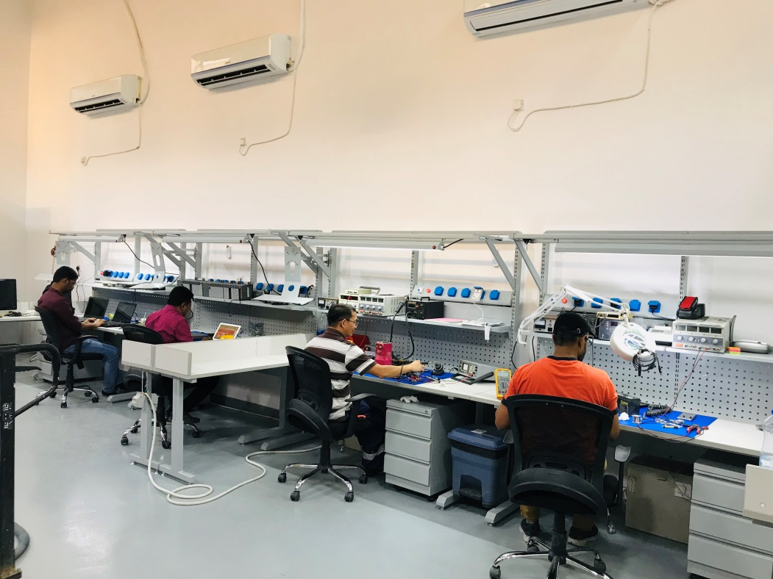
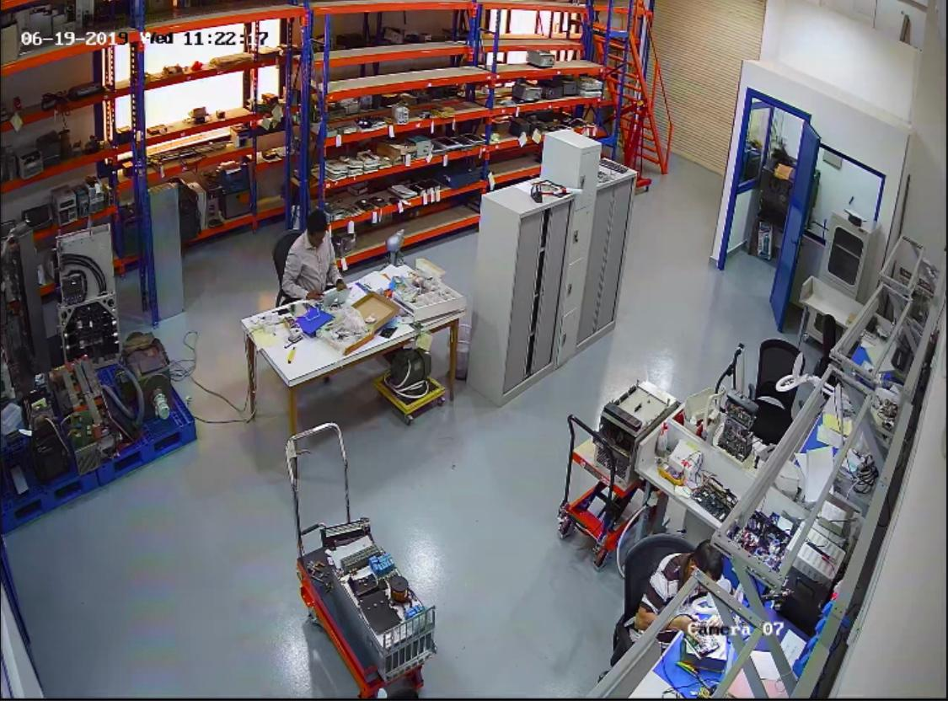
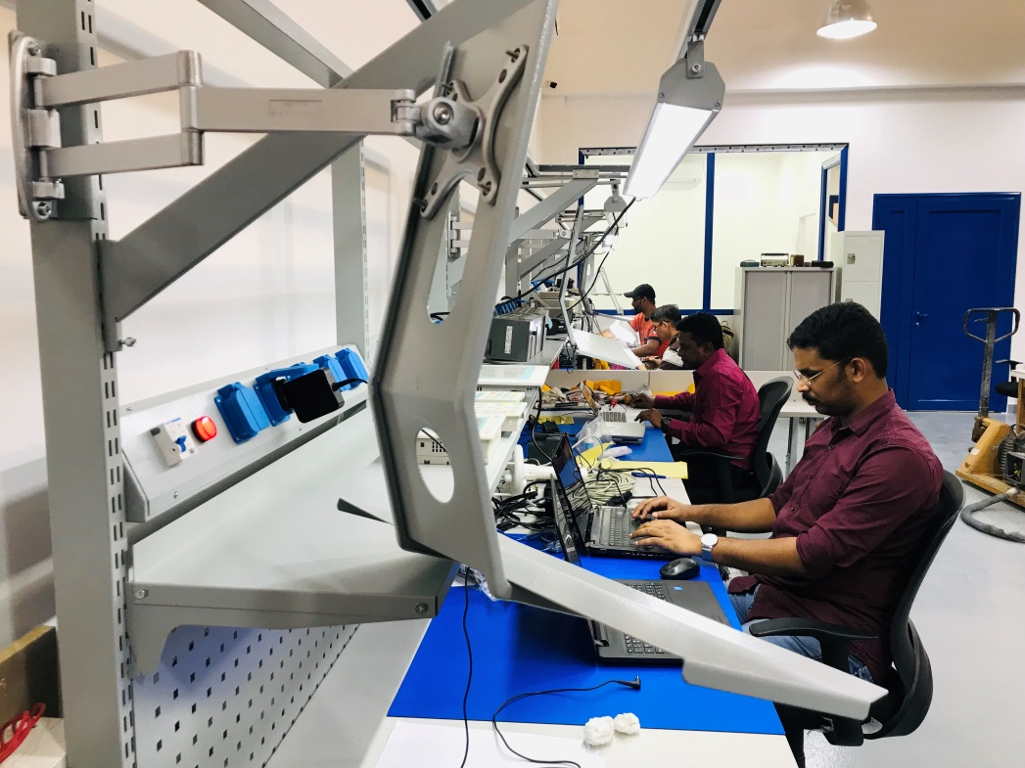
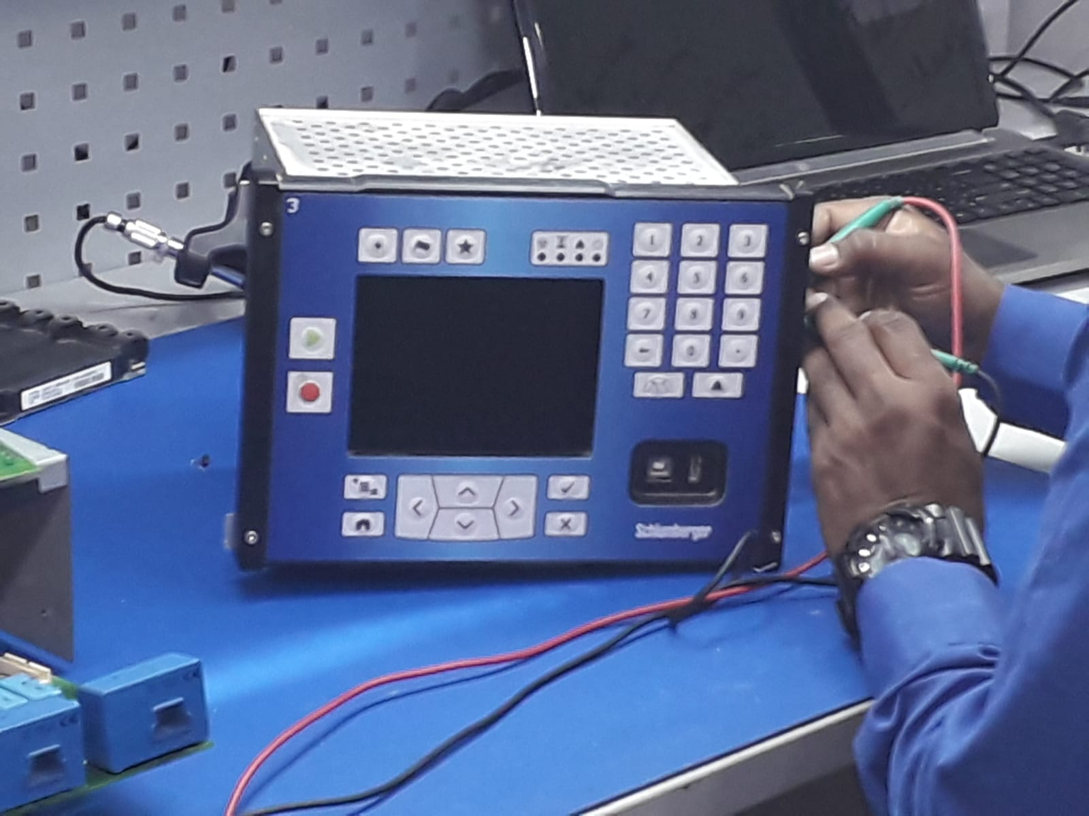
5
Our Facility – Kuwait
TSL Company (Head Office)
Total Area # 300 m2
Al Rai Industrial Area,

Slide 18
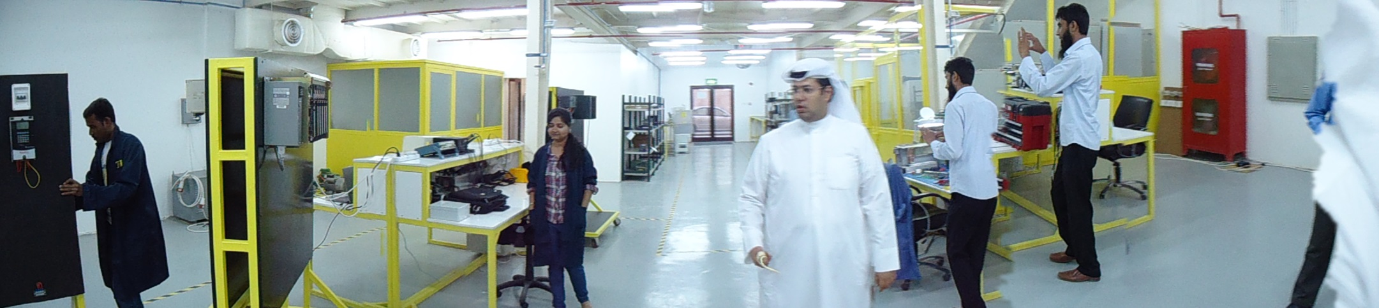
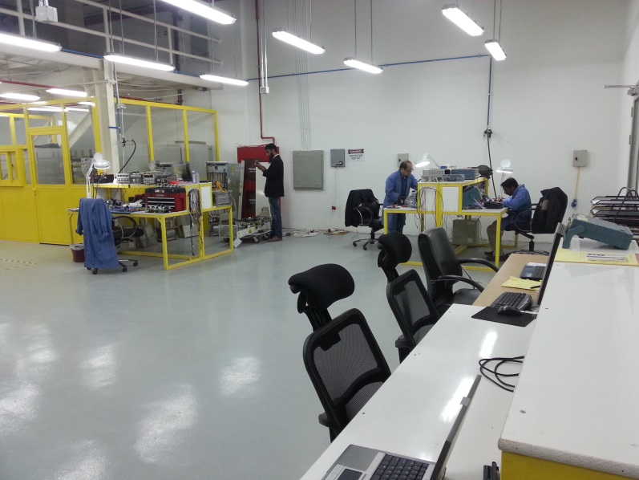
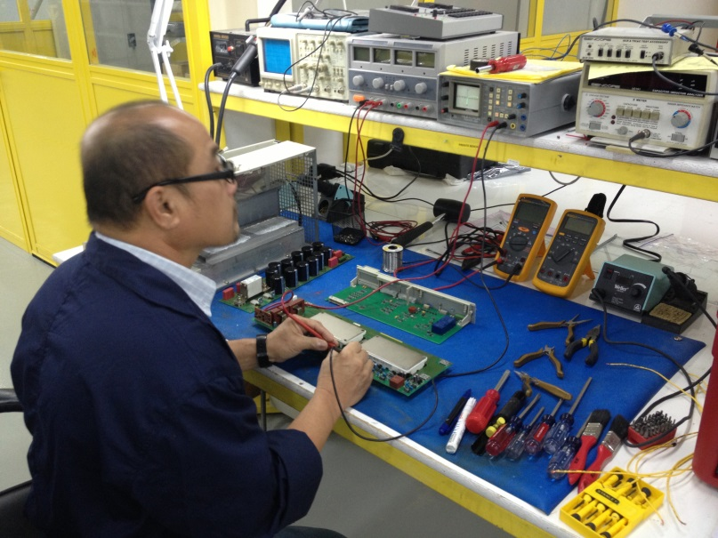
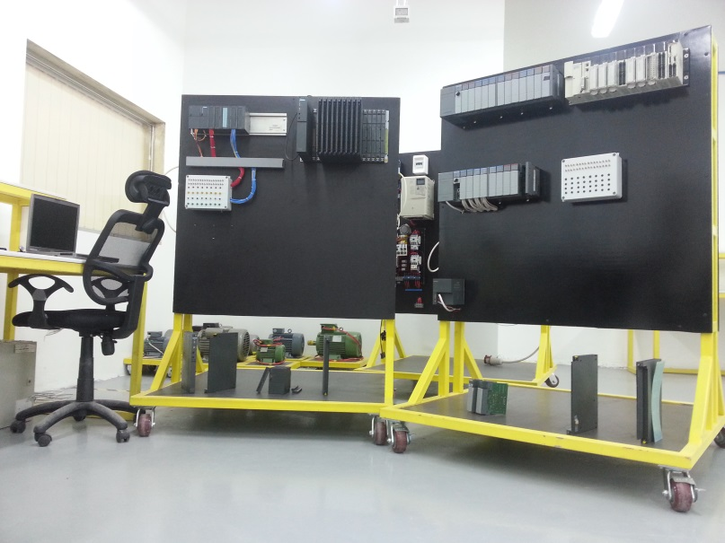
5
Our Facility – Saudi Arabia
KUWAIT TECHNICAL SOLUTION COMPANY RIYADH, Al Azizia Area, KSA
Tel: +966 11 4386616 +966 11 4382026
Email: info-sa@tsl-me.com
KUWAIT TECHNICAL SOLUTION COMPANY DAMMAM, Taiba Area, Abu Hadriya Road Tel: +966 11 550566690 +966 554770084 Email: info-sa.dm@tsl-me.com

Slide 19
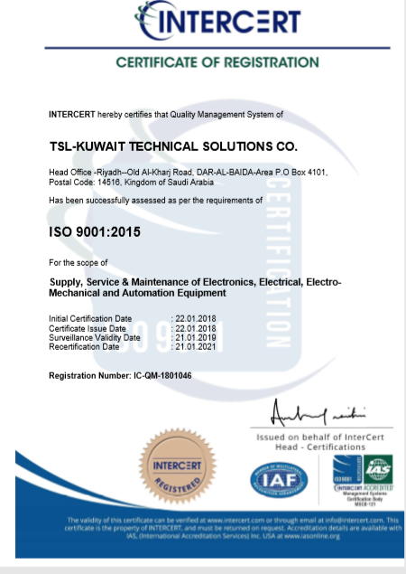
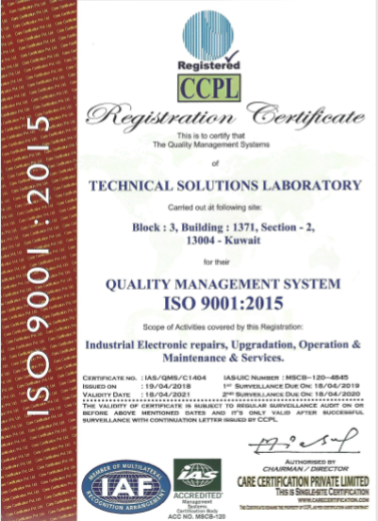
6
Certification and Appreciations

Slide 20
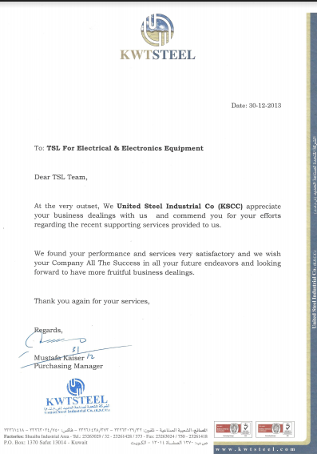
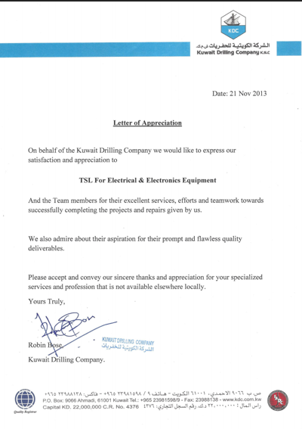
6
Certification and Appreciations (Cont.)

Slide 21
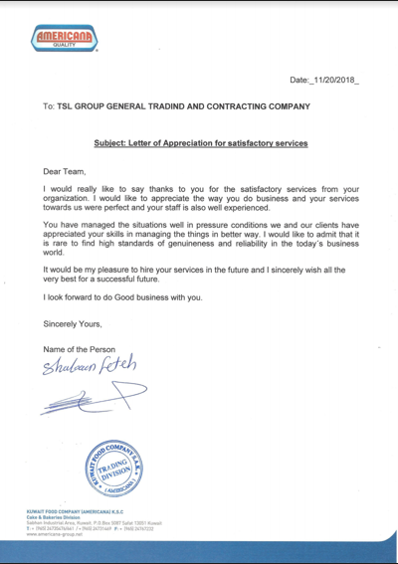
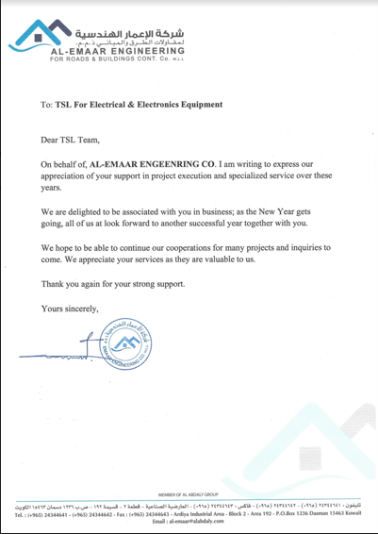
6
Certification and Appreciations (Cont.)

Slide 22


HOW WE CAN SUPPORT YOU!
THANK YOU

