Slide 1

Kuwait (HQ)
Dammam Riyadh Jeddah Dubai
Notes:
Who We are?!

Slide 2
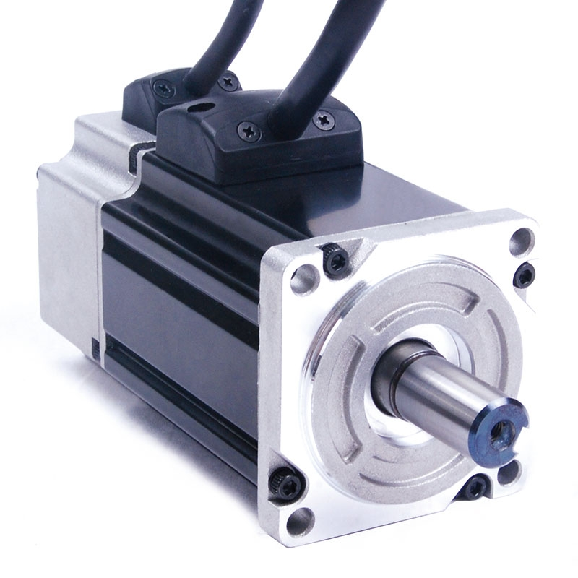
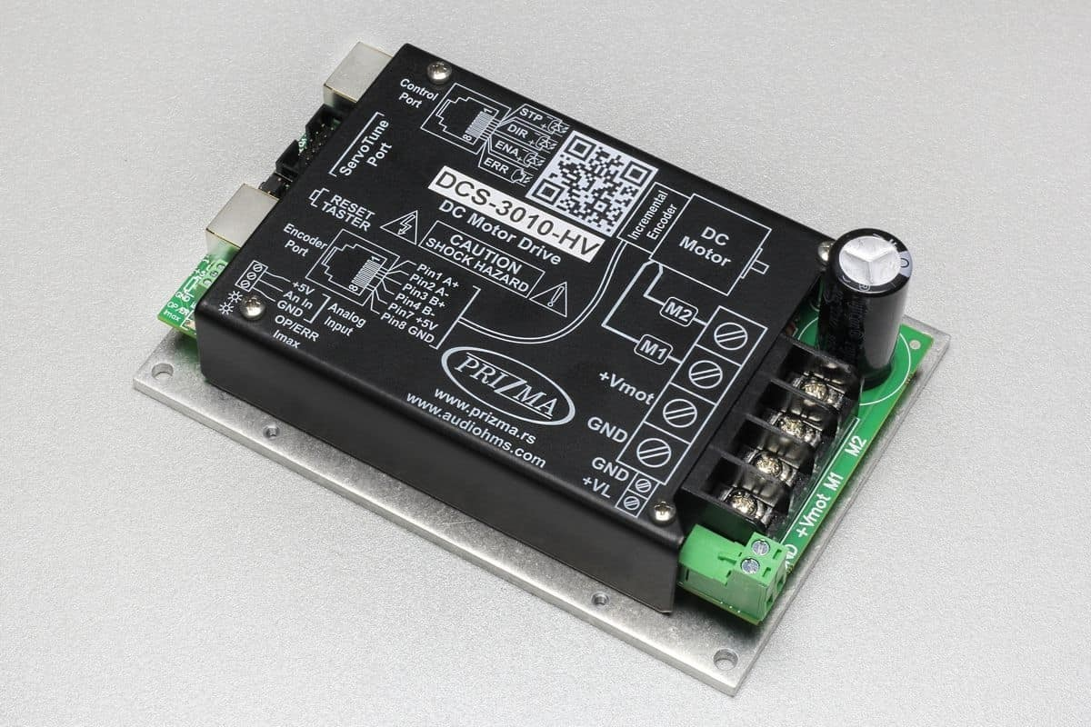
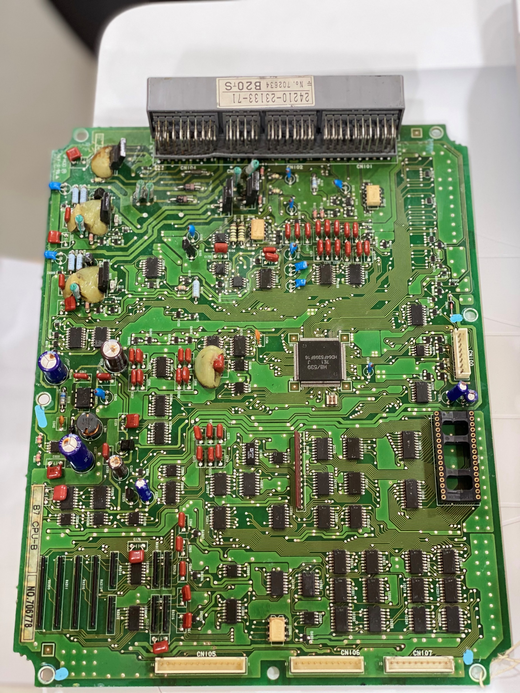
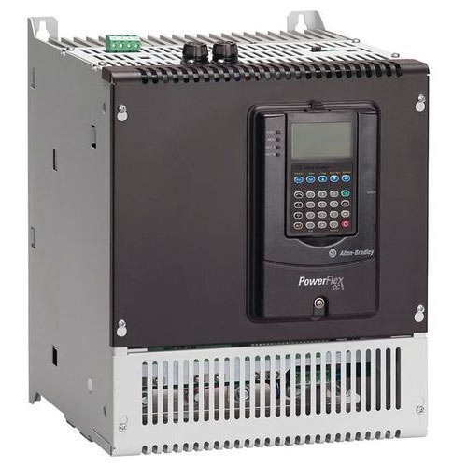
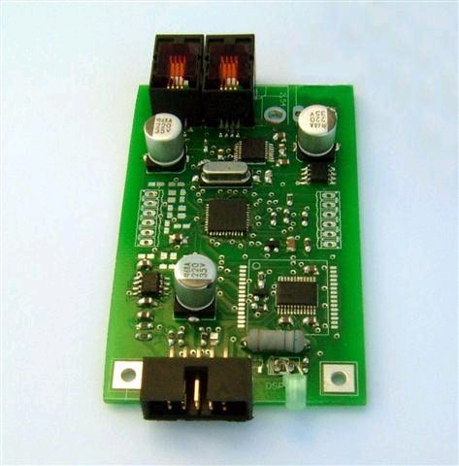
TSL - Concept
Repair it – Don’t Replace It!
Value in Country
Fast Turn Around
Lower Prices
Less Electronics Waste
Notes:
MEW Case of Cost 10%

Slide 3

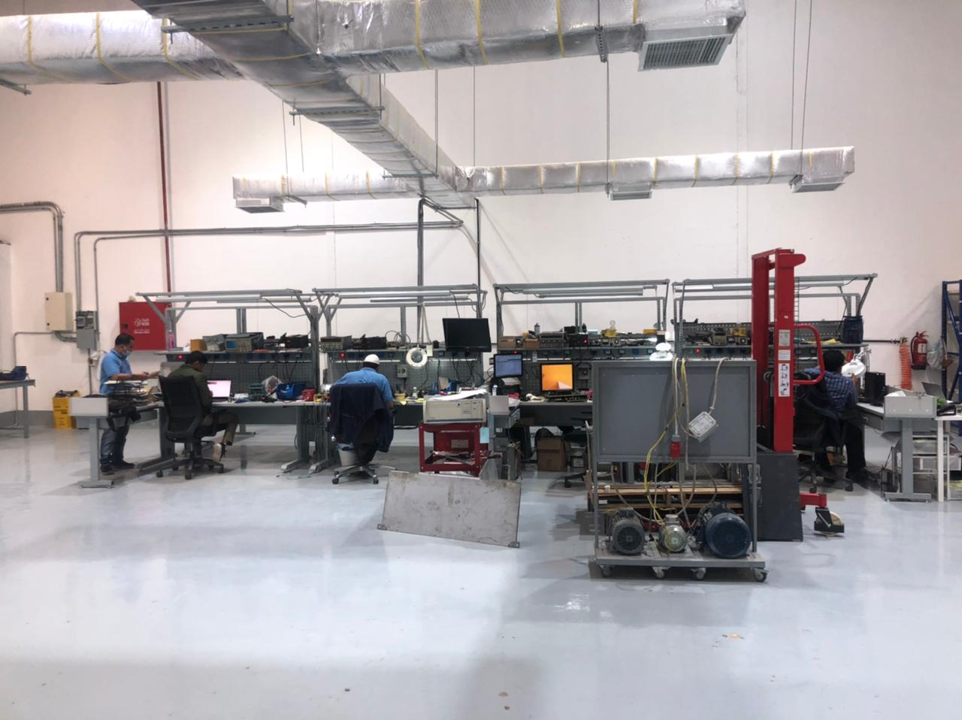
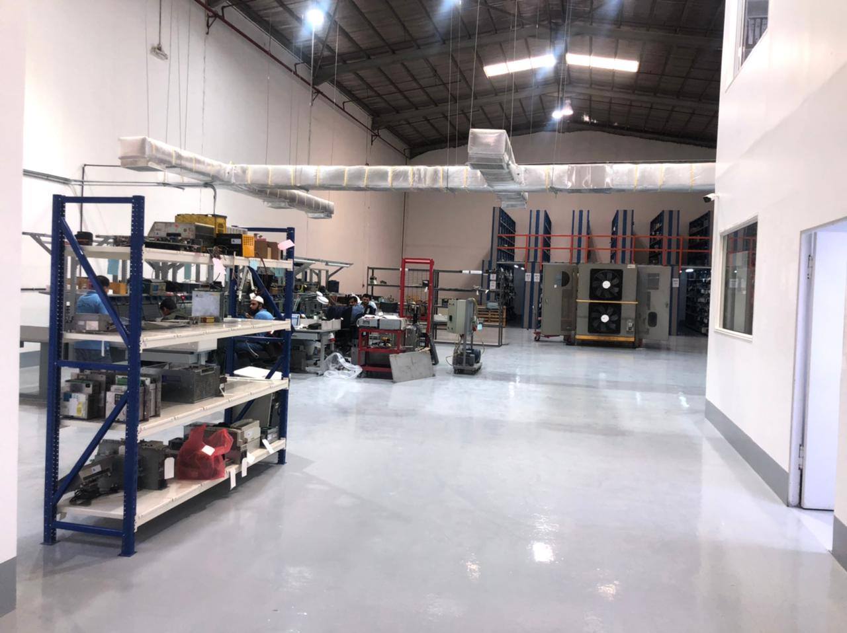
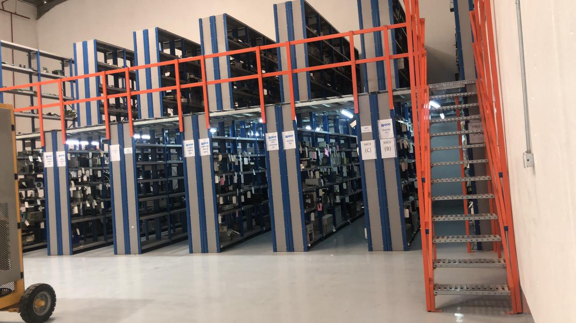
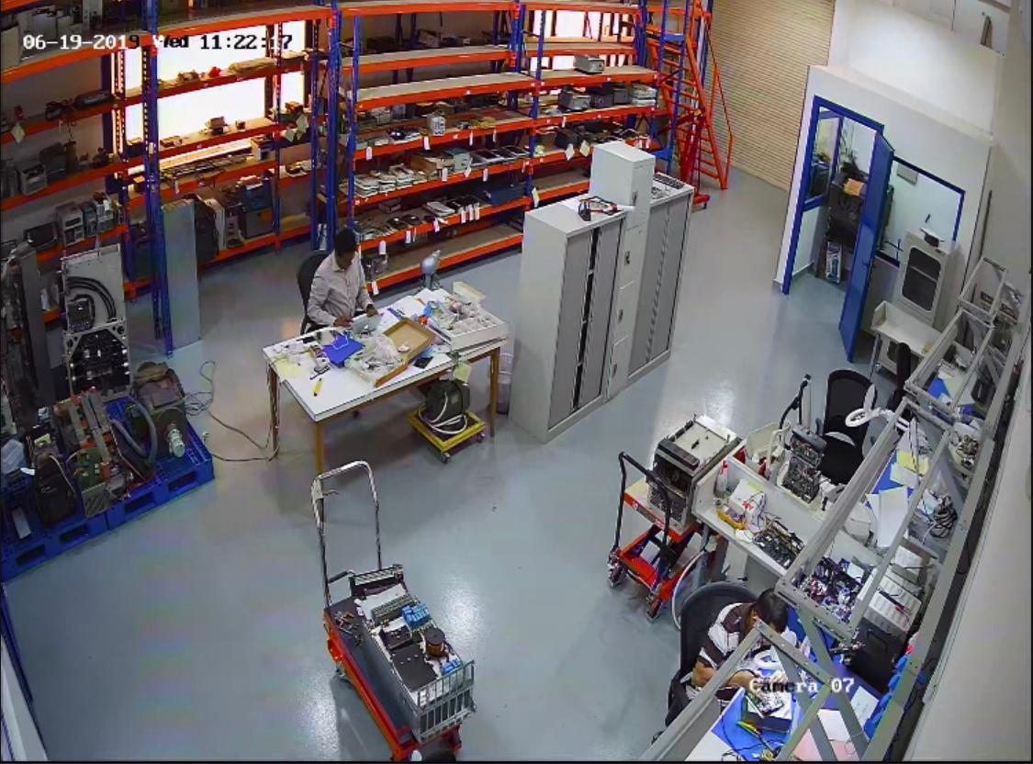
Where We Are:

Slide 4
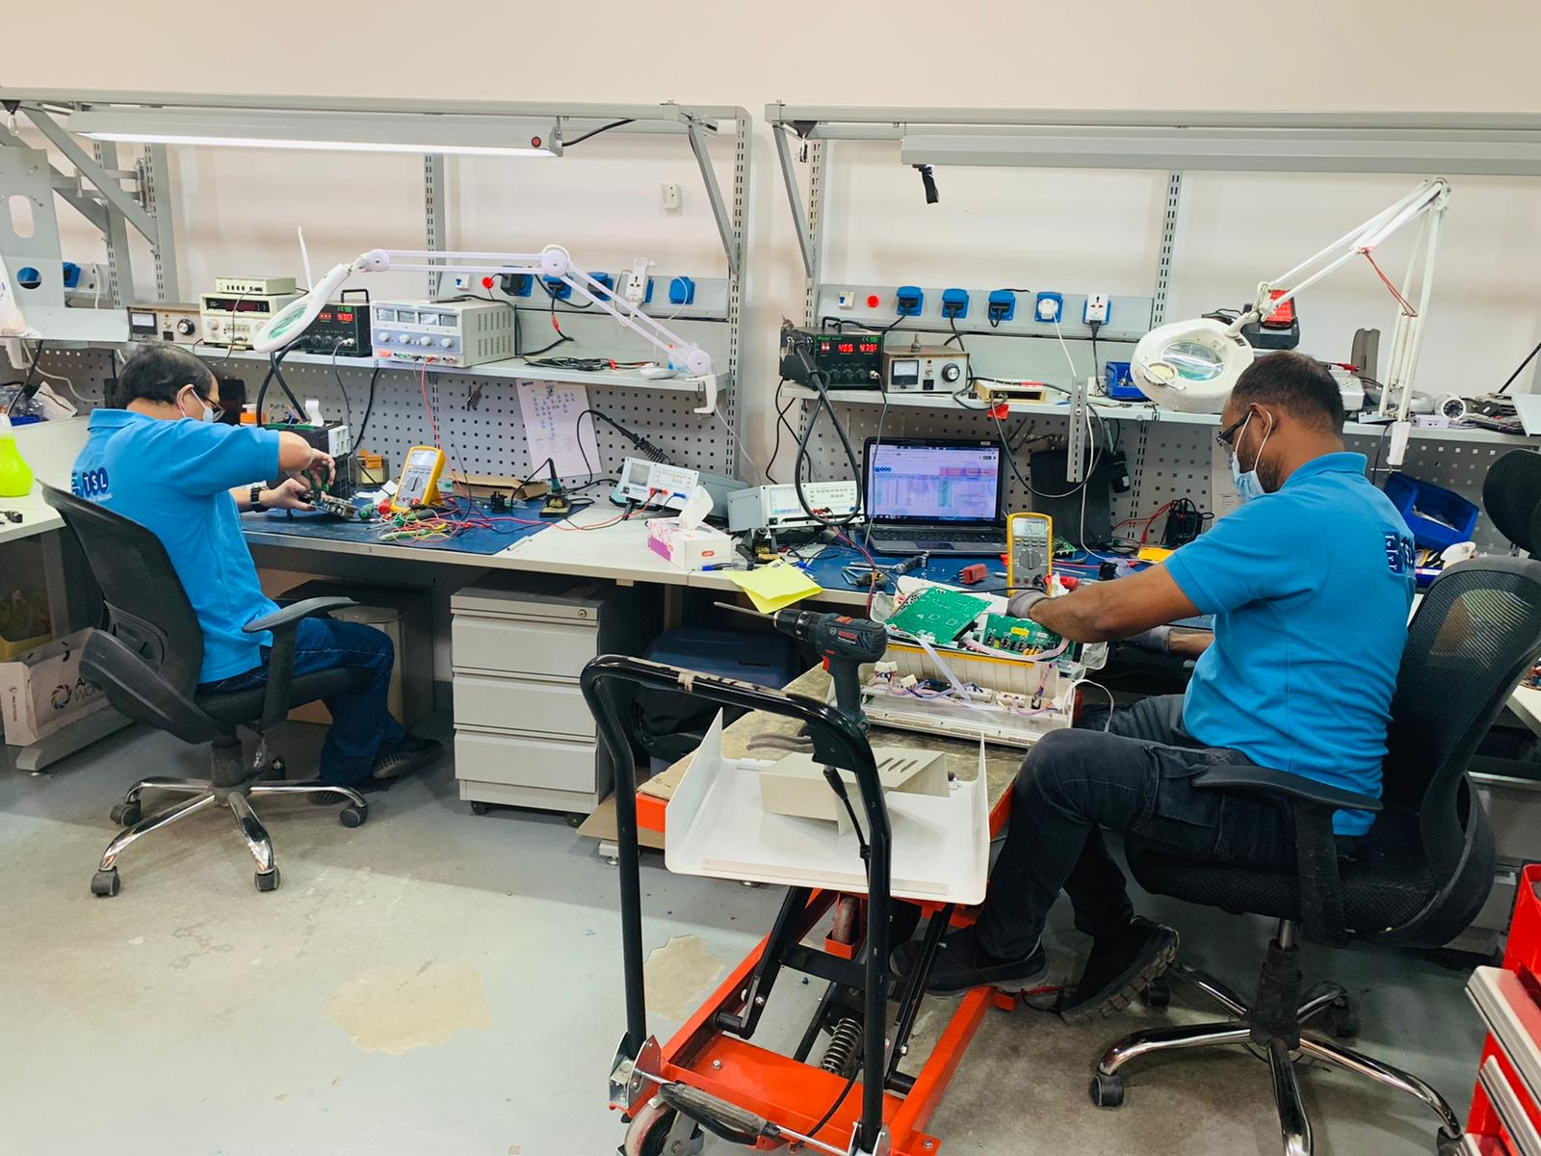
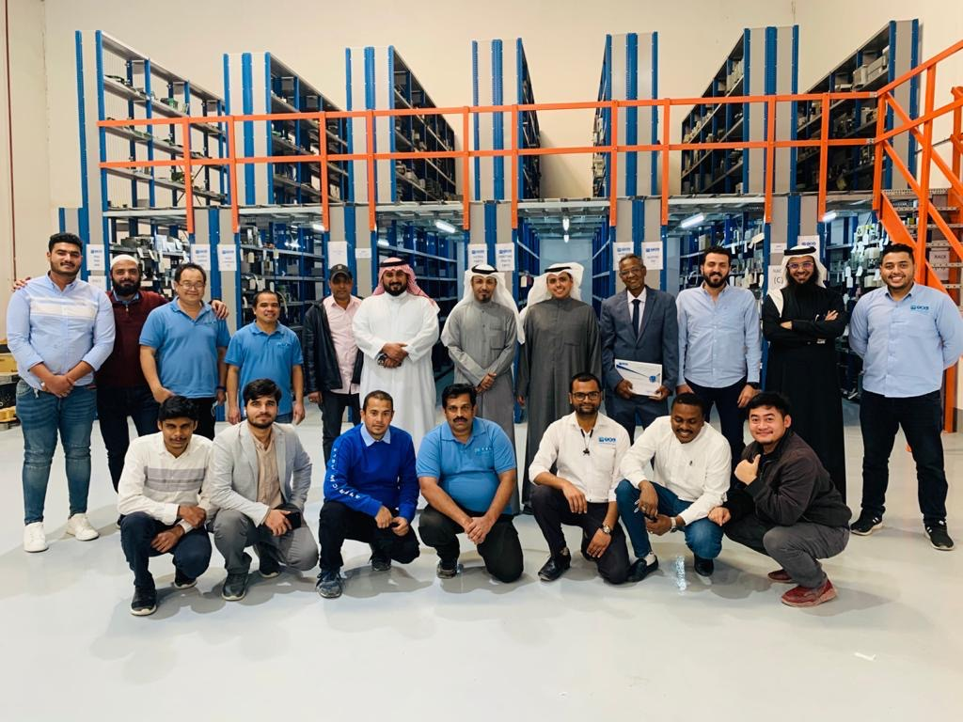
Where We Are:

Slide 5

Our Customers:
Factories: F&B, Steel, Packing, Paper, Chemical, Glass
Services Companies: O&M, Transport, Marine
Electricity – Water – Wastewater: MEW, MPW
Oil & Gas (Government & Private: KNPC, Equte, KOC, KDC
Building Management Systems: Malls, Commercial Buildings, Stadium

Slide 6
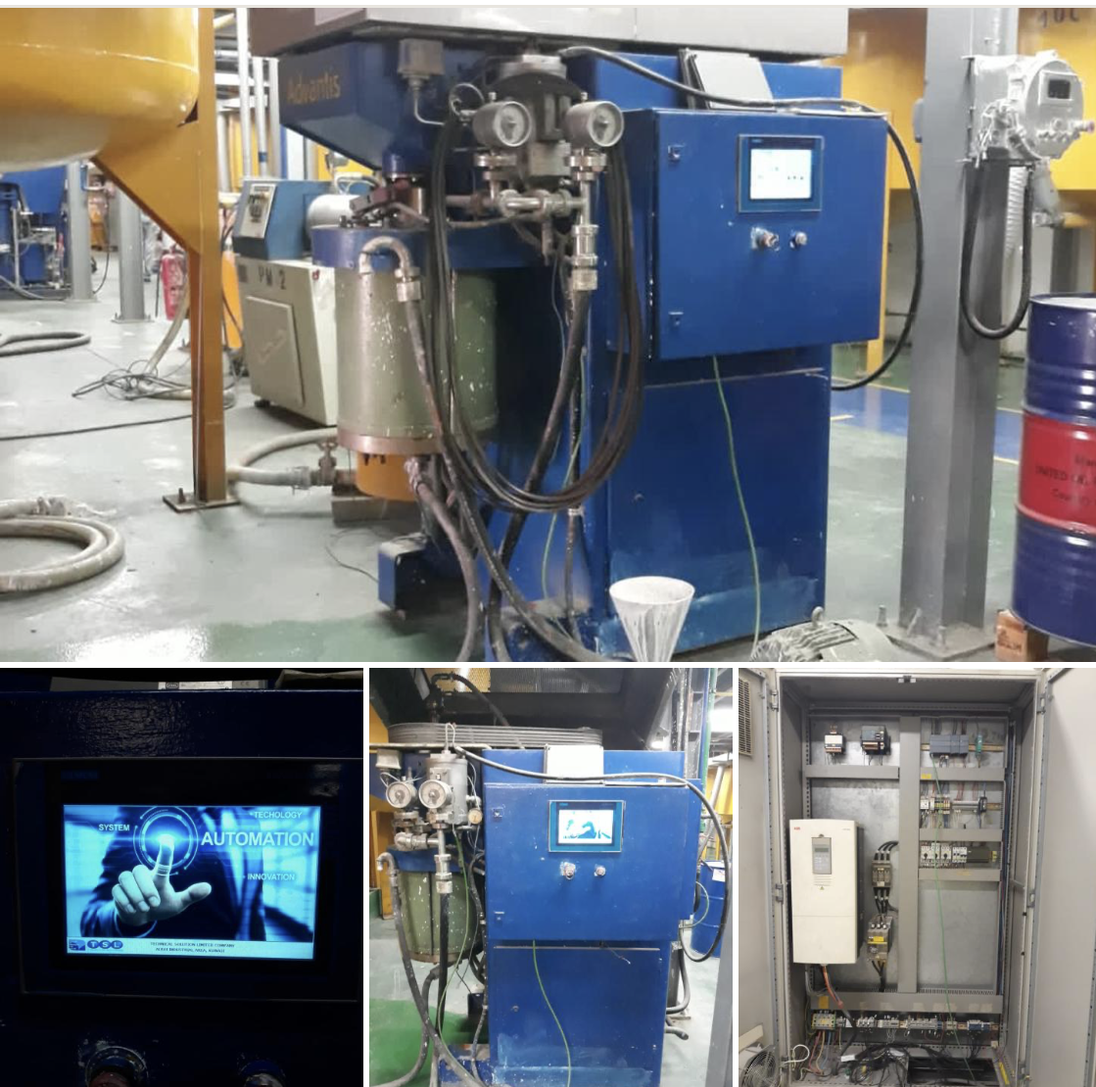
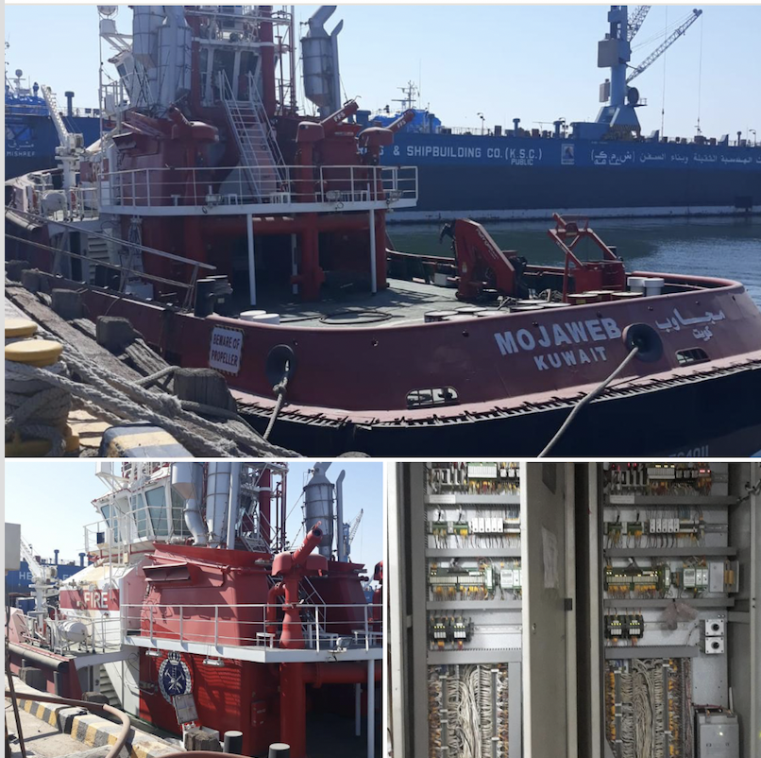
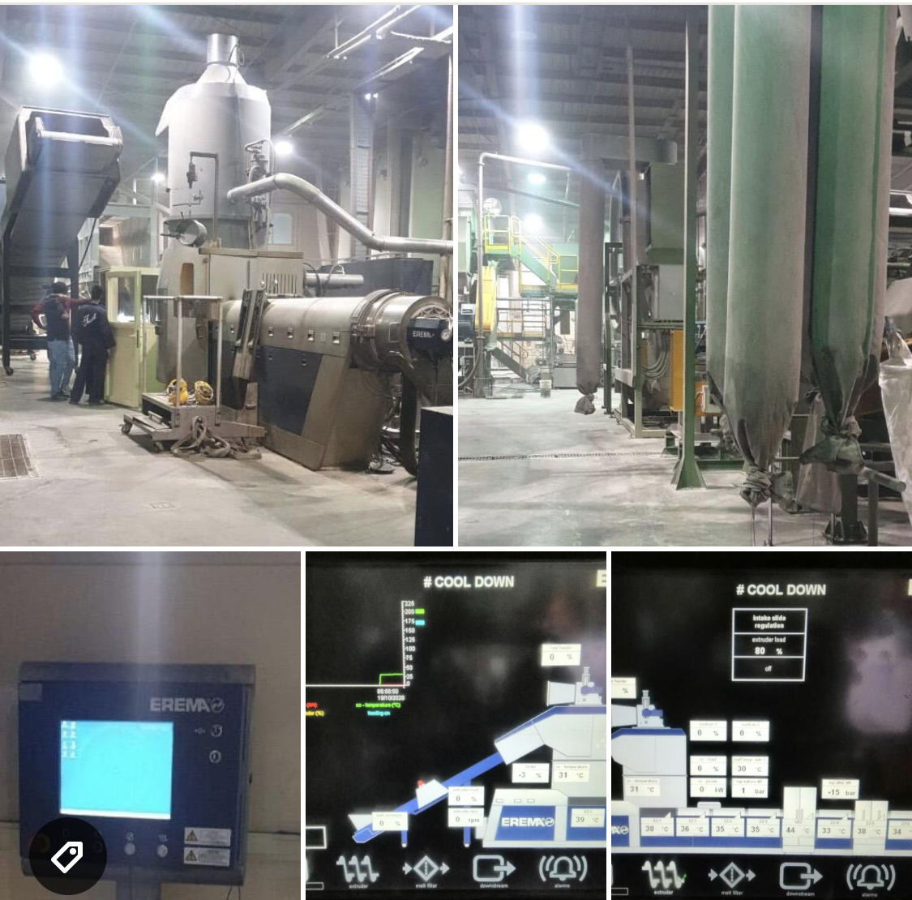
Automation Services:
OEM Strength
Local Solution with COVID

Slide 7
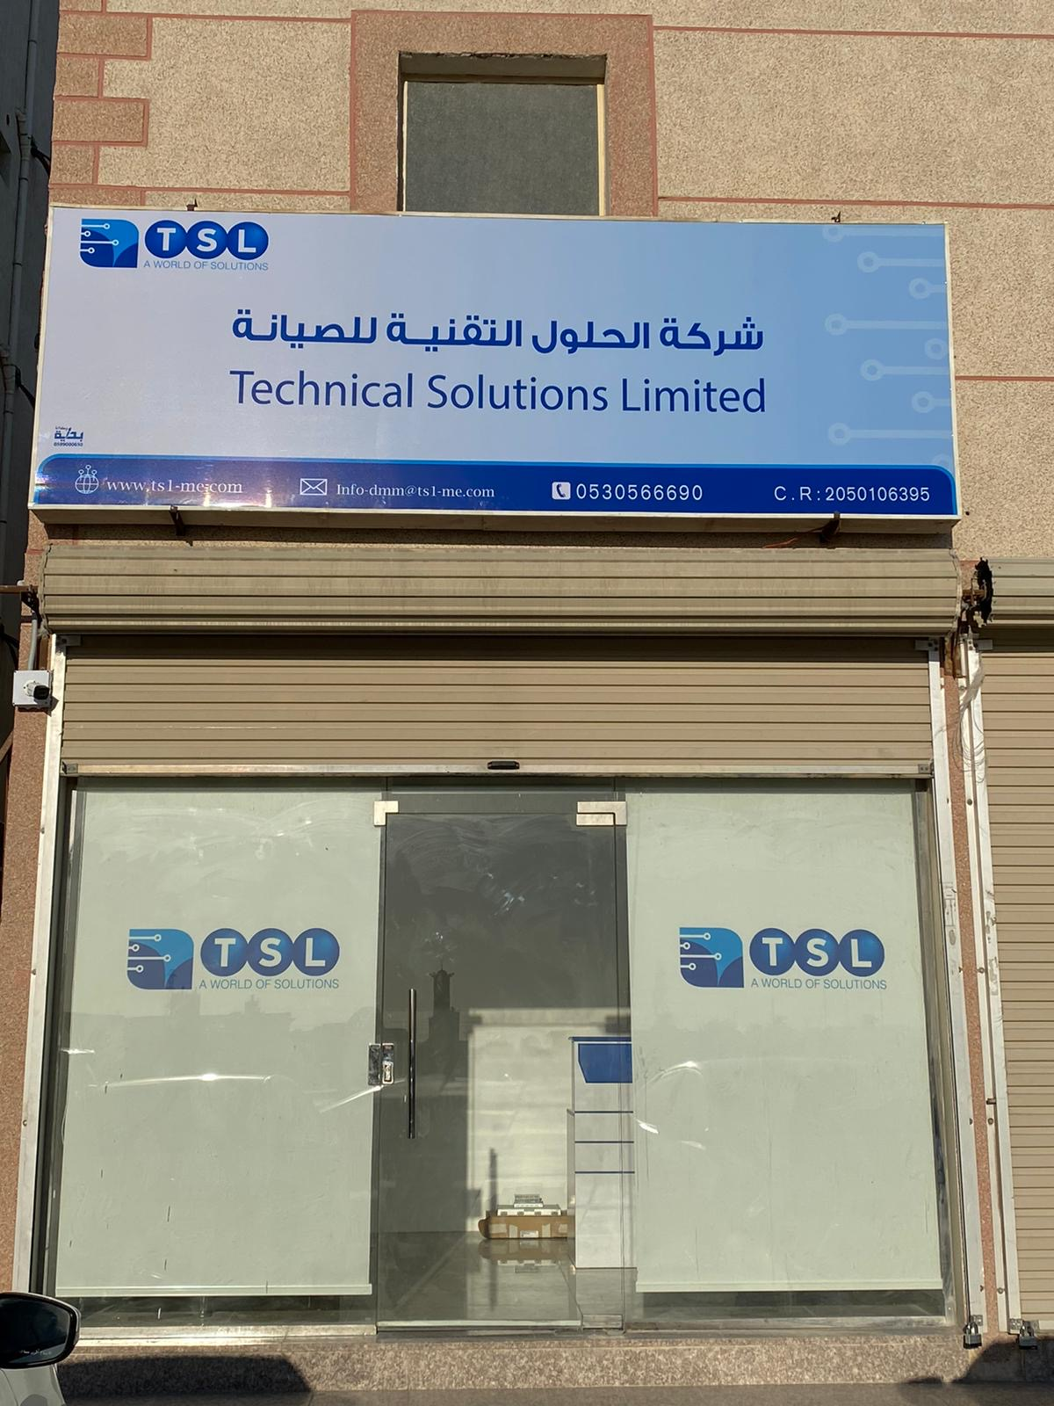
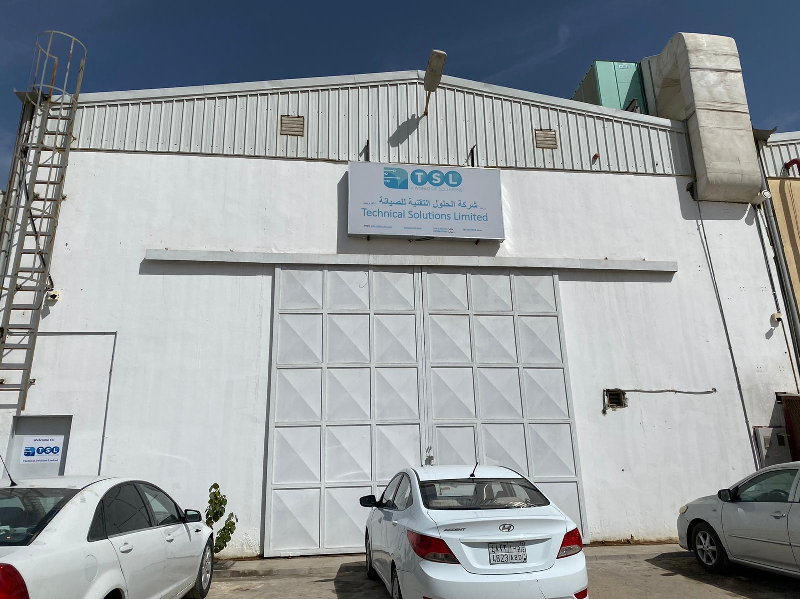
TSL in Numbers:
TSL have 5 Locations in 3 Countries (Kuwait – Saudi – UAE)
TLS have 50 Employees
TSL have over 5,000 satisfied clients
Most of what you EAT, DRINK or USE… TSL has Helped!

Slide 8

























Major Client – Kuwait

Slide 9






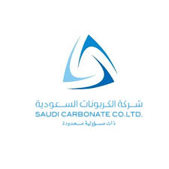



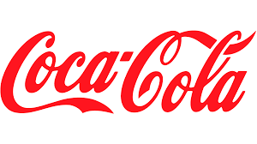







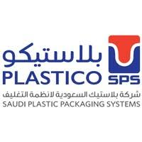






Major Client – Saudi Arabia

Slide 10


