Slide 1

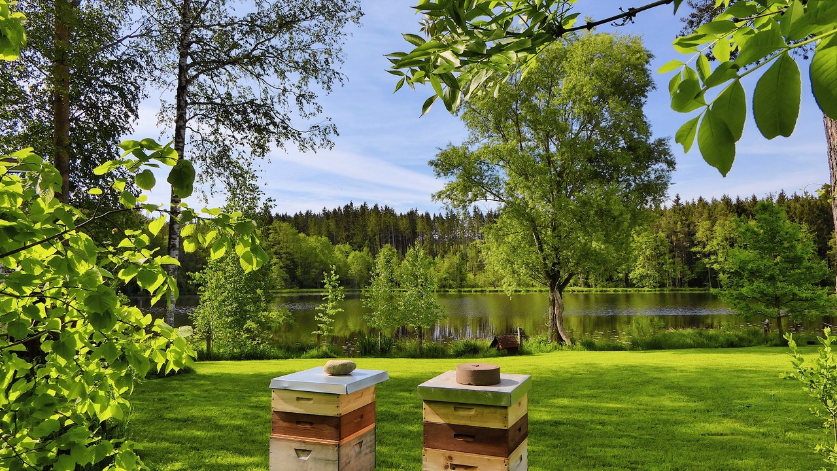

Paradies-Honig
Imkerei am See - Alexander & Meike Wacker, Seehäusl 3, 86935 Rott

