Slide 1

Introducing Backflipt
Intelligent Middleware for
Intelligent Content Management

Slide 2




Surfacing the most relevant content or information at the point of interaction
Sales Professional
Assets at fingertips for todays meetings
New assets that can help close a deal
Winning assets for my active deals
Surfacing means suggesting contextually-relevant content or information at the right time, in the right format and the right application relevant to an interaction
It accomplishes this by tracking previous behavior and interests of a user and her/his network - and then correlating relevant content and information with those interests using Machine Learning and AI techniques
Marketing Professional
Clustered collateral based on content, including duplicates and near-duplicates
Most used, most successful in sales
Most read, most effective for customers
Service Engineer
Trending insights from other engineers
Successful resolutions
New information that help resolve tickets
Doctor
Daily schedule of patients’ records
Latest news and insights relevant to the patient conversation
Treatments, that are trending
Drug updates and alerts

Slide 3

Backflipt builds knowledge by collecting signals from multiple sources using existing user privileges, aggregating them and correlating them with other signals across the enterprise
Backflipt Middleware : Machine Learning and AI
CONTENT
SIGNALS
PEOPLE
SIGNALS
APPLICATION
SIGNALS
EVENT
SIGNALS
Relevant Content from Applications, websites, enterprise repositories
Relationships between content across different formats
actions with content or similar content
Interactions with others
Historical behaviors and patterns
Information and content in applications like CRM apps, L&D platforms, email or any functional application
Calendar events
Documents or links shared, opened or downloaded
Content added or changed
Users added or changed

Slide 4
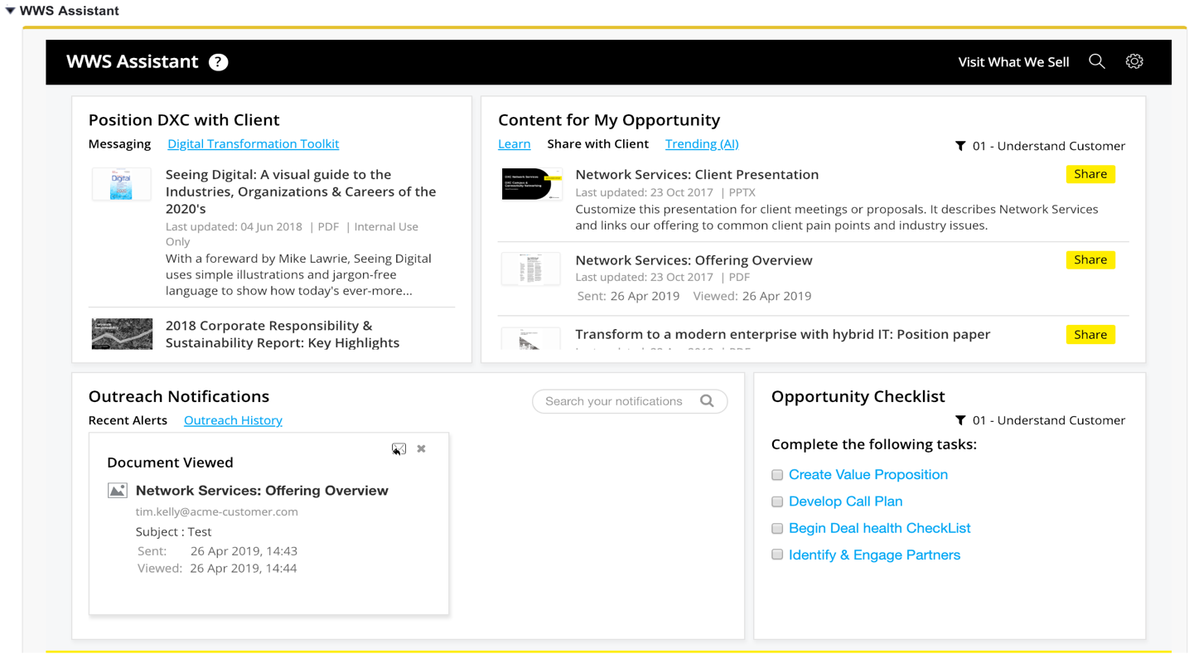
Salesforce Example: embedded Panel with Content Surfacing
Executive Tops-Down guidance, announcements / mandatory content
Visible automatically to all Sellers
Expectation to share is tracked
Salesforce Content Assistant
Visit your Content Platform
CEO Message to all Customers
Based on current ‘Opportunity’ and Client interests, relevant content not shared already is Surfaced.
With a forward from the CEO, we want you to share this important strategic announcement with all our customers.
Playbooks can be defined to ensure desired content for each offering is surfaced in the correct Sales Stage to ensure consistent engagement.

Slide 5
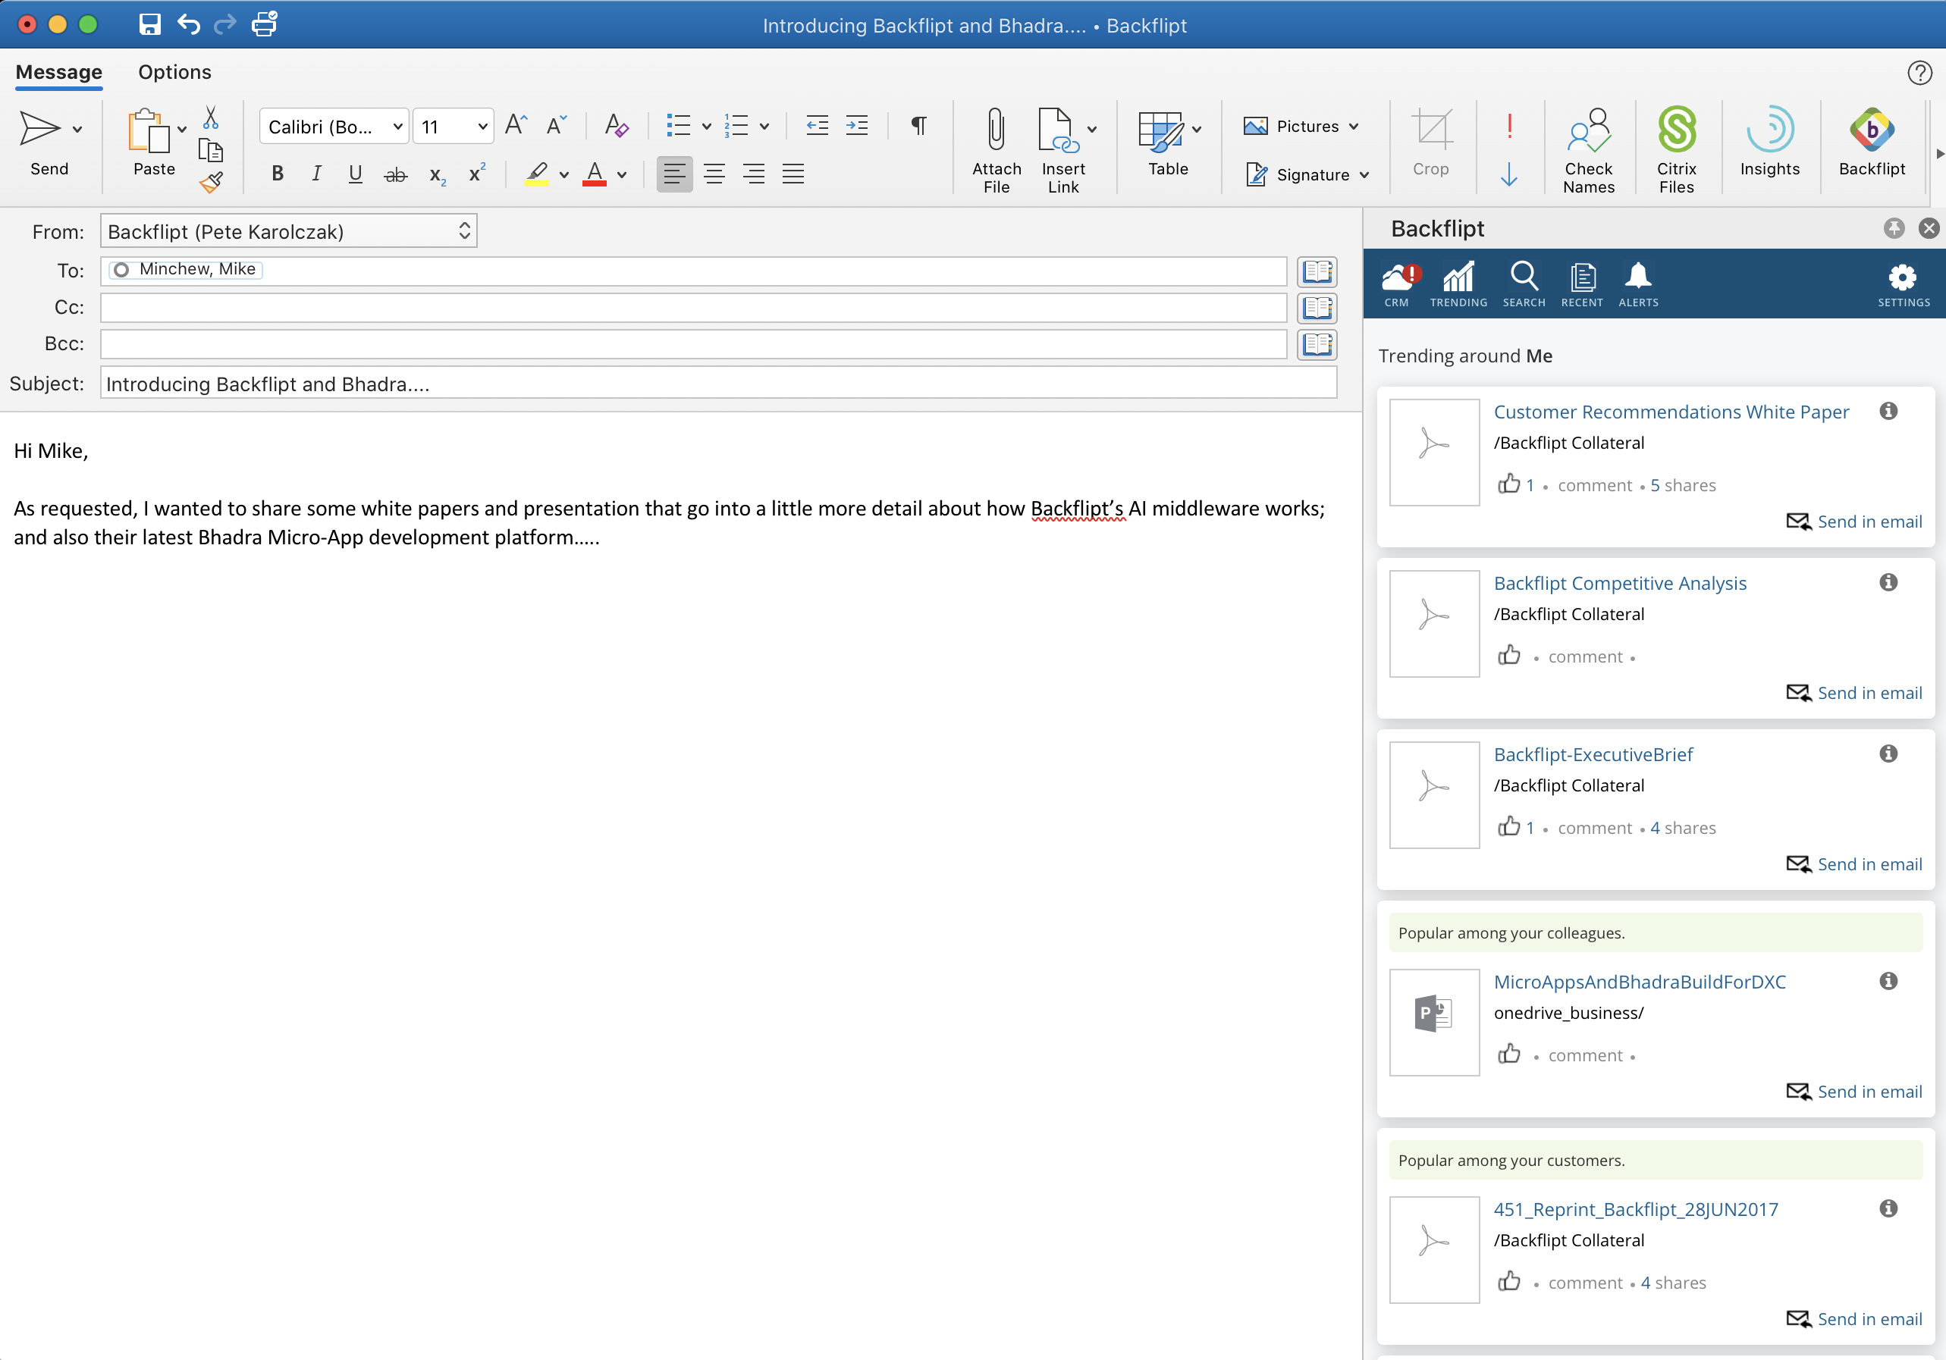
Email Example: embedded Plug-in with Content Surfacing
Plug-in appears seamlessly within the existing Outlook Client experience
Context changes as different email is created/read with clients/peers
Jessica.R.Seller@Backflipt.com
Mike.Q.Customer@AcmeCorp.com
The TO: recipient is external and then found to be a client in Salesforce
Historical interactions now known
Previous content shared known
Sales situation also known
When reading RECEIVED email, any subject matter or content reference is interpreted and to surface content aligned with the conversation
Suggested Content is surfaced based on the interaction at the point of interaction; in this case: Email

Slide 6
Introducing Bhadra
A platform to build and manage enterprise class Micro-Apps to intelligently automate the recurring routines of an enterprise user

Slide 7






The Next Chapter - AI and ML Powered Micro-APPs
+
We believe the next chapter, beyond Content Surfacing, includes light-weight but powerful Micro-APPs;
surfacing recommended content AND suggested actions via simple automated workflows

Slide 8
An example of the Micro App by Bhadra
Get the information to the Seller needs BEFORE the meeting
Micro App brings information from SFDC, Outlook and any repository to one place.
Micro App
SFDC-Calendar App 2/10 8 AM
Trigger everyday morning at 8 AM local time for the user
Fetch the user’s calendar events for that day
Use any customer information to fetch sales information from Salesforce
Use email address to get last interactions from Email
Get additional content relevant for this conversation
Notify the user about relevant content within each meeting invitation
10 AM Meeting with ACME-Opportunity-500k
Amount: $500k
Sales Stage: Evaluation
Region: Pacific West
Contact: Tim Kelly
Last Email Exchange: DeepLink Outlook Email Exchange with TimKelly@acme
Content Exchange: DeepLink OneDriveConnect.doc

Slide 9
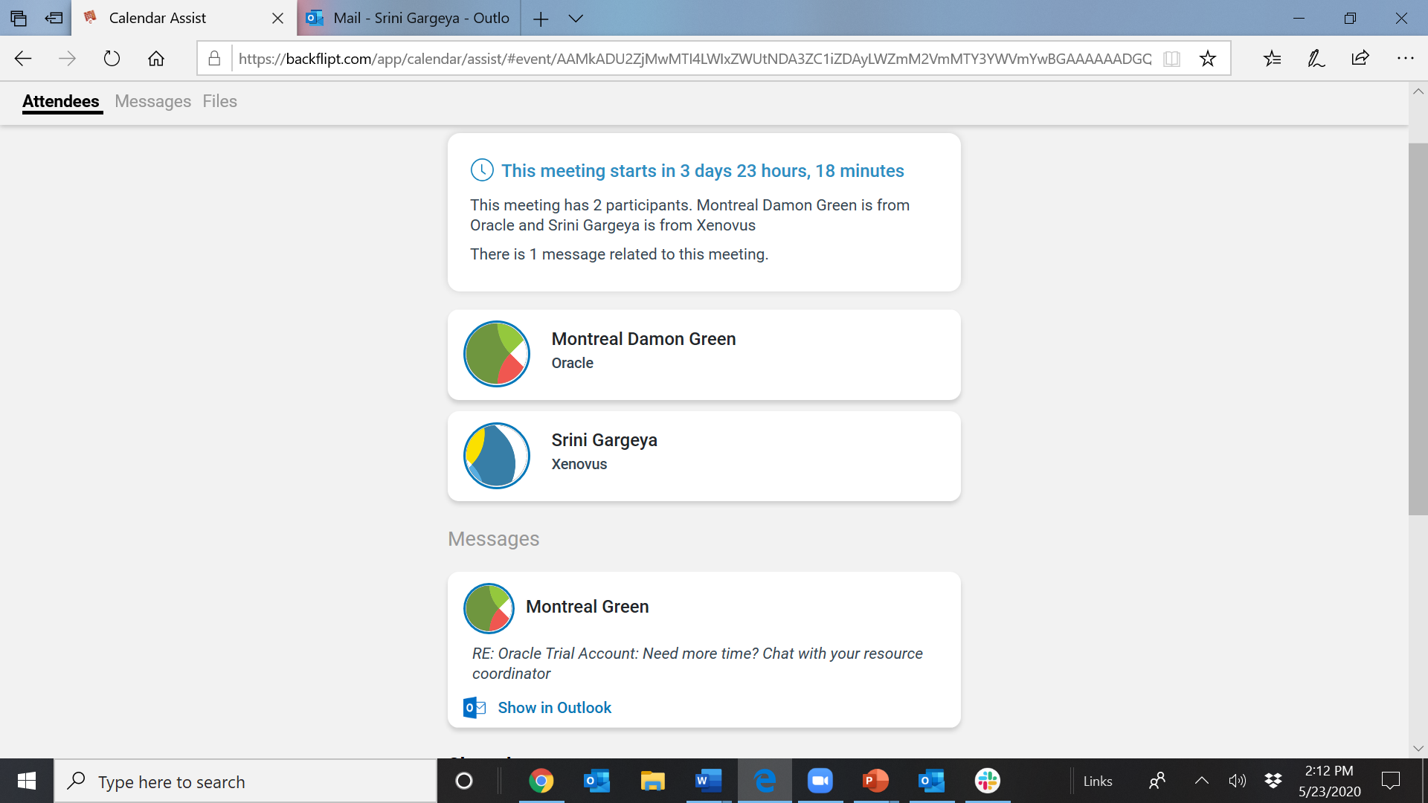

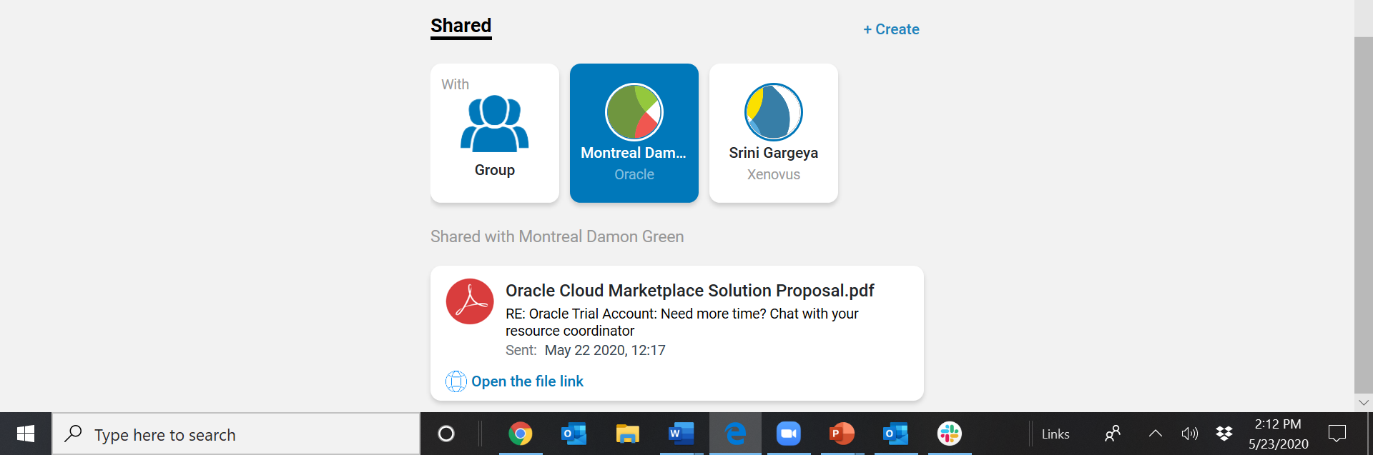
Example: Meeting Preparation Micro-APP
Jessica.P.Seller
This micro-App is integrated with a user’s calendar and core workplace portal. Its purpose is a ‘Primer’ for all meetings especially w external guests
Your upcoming meeting includes yourself plus Tim Kelly of the Acme Corporation. You have interacted with Tim Kelly before.
Other attendees are discovered and behind this card is a LinkedIn profile if additional information is required
Tim Kelly
Acme Corporation
Jessica Seller
When this guest was selected, a full history of previous interactions and documents/content shared in prior correspondences is presented.
Tim Kelly
Acme Corporation
Jessica Seller
Scroll further and optional actions are offered to resend documents; send suggested new documents, etc.

Slide 10
We look forward to discussing how our Content Surfacing AI middleware and Bhadra Micro-Apps can be integrated into your software platform.
Thank you.

