Slide 1
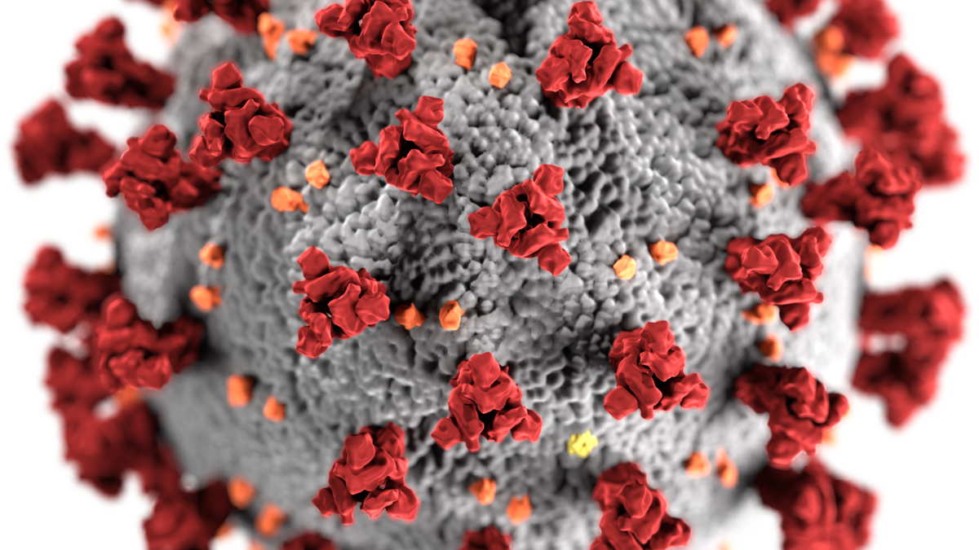
Empire City Laboratories is dedicated to help combat the novel COVID-19 virus.
We offer both PCR testing and Antibody testing

