Slide 1
New Role
Point of View Document
Brian Rueger
Month 2020

Slide 2

  About Me
  Leadership Philosophy
  Qualifications
  30-60-90 Day Plan
  FY19 Success Defined
  Sponsors

Slide 3
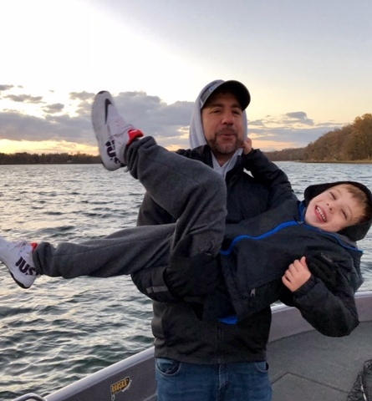

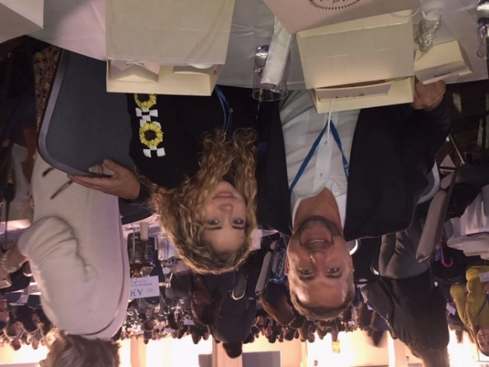
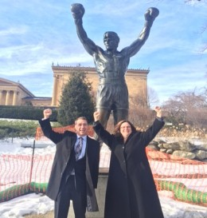
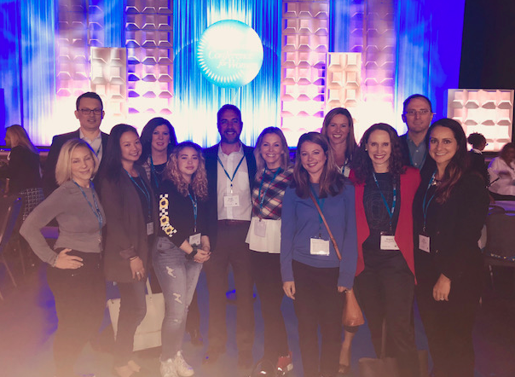
My
“What Matters?”
Servant Leadership
“Why We CAN” Mindset
Culture by Design
Golden Rule
Be Present

Slide 4





Leadership Philosophy
My formula for success has been:
Hiring great leaders
Over communicating the stretch vision
Making good, data-driven decisions
Finding ways to scale it
"Great leaders are almost always great simplifiers, who can cut through argument, debate and doubt to offer a solution everybody can understand."
– Gen. Colin Powell, former U.S. Secretary of State
Key Capabilities
Sense-making
Relating
Visioning
Inventing

Slide 5
Why Me & Why This Role
Execute for Results, Care for Culture
Executive Sponsor
PHL Connected Women
Manager Excellence
&
Presidents
Club
Market leader for CSR
Leadership Instructor, USMC
Passionate Mentor and Sponsor
Track record of Success & Leadership
History of exceeding growth targets
Selected for and implemented leadership programs
Proven adaptability
Diverse Industry & Role Experience
Software & CX Background
IT Services Sales
Refugee Operations in Cuba
Think Big & Act Small
Culture Builder
Model Optimization
Program Development & Execution

Slide 6

30-60-90 Day Plan
90 day Goals
People
Pipeline
Process
Build Trust
Market Visits - Town Hall
Leadership Team
Direct Teams
Engineering Team
Dotted line resources
90 day Pipeline
Key Deals
Qtr Event Calendar
Portfolio Balance
2X2
Team Cadence
Top | Down expectations
Bottom | Up expectations
Forecast Methodology
Reporting Packages
Old vs. New

Slide 7
30-60-90 Day Plan
90 day Goals
Transition in rear view mirror
Rhythm/Cadence in place
Hit Plan in current Qtr
Leadership engagement w/:
Top 15 Customers | Prospects
5. Pipeline supports next Qtr
6. Hire Key Roles
People
Process
Build Trust
Market Visits - Town Hall
Leadership Team
Direct Teams
Engineering Team
Dotted line resources
Team Cadence
Top | Down expectations
Bottom | Up expectations
Forecast Methodology
Reporting Packages
Old vs. New

Slide 8


FY – Define Success
Hit Growth Targets
Exceed Margin Guidance
Consistency in Execution
&
Brilliant in the Basics
Executive Relevance
Vision and Plan set for Next Fiscal

Slide 9
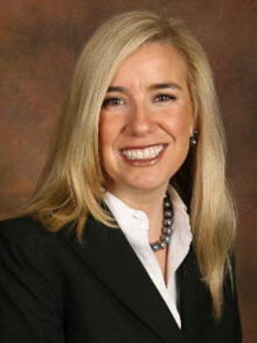
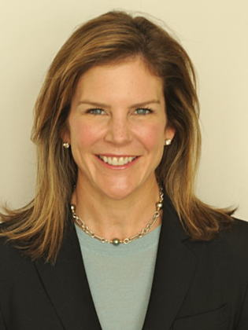
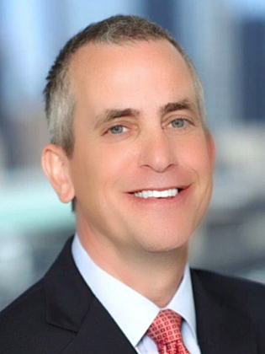
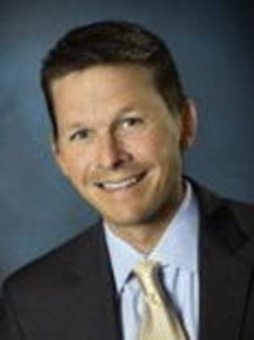
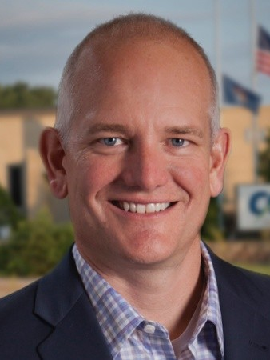
Sponsors
Lynne Doherty
SVP Americas
US Commercial
CISCO
Lynley Noviello
VP
Global Services & Customer Experience CISCO
Bill Kohut
AVP Americas Commercial West CISCO
Britt Norwood
AVP Enterprise West-Key Segment
Joe Smith
CMO
CCI

Slide 10

Thank you

Slide 11

Appendix

Slide 12
Word of the Qtr: Kairos
“a time when conditions are right for the accomplishment of a crucial action: the opportune and decisive moment”
FY20 Theme: Ride the Wave
FY20 will begin with a Wave of significant Change
Why this as a theme? “From a Non-Surfer”
Tide matters, wind matters, wave conditions matter (external factors)
Takes a lot of work and energy to paddle out (you have to want it)
Lots of dangers(competitors) reef, rip tides, sharks, other surfers
Right wave, right height, go with the wave, lean into it, enjoy the ride. Make the paddle out-worth it!

Slide 13
Select “Excellence in Role or The Gold Standard”
GTM
Leverage the power of ONECisco
Planning and regular cadence with extended team and virtual sales
Scale through partners
Leverage programs to build pipeline
Operational Excellence
Stretch vs. Hero forecasting- 70% commit w risk.
Thorough deal assurance knowledge
Comprehensive territory plans with Qtrly milestones
No past due opportunities
All opportunities have technology and SE assigned
Leverage GFEP for Post-Sales Support
Architectures & Solutions
Utilize account data and knowledge of customer business models to capture market transitions
Protect the base- aggressively pursue all LDOS and renewals in account base.
Builds migration path to RSW solutions vs boxes (Quote 3 and sell 1 EA)
Leverage channel and extended team to sell to IT
Utilize BE Heat Map across accounts
Training & Development
Aligned to forecast confidence guidelines
Leveraging account plan template and heatmap
Completes mandated corporate and SP training
Contributes and makes an impact beyond role
Leverage the RCDN SE Lab
Notes:
Page 13
Deeper into account base coupled with Scale & Velocity

Slide 14
Leadership Expectations–Sales Leaders
Be a Culture
Builder
Personal Humility and Professional Will (Be a role model)
Engage others in shared meaning
Scale through influence
Own the Number and the Details
Demonstrate sustainable value to our customers, partners and cisco team
Timely communication | Limit surprises | High Care Factor
Know our business | Ensure each IC contributes to knowing the business
Contribute Beyond Region Objectives
Be part of the solution
Share a better idea (Better to light a candle than curse the darkness)
Make each other successful

Slide 15
Leadership Expectations–Sales Leaders
Grow in Role
If you aren’t learning you aren’t moving forward
Positively influence the learning of others
What’s next discussion bi-annually?
(own your development plan)
Live by the Golden Rule
Don't tolerate intolerable behavior
Don't let people waste other people's time
Say Thank-you often

Slide 16


1993
Officer, USMC
1999
Account Manager, Branch Manager and Area Director
CAREER: TIMELINE
2004
Inside Sales Manager, Outside Sales Manager, General Manager
2014
Regional Manager, Southwest Territory
Regional Manager, Metro Philly Select
2017
Operations Director, Service Provider US
2019
Operations Director, Mid Markets Select
2020
xyz

