Slide 1
General requests
Like your rough sketch, just some minor request to suit my requirements please.
I have marked in red text all requests/changes
All fields to be editable
Document to be in ms word
I will need to update/edit, send multiple property information to multiple parties
All photos to be an insert, so I can easily remove and update photo as required
Do u design logo, I have attached a logo but I need some thing better.

Slide 2


Need a logo designed
Sample logo:
Pg 1

Slide 3
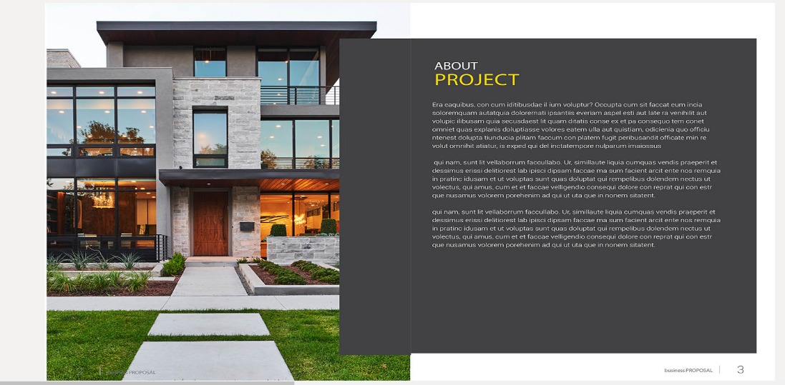
TBC
Purchase an existing house on a block of land, obtain development approval to demolish existing house and build two townhouses (dual occupancy side by side)
My content
Pg 2
Pg 3

Slide 4
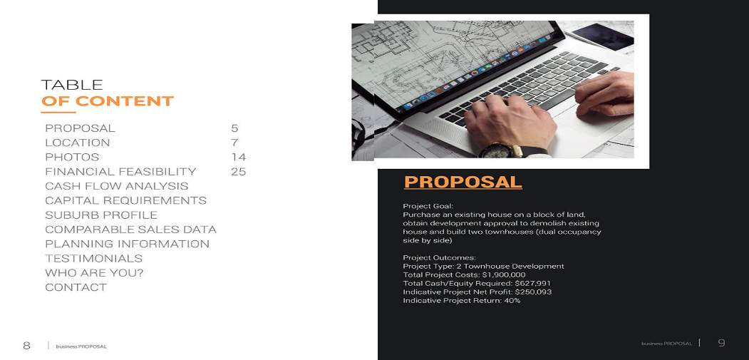
Project Goal:
Purchase an existing house on a block of land, obtain development approval to demolish existing house and build two townhouses (dual occupancy side by side)
Project Outcomes:
Project Type: 2 Townhouse Development
Total Project Costs: $1,900,000
Total Gross Realised Value: $2,400,000
Indicative total Project Net Profit: $250,093
Indicative Project Return: 40%
What we are looking for:
Equity from Joint Venture Partner: $ xxxx
Serviceability from Joint venture Partner: $ xxx
Return on investment: $xxx
% Return: 20%
My content
Pg 4
Pg 5

Slide 5
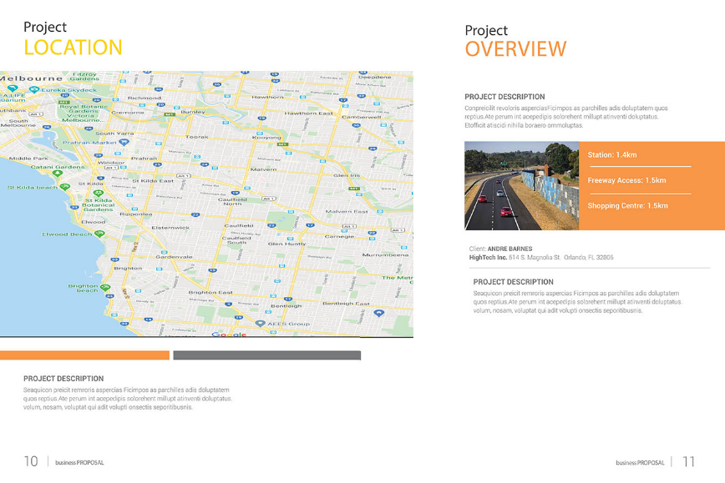
Delete
Pg 6

Slide 6
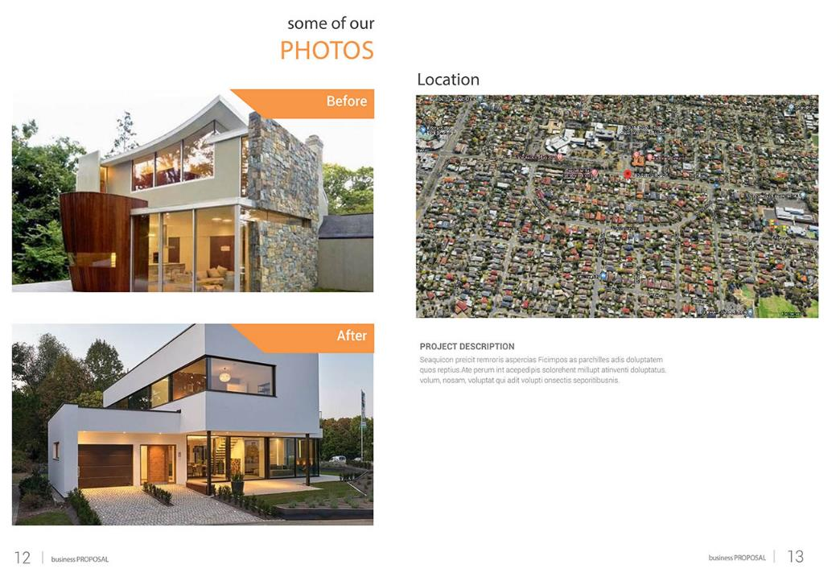
I will be updating these photos, so I need a good picture place holder , so I can just delete and paste new photos
This location map will change, so I need a picture place holder
Pg 8
Pg 7

Slide 7
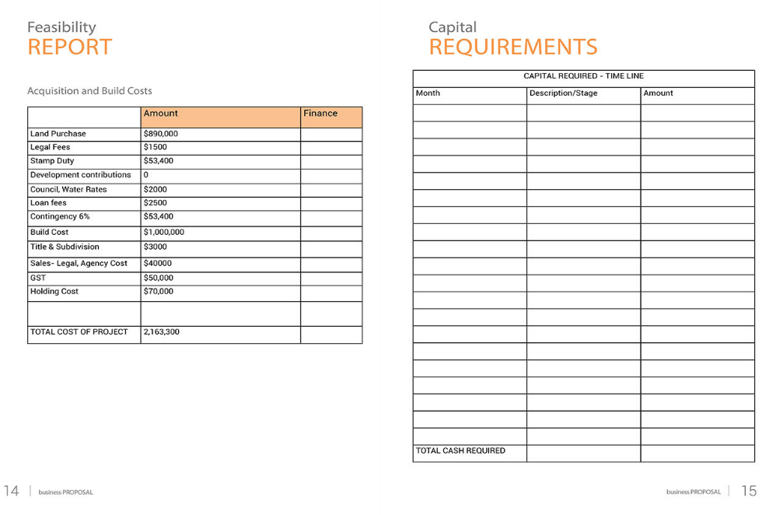
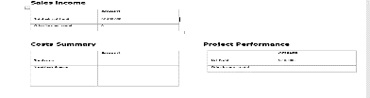
Pg 9
Pg 10

Slide 8
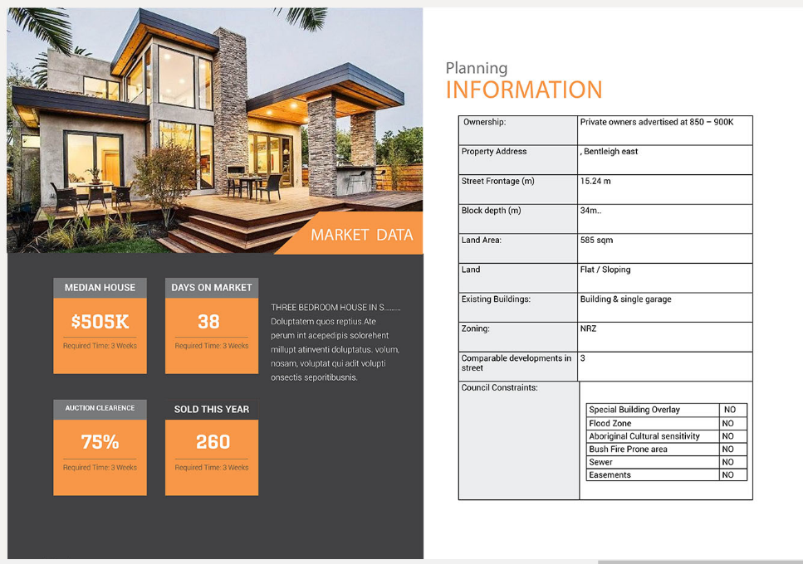
Pg 12
Pg 11

Slide 9
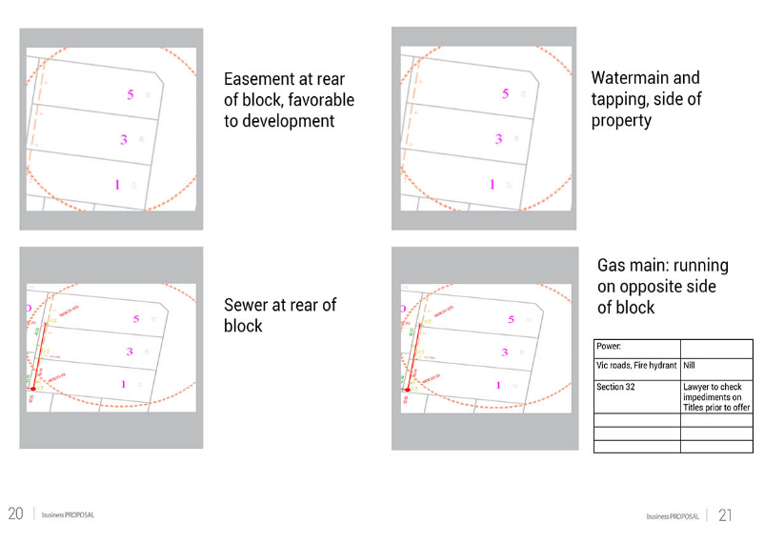
Can this be in one page, give place holder so I can copy paste ino the placeholder based on different property services images
Easement xxxxx
sewer xxxxx
watermain xxxxx
Gas main xxxxx
Pg 13

Slide 10
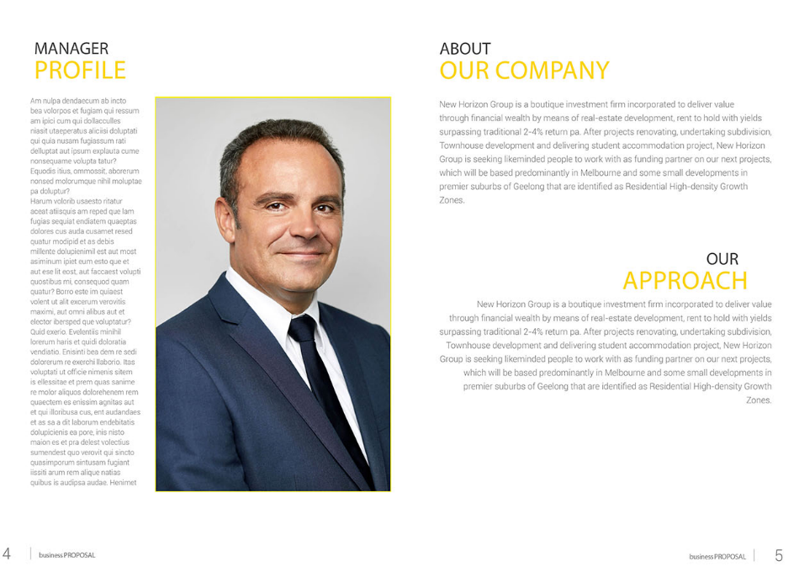
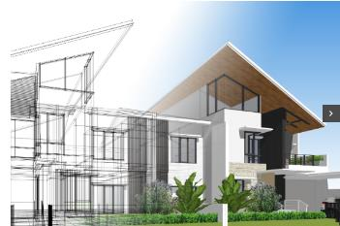
DELETE manager–NOT REQUIRED
KEEP it
KEEP it
Pg 14

Slide 11
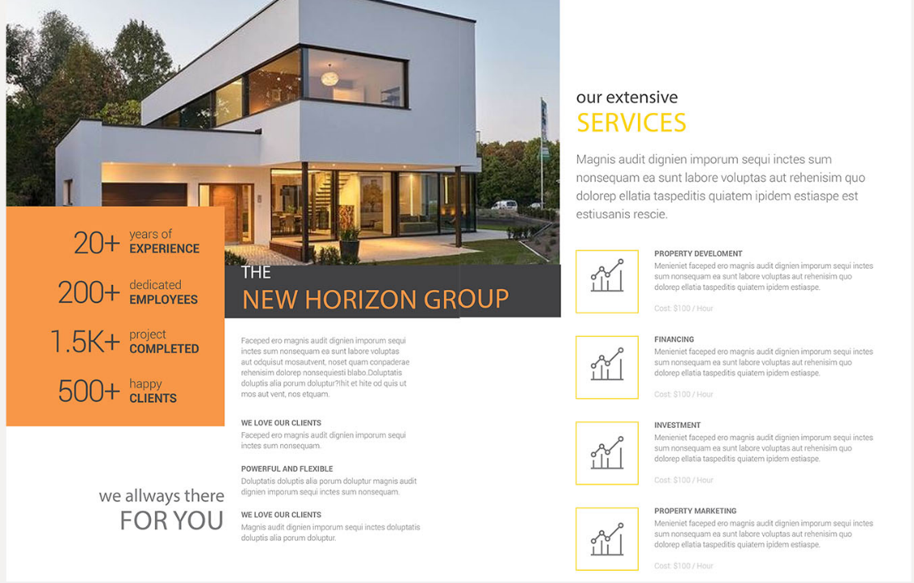
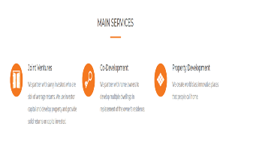
Include this content in your layout
Remove – we love clients, experience etc.
Combine this into one page the photo and call it our services , add three services
Pg 15

Slide 12

Combine into 1 page, keep 2 referee boxes instead of 4
Pg 16

