Slide 1



Slide 2


Company logo

Slide 3
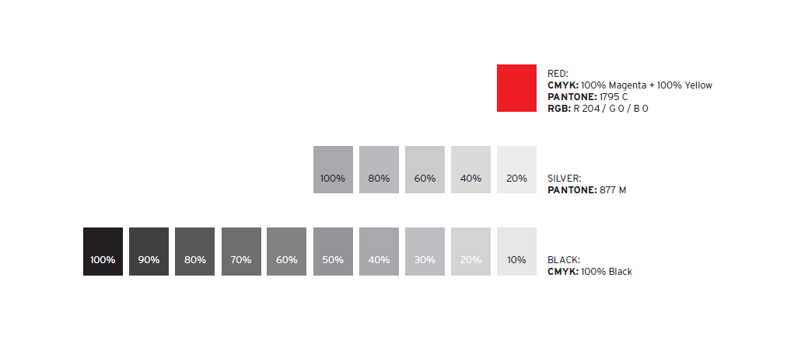
Color-scheme

Slide 4

Script I
for headlines; only capital letters
for headlines; only capital letters

Slide 5
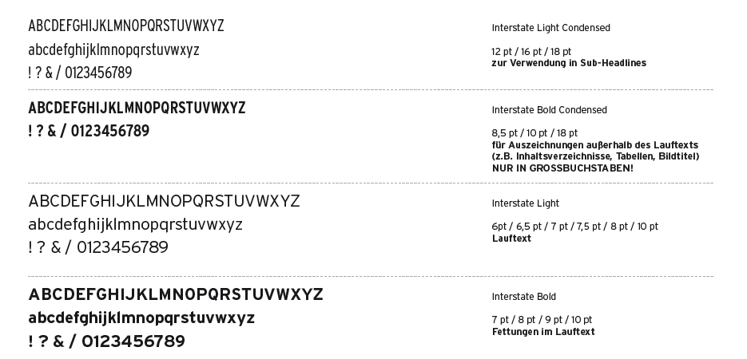
Script II
for sub-headlines
for remarks not part of the running text (e.g. Content, Agenda, Tables, Image titles); ONLY IN CAPITAL LETTERS
for running text
for running text - bold

Slide 6
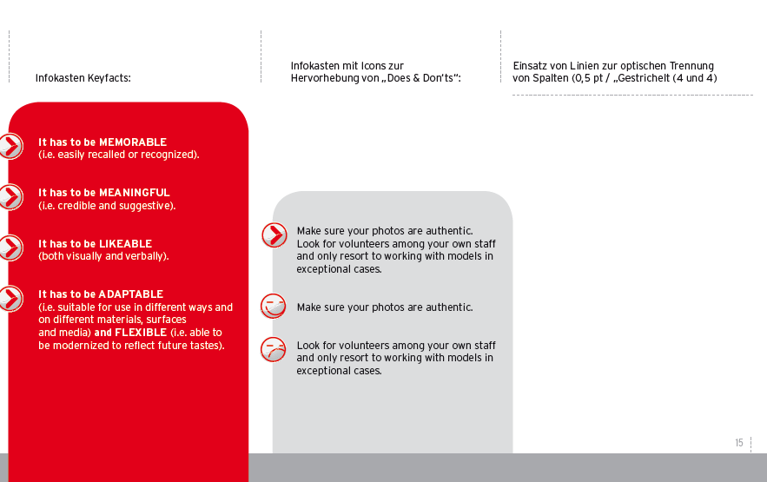
Infoboxes
Infobox Keyfacts
Infobox for Does & Dont‘s
Lines for optical separation; 0,5pt, dashed

