Slide 1

Solving
Children’s Scoliosis
Incubated by

Slide 2

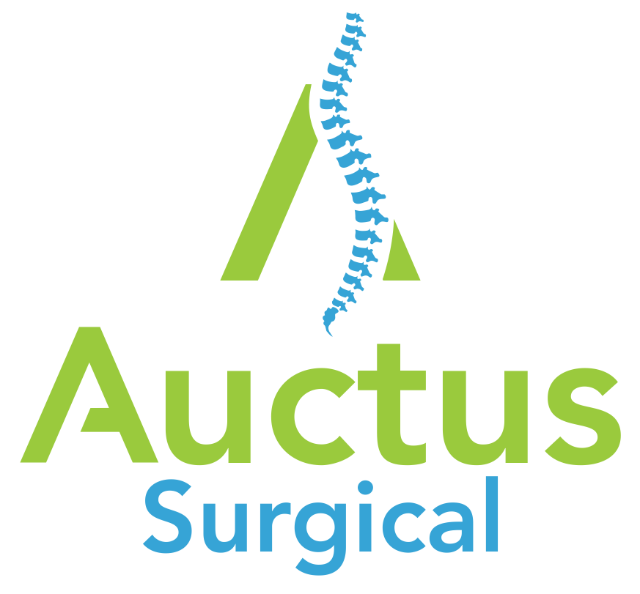
Mission
Develop novel technologies focusing on non-fusion scoliosis correction allowing for non-surgical dynamic adjustment of implants over time.
2

Slide 3
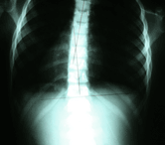
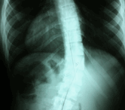
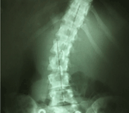
Problem
Scoliosis affects 2-3% of the population, or an estimated 6-9 million people in the U.S.¹
Mild scoliosis
10- to 24-degree Cobb
Treatment: Monitoring
Moderate scoliosis
25- to 39-degree Cobb
Treatment: Bracing
Severe scoiliosis
> 40- to 50-degree Cobb
Treatment: Fusion
Definition:
Cobb angle is a term that means the degree of curvature. The Cobb is used to measure the magnitude of spinal deformities, especially in the case of scoliosis.
Scoliosis is considered any lateral (sideways) curvature of the spine that is at least 10 degrees as measured by the Cobb angle, which is found by examining an x-ray of the back.
“Scoliosis.” AANS, American Association of Neurological Surgeons, www.aans.org/Patients/Neurosurgical-Conditions-and-Treatments/Scoliosis.
Notes:
Pictures: “ What Is Scoliosis?” What Is Scoliosis? Mild, Moderate, Severe, South Florida Scoliosis Center, www.southfloridascoliosiscenter.com/wisfeed.html.

Slide 4

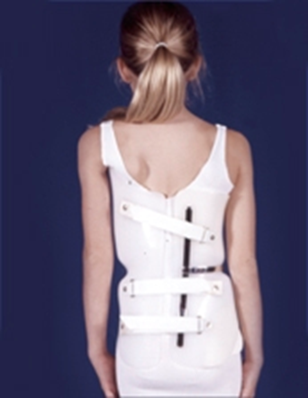
Problem
Current Pediatric Scoliosis Treatment Options - Bracing
  For scoliosis patients with Cobb 25-39°
  Start bracing as early as 2 years old
  Bracing Limitations
      Poor Compliance (50%)
      Rarely straighten spine
      Multi-year treatment
Bracing
4

Slide 5
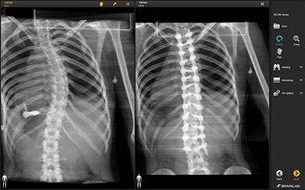
Problem
Current Pediatric Scoliosis Treatment Options - Fusion
  For scoliosis patients with Cobb > 40-50°
  Fusion on early onset scoliosis and adolescent idiopathic scoliosis (AIS) patients
      Fusion limitations
      4+ hour surgery
      Fusion is irreversible
      Complications, infections, failures
      Limiting motion for life
      Adjacent segment disease: illnesses caused around a fusion site. Most commonly occurs due to physical stress on surrounding spinal segments after a fusion operation
Alli, Renee A. “What's the Treatment for Scoliosis?” WebMD, WebMD, 26 Oct. 2018, www.webmd.com/back-pain/treatment-for-scoliosis#1.
5

Slide 6
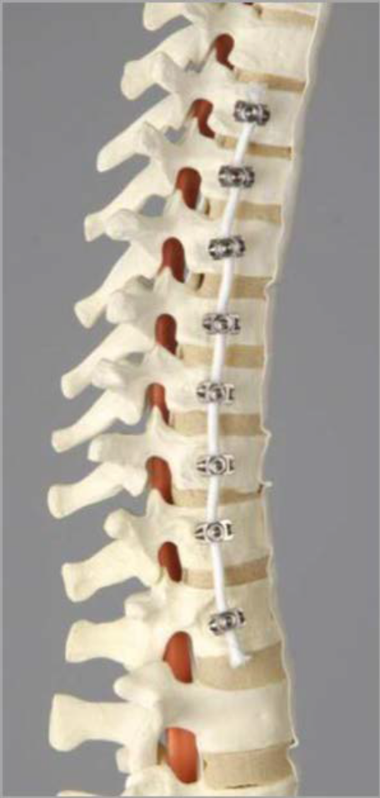
Solution
Current Pediatric Scoliosis Treatment Options - VBT
Cobb > 40°
For early onset scoliosis patients with skeletal growth remaining
Ages generally 8-12
Procedure currently performed by 15-20 surgeons
Limitations
No ability to adjust tether. Over-correction can result.
Tethers break – 10% breakage rate per data submitted to FDA
Non-Fusion
Vertebral Body Tethering (VBT)
Zimmer System recently approved by FDA under HDE Exemption. Provides regulatory clarity
6
Colduvell, Kathleen, “VBT - Revolutionary Treatment for Scoliosis”, Nurse.org, 5 Jan 2018, https://nurse.org/articles/vertebral-body-tethering-for-scoliosis/

Slide 7
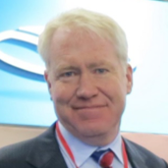
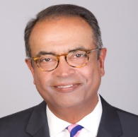
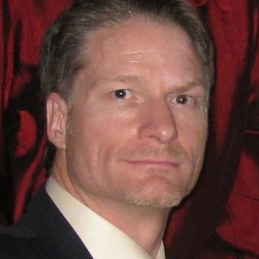
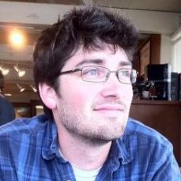
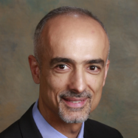
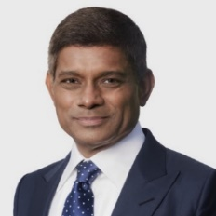
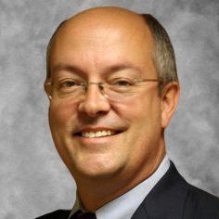

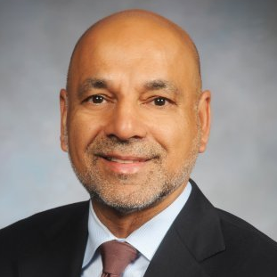
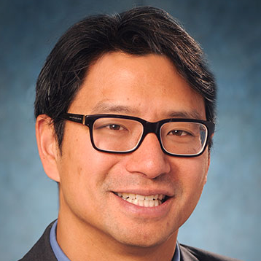
Founding Team – Experience in Orthopedic Implants
John Barrett
Founder and CEO
Murali Kadaba Ph.D. Co-Founder Chief Science Officer
John Ashley
Co-Founder VP R&D and Operations
Dillon Kwiat
Co-founder and Senior R&D Engineer
Co-founder and CEO
of CoAlign Innovations- Acquired by Stryker
in 2014
Leadership positions at Abbott Labs and Baxter
Previous Chief Science Officer at CoAlign Innovations
Previous leadership positions at Vertiflex, Stryker and Howmedica
Previous VP of R&D at CoAlign Innovations
Previous leadership positions at Spinal Kinetics, Benvenue, Oratec and Foxhollow Technologies
Senior R&D engineer at University of California, San Francisco
Mohammad Diab, MD
Professor and Chief of Pediatric Orthopedics, UCSF
60+ tethering procedures performed
Neel Anand, MD
Professor of Surgery and Director of Spine Trauma at Cedars-Sinai
Medical Center
Dennis Crandall, MD
Medical Director of the Sonoran Spine Group, Phoenix, AZ and Clinical Professor at the University of Arizona School of Medicine
Harsh Grewal, MD
Professor of Surgery and Pediatrics at St. Christopher’s Hospital for Children and attending surgeon at Shriner’s Hospital for Children, Philadelphia
300+ tethering procedures performed
Steve Hwang, MD
Neurosurgeon at Shriner’s Hospital for Children, Philadelphia
60+ tethering procedures performed
7

Slide 8

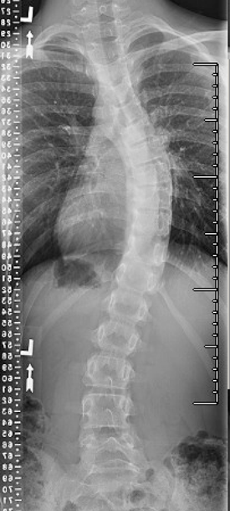
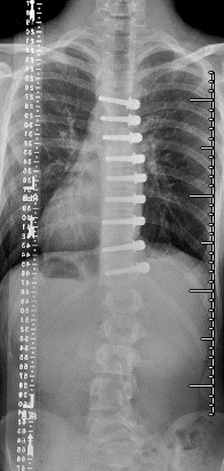
VBT Tethering Procedure – Dr. Diab (UCSF)
11 year old
Cobb > 45°
Progression despite bracing for 5 years
2 years after spinal tethering
8

Slide 9
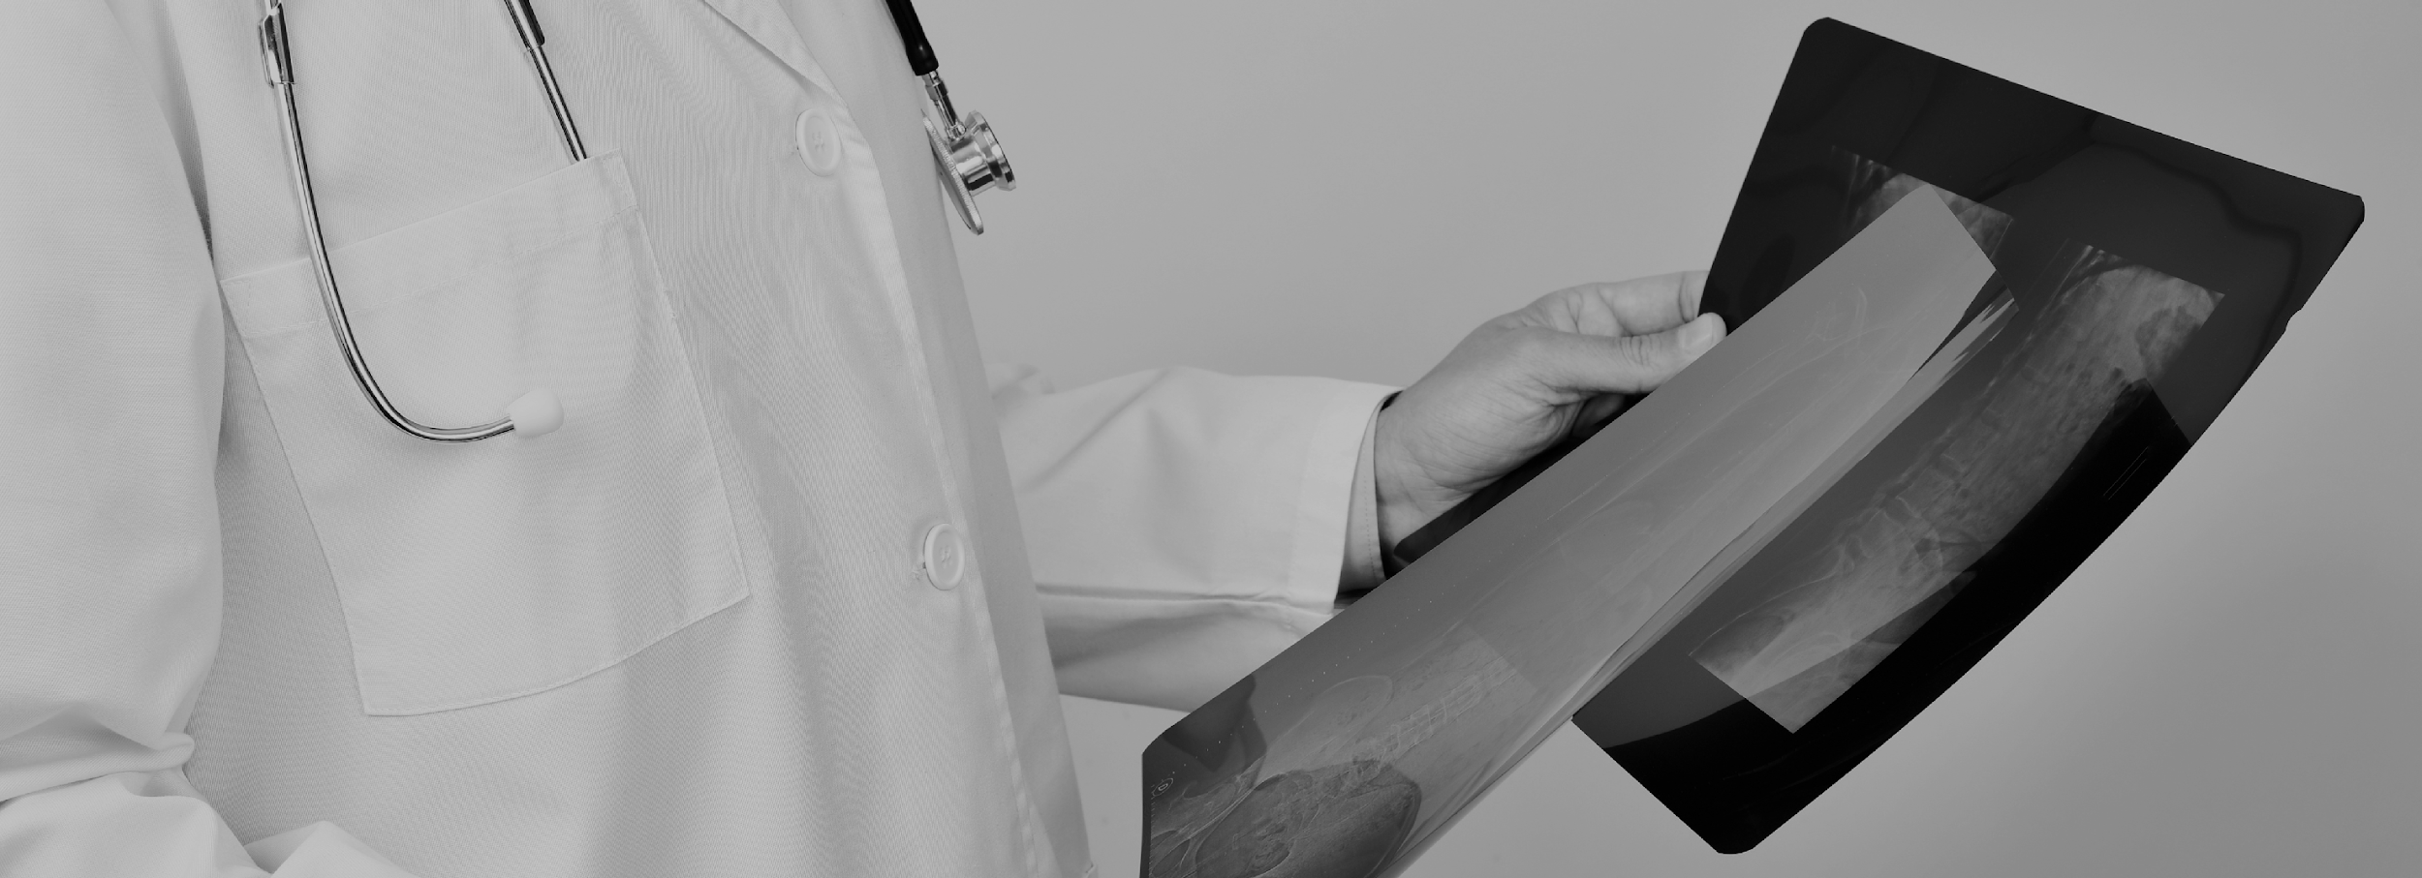
Benefits - Advantages of VBT over Fusion
  Does not “burn any bridge”:
  fusion remains an unimpacted option
  if this treatment modality fails
  Continued
  skeletal growth
  Single treatment event
  Partial Motion
  Preservation
  Little impact on activity
  and appearance

Slide 10

Benefits - VBT has Proven Results
Between the Shriner’s group and Dr. Diab at University of California San Francisco (UCSF), 350+ VBT procedures were completed.¹
  Benefits of VBT over Fusion
  ~66% Cost Savings ($50K compared to $150K)
  50% Saving in Surgery Time
  (1.5-2 hrs compared to 4-6 hrs)
  50% Saving in Hospital Stay
  (2-3 days compared to 6-7 days)
  Confirmed improved self-confidence for
  surgical recipients
Colduvell, Kathleen. “VBT - Revolutionary Treatment for Scoliosis.” Nurse.org, Nurse.org, 5 Jan. 2018, nurse.org/articles/vertebral-body-tethering-for-scoliosis/.
10

Slide 11
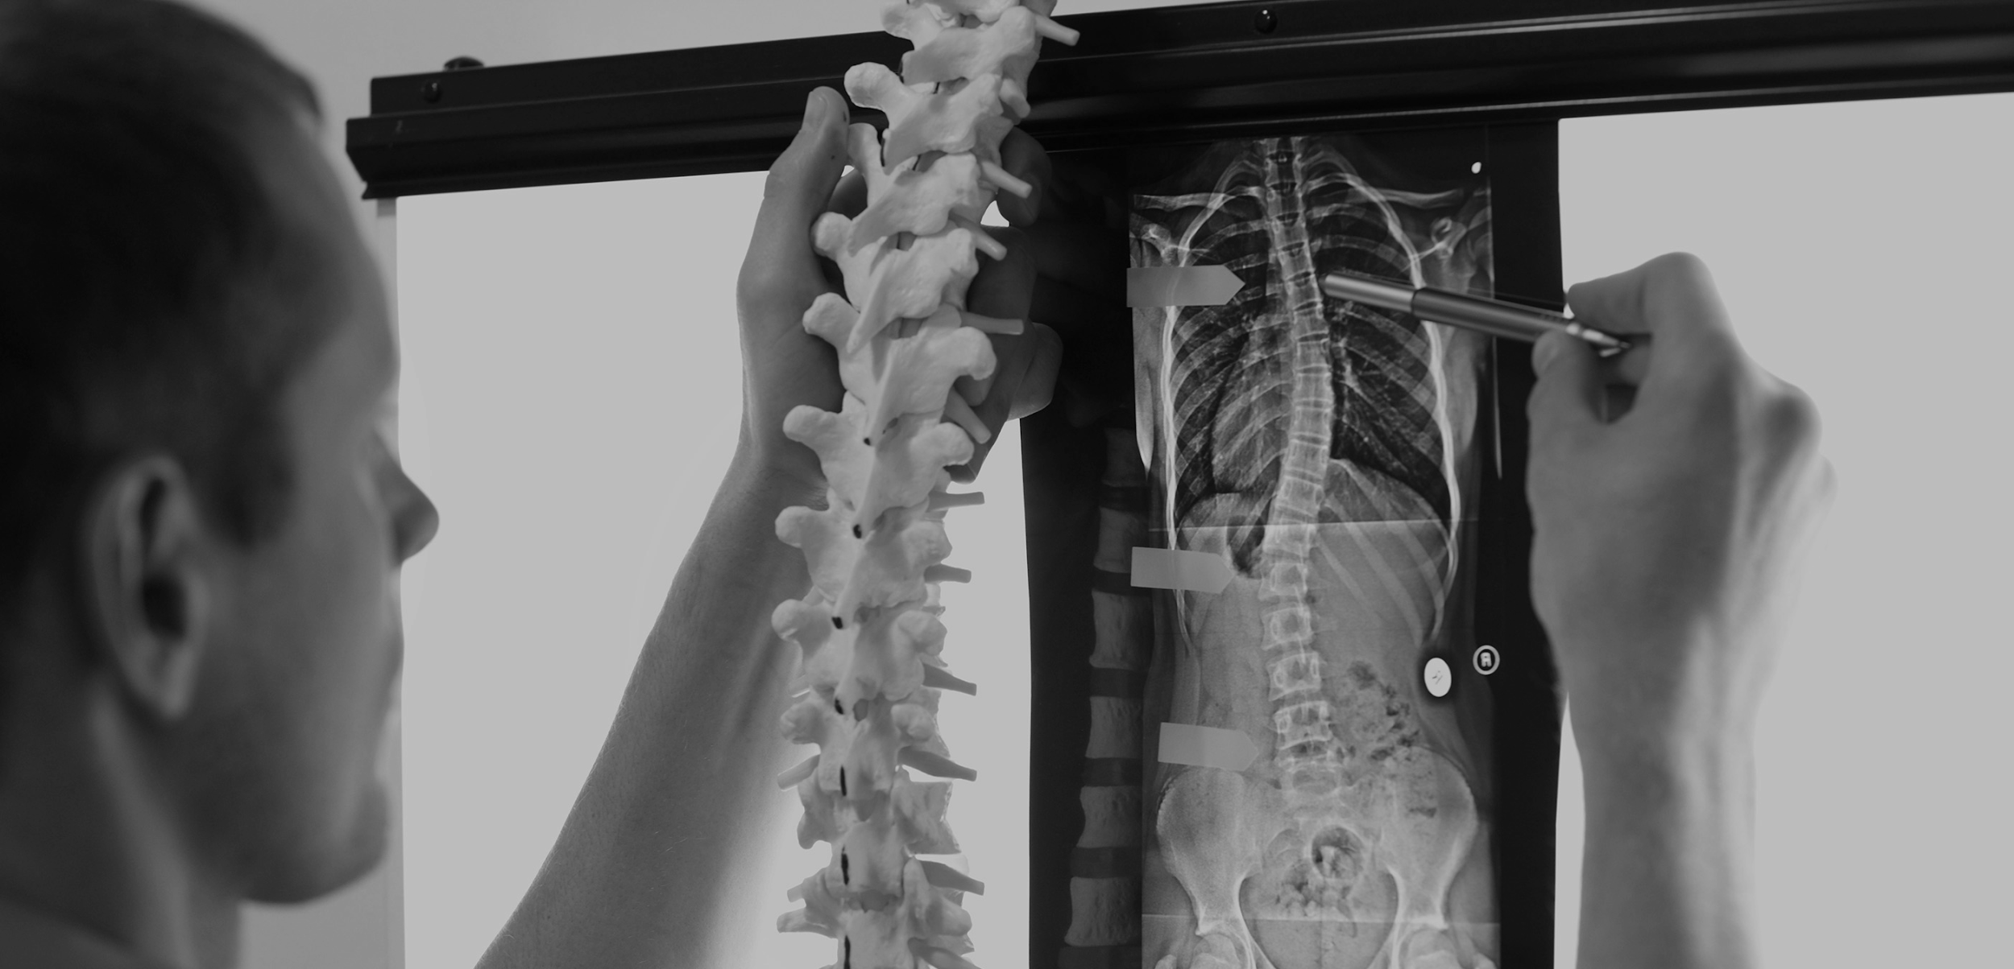
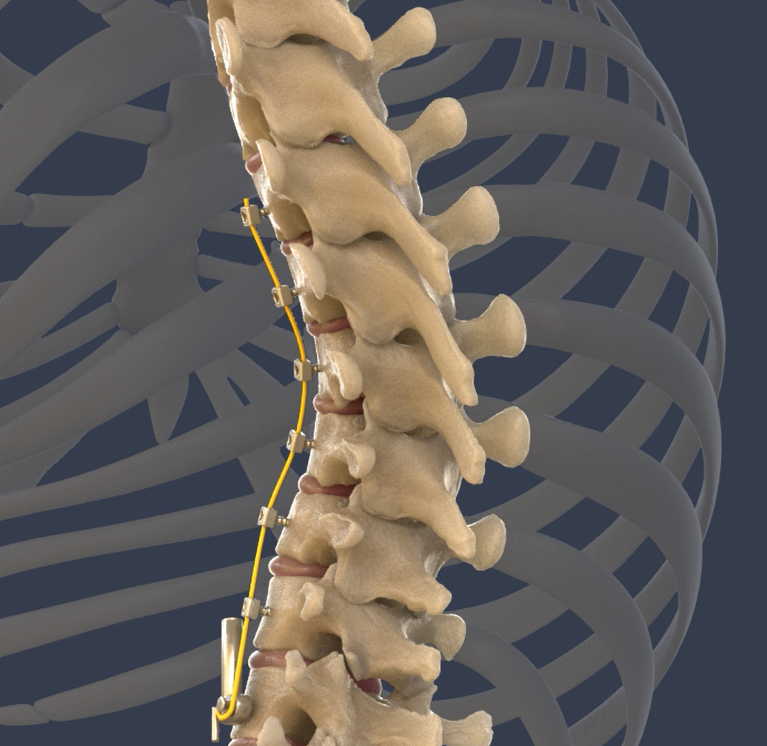
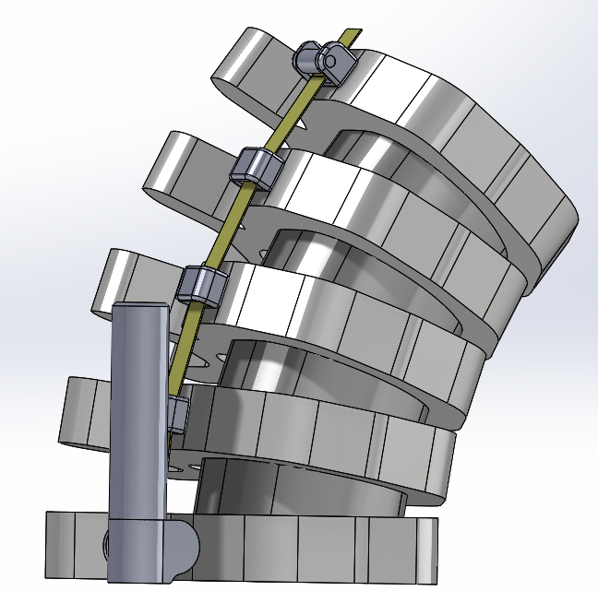

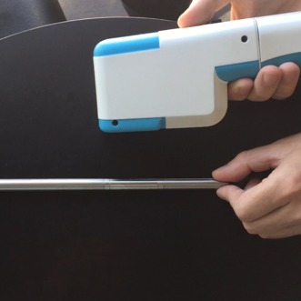
Solution
Auctus Dynamic Tethering System – Magnetic Tensioning
  Anchoring screw with cleat mechanism
  Magnetically activated dynamic tension
  External Magnetic controller
  Slider screws
  Complete non-surgical adjustment
  Most effective in making gradual non-surgical adjustments over time
  Magnetic engine attached to vertebral body via screw. Tether wraps around spool. Spool powered via external controller
  Prevents over-correction and can act as internal brace
11
Notes:
DO ARROW

Slide 12
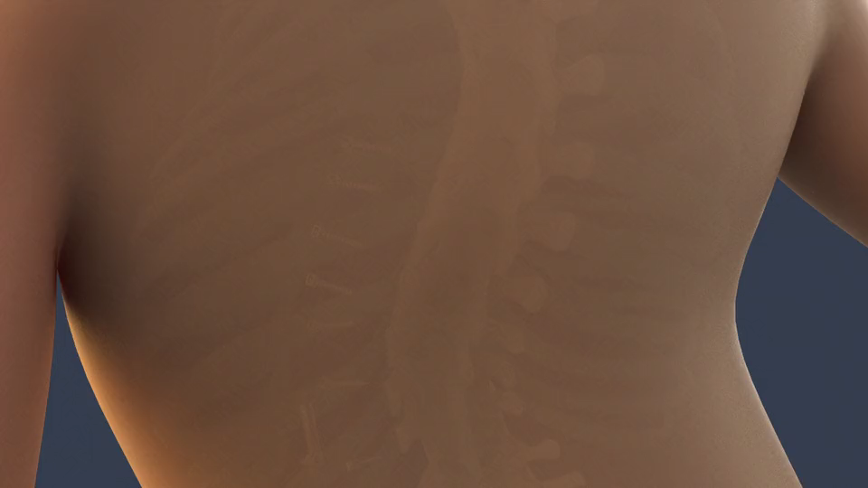

Slide 13
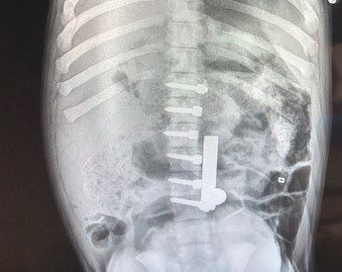
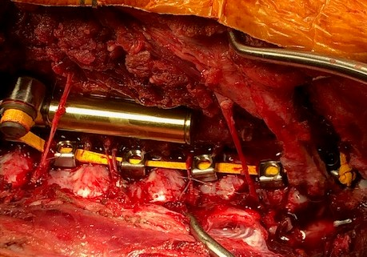
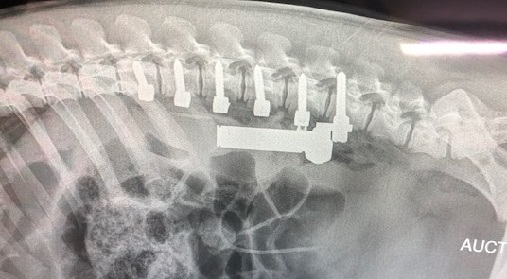
Pilot Pig Study
  2 Pigs – 3months old, 25KG
  Xrays every 2 weeks. Adjustments made
  10 weeks total Pigs doubled in size
  Testing system performance and durability
  System remained functioning and intact throughout

Slide 14
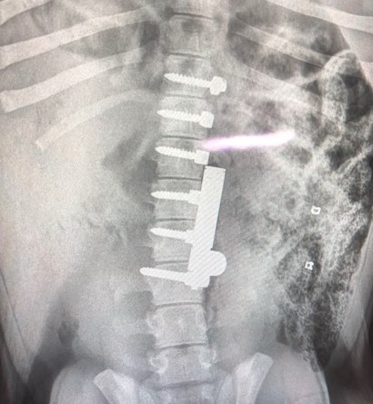
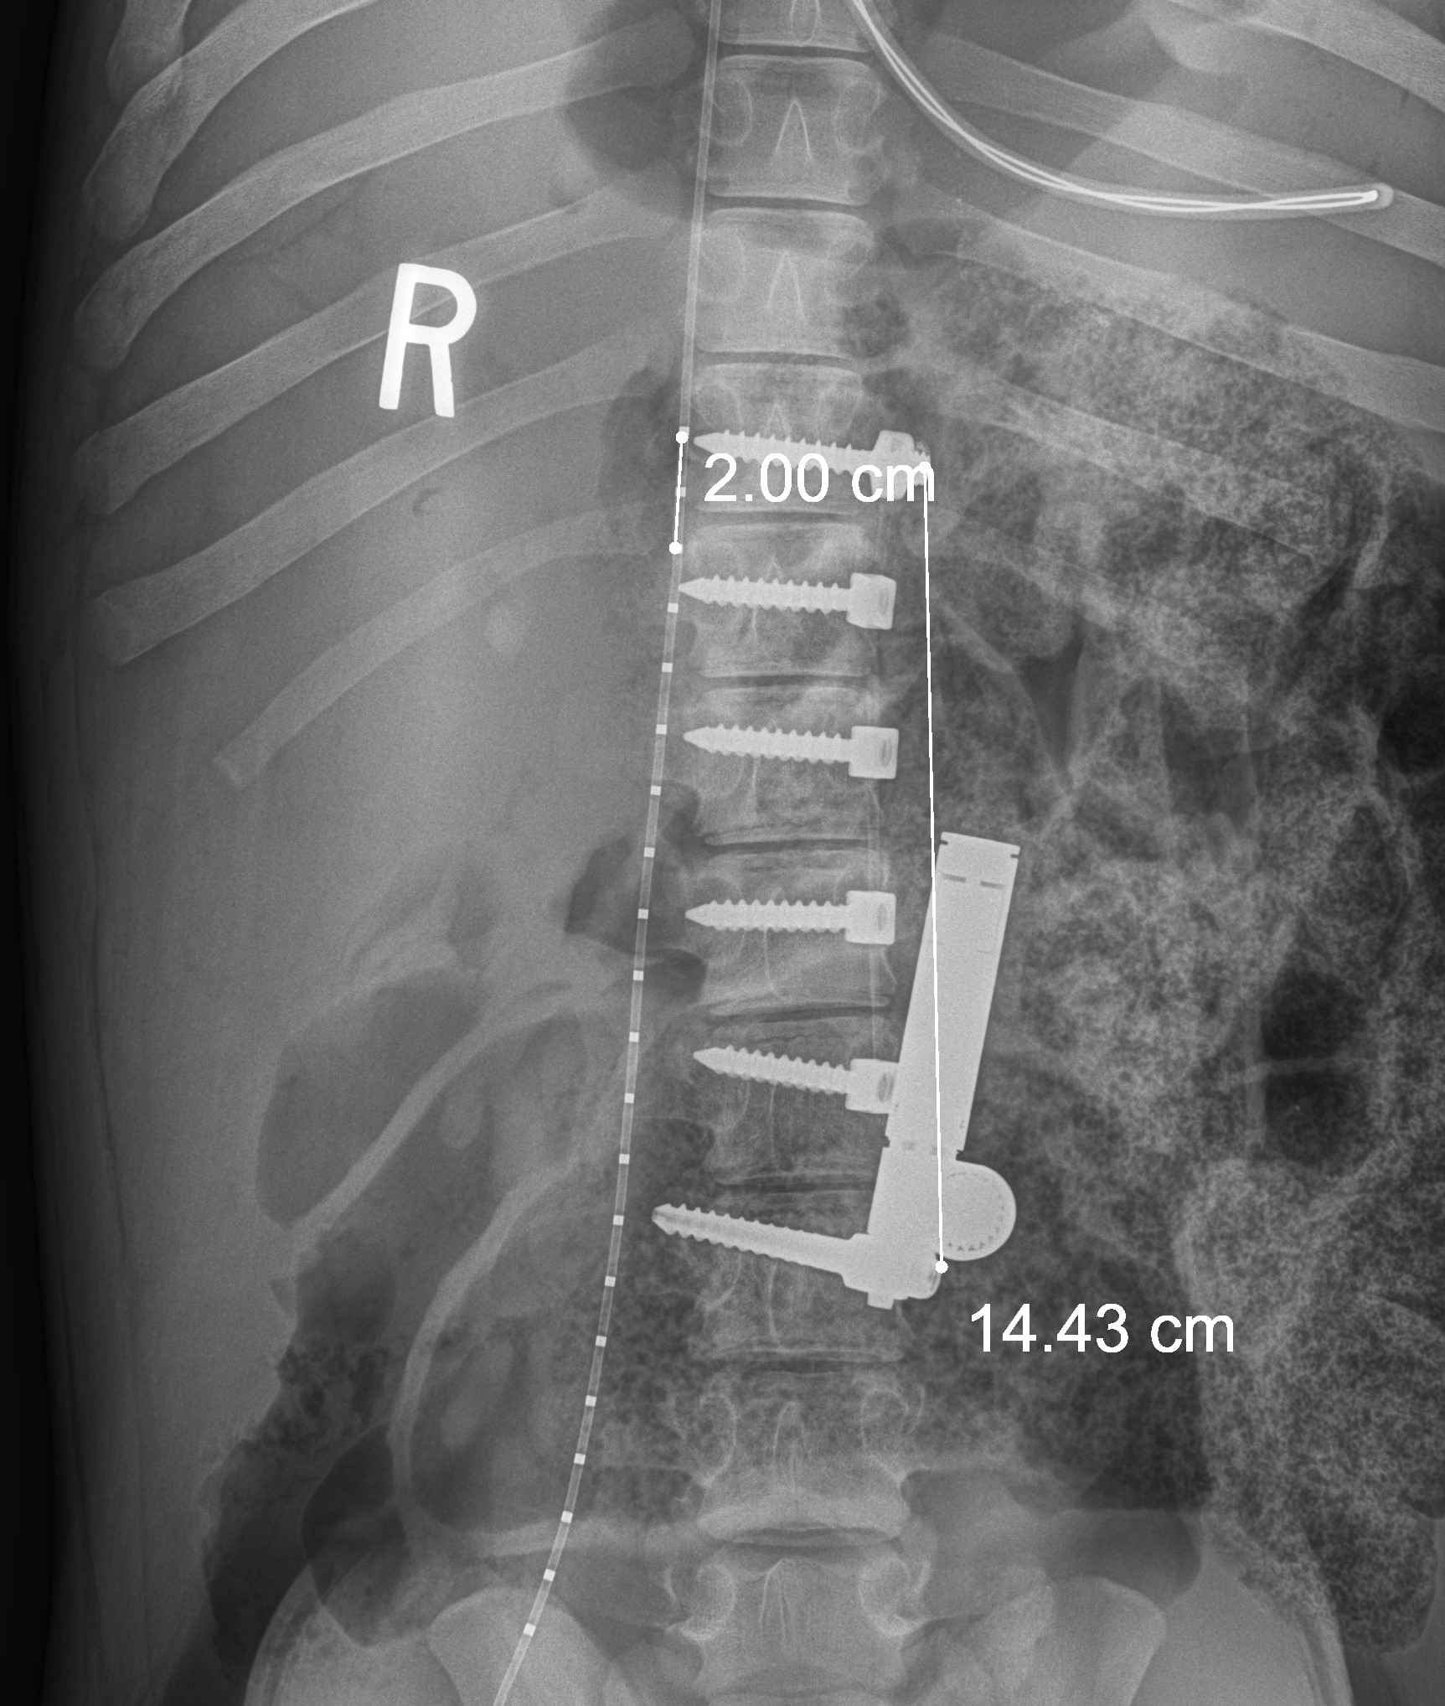
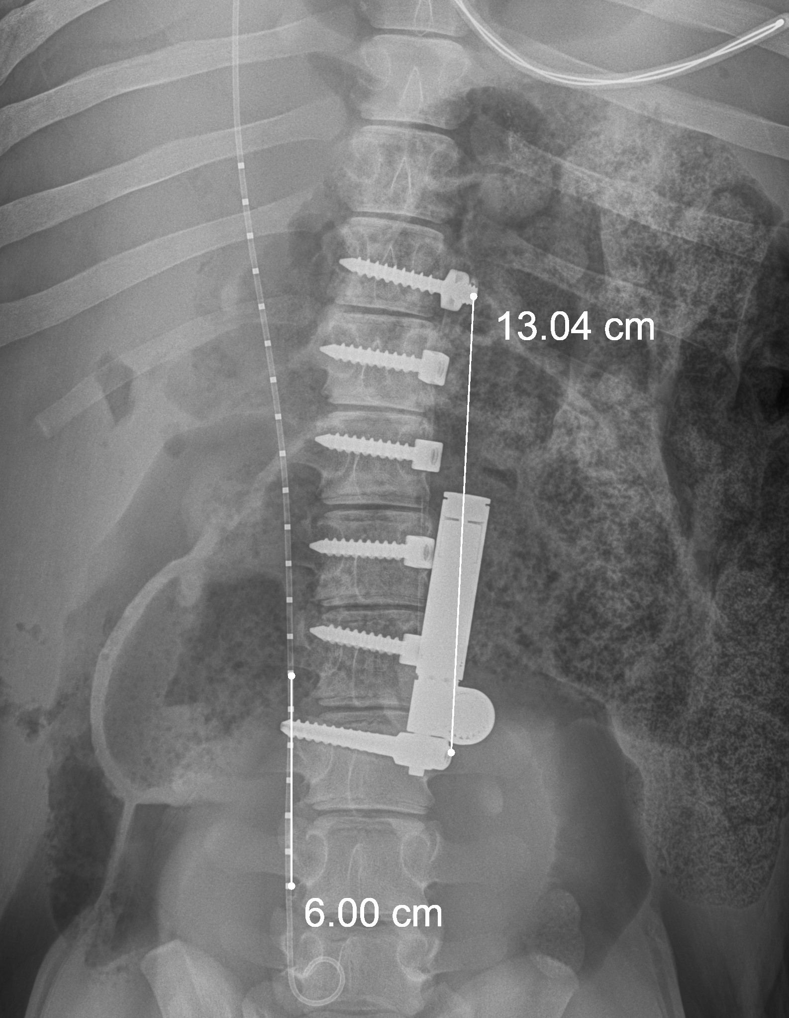
Pig Study #1 AP View
Post Op
2 Weeks Post Op
After tensioning

Slide 15

Tethering Market Segments
Early
$300M
$400M
$1B+
Current Tether Market
Future Market – AIS Fusion
Future Market – Early Intervention
8-12 y/o
Cobb > 40 degrees
Growth remaining
Flexible spine
10,000 patients
10-16 y/o
Cobb > 40 degrees
Close to skeletal maturity
Regular “brace-like” adjustments with non-surgical system (magnetic engine)
30,000 patients
Cobb 30-40 degrees
Never progress to fusion,
never wear a brace.
Develop laparoscopic system
100K+patients
15
15

Slide 16

Competition
 | VBT - Auctus | VBT - Zimmer | FUSION | BRACING
FDA Approved
Over-correction Management |  |  | N/A | N/A
Tether can break under pressure | No | Yes | N/A | N/A
Minimally Invasive Surgery |  |  |  | N/A
Full Spinal Motion
Blood Loss | Low | Low | High | N/A
Recovery Time^{1,2} | ~6 weeks | ~6 weeks | ~12 weeks | N/A
Muscle Sparing |  |  |  | N/A
“Treating Scoliosis with Anterior Scoliosis Correction - a Muscle Sparing Scoliosis Treatment”, Institute for Spine & Scoliosis, https://www.spineandscoliosis.com/procedures/scoliosis-treatment/anterior-scoliosis-correction/
Sherman, John E, “Postoperative Care for Spinal Fusion Surgery”, 2015 10 30, Spine-Health, https://www.spine-health.com/treatment/spinal-fusion/postoperative-care-spinal-fusion-surgery
16
16

Slide 17
Regulatory and Clinical
Recent clarity on pathway and indications via Zimmer approval.
  - HDE pathway is shortest route to commercial use.
  - However Denovo 510k may be preferred pathway with a manageable trial with 30-40 patients and 2 year follow-up
FDA making effort to facilitate pediatric approvals (small sample sizes, shorter follow-up, non-randomized trials)
Pursue early feasibility trials on growth modulation and AIS indications
17

Slide 18

Timeline to First-In-Man and Financing
H1 2020
H2 2020
H1 2021
H2 2021
H1 2022
H2 2022
H1 2023
Identify First-in-man locations
Submit IDE
Commence trial on AIS internal brace patents
Continue European cases
Prepare HDE submission
Initial HDE approval – Growth Modulation
$10M financing
Complete $2M financing
Design Freeze
V&V testing
Additional in vivo animal trial
First-in-man
trial begins
$10M financing
CE Mark
Complete enrollment in FIM
18
18

Slide 19
Accomplishments to Date
Successful completion of pilot animal trial
Fully functional system validated in vivo for 10 weeks with no clinical complications
Positive dialogue with FDA on regulatory strategy, given recent Zimmer approval
Winner and grant recipient of the “Make Your Medical Device Pitch for Kids!” competition hosted by The National Capital Consortium for Pediatric Device Innovation (2019)
19

Slide 20
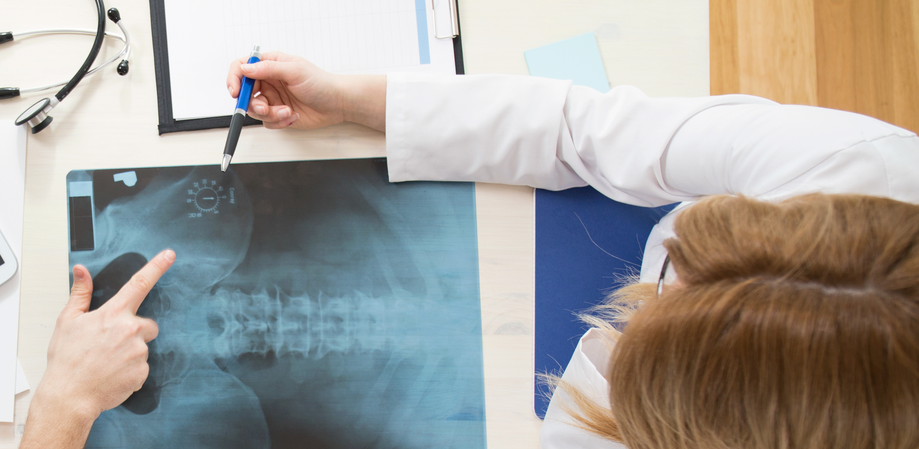
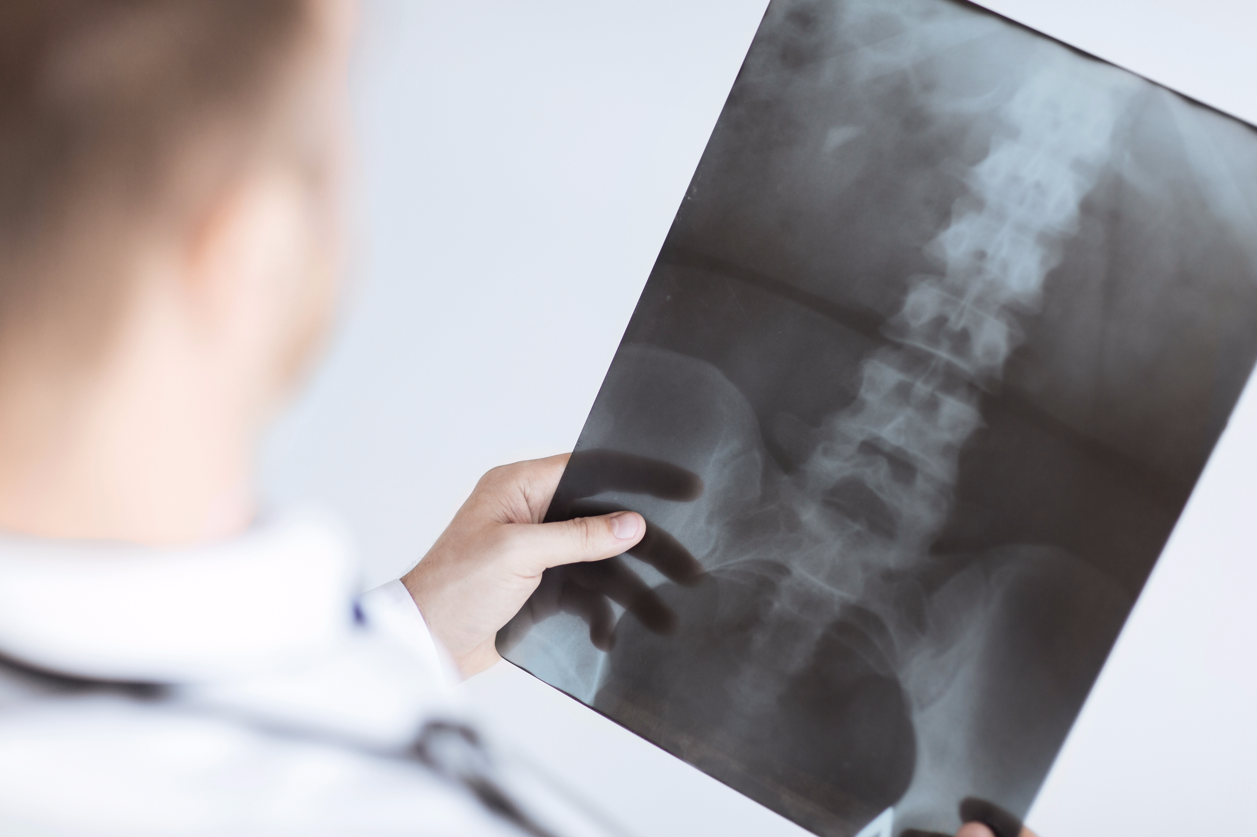
Key Points for Investment
  Vertebral Body Tethering procedure
  – potential non-fusion game-changer
  Dynamic system is the key
  Experienced team with a previous successful exit in the spinal implant market
  $20-30M total capital
  $200-$600M Exit within 5 years
20

Slide 21
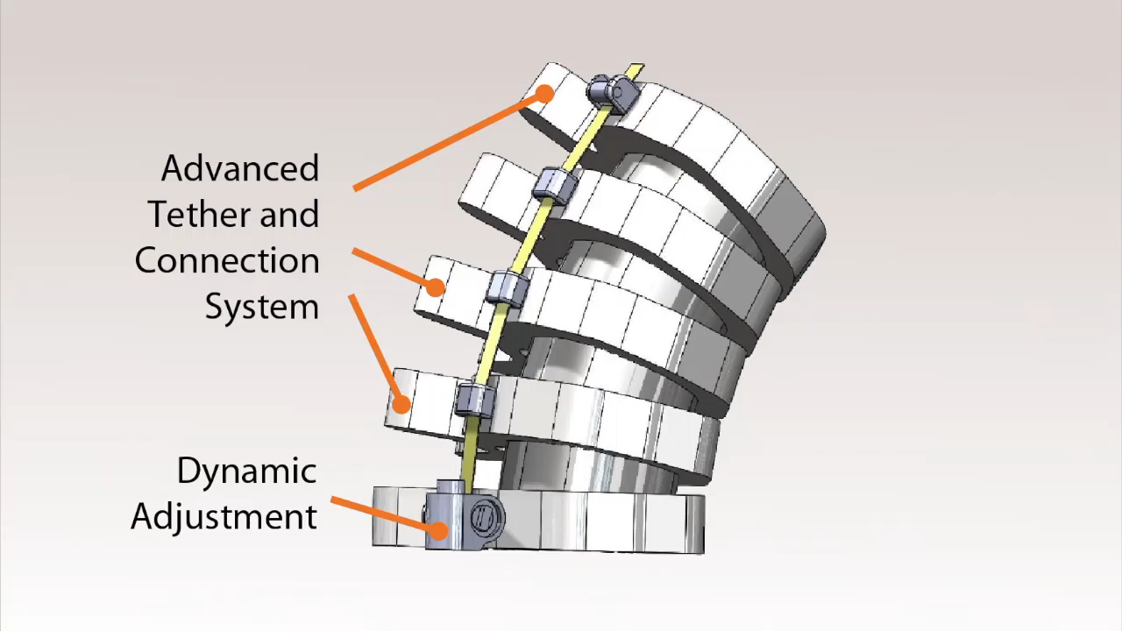
Video of Mohammad Diab, MD

