Slide 1
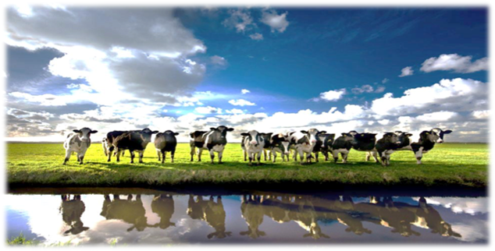

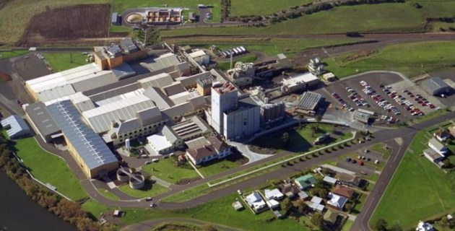
Integrated Australian Dairy
Introduction April 2020

Slide 2

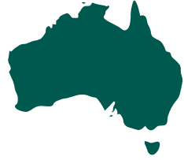


Integrated Australian Dairy
100% Australian owned and
operated Pro Vitamin Company
with integrated dairy focus
Manufactures dairy products for functional ingredients, human nutrition and specialised
animal nutrition
Active participant in the
circular economy with focus
on sustainability
Primary production
Nutritional R&D
Dairy processing
Sales & marketing
International/ Domestic trade & logistics

Slide 3

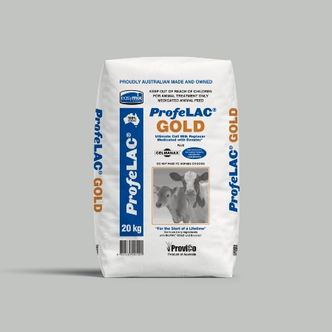
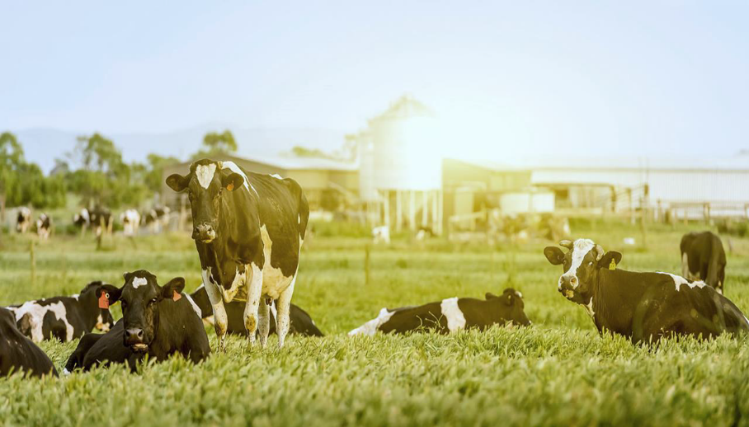
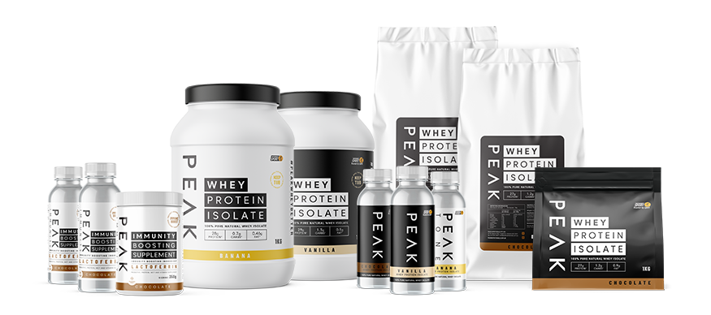
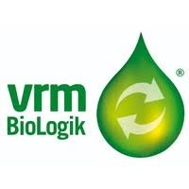

Core Divisions
Nutrition
Rural
Sustainability
Milk Recovery
VRM Biologik
FutureFeed CSIRO
Waste treatment plant at Dennington
Renewable energy generation
Functional milk powders
Growing up formulas
Peak Nutritionals
Whey protein powders
Seniors formulation
Retail powders
Truganina and Dennington Plants
ProfeLAC: Calf milk replacer
ProfeSTART: Colostrum supplement
FortiMILK: Vitamin Mineral Premixes
Feed Supplements
Feed Export
Liquid CMR: Calf Milk Replacer
Calf rearing operations at Dennington

Slide 4

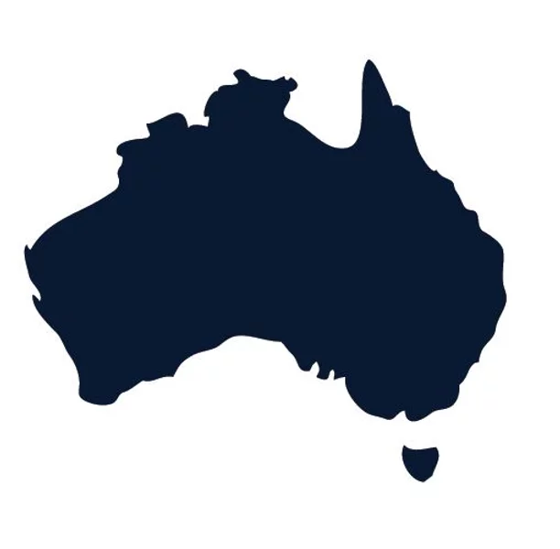
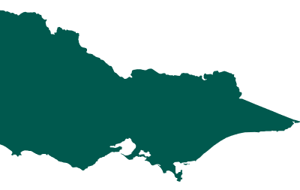

Core Competencies
Success driven by established partnerships & strategically located manufacturing & distribution assets
Corporate & Marketing HQ 10mins from Melbourne CBD
Fully accredited milk powder dry blending facility
Integrated logistics, NPD & distribution located close to port of Melbourne
Advanced wet blend and milk powder drying facility located in a prime dairying region
Diversified product portfolio of milk powders
Established brands in B2B and B2C markets
Existing markets and long term customer base in Australia, Middle East, Asia, Europe and Latin America
65% of the Australian Dairy Industry is in Victoria
ProviCo HQ
Dennington Site

Slide 5
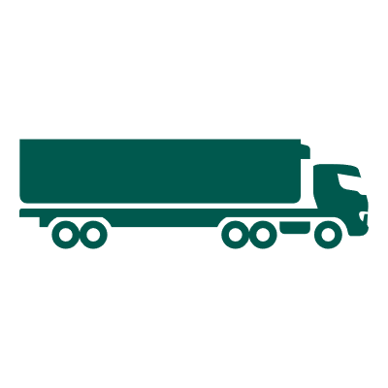
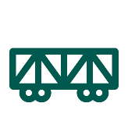




Dennington
35 ha site with a
variety of use options
Key milk district (~2bnL) & reliable
Major water
treatment plant
Road & rail access
Loading & storage
Versatility, strategic location, scale & new production opportunities
Supports & expands established industry partnerships
Functional application-based milk powders for existing customer base
Milk Storage and transfer facility
Wastewater Treatment plant to assist waste streams management
Liquid packaged dairy recovery segregated area for liquid CMR
Located close to customer base for ProviCo Rural range

Slide 6
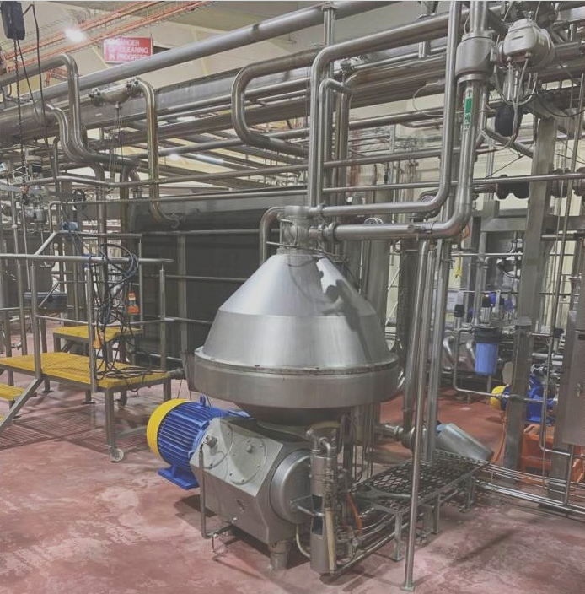
Advanced Site Capabilities
Capacity | Detail
Milk Treatment | 1.2m/ltrs per day
Formulation wet blending | Full milk source, partial or full recombination from milk powders
Evaporation & Drying | 6-9 tonnes per hour
Recent upgrades | Upgrades to milk storage, dryer system and filling room - $16m in 2018/2019
Silos | 6X250k Lt silos for milk/cream storage and transfer
Gas Flushing | To adhere to nutritional powder standards
Value Add Fortification | Vegetable oil, vitamin, mineral and DHA micro ingredient
Milk Transfer Station
Wet & Dry Blending Processing + Packing

Slide 7

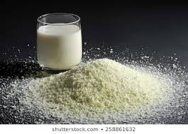

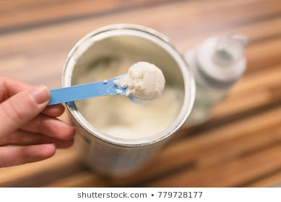
Key Product Portfolio
Application based milk powders
Wet Blended Milk Powders
Instant Full Cream Milk Powder Fortified
Buttermilk powder
Skim Milk Powder Instant and Fortified
Instant Fat Filled Milk Powder
Growing Up Milk Powders
Coffee Creamer powder
Skim Milk Concentrate Liquid

Slide 8
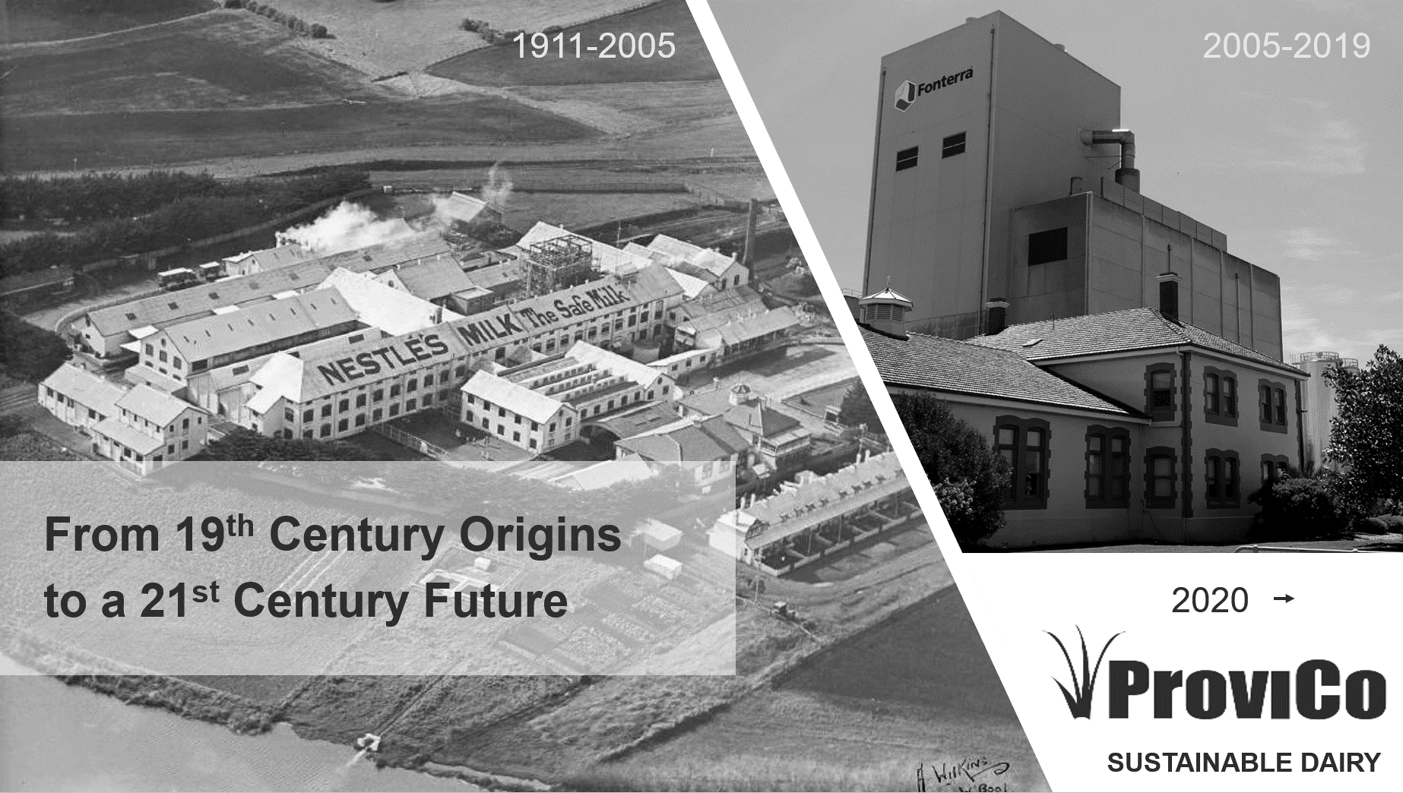

2020+

