Slide 1
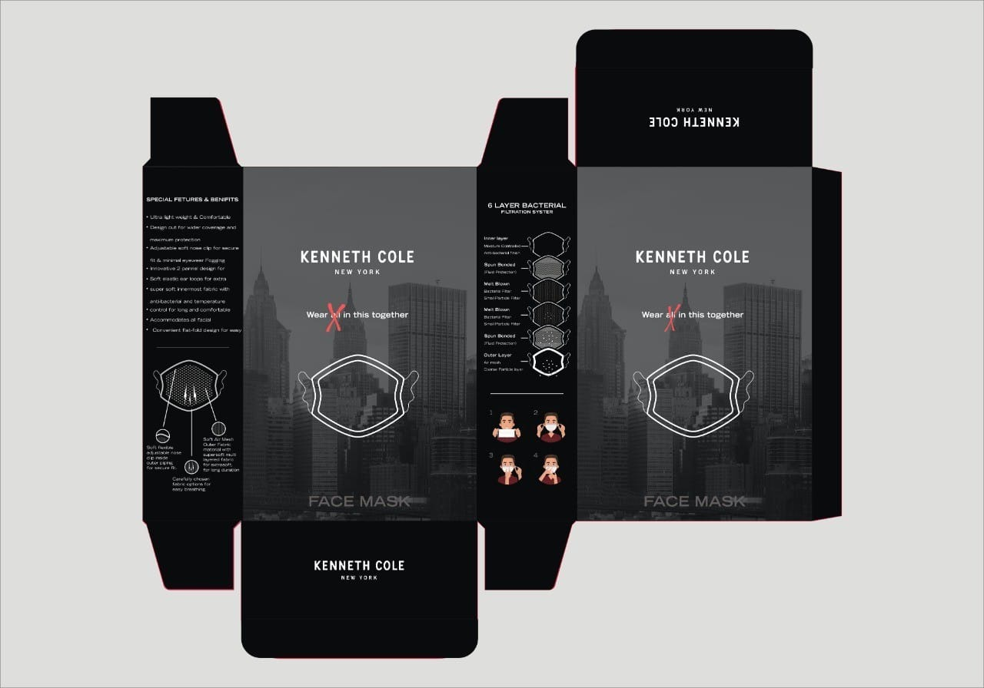
Remove “ALL”
FONT – GOTHIC LT STD BOLD CONDENSED NO 20 OR CONDENSED NO 18
BETTER ILLUSTRATION OF MASK
NEWYORK SKYLINE IMAGE TO BE CHANGED AS PER LINK SHARED
https://we.tl/t-o0P11vs6SB

Slide 2
SPECIAL FEATURES & BENEFITS
Soft, ultra-lightweight fabric for comfortable, easy breathing.
Flexible and adjustable nose clip for secure fit and minimal eyewear fogging.
Designed for wider coverage and maximum protection.
Super soft, antibacterial interior fabric with temperature control for long and comfortable usage.
Accommodates all facial movements.
Flat-fold design for easy storage.
Washable and Reusable
FONT – GOTHIC LT STD BOLD CONDENSED NO 20 OR CONDENSED NO 18
MADE IN INDIA

Slide 3

remove the faces showing how to wear , instead insert wash care

