Slide 1


EPC International Limited
美鋭電路（東莞）有限公司

Slide 2

About EPC
EPC简介

Slide 3
Introduction to EPC /
EPC 简介
  A Hong Kong company established in 2007. 公司成立于2007
  Specialized in manufacturing single sided PCB in its own factory in Dongguan, China 专一单面板生产商，拥有自己在东莞的工厂
  Through continuous upgrade and installation of automated machine, EPC is one of the most efficient single sided PCB factories in China. 通过不断提升自动化设备，EPC现在是中国内最高效率的单面板工厂之一
  Current manufacturing facility as follows: 现在生产基地如下：
  EPC International (Dongguan) Limited 美锐电路（东莞）有限公司
  Production capacity 每月产能: 110,000 square meters a months 110,000平米
  Employees 员工人数: 154

Slide 4
Shareholder structure/
公司架构
SSiu Ming Wah
Johnston 萧铭铧
SSiu SIN YEE萧善仪
80%
20%
80%
EPC International
Limited
世纪国际电路有限公司 –
a Hong
Kong Company
Cong Hai Jie 丛海杰
(Chinese national)
20%
80%
Merix Holding
(Hong Kong)
Limited
美锐控股（香港）有限公司–
A hong kong
company
100%
EPC International
(Dongguan) Limited
美锐电路（东莞）有限公司–
A China company

Slide 5

Corporate Mission/
企业使命
A premium low cost PCB manufacturer that fully embraces human, social and environmental responsibilities.
融入人类，社会，环境，高度责任感的低成本高品质PCB行业制造商。

Slide 6
EPC Business Principles/
EPC 商业原则
Reliability – in QUALITY
品质可靠
Reliability – in DELIVERY
服务交期可靠
Reliability – in COMPETITIVE PRICE
有竞争力单价可靠
Trustworthy – committed to what has been agreed
值得信赖 – 因为致力达成协议
EPC Building Blocks EPC 建筑模块
EPC views relationship with customers from long term partnership
not merely as a supplier.
EPC 视客户为战略性伙伴不单是一家单面板供应商。

Slide 7
Competitive Edges /
竞争优势
Cost Competitiveness/
低成本的竞争优势
Stable Financial position/健全稳定的财务状况
Strong management experience/强大丰富的管理经验
Flexible Support/
合理的弹性体制
Strong commitment in single sided PCB business
对单面PCB事业的慧忠诚度

Slide 8
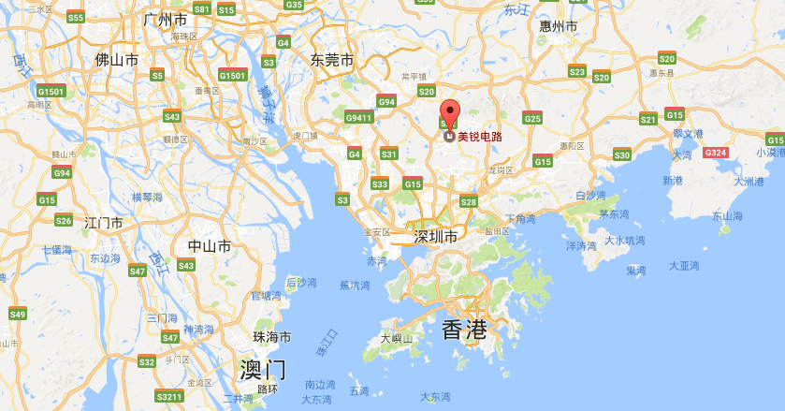
Factory Location
工厂位置
Address: 3HongYe South 2Rd,138 Industrial District ,
Tangxia Town, Dongguan, Guangdong Province, China 523710
公司地址：広東省东莞市塘廈鎮138工業区宏業南2路3号

Slide 9

Factory Overview/
工場概況
HKD
Founded：1993
工場成立：1993年
100% Privately Owned
100％香港私人企业
Registered Capital: HKD49M
資本金：HKD49M
SalesTurnover:HKD138M
(2018), HKD144M(2019)
营业额： 2019年 HKD138M；2019 HKD144M
Professional PCB maker of 1L/2L(NPTH) PCB
单面板，双面板，LED板
Employees: 154
工厂人数：154名
Production Capacity: 110,000 ㎡ per Month
生产产能： 每月110,000平米
Certifications: UL, , IATF16949, ISO14001
認証：UL、IATF16949、ISO14001

Slide 10
Organization structure/
组织架构图
MANAGING DIRECTOR
董事长
萧铭铧
ENVIRONMENTAL AND SPEICAL PROJECTS
丛海杰
OPERATIONS
EXECUTION GROUP
候林英/黄丽/杨庆成
QUALITY CONTROL
朱诗国
SALES/CUSTOMER SERVICES
陈艳珍
FINANCE/TREASURY/ACCOUNTING
黄晓燕
SALES/CUSTOMER SERVICES
丛海杰
Purcha sing
購買部
Maintenance
設備部
（排水処理）
Production
planning
PMC
Production
製造部
Engineering
技術部
Customs
declaration
Department
通関部
Security
保安清洁部
Personnel
Department
人事部

Slide 11

















Main Customers/
主要客户群

Slide 12
Application/
产品应用范围
应用范围 Application | 比例%
家電製品 Household appliances | 60%
電源製品 Power supply | 20%
照明製品 Lighting controlsystem | 10%
其它 others | 10%

Slide 13

Key Capabilities /
工艺制作能力
Overall Thickness/板材厚度 0.70mm~1.60mm± 0.13mm
Copper Thickness/铜箔厚度 1oz or 2oz (35μm or 70μm)
Line & Space/线宽/线距 150μm/150μm (0.15mm/0.15mm) min.
Hole Size(Punching)/模具孔径公差
  FR-1: 0.6mm+0.1/-0mm
  CEM-1: 0.7mm+0.1/-0mm
  . FR-4/CEM-3(≧1.6mm): 1.6mm+0.1/-0mm
  . FR-4/CEM-3(≦1.2mm): 1.4mm+0.1/-0mm
Hole Size(Drilling)/CNC钻孔
  FR-1/CEM-1: 0.3mm+0.05/-0mm
  FR-4/CEM-4: 0.5mm+0.05/-0mm
Rectangular Slot Size/最小槽面积
  FR-1: A: 1.0±0.1mm; B: 0.6±0.1mm (Punching)
  FR-4/CEM-3/CEM-1: A: 1.2±0.1mm, B: 1.0±0.1mm
Surface Finish/表面処理
  OSP/, Flux, Pb Free HAL/无铅喷锡
  max printing size/ 最大版面印刷尺寸 610mm*510mm

Slide 14





Laminates With UL /
板材类型
FR-1/纸质板
  KB: KB3151C(31V0/GV10), KB3152 (HF)(G1V0)
  Eternal: ETL207(HF)(G1V0), ETL204(T)(F1CT/G1V0)
  ETL204(N)(F1CT)
  CCP: CCP3400ST(03V0/G1V0), CCP3400(03V0/G1V0)
  CCP6400SM (HF)(G1V0)
  Panasonic: R8700(R87V0), R8500 (HF)(G1V0),
  CEM-1/半玻璃纤维板
  KB: KB5150 (CTI600)(FRV03), KB5150(FRV03) ,
  Eternal: ETL502(FRV03),ETL502FY(FRV03),ETL502FW(FRV03)
  Shengyi: S3110(FRV03), S3116 (CTI600)(FRV03),
  Q360G(HF)(FRV03)
  CCP: CCP508(FRV03), CCP518 (HF)(GV1)
  NanYa: CEM-1-97PM(FRV03)
  CEM-3/玻璃纤维板
  KB: KB7150(FRV03)
  Shengyi: S2155 (HF)(GV1),S2130(C3CT)
  Panasonic: R1781(FRV03)),R1786(FRV03),R1782F(RV03),R1787(FRV03)
FR-4/玻璃纤维板
  KB6160(FRV03), KB6150(FRV0),S1141(FRV03),FR-4-86(FRV0),S1150G(HF)(5D)

Slide 15
Screen printing ink
丝印油墨类型
UV Solder mask/UV阻焊油
GOO: PSR-310(A-29) (緑色)、PSR-310(SW-27)（白色）
PSR-310(WL-2)（白色）
SQ ：UVC-II-G800N（緑色）、UVC-II-GB998（青色）
Thermal Solder mask /热固阻焊
GOO:PSR-290EXW(WS-2)（白色）
SANWA：IR-530G （緑色）
UV Silk /UV文字油
GOO：PSR-310(W-109)（白色）、PSR-310(C-27)（黒色）
SQ ：UVC-280（白色）、BK-370-1（黒色）
TAIYO：UVR-182E(黒色)

Slide 16

Company equipment 公司设备

Slide 17
2016~2020INVESTMENTS/
2016年~2020年总投资
新设备 New equipment list | 台数 Quantity
Drill machine 钻孔机 | 2
CCD punching 自动冲压机 | 4
Guiding hole punching machine 自动打孔机 | 3
screen printing 自动印刷机 | 9 Japan made（日本製）
E-TEST machine 自动测试机 | 7
Automatic v cut machine 自动Vcut机 | 3
Automatic Packing machine 自动捆包机 | 1
hasl lmachihe 自动喷锡机 | 2 German made（德国製）
Ordinary packing machine 普通包装机 | 1
AVI 自动外观检查机 | 3（中国制2台、日本制1台kurabo）
环境排水处理投资 Environmental wastewater treatment | USD1.2 Million
生产设备投资 Ｐroduction equipment | USD 5.0 Million

Slide 18
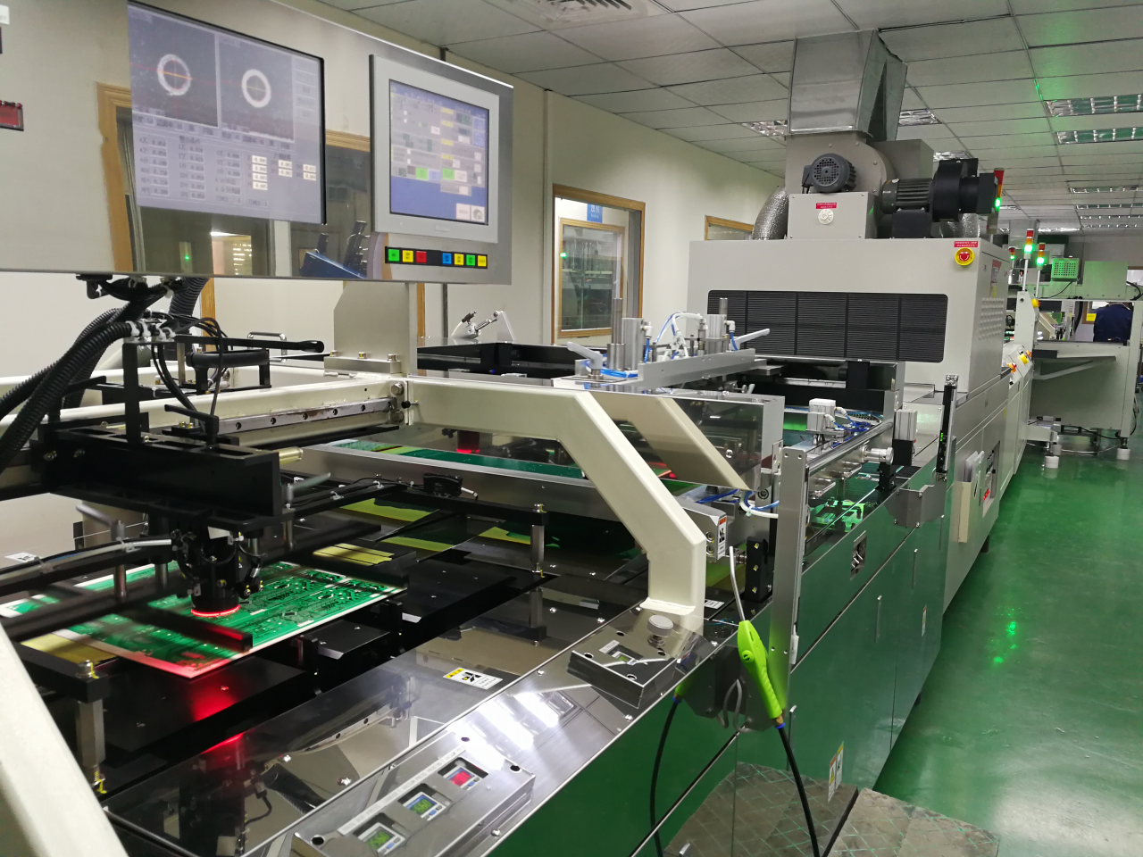
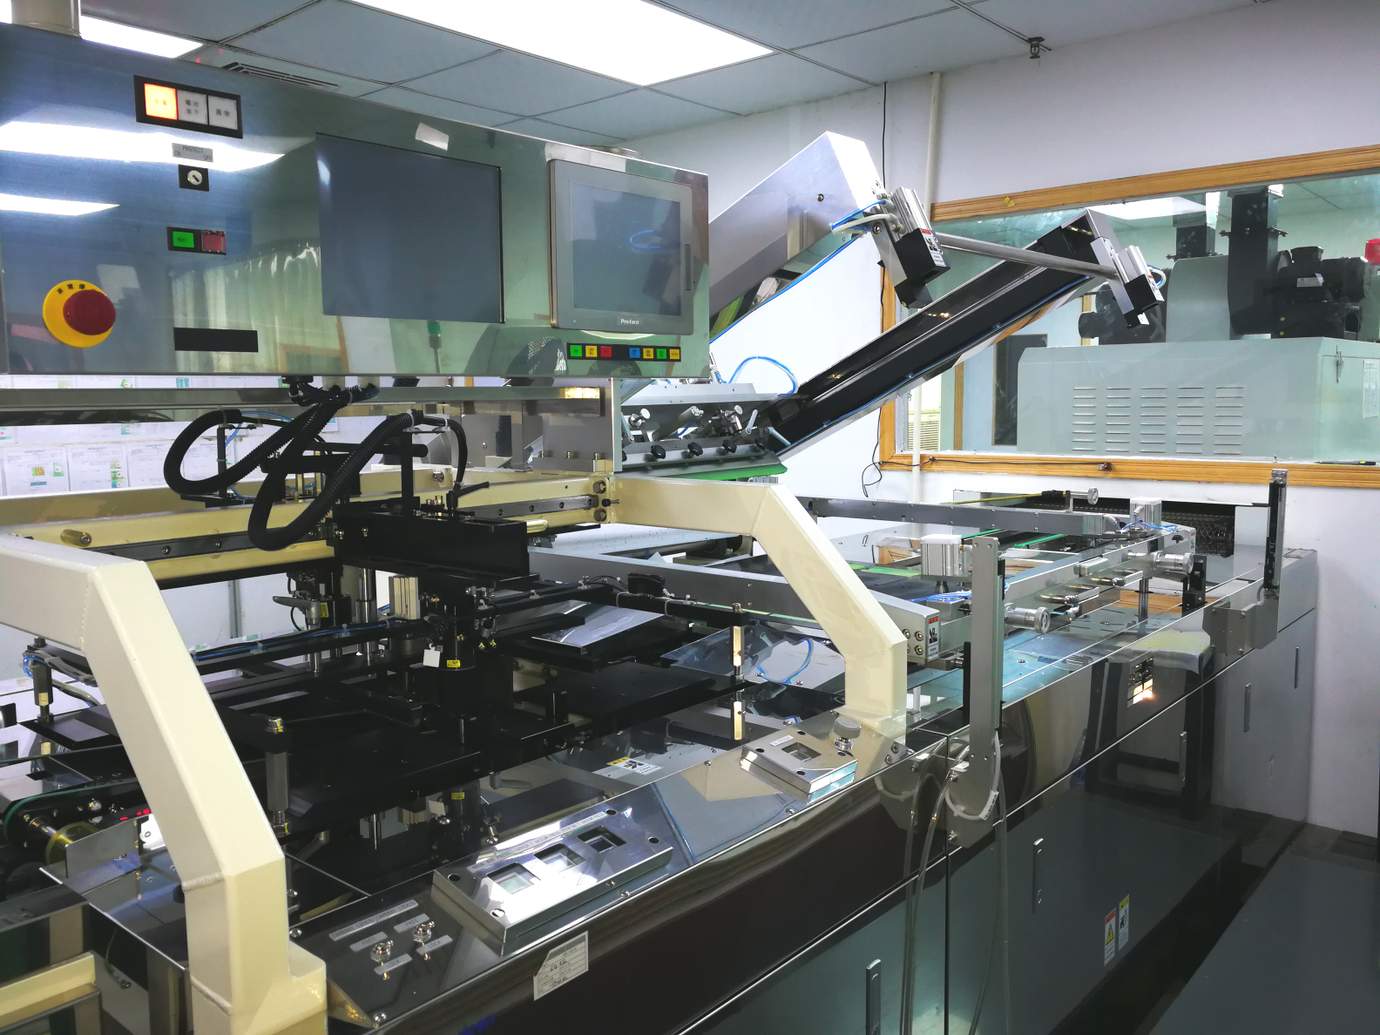
Automatic screen printing line/
全自动印刷设备
All brand new Japan made CCD printing machine ensuring circuit, solder mask and legend printing quality.
全新日本制CCD 印刷机保证线路，阻焊，文字印刷品质。

Slide 19
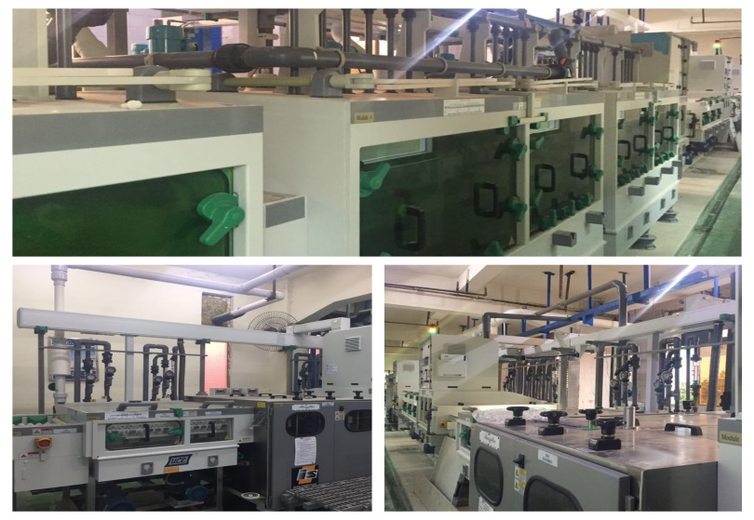
Etching Line/
蚀刻设备

Slide 20
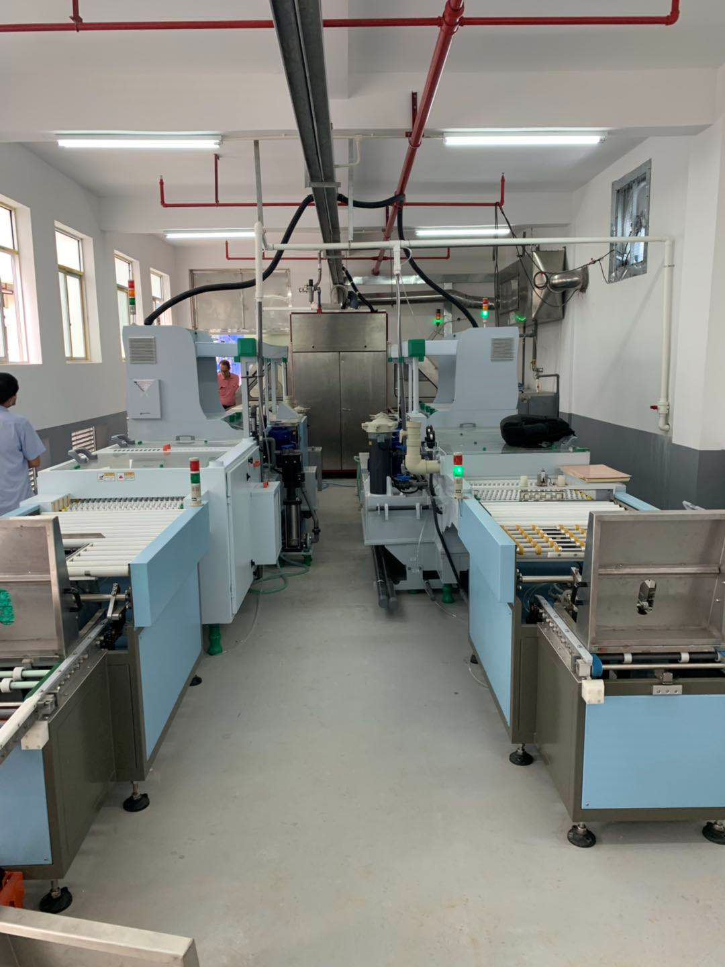
Automatic HASL line/
全自动喷锡设备/前后处理
Fully automatic HASL machine from Pentagal of Germany ensuring HASL quality
全中国唯一全自动垂直德国生产喷锡机，保证喷锡品质。

Slide 21
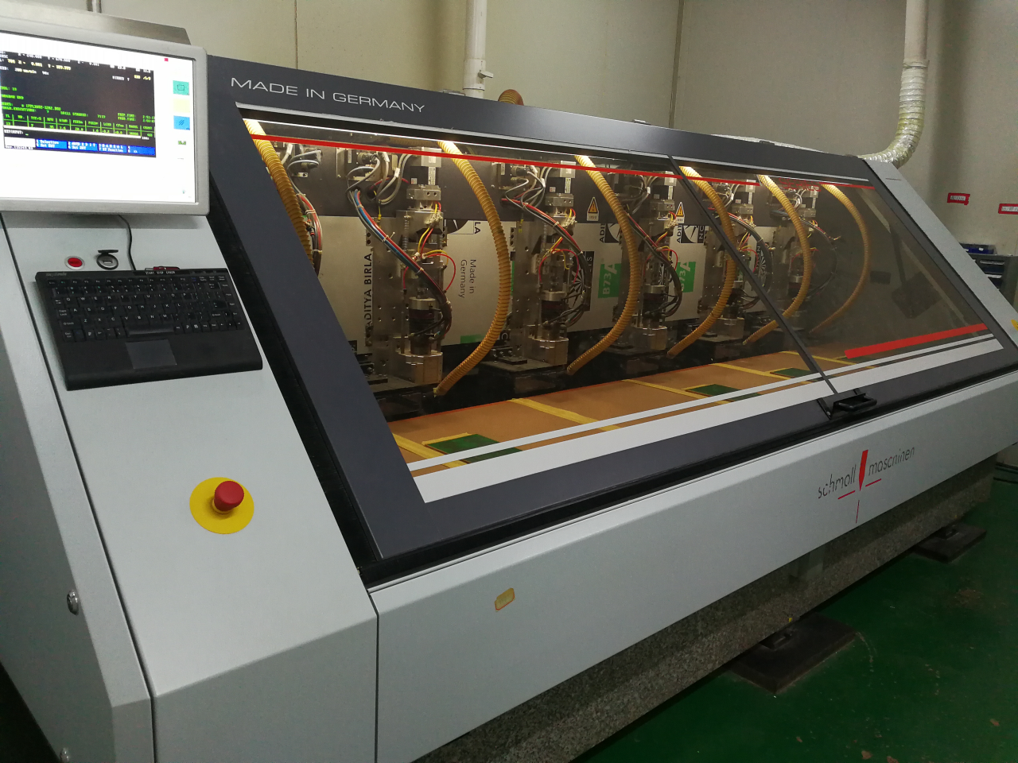
SCHMOLL Drill/
CNC设备
German made routing and drilling machine ensures board quality
德国生产钻锣机保证钻锣品质。

Slide 22
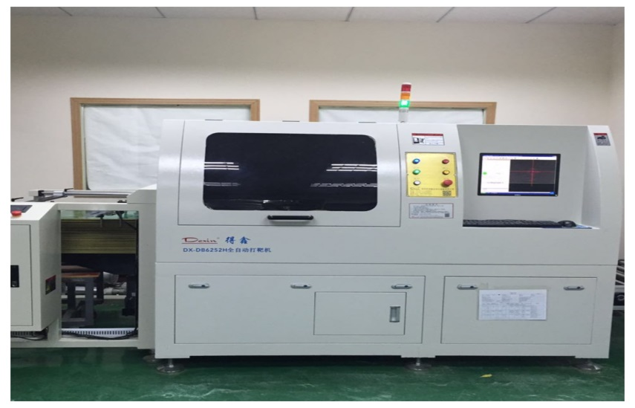
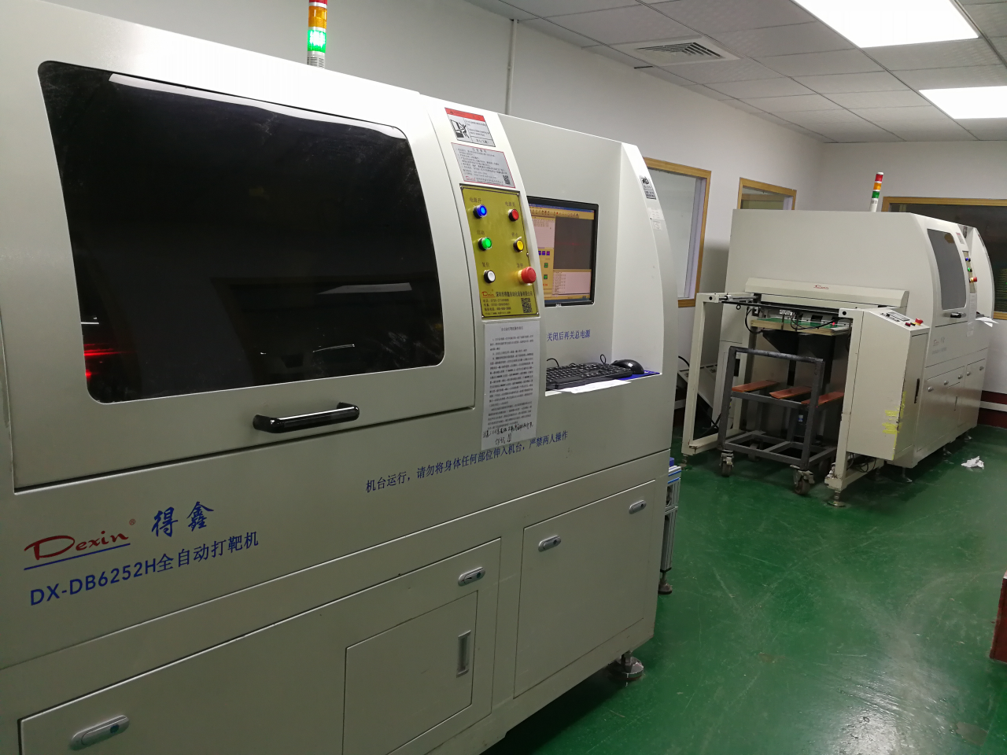
Guiding hole punching machine/
自动打孔设备

Slide 23
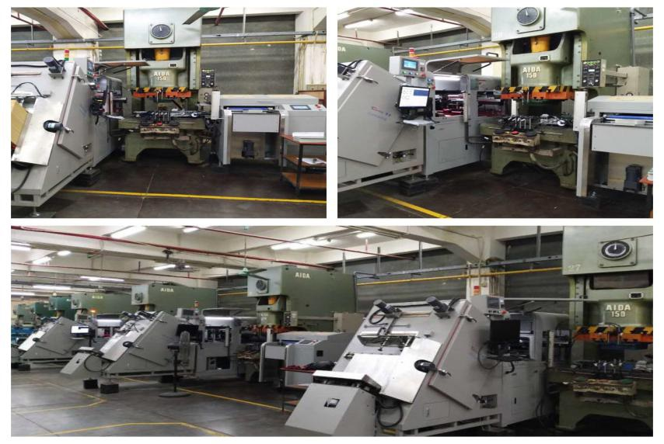
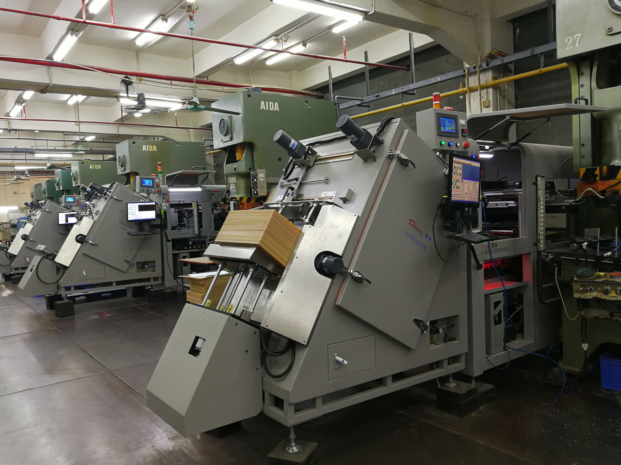
CCD punching/
CCD 冲压设备
All EPC punching machines are Japan made Aida press which are the best In the world.
所有啤机是日本最优秀的Aida啤机。保证冲压品质稳定。

Slide 24
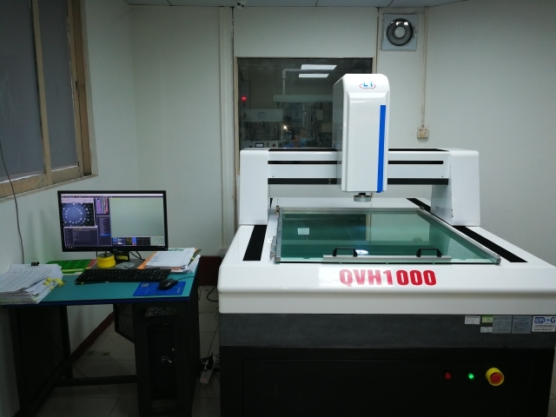
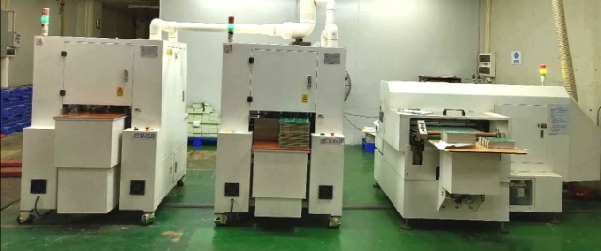
3 dimensional measurer
三次元测试仪器
3 automatic V cut machine
三台全自动 V cut 机
Ensure circuits printed accurately
保证线路印刷准确

Slide 25
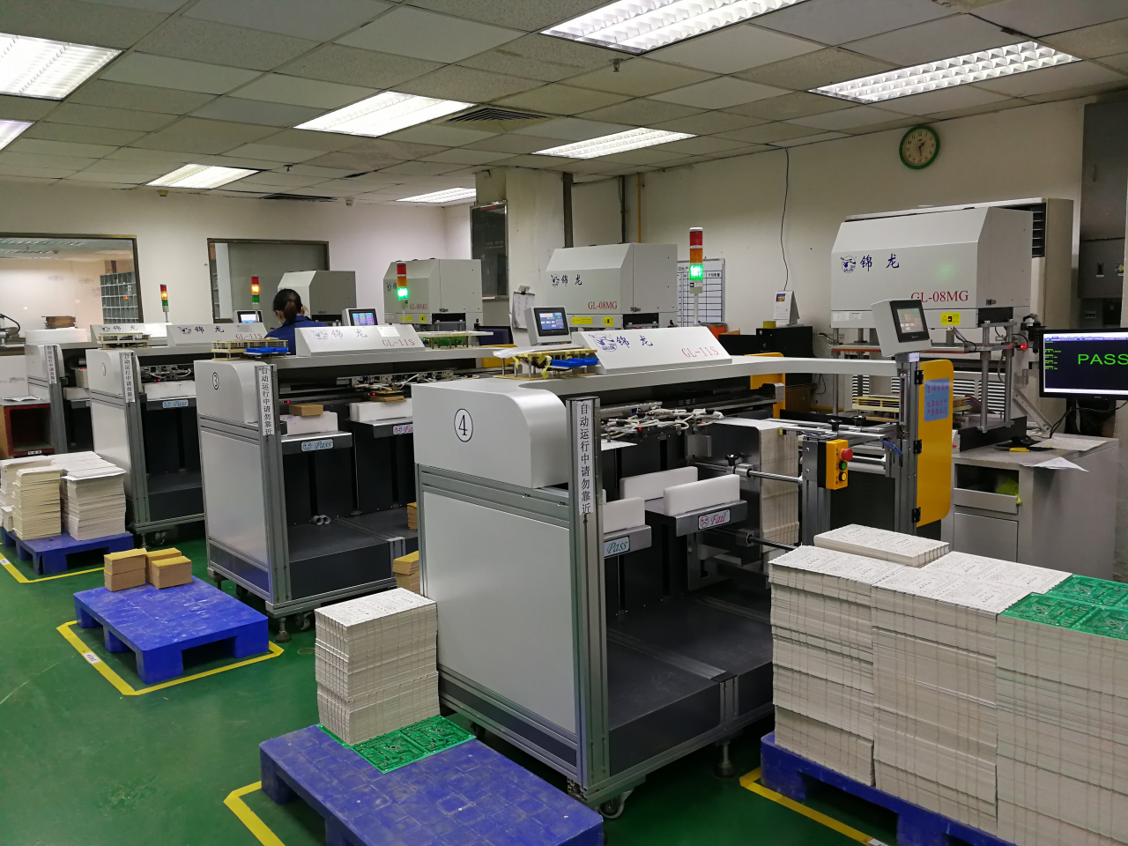
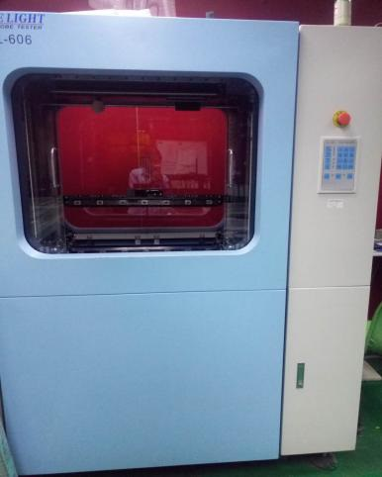
E-TEST machine
自动测试设备
Flying Prob
飞针测试机
100% PCBs undergone E test to ensure no short and open circuits. 100% 线路板通过测试保证没开短路

Slide 26
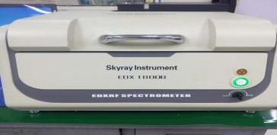
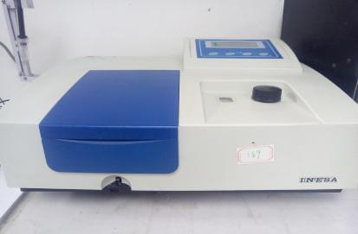
RoHS tester/RoHS测试仪
Ion contamination tester
离子环境测试仪
OSP thickness measurer
OSP 膜厚测试仪

Slide 27
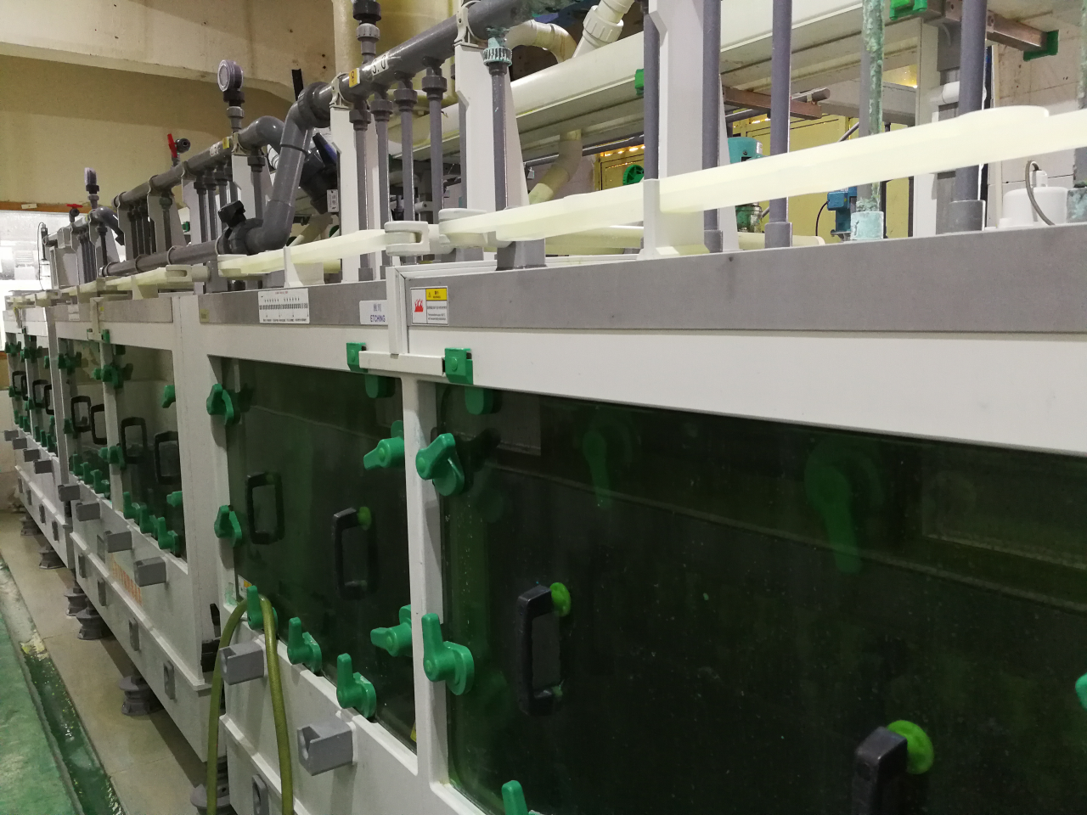
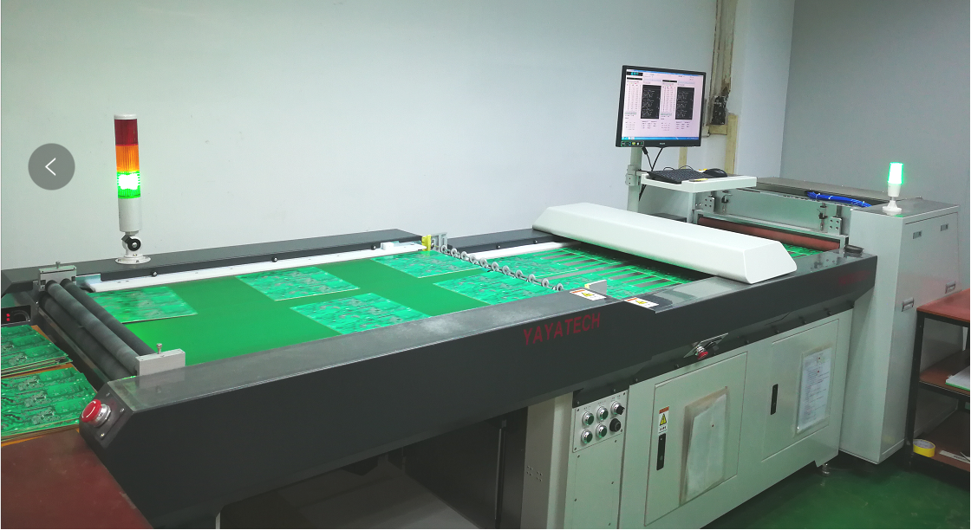
OSP Line/OSP设备线
hole counting machine
数孔设备
New OSP line installed in 2019. EPC has two OSP lines.
2019新装OSP 线，共有2条线。
All boards are subject to hole counting ensuring no
blockage. 所以板经过数孔保证100%没塞孔。

Slide 28
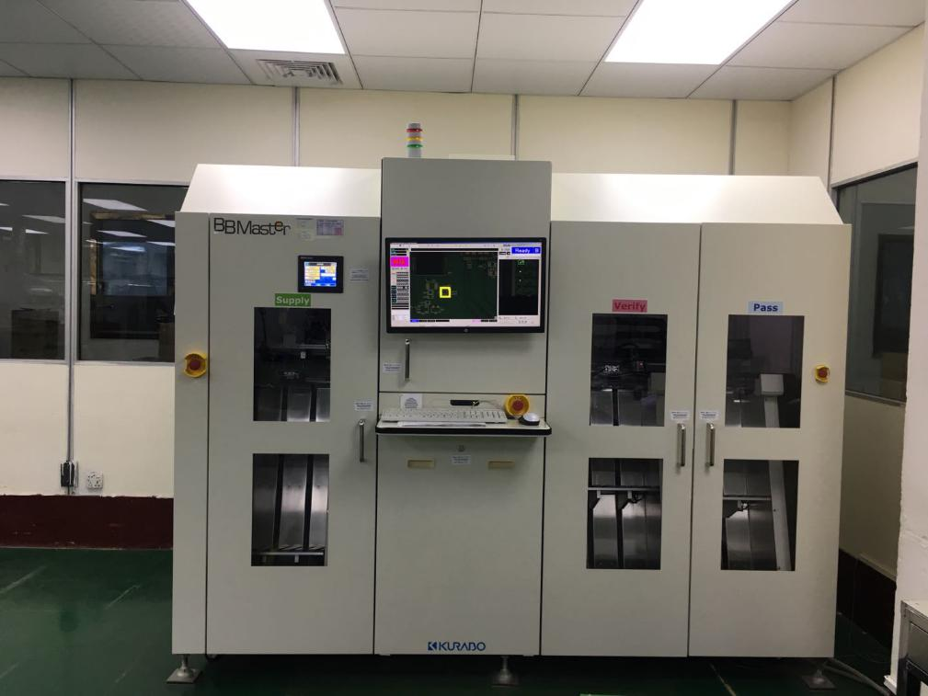
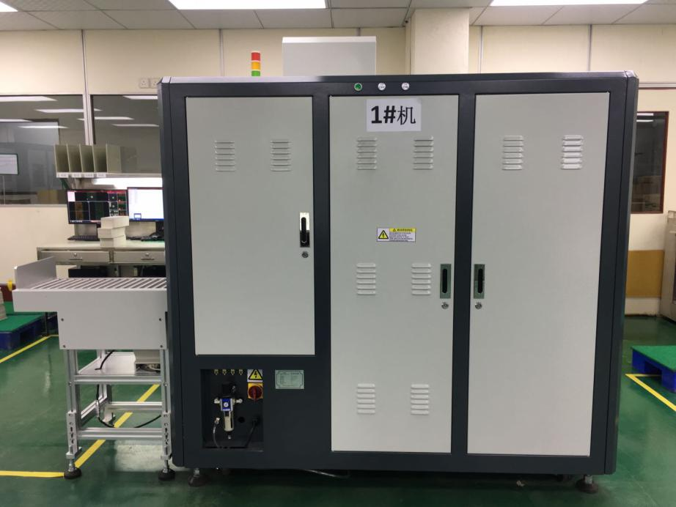
Japan and China AVI for visual inspection日本/中国AVI/外观检查机

Slide 29

Thank You!
谢谢您的观看

