Slide 1
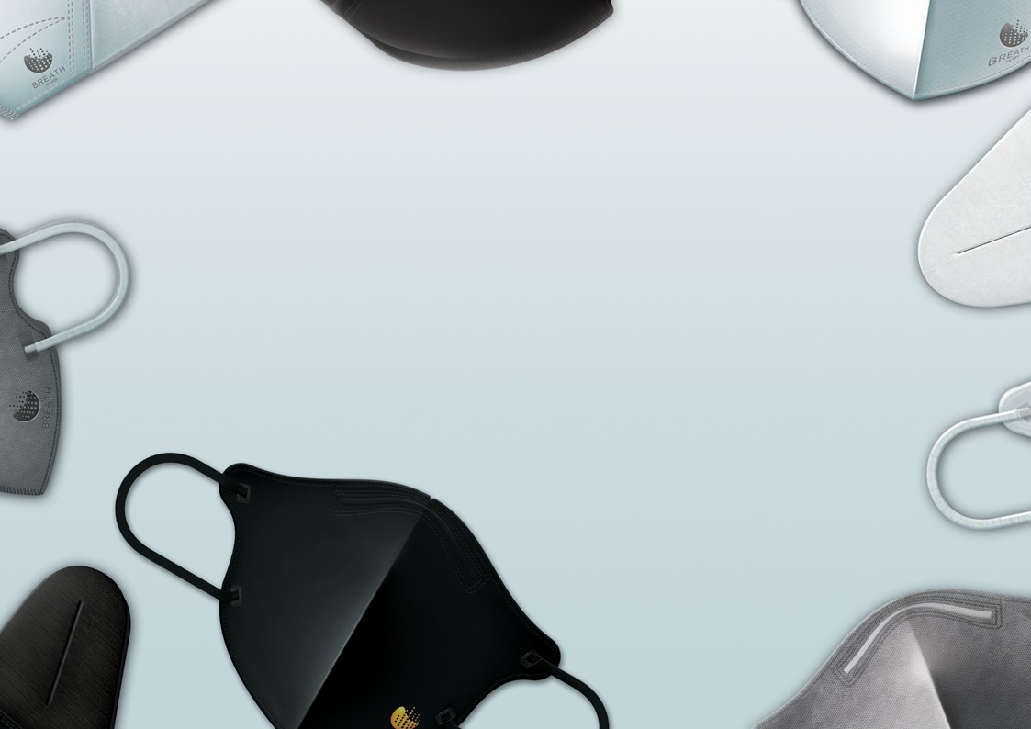
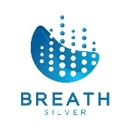

My company, OGP TECH Co., Ltd., is a global marketing partner for N2CELL mask manufacturer.
Brand name is BREATH SILVER.
OGP TECH is planning to being a main player in the global market for PPE (Personal Protection Equipment)
including BREATH silver mask and other products using BREATH SILVER.
So, our new logo should be
Fit for N2CELL and BREATH Silver logo (in terms of color and shape)
Contains global marketing and health care
Company Name along with logo. OGP stands for Optimum Global Parner
If logo design selected, I am planning to expand our project to all required marketing materials.
R1. 2020.03

