Slide 1
Our Starters 6€
Pate
Soup
Hummous with crudités
Avocado pecheur
Our Mains 10€
Steak Frites (supp 2€)
Moules Frites
Shepherd’s Pie
Chorizo Lasagne
Seafood pasta with four cheese sauce
Mushroom Risotto
Our Salads 10€
Salad Niçoise (supp 2€)
Caesar Salad
Rillaud and Goats cheese salad
Greek salad
Our Desserts 6€
Douillon pomme
Chocolate Mouellex
Chocolate Mousse
Seasonal crumble
Banana Split
Our ardoises 7€
Cold meat selection
Cheese board (4 cheeses)
Mixed 50 :50
Menu de jour €13.50 (May, June, September)
Starter, main, dessert + carafe of wine
See board for details
Children’s Menu (<12 years old) 10€
Pasta with ham and cheese
Or Pizza & Chips
Followed by two scoops of ice-cream

Slide 2
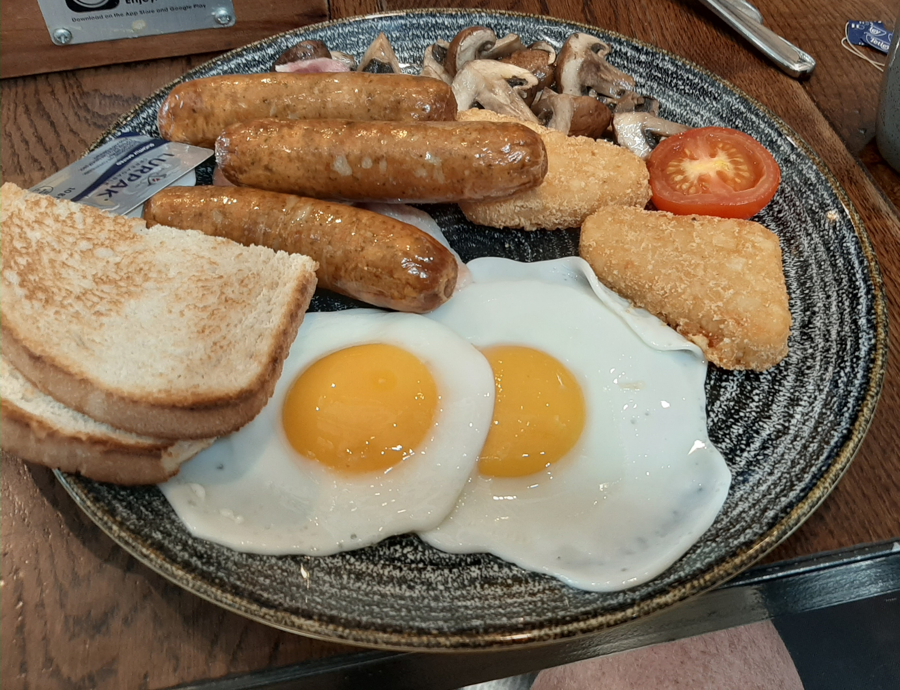
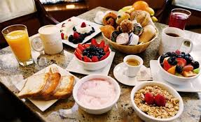
Brunch
Sunday
11h00 to 15h00
22€
Tea
Coffee
Hot Chocolate
Fruit Juices
Cereals
Yoghurts
Breads
Jams
Boiled eggs
Baguette
Croissant
Pain au chocolat
Fresh Fruit
Cheeses
Cold meats
Eggs
Sausage
Bacon
Hash Brown
Baked Beans
Chicken wings
Quiche
Pate
Smoked Salmon
Pan cakes and syrup
Brioche and Muffins
Fruit tarts
Fruit salad
Chocolate mousse
Chocolate Mouelleux

Slide 3
Themed Nights – 15€ per person
Hog Roast
Paella
Chilli Night
Fouées
BBQ
Pizza

