Slide 1
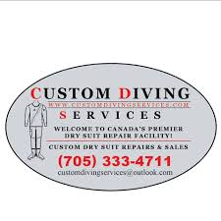
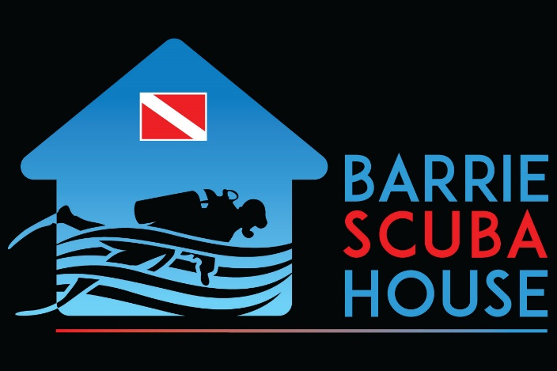
Current Logo
Parent Company Logo
Current logo is very dated, too wordy & cluttered, not impactful
Logo should invoke trust, professionalism, adventure
Want to extend the logo design of the parent company, Barrie Scuba House, to the newly purchased Custom Diving Services, so people can see the affiliation

Slide 2
What we do:
Custom Diving Services specializes in the sales and repairs of scuba diving drysuits
We offer a full repair service for all makes of scuba dry suits, from simple punctures to boot changes, neck seal replacements and zipper replacements, leak tests
Our commercial customers include military, police, fire departments, and contractors such as dock workers
Our residential customers include technical divers and cold water divers
Design considerations:
Want to extend the logo design of the parent company, Barrie Scuba House to Custom Diving Services so that it’s obvious they are affiliated with each other
Want to position the company name on the left so that when shown together the words “SCUBA” from Barrie Scuba House and “DIVING” from Custom Diving flow together in the same font & colour
The primary image should be of a drysuit (not a regular wetsuit) or of a technical scuba mask
Resulting logo needs to feel very masculine & bold, almost military inspired
Background colour you choose should work with the colours of Barrie Scuba House

Slide 3

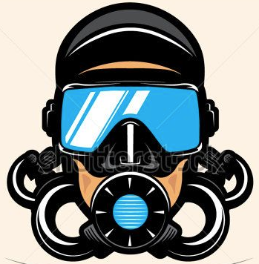
Example
CUSTOM
DIVING
SERVICES
Same font, can be any colour but prefer “Diving” in red to align with Barrie Scuba House
Same gradient bar
Background colour up for design
Icon up for design. Suggest mask, drysuit, or drysuit valve
Would like to repeat the water waves from Barrie Scuba if possible
Would like to add a scuba flag, if possible, maybe in the mask visor

Slide 4
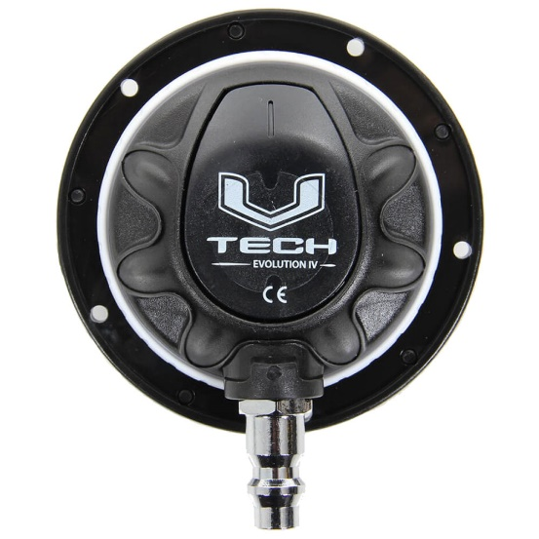
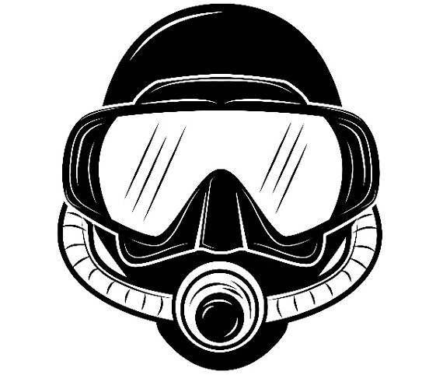
CUSTOM
DIVING
SERVICES
CUSTOM
DIVING
SERVICES

Slide 5
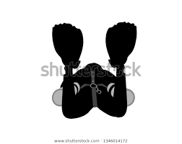
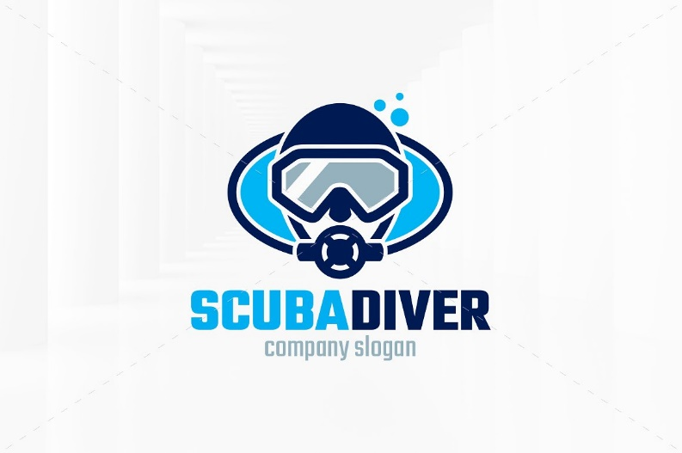
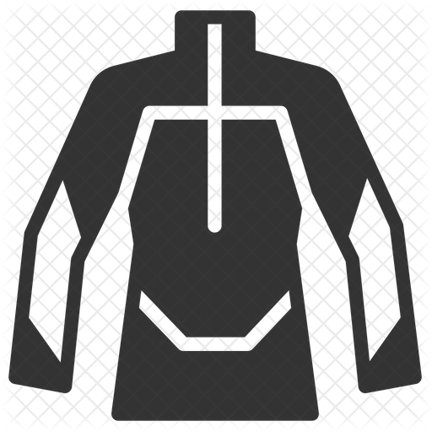
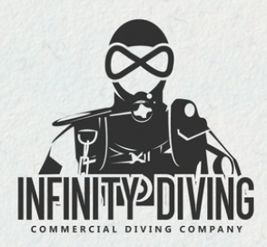
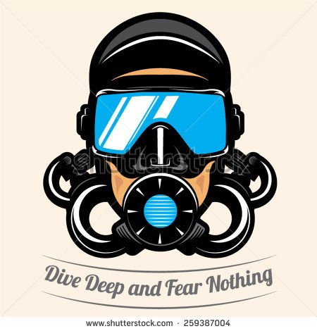
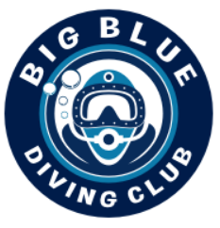
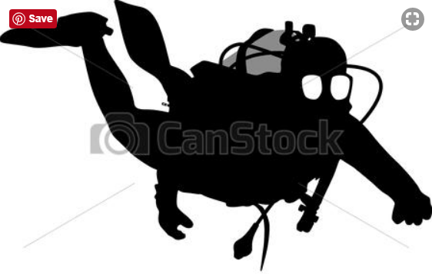
Examples of strong, masculine tech diver images

Slide 6
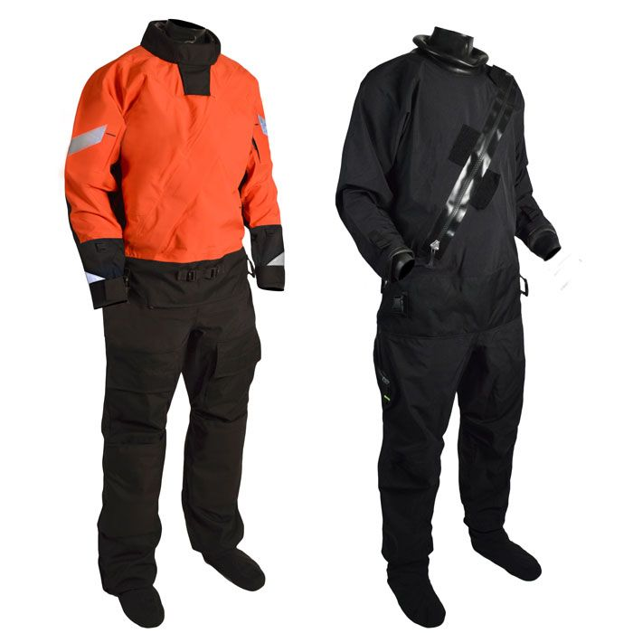
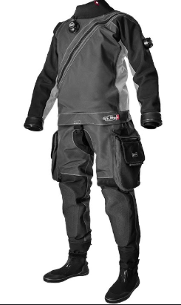
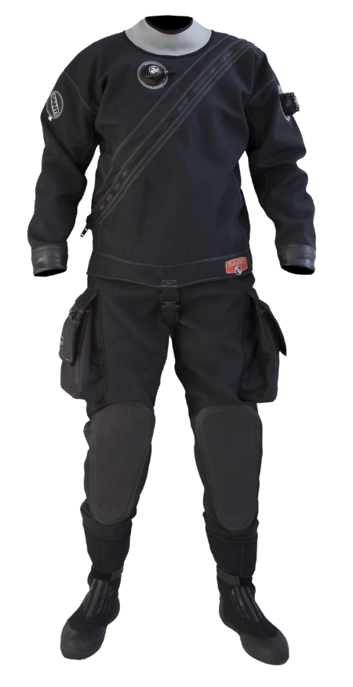
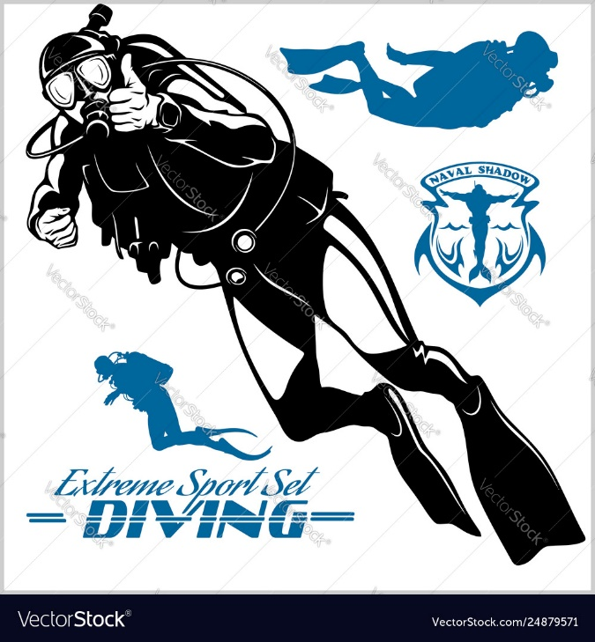
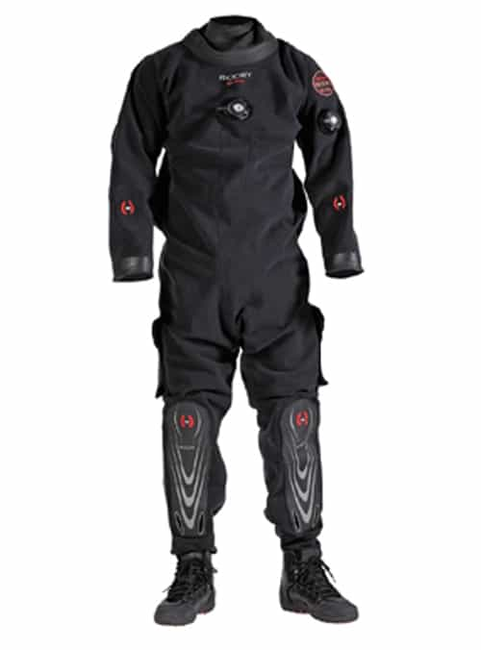
Examples of drysuit images – but need to be vectorized

Slide 7
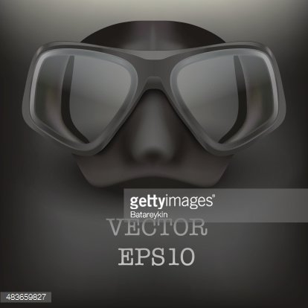
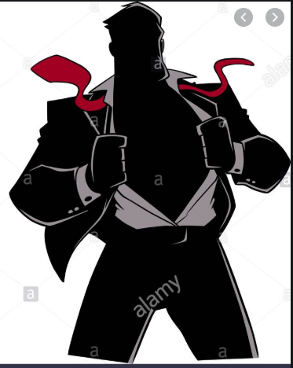
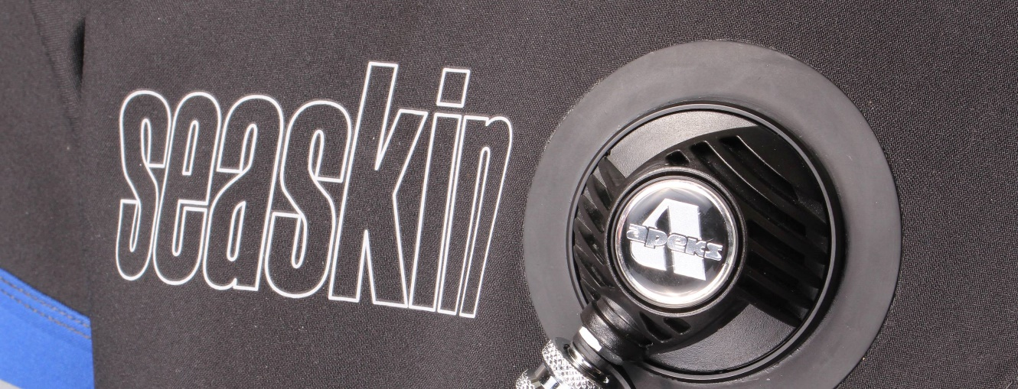
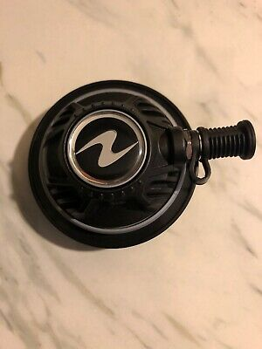
Drysuit valves examples

