Slide 1
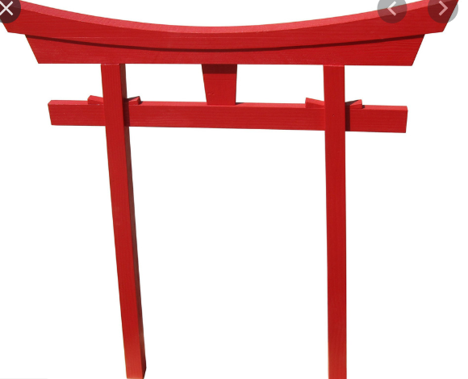



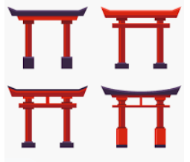




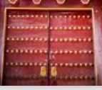
IDEAS FOR THE Mojo Dojo Workbook Cover
I like the gold dots on the gates of the doors entering the Dojo. I would like the back of my logo character going into the Dojo on the Workbook.

