Slide 1

Auspride & Akta Vite Milk

Slide 2
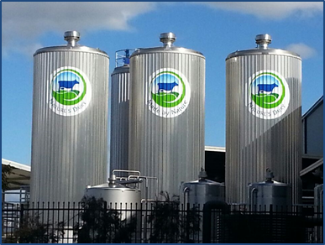
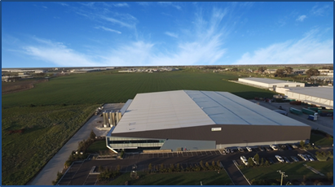
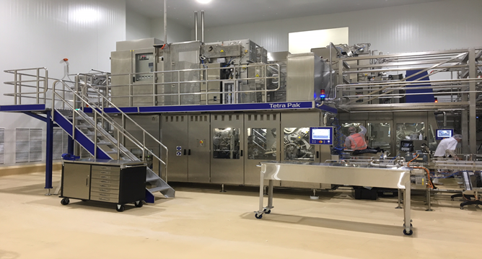
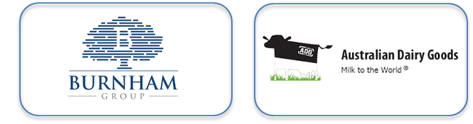

About Nature’s Dairy
“Creating healthy trusted Australian products that provide nutrition to all generations around the world”…
SPECIALIST BEVERAGE MANUFACTURER
Ambient / Chilled Extended Shelf Life (ESL)
Advanced pack formats
Experienced team with broad industry knowledge
STATE OF THE ART MANUFACTURING FACILITY
Tetra integrated processing and packing capability
Modern site with highest hygiene standards
Export & Domestic accredited facility
Strategically located in Melbourne
Scalability to accommodate customer growth
PROUDLY 100% FAMILY OWNED

Slide 3
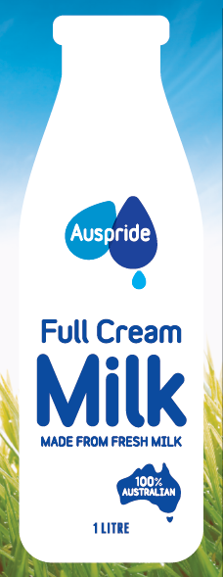
Auspride – UHT Milk
Premium quality Australian UHT milk, made from fresh milk.
In response to the shortage of various ambient shelf stable goods, Nature’s Dairy Australia is responding by prioritising domestic supply and making available its premium quality nutritious Australian Pride UHT milk to Australian consumers.

Slide 4
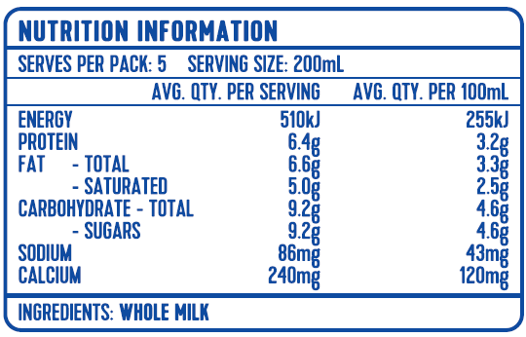
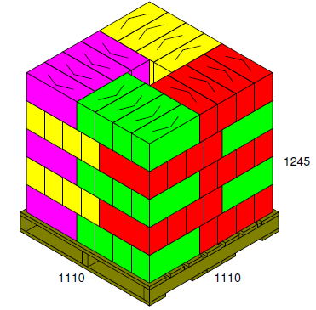
Auspride – UHT Milk
Premium quality Australian UHT milk, made from fresh milk.
Product Specifications:
Pack Configuration: 12L per carton (2 x 6)
Pallet Configuration: 16 cartons/layer, 5 high, 80 cartons per pallet
Price – AUDXXXX/L EXW Melbourne

Slide 5
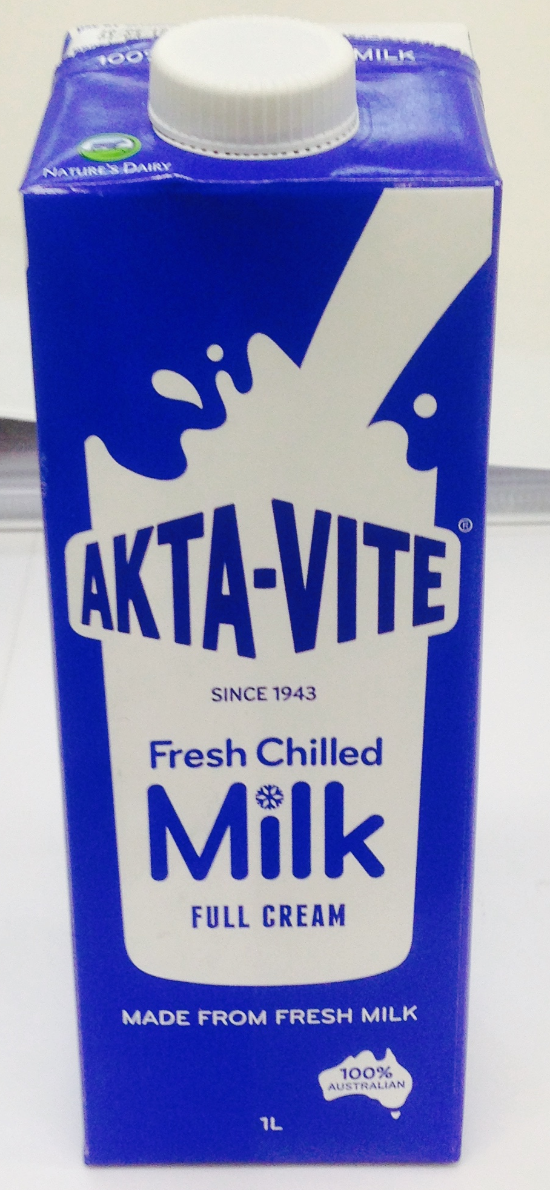
Akta Vite – ESL Milk
Premium quality Australian ESL milk, made from fresh milk.
From the families that have a history of supporting Australians in difficult times comes the Akta-Vite Extended Shelf Life (ESL) milk.
Manufactured by Nature’s Dairy Australia, Akta-Vite ESL Milk offers fresh premium chilled Australian milk with a shelf life of 70 days.

Slide 6
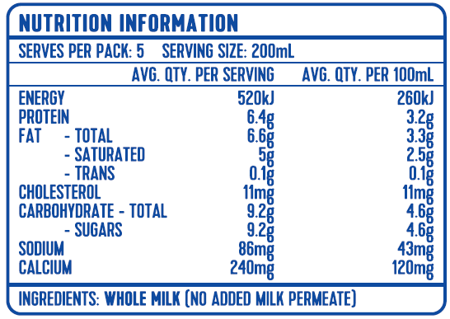
Akta Vite – ESL Milk
Premium quality Australian ESL milk, made from fresh milk.
Product Specifications:
Pack Configuration: 12L per carton (2 x 6)
Pallet Configuration: 16 cartons/layer, 5 high, 80 cartons per pallet
Price – AUDXXXX/L EXW Melbourne

Slide 7



