Slide 1


PROTEIN VITAMIN COMPANY

Slide 2
PARENT COMPANY
Peak Nutritionals is 100% owned by Australian company, ProviCo Australia.
PROVICO AUSTRALIA
ProviCo Australia is 100% Australian owned and supporting Australian farmers. With manufacturing sites in Truganina and Dennington in Victoria.
PROTEIN VITAMIN COMPANY
PEAK NUTRITIONALS
100% Australian owned and operated, all Peak Nutritionals products are processed at our fully accredited factory in Melbourne, Victoria.

Slide 3
COMPANY BLOOD LINE
The family behind ProviCo Australia, the Nicholas Group started when Pharmacist George Nicholas (founder) opened his first pharmacy on Punt Rd, Windsor in July 1912.
INVENTION OF ASPRO
NICHOLAS
GROUP
HISTORY
Responsible for one of Australia's greatest inventions, it was in 1915, during WWI that George created Aspro. A product desperately needed after Germany cut the supply of Aspirin to Australia during this time.

Slide 4
CREATION OF AKTA-VITE
Moving ahead to 1943 and another great need arose during WWII when nutritious food was hard to come by. Akta-Vite was developed by the Nicolas Group, which was rushed to Australian Soldiers due to its nutrient and vitamin rich formula.
NICHOLAS
GROUP
HISTORY
COVID-19 HEALTH CRISIS
And now, In 2020 as we face a new human crisis with the global spread of COVID-19, this very bloodline has now developed Peak Immunity, proven to protect against viral and bacterial infection.

Slide 5
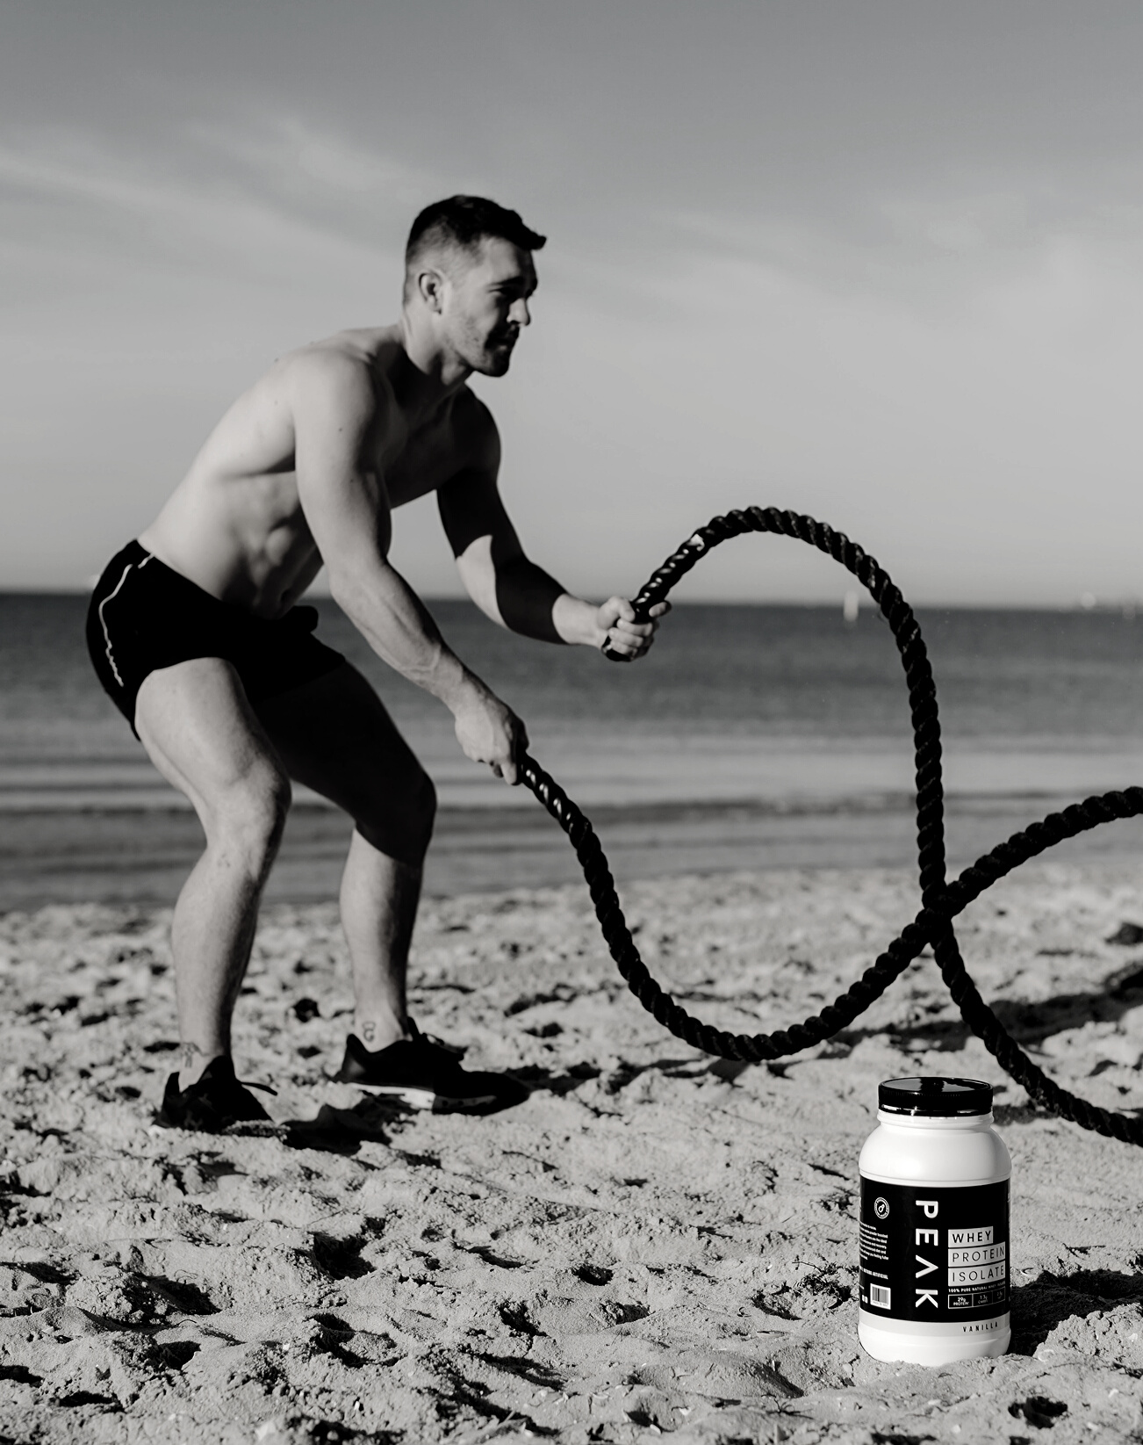
#PEAKWHEYBETTER
Peak Nutritionals saw a need to develop a clean product for the everyday sports person with information that was easy to understand in a cluttered market
PROTEIN VITAMIN COMPANY

Slide 6
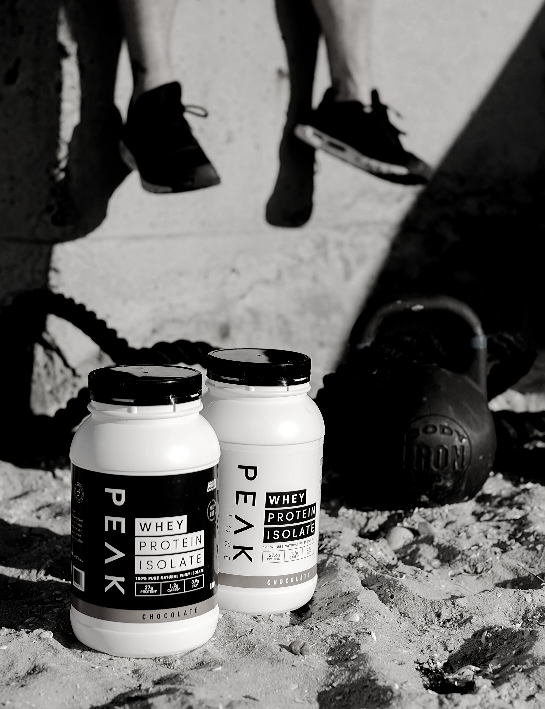
WHY WHEY INTO PEAK?
Protein powders are the most popular dietary supplements. One of the most common types of protein found in these products is whey, which comes from dairy. There are different types of whey protein, including whey isolate (WPI)
and whey concentrate (WPC)
PROTEIN VITAMIN COMPANY

Slide 7
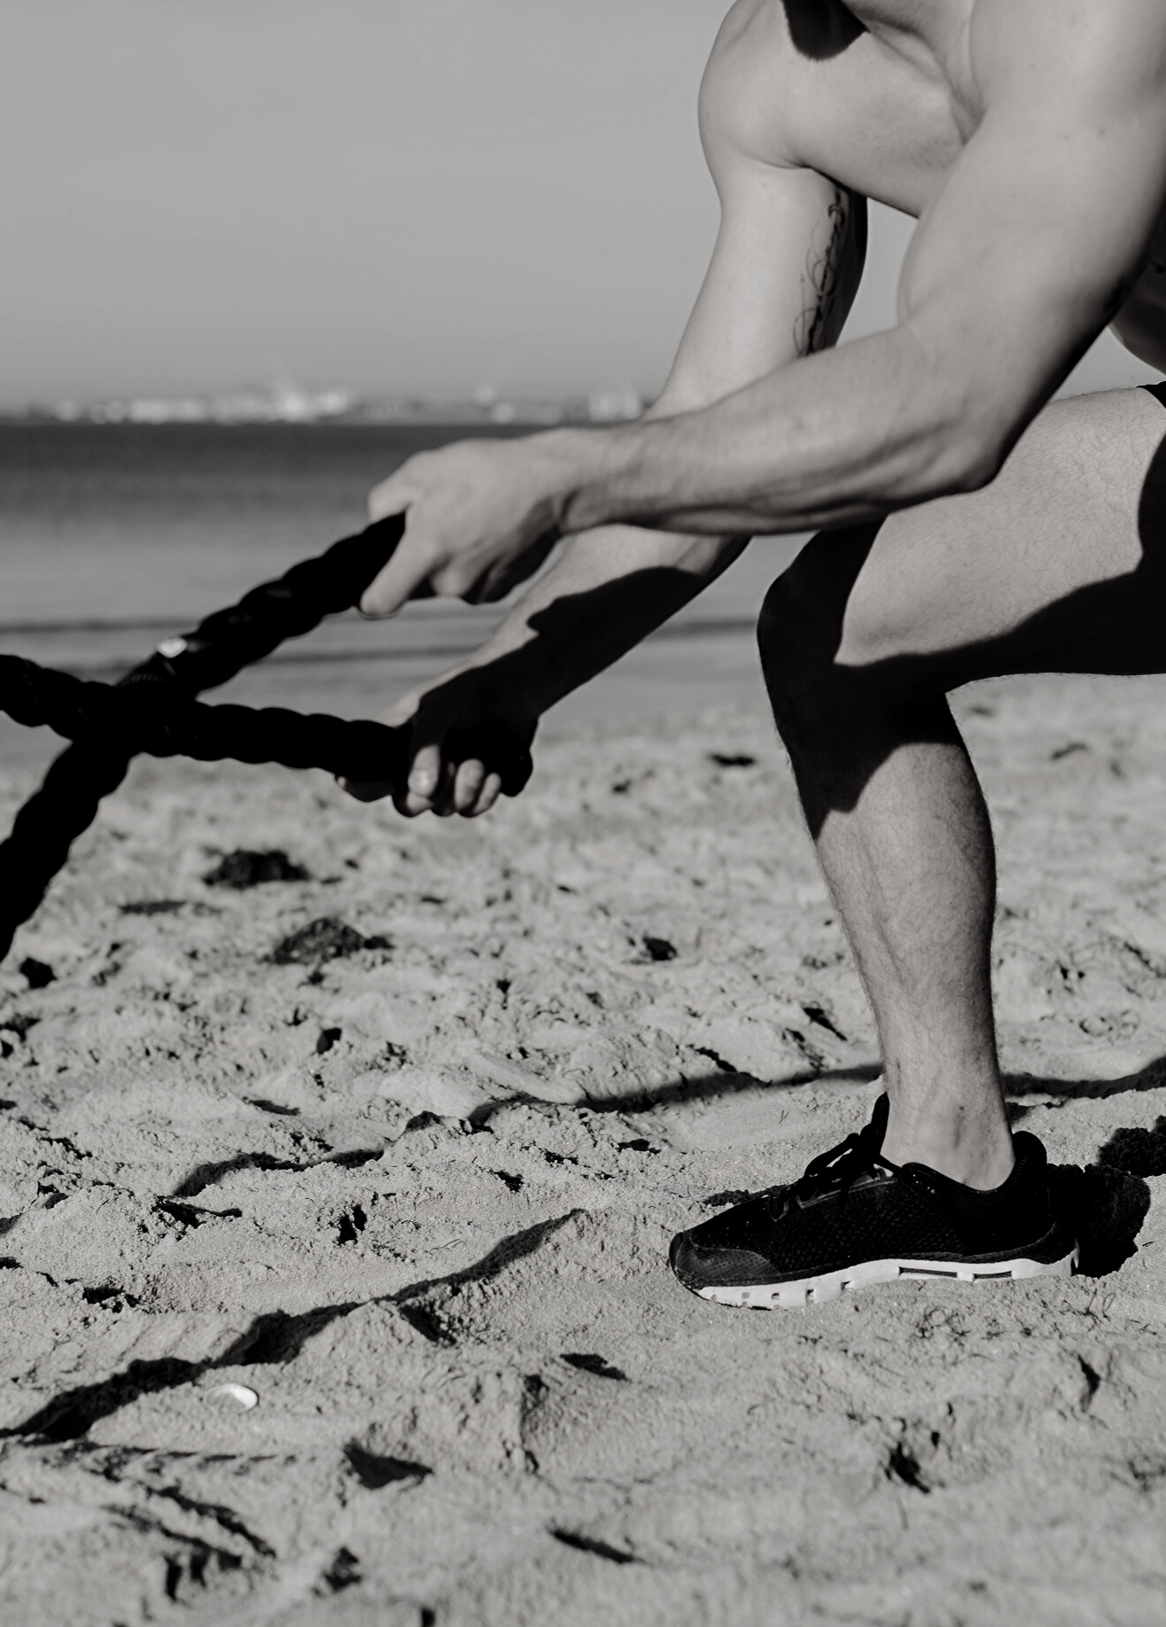
WHY WHEY INTO PEAK?
Peak nutritionals WPI is the product of
a cross flow micro filtration process that
eliminates fats and sugars and is higher
in protein content. This ensures amino
acids are released quickly after ingesting
PROTEIN VITAMIN COMPANY

Slide 8
WHY WHEY INTO PEAK?
Rich in naturally occurring branched chain amino acids (BCAAs) Consisting of ISO leucine, leucine and valine for muscle synthesis, assists in minimizing muscle loss, increases lean muscle growth and repairs muscles after an optimal workout. With the added benefit of digestive enzymes, allowing your body to easily absorb and digest the protein so you can perform at your peak
PROTEIN VITAMIN COMPANY

Slide 9

100% Australian owned and operated, all Peak Nutritionals products are processed at our fully accredited factory in Melbourne, Victoria
#PEAKWHEYBETTER

Slide 10



GMO, GLUTEN & SUGAR FREE
SUITABLE FOR VEGETARIANS
INDEPENDENTLY LAB TESTED

Slide 11

100% NATURAL
LARGE RANGE OF SIZES
Made from 100% natural whey protein isolate, natural flavours and natural digestive enzymes. Our proteins are gmo-free and gluten
free with no fillers
All products are informed sports approved. Each and every batch is tested to ensure our proteins only contain what
we claim.
From single use
ready to drink bottles, 1 KG tubs and sachets, to 5KG sachets for individuals who are serious about their health.
PROTEIN VITAMIN COMPANY

Slide 12

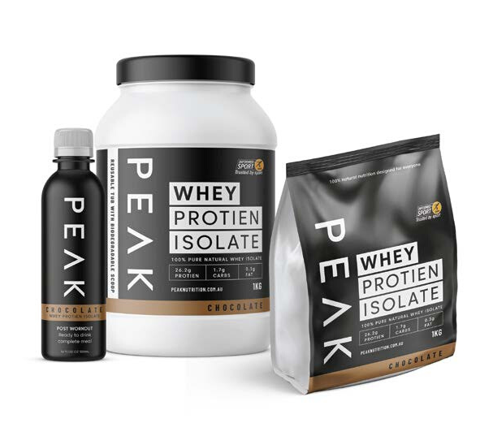
THE PEAK RANGE
RTD's single use ready to drink bottles
1 KG tubs and biodegradable refills
5KG biodegradable refills
350g Immunity tub
THE TONE RANGE
Our Peak WPI Tone formula includes all the benefits of our WPI powder, but with additional nutrients that are vital
to women’s health.

Slide 13

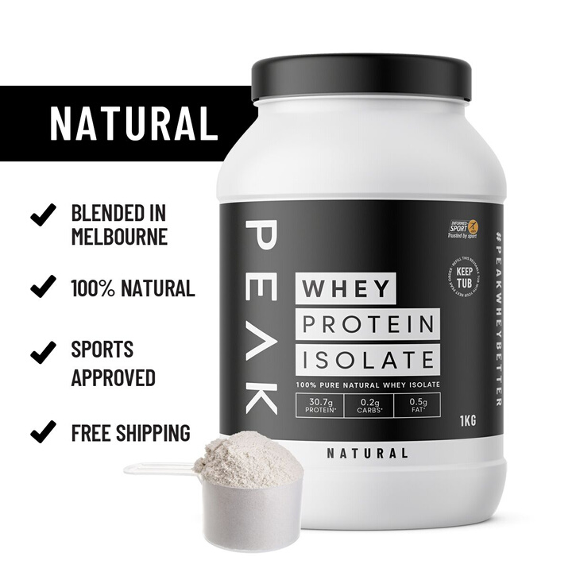
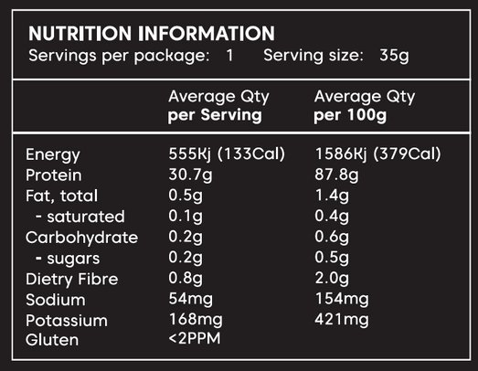

NATURAL
WHEY PROTEIN ISOLATE

Slide 14
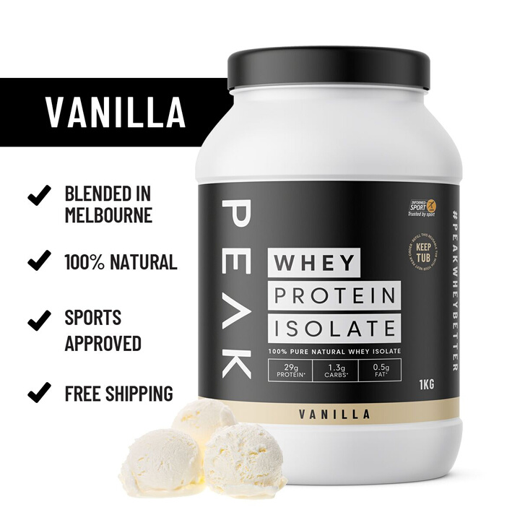
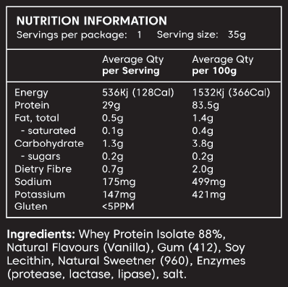
VANILLA
WHEY PROTEIN ISOLATE

Slide 15
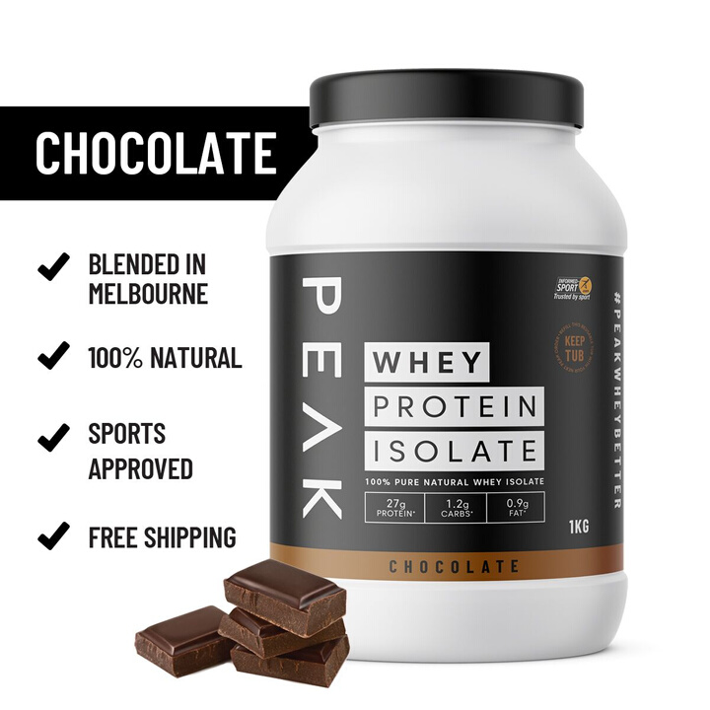
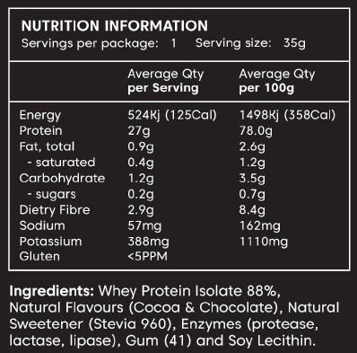
CHOCOLATE
WHEY PROTEIN ISOLATE

Slide 16

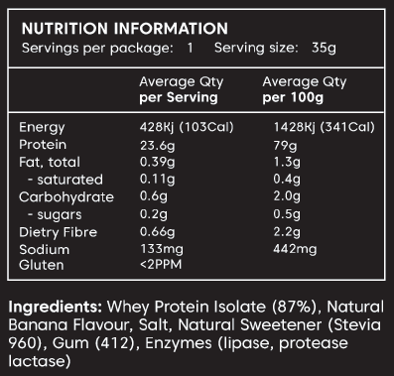
BANANA
WHEY PROTEIN ISOLATE

Slide 17

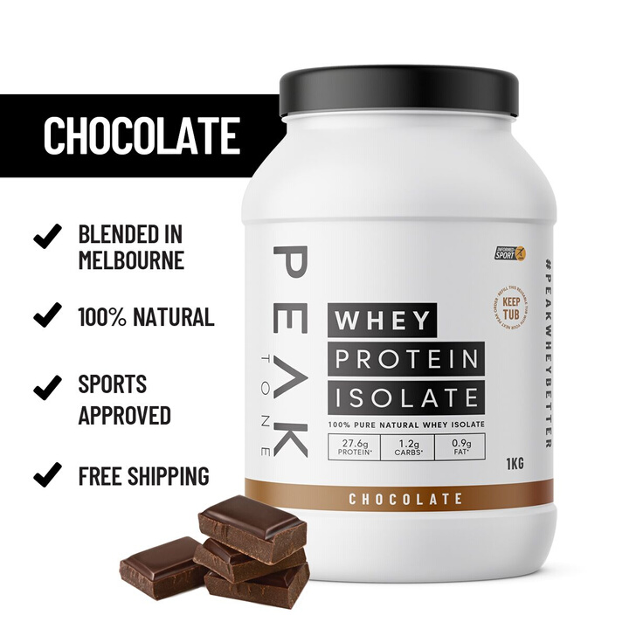
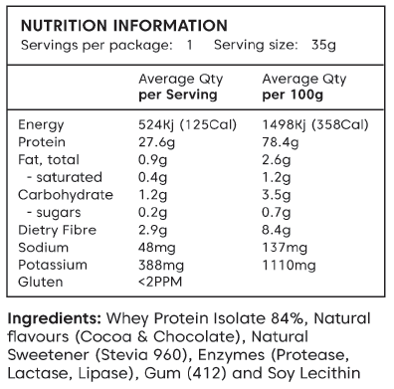
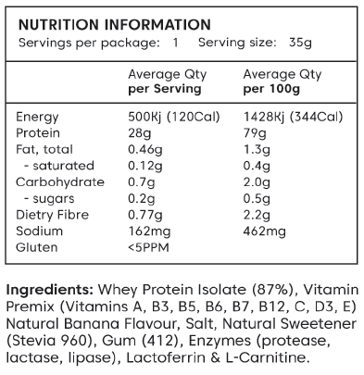
CHOCOLATE
TONE WHEY PROTEIN ISOLATE

Slide 18

BANANA
TONE WHEY PROTEIN ISOLATE

Slide 19

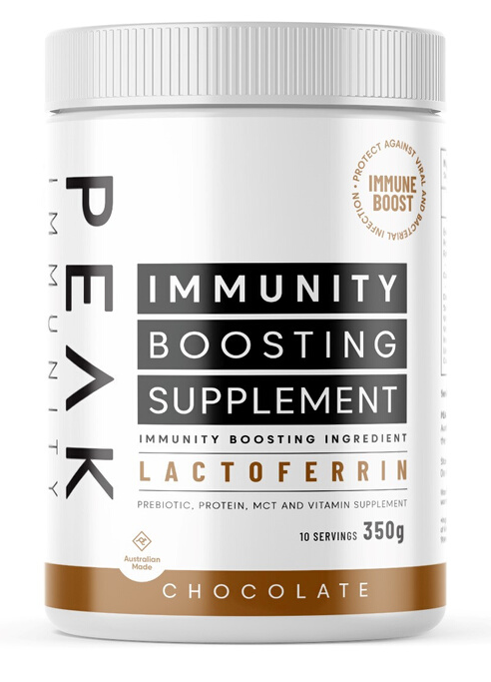
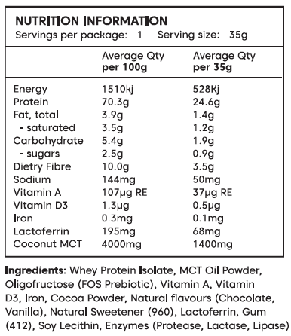
CHOCOLATE
IMMUNITY BOOSTING

Slide 20






TRUSTED BY

Slide 21
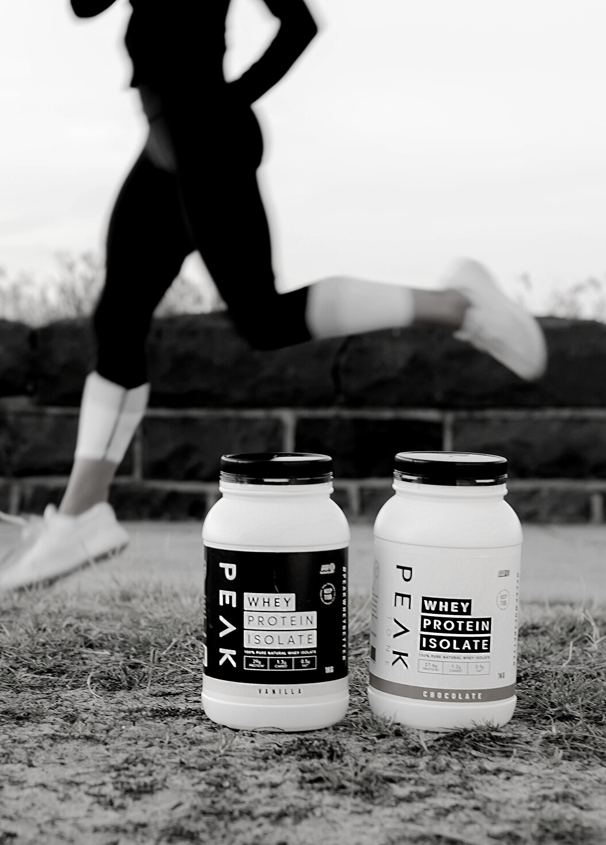
HANNAH TORRES
Sales & Marketing Manager
ADDRESS
37-39 Jessica Way, Truganina, VIC 3029
PROTEIN VITAMIN COMPANY
PHONE NUMBER
03 9394 3800
EMAIL ADDRESS
hannah@peaknutritionals.com.au

