Slide 1

Company Icon Logo
g
F
g
Request: I want a similar feel and look to the Airbnb Logo, but use my logo mockup above as a starting point to make it look fresh and modern. So, I'm looking for a logo that represents the concept of the company without being to cheesy.
Background: We are an app that offers deals for Breakfast, Lunch, Dinner, and Happy Hour.
Company Name: FabnGrab

Slide 2
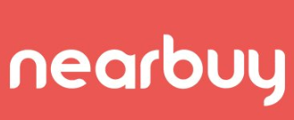
Company Name Logo
Request: For the company font and style, I’m looking for a similar look and feel as the nerbuy company name logo but not over board.
Please add the following variations: FabnGrab and fabngrab, and Fabngrab

