Slide 1
Sweat Consulting Brainstorm
IDEAS + TIMELINE
Sweat Consulting helps sports, fitness, and wellness brands design and execute sales and marketing strategies that are centered in human-empathy and inspire people to live better.
Sweat Consulting helps active lifestyle brands design and execute sales and marketing strategies that are centered in human-empathy and emotion.

Slide 2



BRAND PILLARS:
ART + SCIENCE + SWEAT
ART:
Creative Branding + Marketing
SCIENCE:
Business Strategy + Exercise Science
SWEAT:
Consumer Empathy-Mindset
Experiential Events
Sports, Fitness, Wellness

Slide 3
BRAND PILLARS:
Everything Sweat Consulting Does Is…
THOUGHTFUL: Rooted in strategy. Intentional approach to problems and solutions.
UNIQUE: Fresh approach to sales and marketing to the table. Rejects status quo with outside-the-box thinking.
BOLD: Confidence to push boundaries.
PERSONAL: Deep passion for delivering results. Treats your brand as their own. Leaves brands better than they were found.

Slide 4
WHY SWEAT CONSULTING/REASONS TO BELIEVE
Target consumer : authentic to the space
Buyer Persona:
  Entrepreneur in the fitness space just starting out
  Established fitness brands trying to drive new traffic looking to drive relevancy
  New and/or established CPG brands looking to partner with active lifestyle brands
Other brands these people interact with…
Sweat Consulting Objectives
  Awareness
  Credibility
  Relevancy in the space
Site Needs
  Intake forms (small questionnaire)
  Checkout capabilities

Slide 5
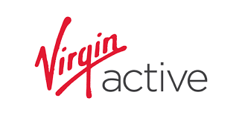
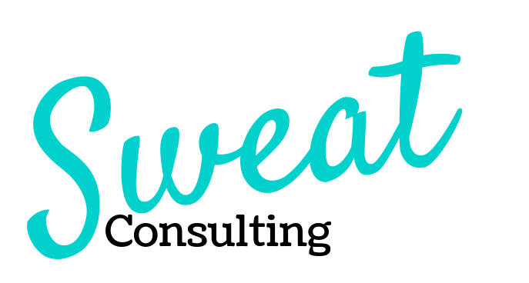
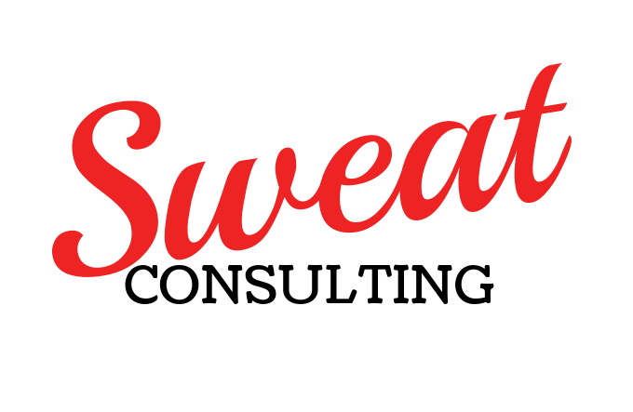
BRAND LOOK + FEEL
Brand Voice
LOGO IDEAS:
Mixed Fonts + Color (athletic/edgy/professional)
Modern: Trendy (creative)
Inspirational/Aspirational: (sports, fitness, wellness)
Smart: Business Savvy

