Slide 1
World Bank
The intercessory savior or antithesis of Africa’s true birthright
Elaina Cohen

Slide 2
Perusal of the world bank in Africa
Active portfolio projects as at 2019-618
Total amount costs for the projects-$73 billion(world bank, 2019)
Key investment areas
Human capital boost
Accelerating digital economy in Africa
Promoting good governance
Increased access to affordable energy
Climate change resilience
Promoting good fiscal policies and financial development (world bank, 2019).

Slide 3
world bank projects in Africa
world bank development indicators for sub-Saharan Africa on manufacturing, insurance & finance and ICT between 2014-2018.
Critics on world bank programs in Africa argue that infrastructure alone cannot address pertinent African problems such as poverty
Data source : http://datatopics.worldbank.org/world-development-indicators/
Notes:
As shown in the graph, manufacturing has the greatest focus for world bank projects in Africa. Majority of these projects have been aimed at helping African countries take off to manufacturing and reduce overreliance in agriculture. In addition, they are set to reduce unemployment and boost income, which is instrumental in moving Africa forward.

Slide 4
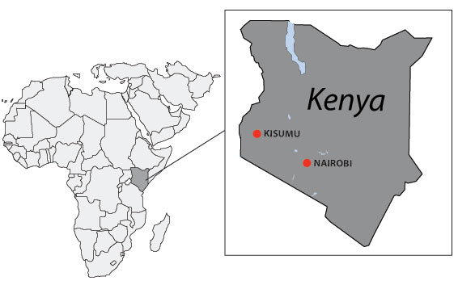
Electricity Expansion
Country: Kenya
Project Objective: To increase electricity supply efficiency, capacity and quality in rural urban and rural areas.
Project impact: More than 1.07 million people connected to the grid as of June 2015(world bank, 2017).
Project link: https://projects.worldbank.org/en/projects-operations/project-detail/P103037
Timeline | Total Project amount | Amount committed
May 2010- December 2017 | $1390.65 million | $330 million
Notes:
In my opinion, the world bank’s intervention was good for Kenya. This is because had a significant impact in boosting the Kenyan energy sector. The world bank helped jumpstart electricity connectivity through reducing the cost of connecting to the external grid. The project had an impact of connecting over 1 million Kenyans to the grid increasing their access to affordable energy.

Slide 5
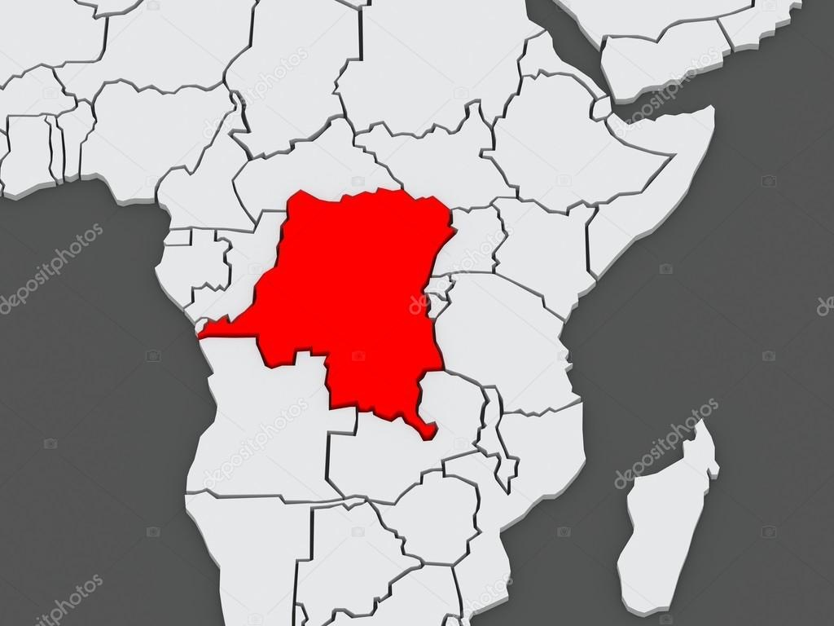
Governance II
Country: Democratic Republic of Congo
Project Objective: To enhance governance capacity in human resource management and public finance. Support decentralization of administration.
Project impact: No data exists on the project results/outcome
Project link: https://projects.worldbank.org/en/projects-operations/project-detail/P103037
Timeline | Total Project amount | Amount committed
May 2013- date | $66.95 million | $66.95 million
Notes:
Among the current concerns of world bank development and its partners is enhancing the current state of human rights, democracy and governance. This would have a major impact in ensuring free and fair elections as well as promoting other democratic process. In my opinion, the world bank intervention in Congo failed to achieve its intended results as it does not incorporate training to political parties, which are best positioned to promote democracy in Congo. Similarly, more focus should be in educating citizens on decision on their rights and how to respond to violations through legal institutions, thus encouraging them to participate in politics and advocacy.

Slide 6
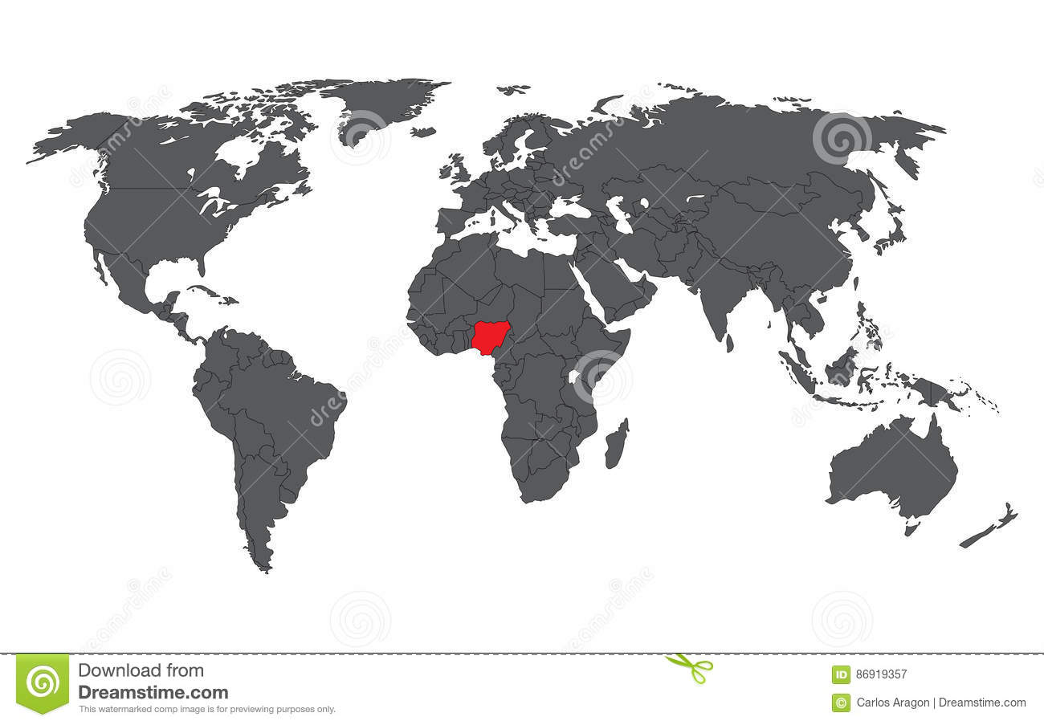
Third Lagos State Development Policy Operation
Country: Nigeria
Policy Objective: Support the government of Lagos state in improving investment climate and public finance
Project impact: Lagos state attained a fiscal surplus of 0.09% from a fiscal deficit of 0.38% of GDP between 2013 to 2015(World bank, 2016).
State reported increased transparency to reporting fiscal risks to state budget.
Policy link: https://projects.worldbank.org/en/projects-operations/project-detail/P151947
Timeline | Total Project amount | Amount committed
June 2015- December 2016 | $200 million | $200 million
Notes:
In my opinion, the project had a positive impact in improving the investment climate in Lagos state. Lagos is one of the largest states in Nigeria in terms of GDP and improving the state’s investment climate implies opening the country for investors, which is one of the factors critical for Africa’s growth.

Slide 7
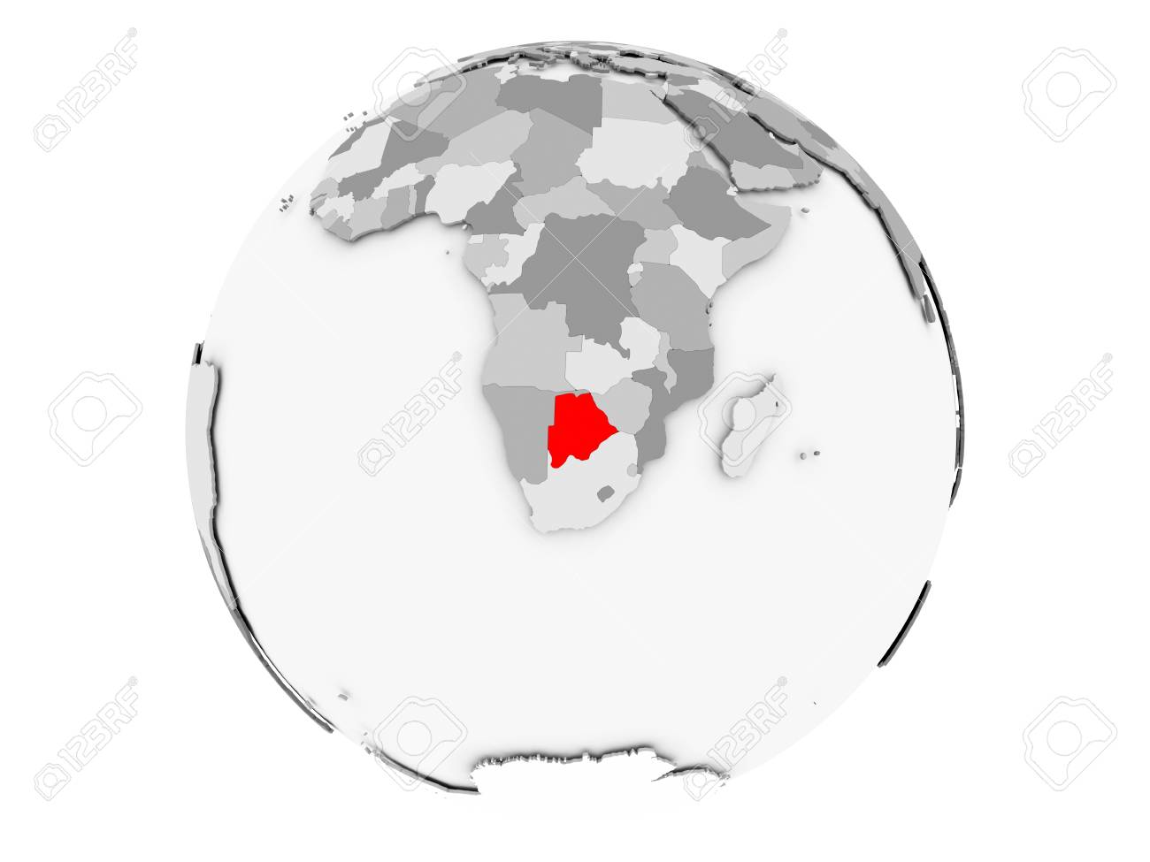
National HIV/AIDS Prevention Support Project
Country: Botswana
Project Objective: Assist the government of Botswana in prevention and management of HIV/AIDS through enhanced coordination capacity and effective mitigation activities.
Project impact : The percentage of women who identified correct ways of preventing HIV transmissions and rejected misconceptions against the disease increased from 40% to 46% between 2008 to 2014(world bank, 2015).
Over 566 health facilities constructed/renovated or equipped between 2008 to 2015.
Project link: https://projects.worldbank.org/en/projects-operations/project-detail/P102299
Timeline | Total Project amount | Amount committed
July 2008 - march 2015 | $50 million | $50 million
Notes:
The world bank project is a good intervention. This is because Africa remains the most affected continent by the HIV/AIDS pandemic. Specifically, Botswana has among the most severe prevalence in the world at 24.8%, third highest globally globally(WHO, 2020). The pandemic has affected other sectors critical to the economy that include education. Interventions that aim to reducing the impact of HIV/AIDS are critical to Africa’s growth and future.

Slide 8
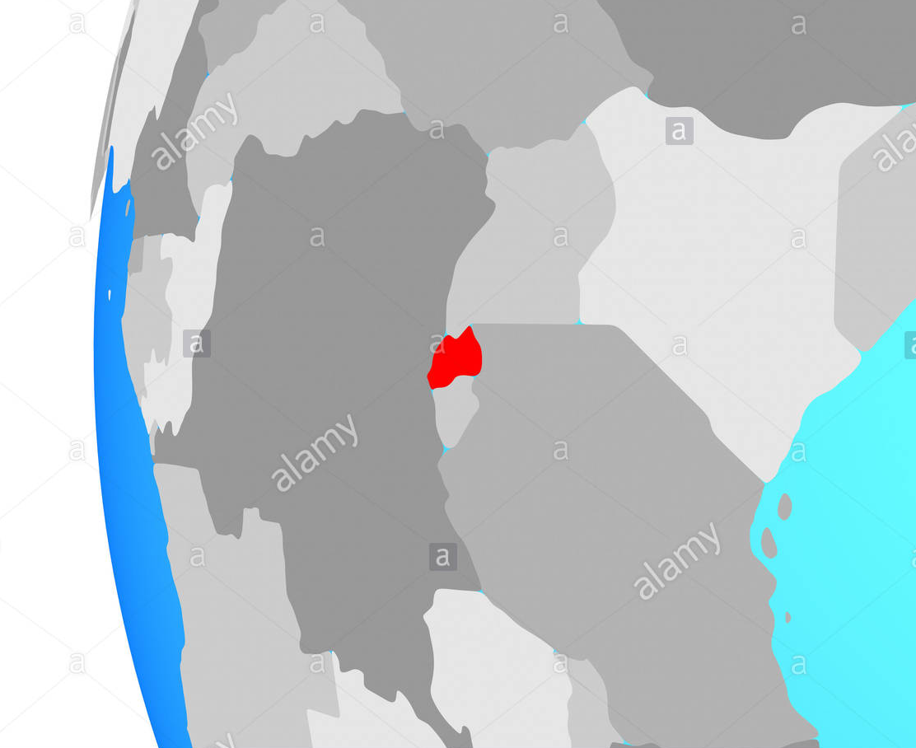
Energy Sector Development Policy Loan
Country: Rwanda
Project Objective: Enable Rwanda fiscally develop sustainable electricity services expansion. Enhance operational efficiency accountability and affordability of electricity.
Project impact: Total percentage of electricity supply to households increased to 43% from 40.7% between September 2017 to December 2018(World bank ,2018).
Project link: https://projects.worldbank.org/en/projects-operations/project-detail/P162671
Timeline | Total Project amount | Amount committed
Dec 2017 - Jun 2019 | $125 million | $125 million
Notes:
The world bank investment in Rwanda is a good intervention for Africa. Energy remains a critical sector for Africa’s development. Investments by the world bank across the energy sector are positioned to have a major impact in Africa’s development. Although the institution has been criticized for attaching conditions to loans advanced to African states, African need sustainable energy to take off to manufacturing economies.

Slide 9
Sources
World Bank Group. (2019). Overview. World Bank. Retrieved 23 March 2020, from https://www.worldbank.org/en/region/afr/overview#3.
World Bank group. (2016-19). Projects & Programs. World Bank. Retrieved 23 March 2020, from https://www.worldbank.org/en/region/afr/projects.

