Slide 1
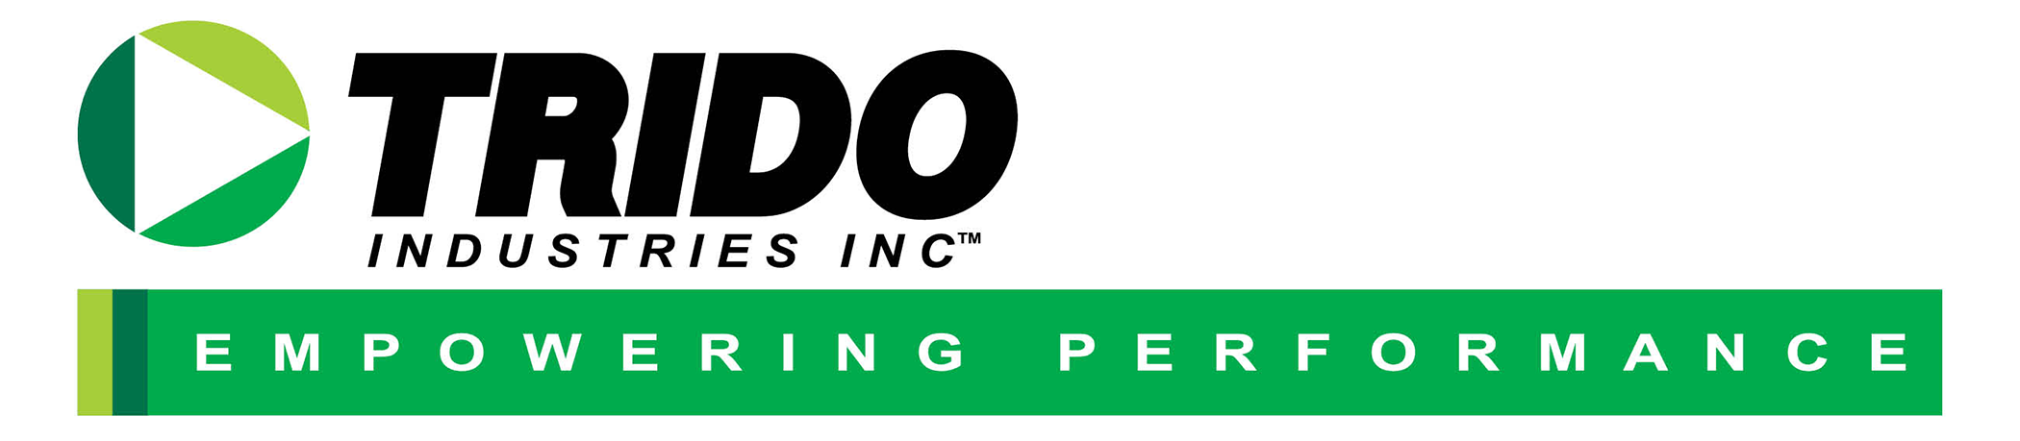
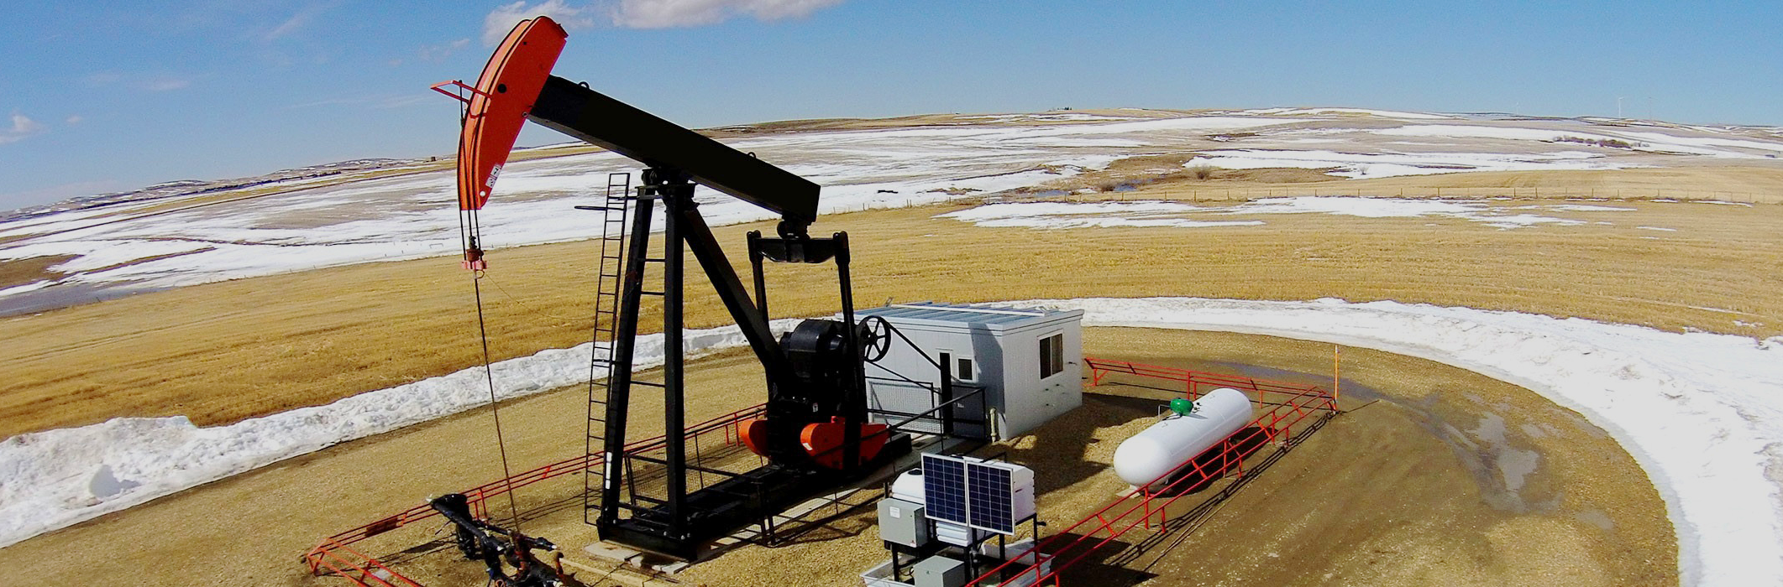
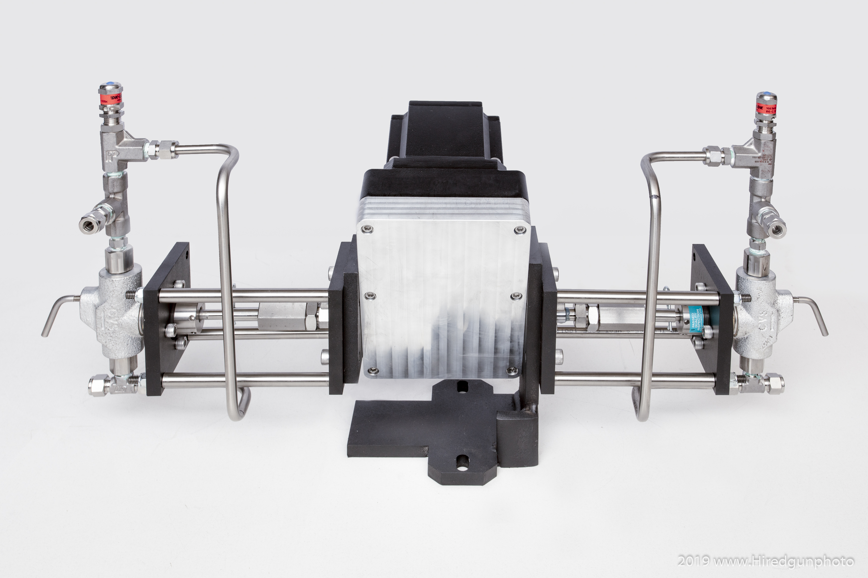
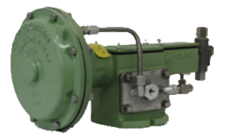
Leveraging the Carbon Market to meet Emissions Reduction
Trido Carbon Fund I Inc.

Slide 2
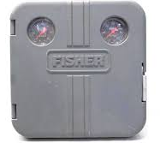

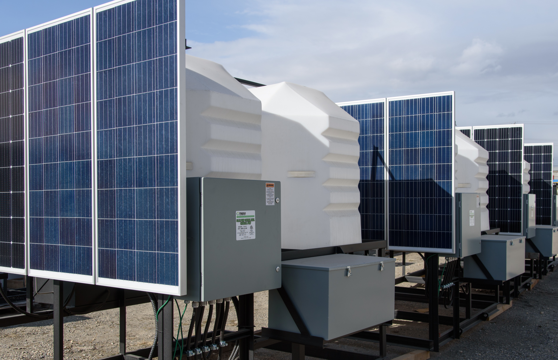

Change Out
Regulatory Compliance
Directive 60
Methane Reduction Retrofit Compliance Plan (MRRCP)
Fugitive Emissions Monitoring Program (FEMP)
Solar Chemical Injection Pump
High to Low Bleed Device Conversion
Replace existing pneumatic pumps and controllers or install new greenfield pumps and skids with
NO CAPITAL OUTLAY
Notes:
Solar chemical injection pump
High to low bleed device conversions

Slide 3
Producer Benefits:
Proven & Reliable
Reduces Downtime;
Lowers Op Costs
Improved Economics
Reduces Emissions
Improves ESG matrix;
Lowers Greenhouse Gas Emissions Intensity;
Increases EV
Carbon Offsets
No CapEx expenditures
Generates additional income stream from assets

Slide 4
Brownfield Conversion Example
  Pneumatic 5100 to Trido Dual Head Electric Pump
Lease Payback
Positive Cashflow
Deploy in 2021
Directive 60
Notes:
1/2" piston 2 heads 20L/day $15 credit payout

Slide 5
HOW DOES IT WORK?
Producer Task
Trido Task
Gather pump data
Rate
Pump type & Size
Operating Days
Assess sites to determine eligibly
Sign Offset Lease Agreement
Install equipment
Collect Data & Credits
Data Audited & Submitted
Funds paid out to producer after lease payout
Credits Generated
& Issued
Paydown Lease
Producer Funds
Trido Funds
Funds Split
Credits Sold

Slide 6
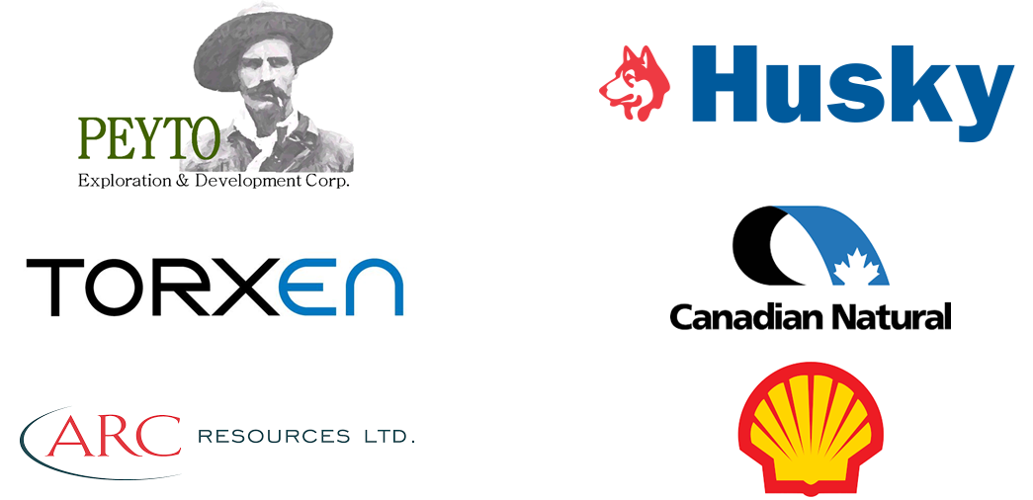

The Trido Advantage
Current Trido Customers Include
Proven Track Record:
  3000+ pumps installed to date
  Solar chemical Injection pump systems
  9 years in operation
  Equipment deployed throughout Western Canada and the USA
Only system to deliver verifiable carbon credits over multiple collection platforms

Slide 7
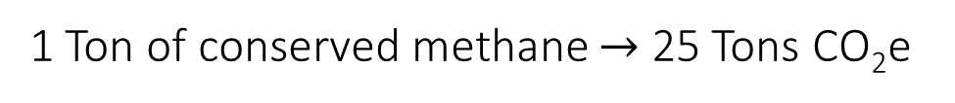
Why Methane?
Methane (CH₄) has a Global Warming Potential (GWP) more than 25 times carbon dioxide (CO₂)
Alberta’s Climate Leadership plans to reduce methane emissions from upstream oil and gas operations by 45% before 2025
1 Ton of conserved methane $→$ 25 Tons CO₂e
Replacement of Pneumatic devices is one of the lowest cost options on a per tonne of CO₂e basis 160,000 pneumatic pumps are currently installed
Environment and Climate Change Canada. Proposed Methane Regulations Webinar: 2017
Notes:
As part of the Pan-Canadian Framework on Clean Growth and Climate Change, the Government of Canada reaffirmed its commitment to reduce methane emissions from the oil and gas sector by 40 to 45 percent from 2012 levels by 2025. Alberta Target is 45% by 2025 from 2014 levels.
Smaller facilities are limited to pneumatic devices that do not exceed 0.17m3/h (low-bleed device threshold)
Our strategic alliance with GreenPath allows us to reduce 86% of methane emissions due to their tools to accurately quantify sources of leaking and venting emission sources.

Slide 8
What are your options?
Everyone has a different need and fit
Self Finance
Trido Financing

Slide 9
Self Financing – Great if you have capital to Deploy
How can Trido Carbon help you with this?
Trido Carbon can manage your carbon credit program for you this includes:
  Registering the locations and equipment in one of Trido’s Alberta Emissions Offset Registries
  Gathering the required documentation and pictures to ensure credits can be audited successfully
  Gather data and process when it comes time to generate the credits
  Process, audit and verify the credits
  Market the credits so that you receive top dollar.
Trido takes a percentage of the credits, no hidden fees or costs. We get paid when you are successful and get paid.

Slide 10
Trido Financing – Save your capital but still get compliant
Trido Financing Options:
High to Low Bleed change outs:
  The program in most cases finances the cost of removal and replacement of the equipment
  Payout times can be under a year.
  The Producer’s percentage initially is used to pay down the capital costs
  Once the project reaches payout the Producer receives their portion of the revenue
Pump & Compressor change outs:
  Again the program can finance all of the equipment costs and some of the installation or all of the installation costs
  Payout times can be one to two years.
  The Producer’s percentage initially is used to pay down the capital costs
  Once the project reaches payout the Producer receives their portion of the revenue
In either case if the project doesn’t get to payout the producer only owes the balance outstanding there are no additional charges.

Slide 11
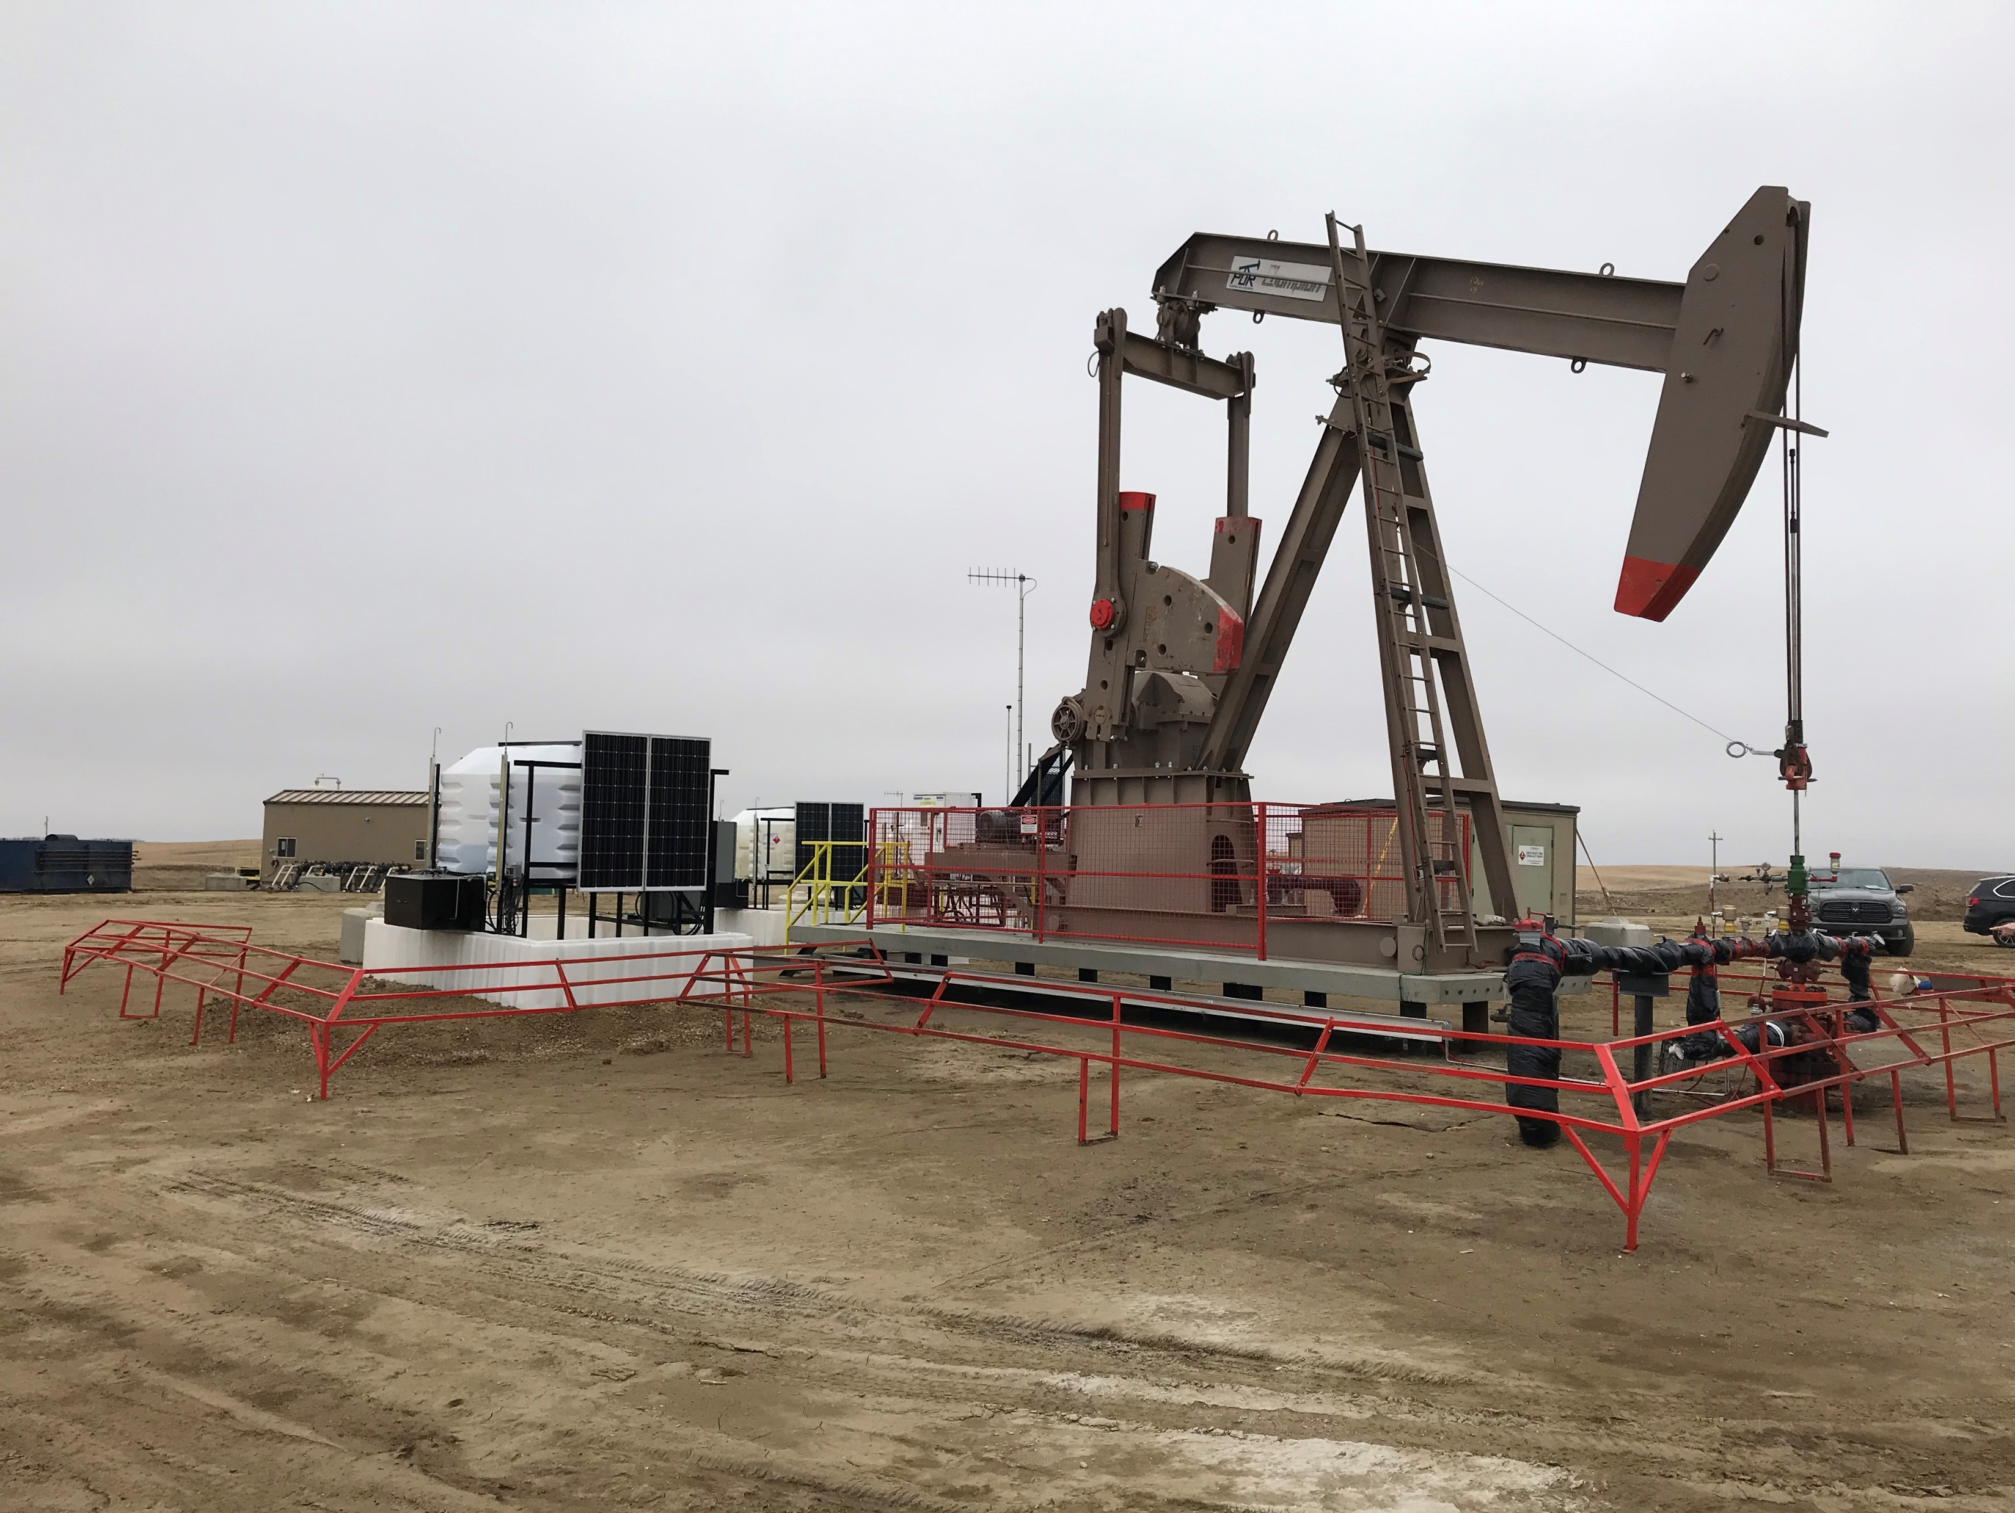
What’s next?
Identify suitable well sites
Lease equipment to reduce emissions
Conserve fuel gas and generate offset credits

Slide 12




Thank you
4015
tridoind.com

