Slide 1
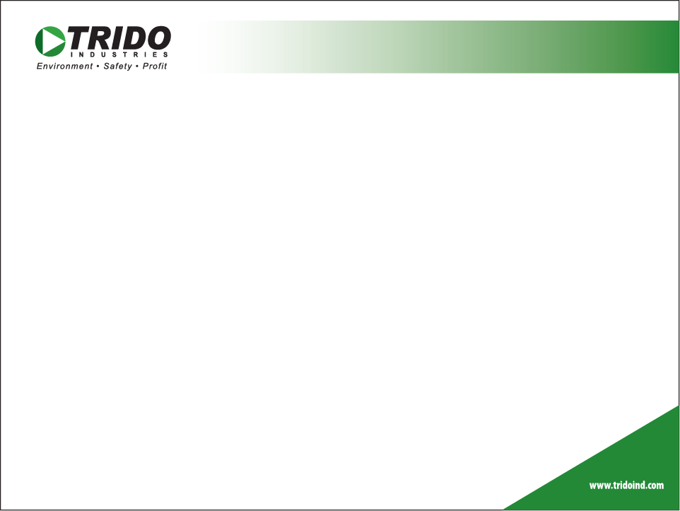
Products
RELIABILITY
VERSATILITY
ACCOUNTABILITY
PROFITABILITY

Slide 2
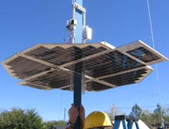
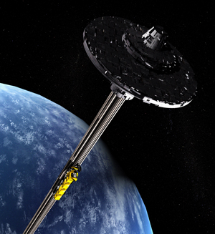
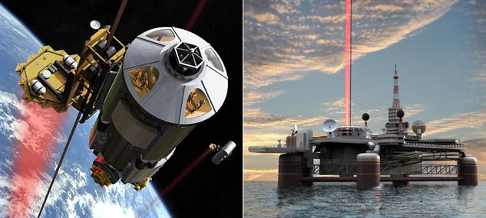
Reliability Motor
Low Power Draw Motor
Developed for NASA Space Elevator
By University of Saskatchewan

Slide 3
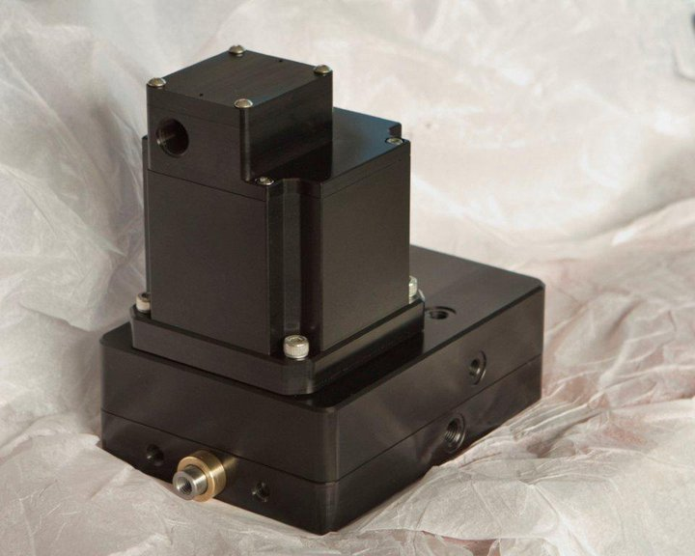
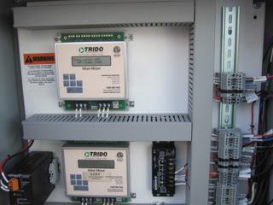
Reliability Motors
TRIDO motor was conceived and designed to work in space from solar power
Rare Earth Permanent Magnet 24 Volt AC 3 Phase Brushless Motor
Class 1 Div 1 Groups C & D
95% Efficient - T3 Temperature Rated Cool Running
DC to AC back to DC creating a soft start 300 to 400 mA on start up.

Slide 4
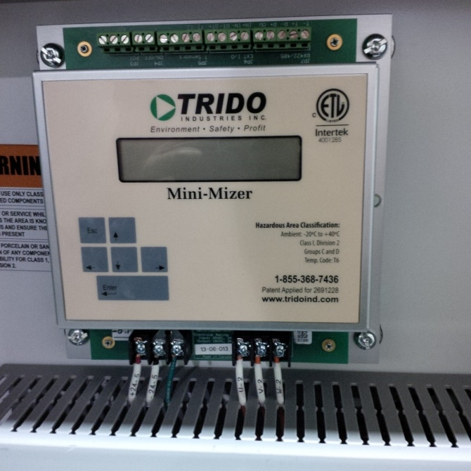
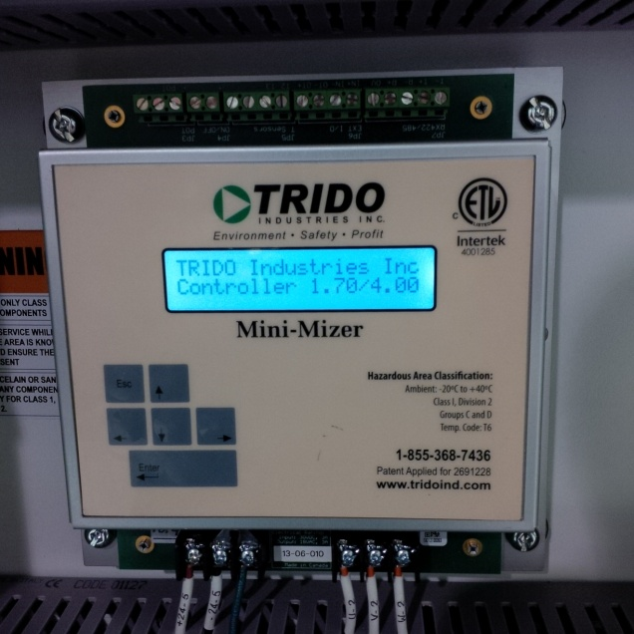
Accountability Controller
VFD Controlled
Class 1 Div 2 – 24 Volts DC
Easy to program and operate
4 operating Modes
Variable - Pressure – Temperature – SCADA

Slide 5
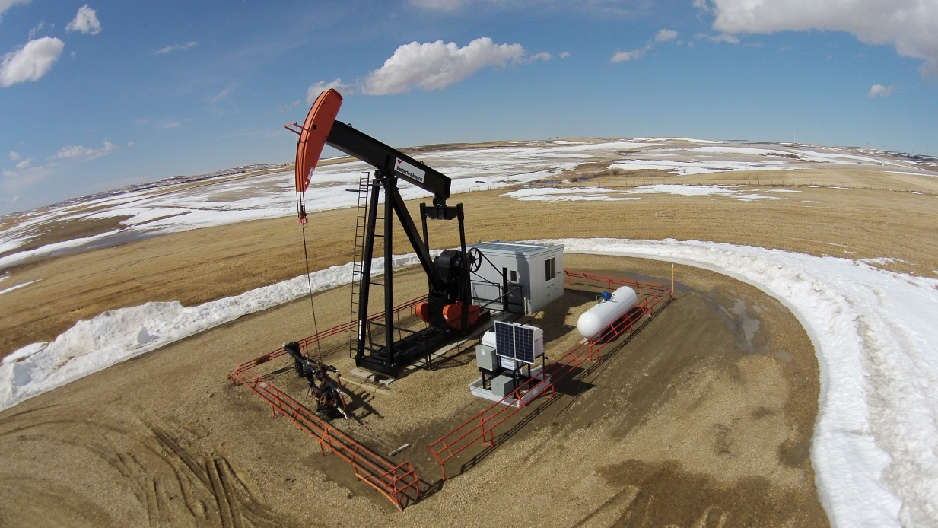
Products
Solar Powered
Chemical Pumps

Slide 6
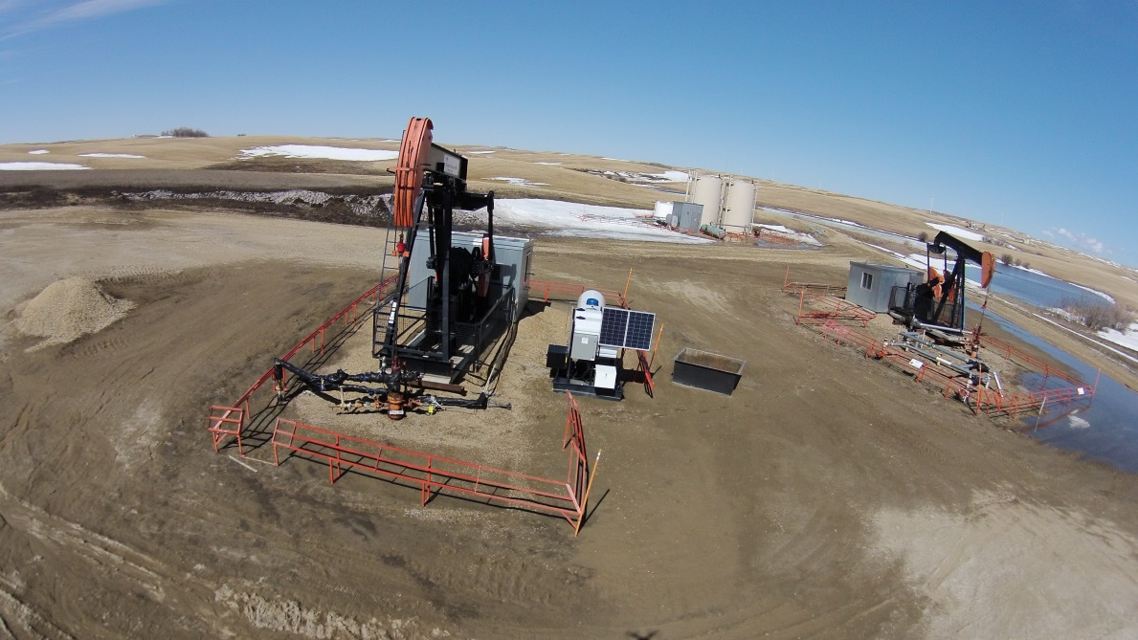
Chemical Pumps
Variable Rate Injection
Run any fluid head on the market 5100, Williams
Multi Point and Multi-Chemical Injection
Reduce your C02 Footprint
Accurate Pumping at low volumes
High volume High pressure pumping

Slide 7
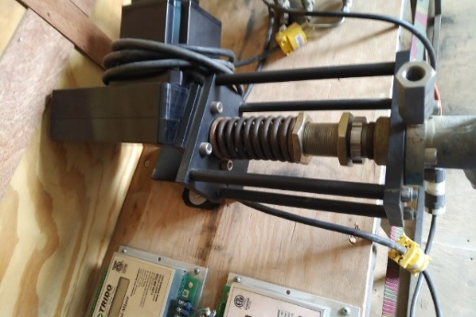
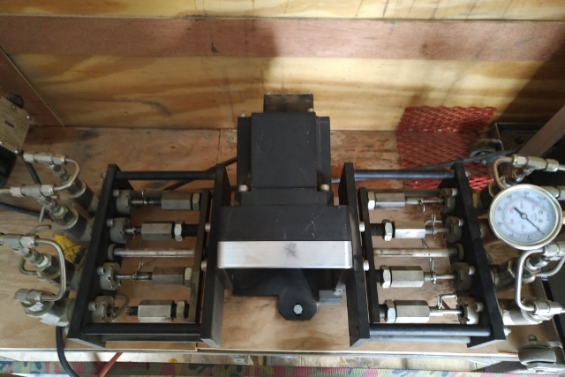
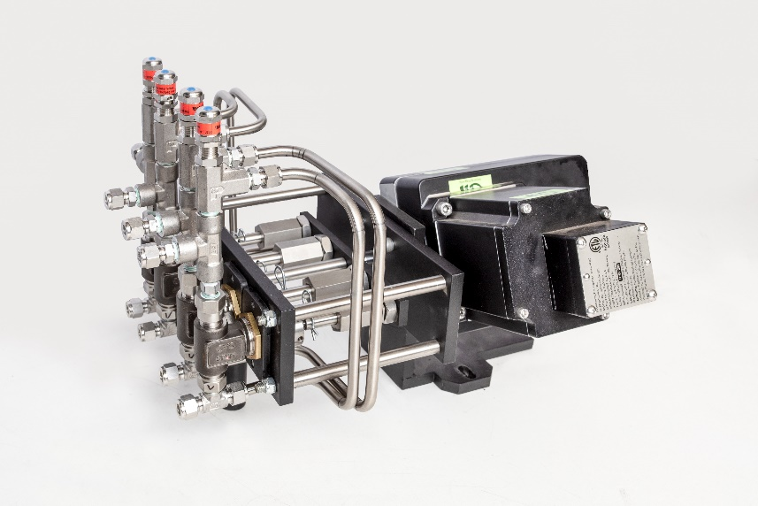
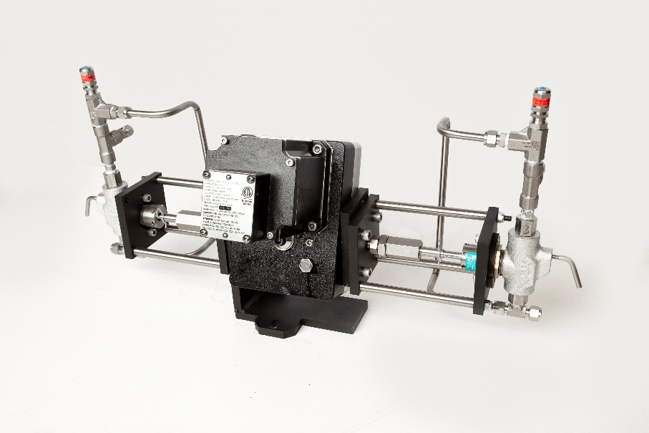
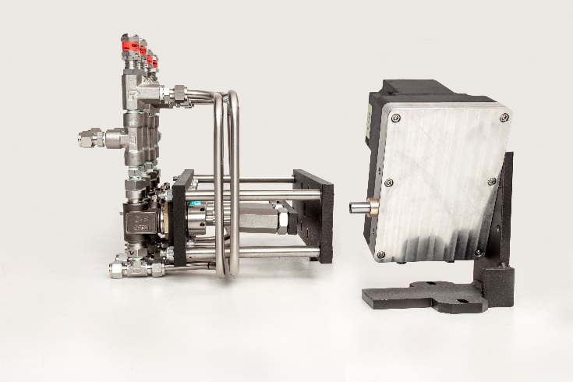
Versatility Products
Multi-Head Systems 1 to 8

Slide 8
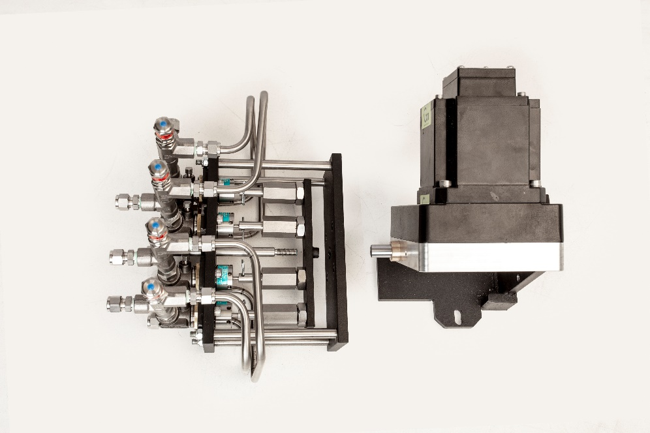
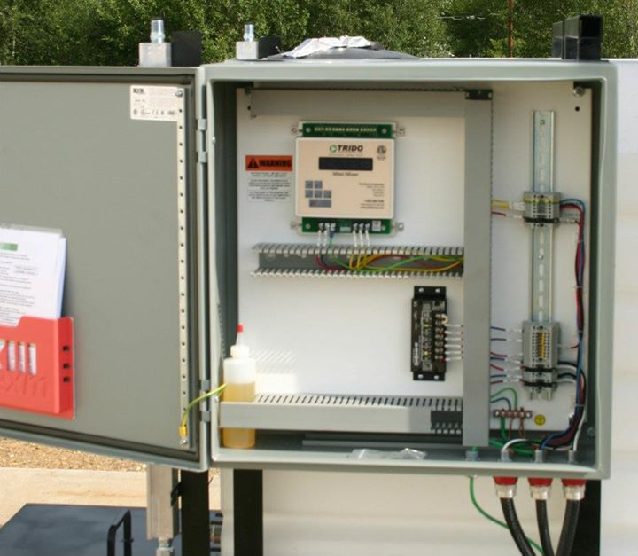
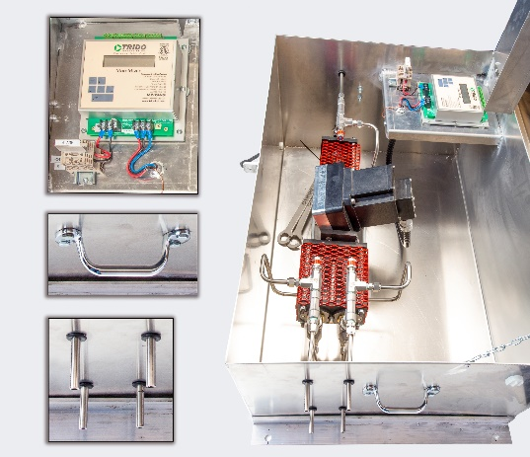
Versatility Products
Infinitely adjustable deliverability of chemical

Slide 9
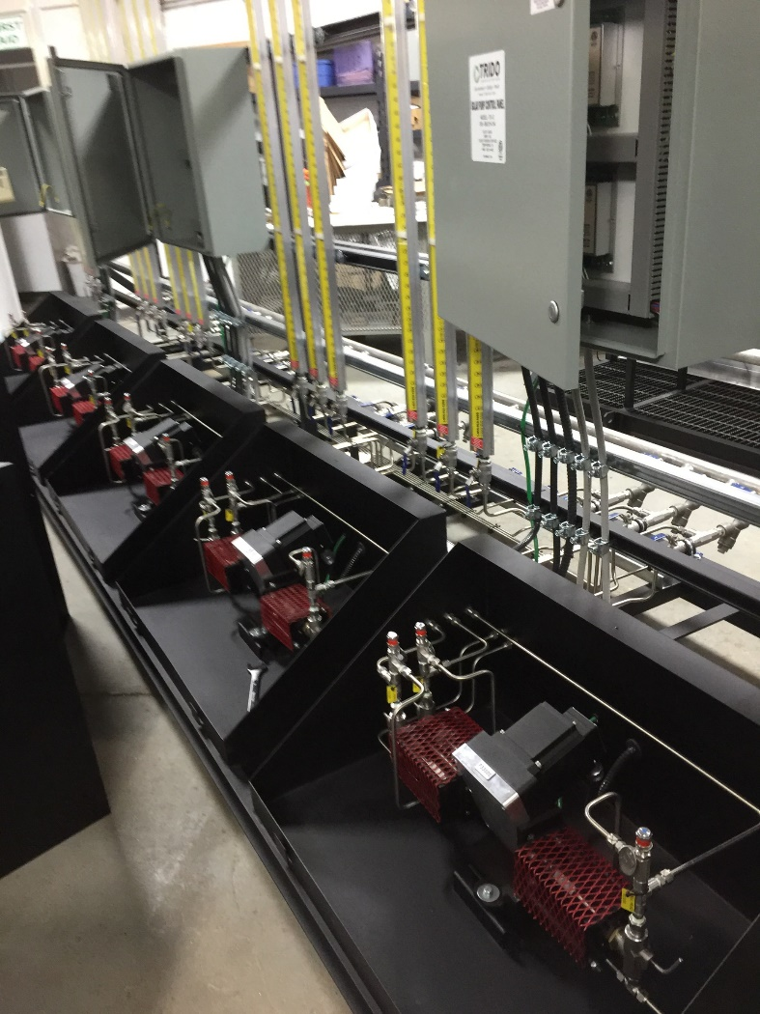
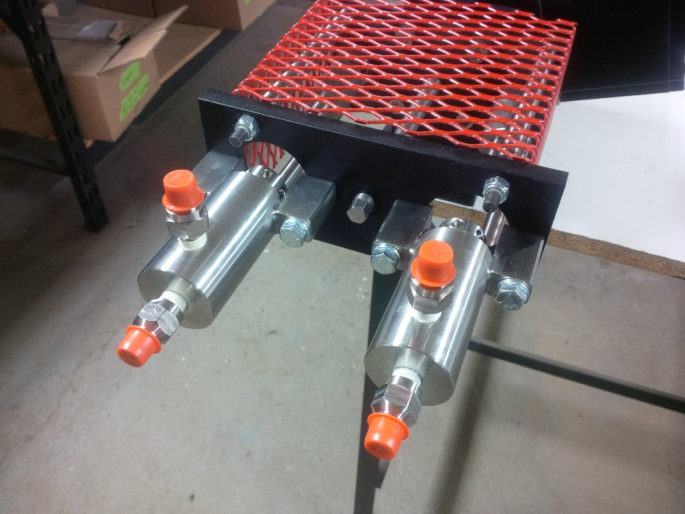
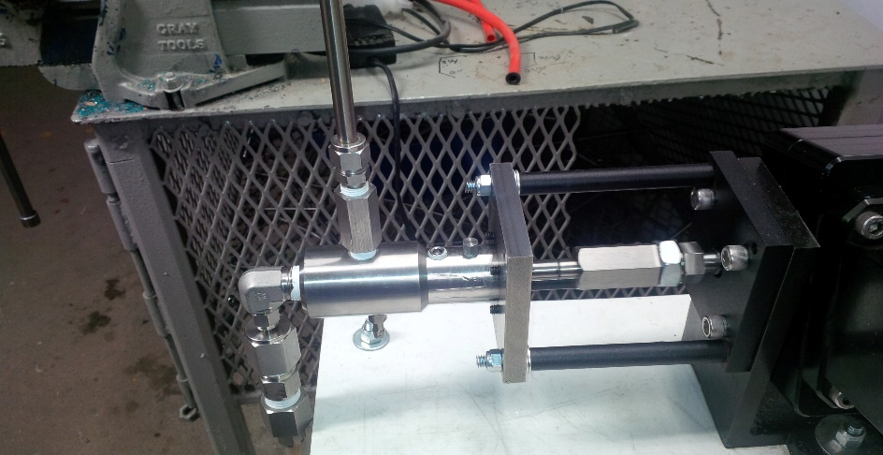
Versatility Products
TRIDO Solar pumping Systems will accept any pumping head on the market

Slide 10
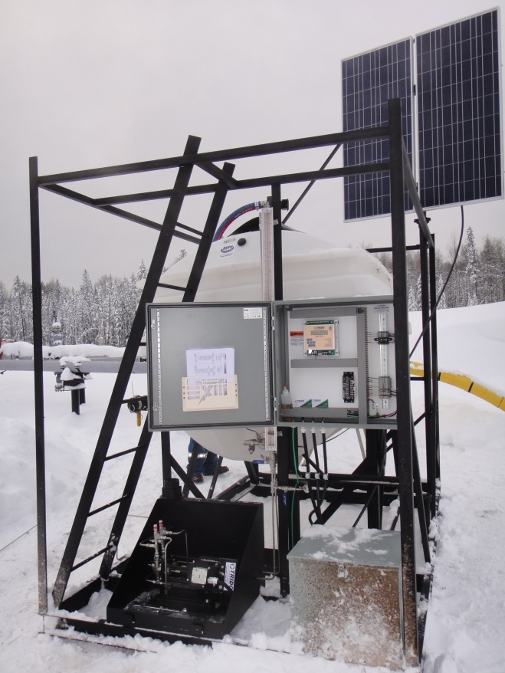
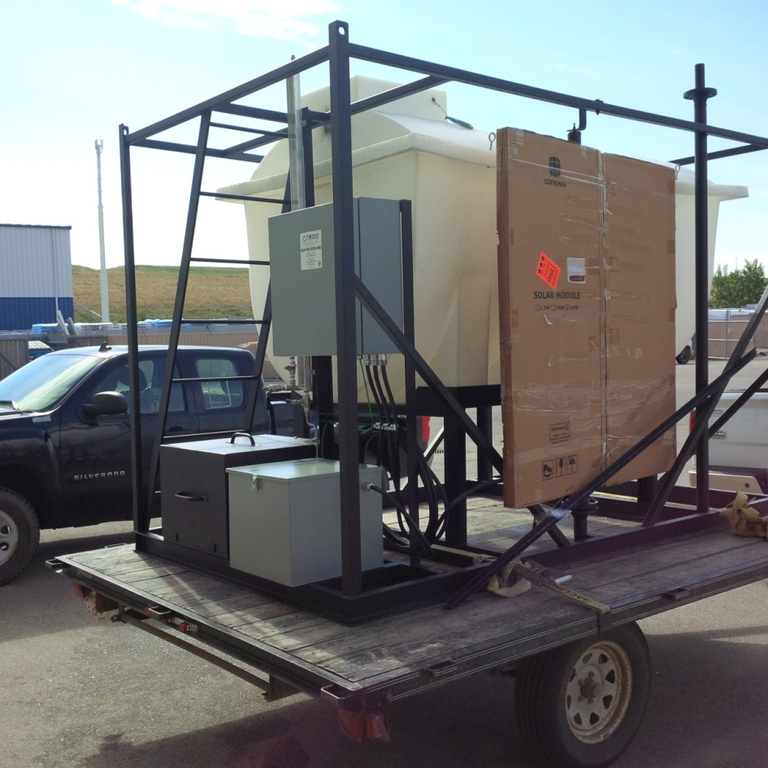
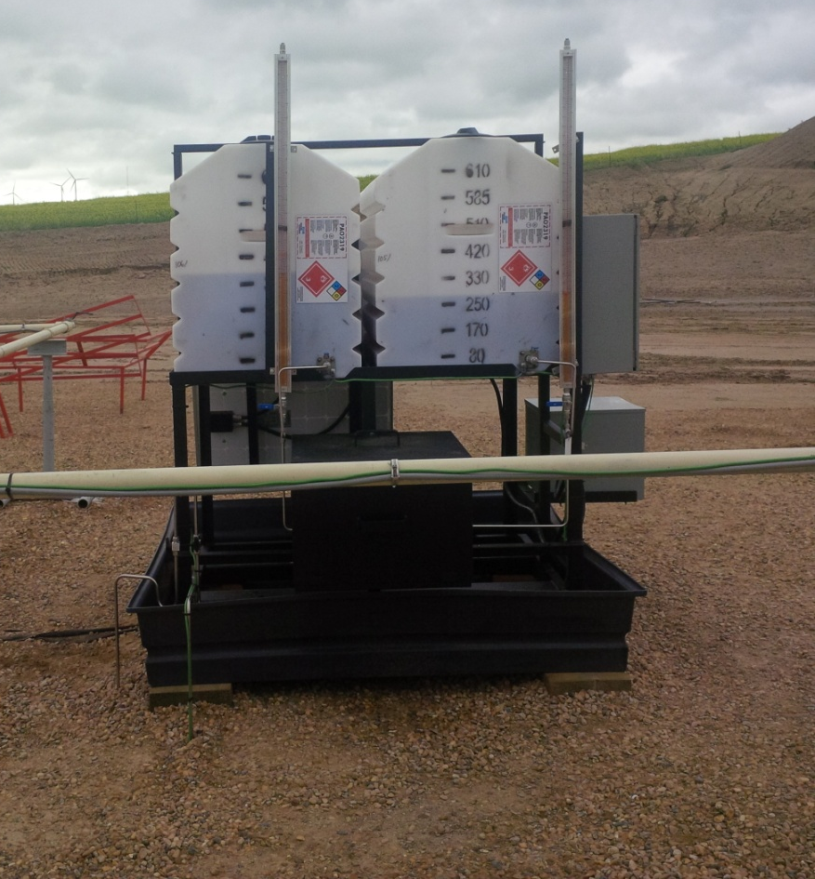
Versatility Chemical Pumps
Custom Skid Units

Slide 11
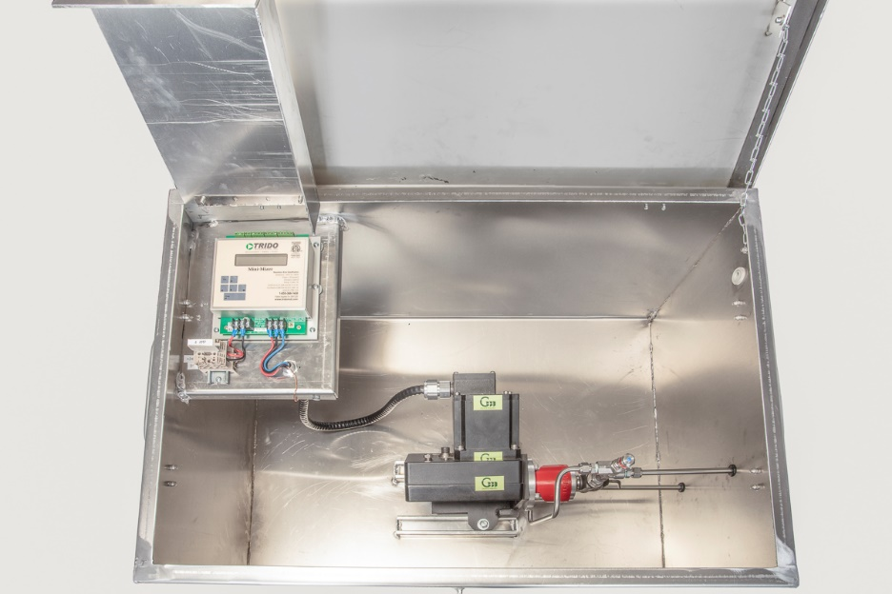
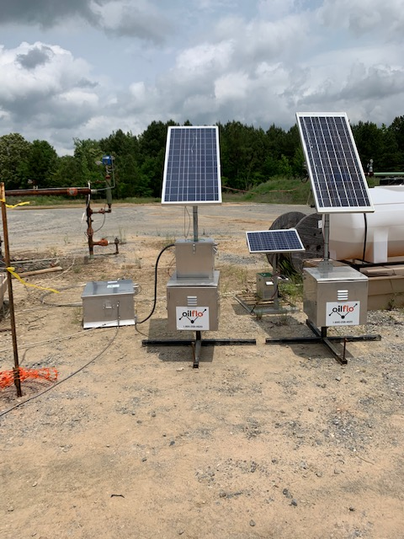
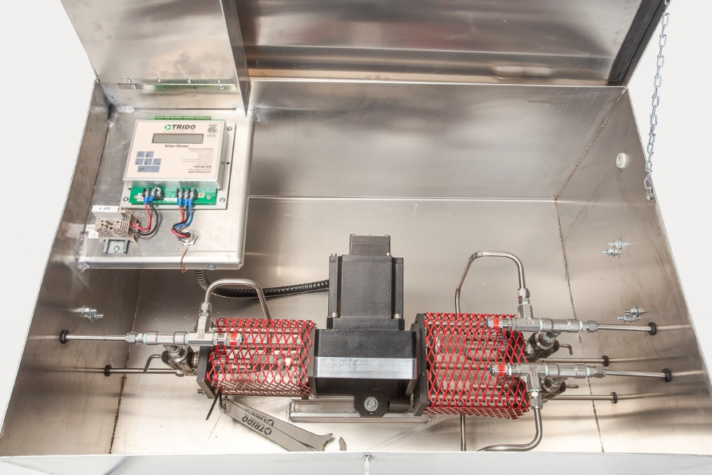
Self Contained Pumps

Slide 12
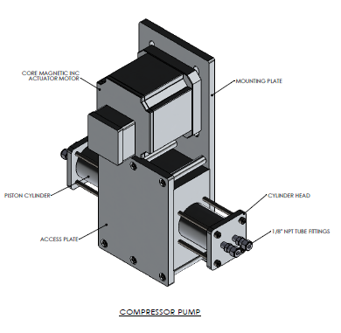
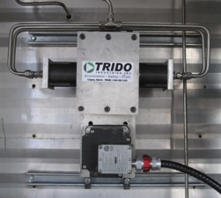
Products
Solar Powered Instrument Air Compressors

Slide 13
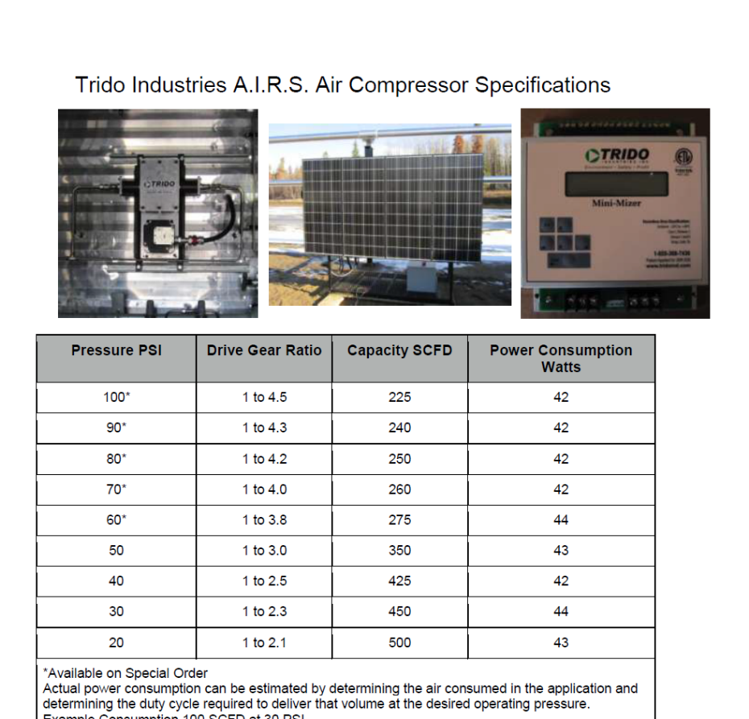
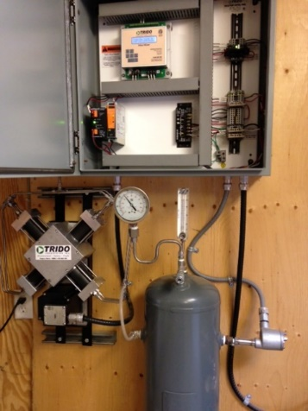
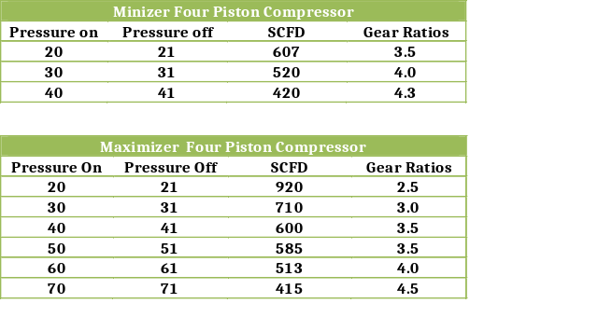
Compressor
2 Head Compressor
4 Head Compressor

Slide 14
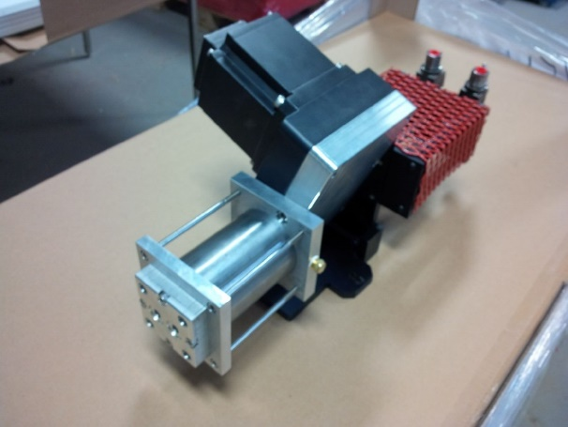
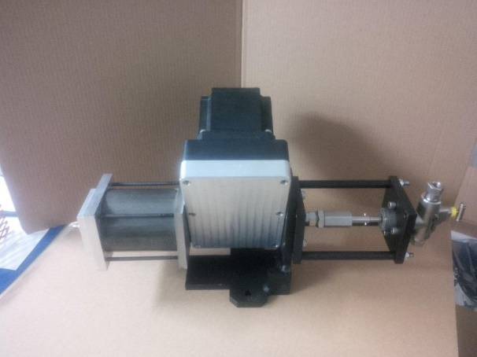
Compressor
2.75 Compressor c/w Dual Head Chemical Pump
80 psi
125 scf/d
3.25 Compressor c/w Single Head Adjustable Chemical Pump
30 psi
200 scf/d

Slide 15
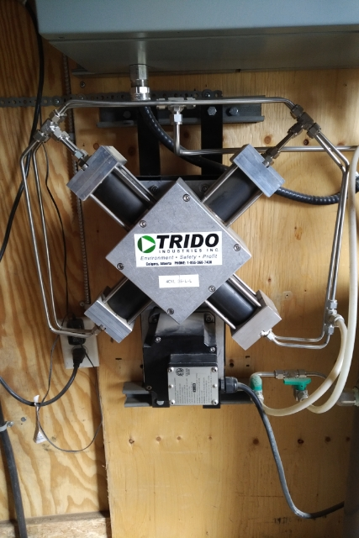
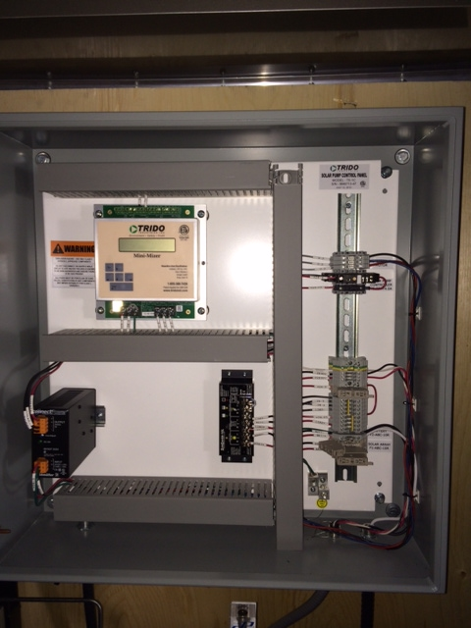
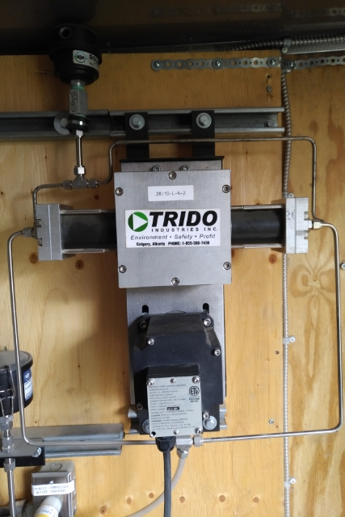
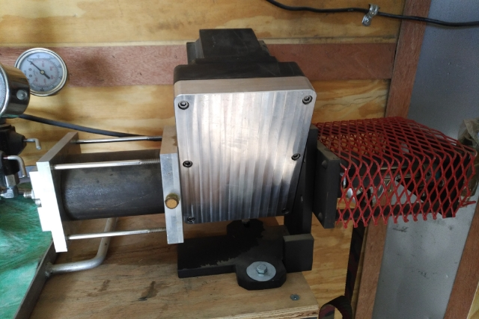
Compressor Configurations

Slide 16
Products
New developments in Compressor Design
Improved bearing design for Easier field servicing of compressor
Improved performance at higher pressures
New valve design for longer time between servicing
Larger valves for better air flow
Use of high strength self lubricating material in shuttle
New seal design for increased compressor efficiency and longer seal life
Servicing once a year cleaning and changing o-ring seals
See video on website.

Slide 17
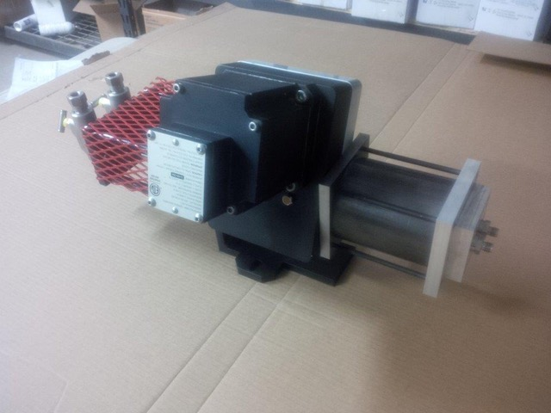
Products
Combination Compressor Injection Pump
Cost effective solution for wells require chemical injection and small volume of instrument air
Powered by Trido Industries efficient motor controller
Produces 200 SCFD of air at 40 PSI at 32.5 strokes per minute
Power any of Trido’s single to 4 head injection pumps

Slide 18
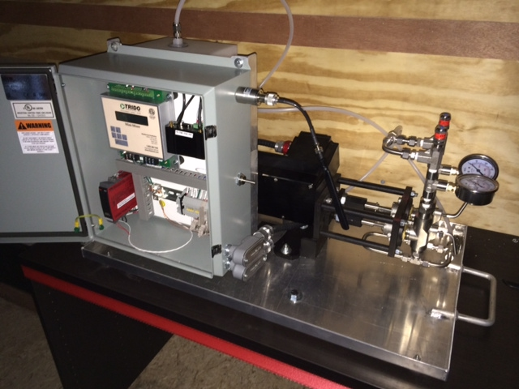
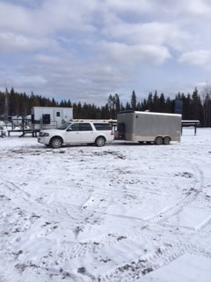
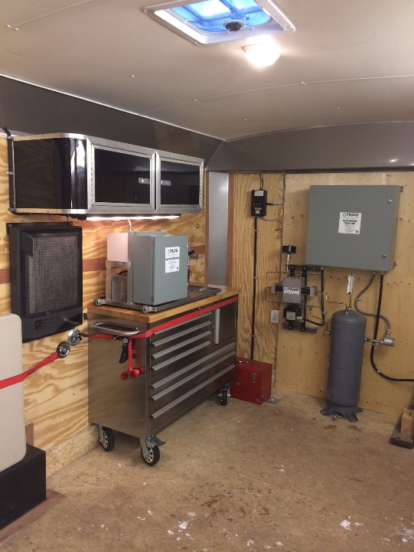
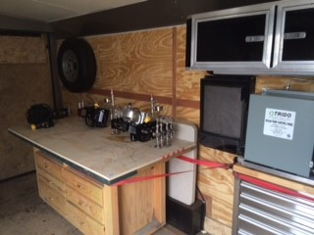
Profitability
Test and Support Trailer

Slide 19

Profitability
Chemical Cost Savings
Sell the gas don’t vent it
Less work overs
Less Operator intervention
Capture Carbon Credits
Better Environment

Slide 20
Questions?
Questions?
403-807-9977

