Slide 1

Brief Logo OpenText Business Lab'

Slide 2
Who we are
Losam Agency, marketing agency specializing in the creation and animation of communities.
Losam Agency created OpenText Business Lab' for the company OpenText, a think tank dedicated to Head of IT around Enterprise Information Management:
What is OpenText Business Lab'?
5 meetings a year (1 dinner + 4 breakfasts meeting)
1 founding committee composed of 8/10 leaders which will define the themes of the different meetings

Slide 3
Who is OpenText
OpenText is the leader in Entreprise Information Management (EIM). EIM products enable businesses to grow faster, lower operational costs, and reduce information governance and security risks by improving business insight, impact and process speed. OpenText Information Management solutions help organizations unlock the Information Advantage of driving sustainable growth to solve the world’s biggest challenges.
OpenText EIM solutions capture, govern, exchange and use information to its full potential while keeping it secure. EIM is a holistic approach to transforming information management, both inside and outside of enterprises.
EIM platforms reduce sprawl and integrate information as it flows through business processes. EIM accelerants are disruptive horizontal technologies. Used with EIM platforms, accelerants process and enrich information at incredible scale to fast-track business transformation.
More informations can be found here :
https://www.opentext.com/

Slide 4
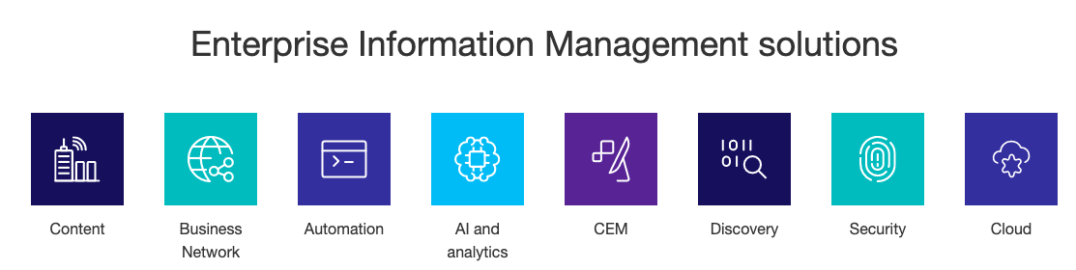
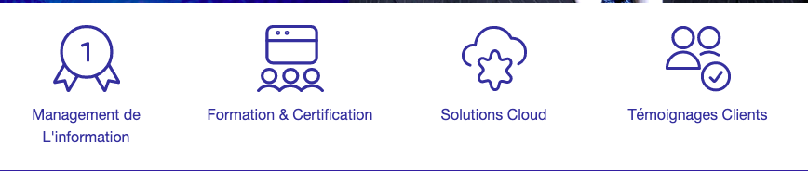

OpenText - Brand Guidelines
Colors used :

Slide 5
OpenText Business Lab'
Target :
Chief information officer (CIO),
IST manager
ISD organisation
Leaders who are interested in improving their information management systems and process
Positioning :
High-end, we address a target of IT decision makers
Improving Information management systems and process - the theme of the think tank
Professional, we address companies exclusively

Slide 6
Brief
What: Creating a logo
Sector: IT / Information system
Logo text: OpenText Business Lab’
Elégant
Amusant
Traditionnel
Personnel
Féminin
Coloré
Bas de gamme
Audacieux
Sérieux
Moderne
Professionnel
Masculin
Noir et Blanc
Haut de Gamme
v
v
v
v
v

Slide 7
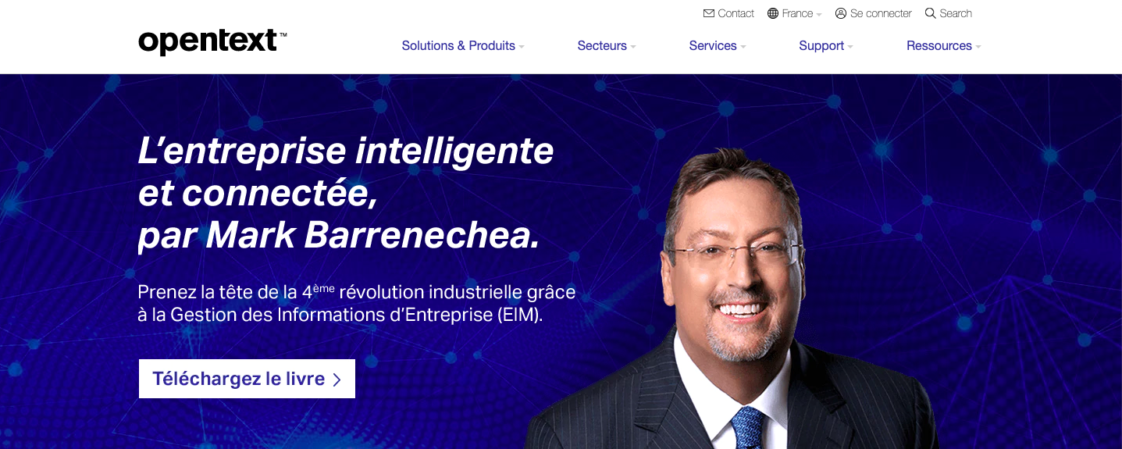
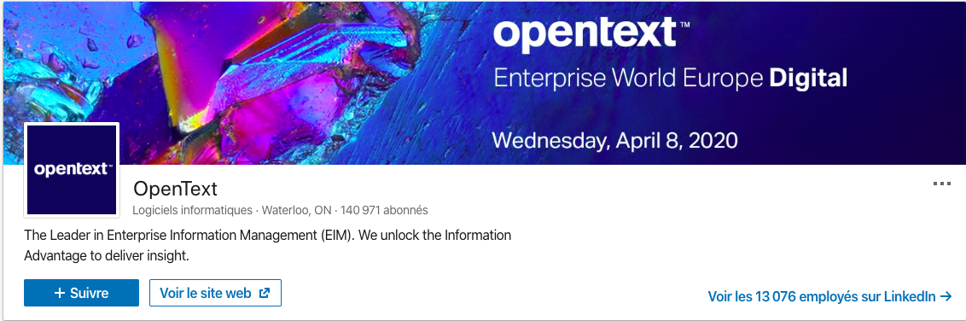
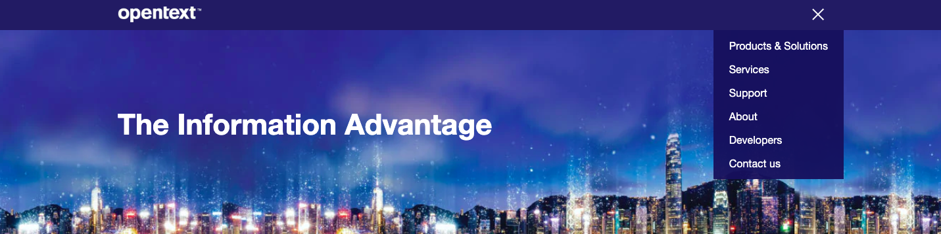
DNA of OpenText
Keep the DNA of the client OpenText

Slide 8
Inspiration #1
Colors used :
Holistic vision

Slide 9
Inspiration #2
With the « b » of business
Pixels
Connexion

