Slide 1
Identity and Access Management
Solution Overview
March 2020 – version 4.2

Slide 2
Agenda
Company background
Solution overview
Success stories
Solution Architecture
Notes:
There are several Identity Management solutions on the market. Most are either point solutions which don’t address the full nature of the problem and others which are offered by large vendors are very complex and expensive to deploy. Their complexity in part comes from the way in which the solutions were developed which was through acquisition. This means that integration is fragile and is a source of problems for customers
OpenIAM was started in April of 2008 in the US by team of security experts who have experience with large customers
The idea was the create a solution that was designed to work together as one cohesive solution with no need for integration. This also has an easy to use web interface that can easily be rolled out to end users.
The result are deployments are quicker and have a low total cost of ownership.

Slide 3
About OpenIAM
OpenIAM was founded in the United States in 2008
Self-funded, organically growing and profitable
Feature complete next-gen IAM platform
  Architected from the ground up to provided a unified platform
  Modern architecture leveraging micro-services and containers
Growing global clientele – Mid to Large enterprise across industries
Distributed engineering and support team (US, Europe, India)
Growing partner network

Slide 4




















Some Customers and Partners Using OpenIAM
Notes:
.

Slide 5
Solution Highlights
Capability | Description
Unified Feature complete solution | Unified platform consisting of: Identity Governance Web access management Multi-factor authentication (MFA) Customer IAM (CIAM)
Flexible deployment model | Customer choice to: Deploy on-premise / cloud (AWS, Azure, Google) with RPM Kubernetes / Docker swarm IDaaS (Identity as a service provided as SaaS)
Extensive integration and customization options | Large connector library with SDK to create new connectors Support for SSO standards Workflow Scripting Extensive REST and SOAP API
High availability and Scalable | Deployments can be compressed into a small footprint for SMB customers and scaled to multi-node cluster out to support millions of users
DevOps Ready | Out of the box Terraform scripts to simplify deployments and maintenance
Developer Friendly | Open framework based on standards Use of well-established tools such as (Groovy script, Terraform, Docker,etc) to reduce the learning curve Connector SDK

Slide 6
Customer Benefits
Benefits | Description
Lower operational costs | Operational costs are reduced as result of: Automated identity provisioning/deprovisioning reduces Self-service functionality
Improved security and audit compliance | Security is improved along with audit compliance as a result of: Comprehensive traceability of events ranging from authentication to how access was gained Periodic access certification Adaptive authentication Integrated MFA
Improved end user efficiency | End-user efficiency is improved from: Single Sign On (SSO) Self-service portal which empowers end users to help themselves and not wait for helpdesk ticket resolution
Extensible across the enterprise | Extensive connector library Rich REST API to allow integration with other enterprise systems
Common platform for internal and external users | Platform can be use for internal and external users Supports Identity Governance, Web Access and CIAM use cases

Slide 7
Product Details

Slide 8
Solution Stack
Identity Governance
User life cycle management
Web Access Management
Flexible authentication (Password, Certificate, Social login, OTP)
Multi-factor Authentication
Self-service portal with forgot password
Workflow based Request approval
Audit and Compliance
Session management
Integration API – REST & SOAP
Mobile app with Push Notification
SMS
Mobile App - iPhone & Droid
OTP
Integration API – REST & SOAP
Access Review / Certification
Credential provider for Windows, Mac, Linux
Adaptive Authentication
Self registration and social registration
SAML 2, oAuth2, OpenID Connect)
rProxy for SSO to legacy applications
Single Sign-on (SSO)
RBAC Authorization
Active Directory Password filter

Slide 9
Identity Governance Functionality
IGA Feature | Description
User life cycle management | Integration with one or more authoritative sources to enable automated Provisioning and de-provisioning Role and Rule based provisioning Reconciliation Orphan management Entitlements synchronization (Groups, Roles, Resources, Organizations) from source systems to OpenIAM
Self-service Portal | Portal for end-users enables: Profile management, Inbox, request/access, SSO
Self-service forgot password | Configurable forgot password to allow end-users to reset their own passwords. Supports: Challenge questions SMS based one-time tokens E-mail based password reset link
Workflow | Pre-configured workflows for: New hires / Positions changes / Self registration / Terminations
Request / approval | Workflow based request/approval. Shopping cart model Browser based configuration to add multiple approvers and SLAs to workflows Service catalog with flexible search and drill down functionality to easy find entitlements to request
Audit and Compliance | Fine grained audit tracking Out of the box reports to support compliance activities Export audit events as syslogs
Access Certification | Certifications based on Users, Groups, Roles and Applications Automated closed loop remediation Provides improved visibility of access privileges across the enterprise.
Group Management | Provisioning and deprovisioning of groups Request /approval model supports group creation
Integration API | Extensive secure REST API allows for varied integration options.

Slide 10
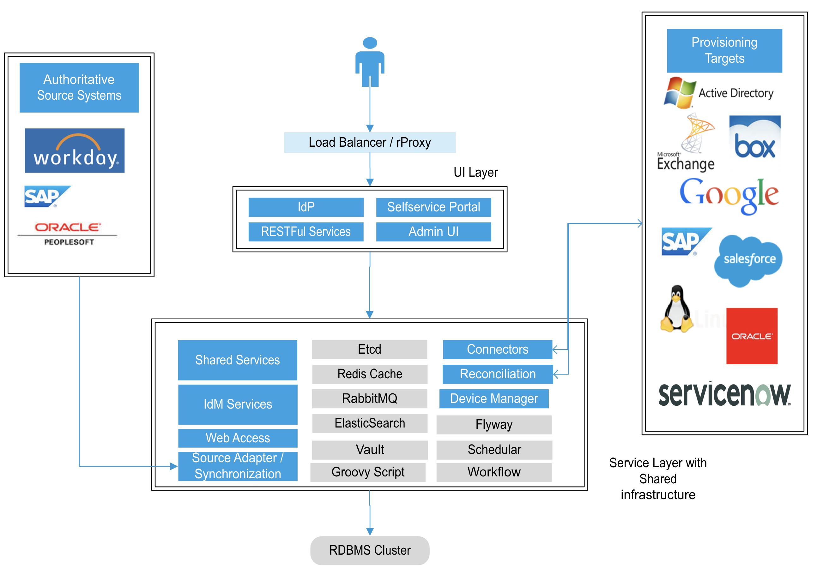
Identity Governance

Slide 11
Target System Connectors
On-Premise Systems | Cloud Services
Microsoft Active Directory and Azure AD | Google GSuite
Microsoft Exchange | Salesforce.com
Microsoft Powershell Script | Microsoft Office 365
Microsoft Local Windows | Box.net
LDAP (OpenLDAP, eDirectory, etc) | ServiceNow
(Source Only) CSV | Azure Cloud
Databases: Oracle, MySQL, SQL Server | Amazon AWS
Database Table (Oracle, MySQL, SQL Server, PostgreSQL, DB2) | SCIM 2 (Slack, GitHub, Atlassian Cloud, etc)
Tableau | Freshdesk, Freshservice
Groovy Script | Docker Hub
Linux / Unix | Atlassian - JIRA
Redhat IDM /IPA | Jenkins
ERP: SAP, Oracle EBS | SOAP Services
 | SOAP Services
(Source Only) SAP HR, Oracle HR
(Source Only) ADP, Workday

Slide 12






OpenIAM Identity Governance with AD Password Synch
End User
Windows Desktop
1 – Change password in Windows.
Sent to AD
2 – Send new password
to IDM
Target Systems
Databases
Cloud
Applications
Identity Manager
3 – Synch other systems
with the new password
Linux
ERP
etc.
Identity Services
Shared Services

Slide 13
Web Access Manager Functionality
WAM Feature | Description
Authentication | Password LDAP / AD Authentication Certificate OTP (SMS, E-mail, TOTP) Kerberos Pluggable framework allows for the creation of new login modules.
Adaptive Authentication | Implement robust authentication workflows which take into account Geo-location, Device, and other configurable attributes
Authorization | Flexible RBAC model which support inheritance
Self Registration | Template based registration form builder Configurable registration including support for E-mail or SMS based user identity validation.
Social Integration | Social Login (Facebook, Google, Linkedin) Social Registration (Dynamic registration pull selected attributes from the social media site)
Single Sign On | Supports standards: SAML 2, oAuth 2, OpenID Connect OpenIAM can act as both an IdP and SP
rProxy | Enables SSO to legacy applications using: Form fill, header injection and URL –Rewriting Enforces URL level authorization rules Session management
Device Registration | Framework to allow for the registration and management of devices
Integration | Extensive secure REST and SOAP API

Slide 14
OpenIAM Access Manager
Cloud Applications
Partner
Client Federation
End User Client
Google
SSO / SAML
Salesforce.com
MS Office 365
Access Gateway
Box.net
Federation Gateway
Reverse Proxy / SSO
Self Service
SSO / Reverse Proxy
On-Premise Application
Identity and Access Middleware
Custom Applications
Access Management Services
Identity Management Services
Authentication/ Shared Services
COTS Applications
SOA Stack
IAM Repository
Audit and Compliance
Notes:
This next slide just provides an overview of how the components fit together in the Access Manager.
The Reverse proxy and Identity Provider are critical components.
The Reverse proxy provides high performance and we can process authorization requests in <1 ms and this is under load

Slide 15
Appendix

Slide 16
High Level Competitive Matrix
 | OpenIAM | Oracle | Forgerock | Okta | Sailpoint
Deployment Options | SaaS, On-premise, Multi-cloud | On-premise | On-premise, Multi-cloud | SaaS | SaaS, On-premise, Multi-cloud
DevOps ready for Cloud deployment | Yes | No | Yes | Not Applicable | No
Unified Platform | Yes | No – Collection of products | No – Collection of products | Not Applicable | Yes
Scalability | Strong | Strong | Strong | Not Applicable | Weak
Identity Governance | Strong | Strong | Neutral | Weak (Requires partners solution) | Strong
Authentication, MFA and Adaptive Authentication | Strong | Neutral | Strong | Strong | Neutral
Single Sign On and Web Access Management | Strong | Strong | Strong | Strong | Needs partner solution
Customer IAM | Strong | Neutral | Strong | Strong | Needs partner solution
REST API | Strong | Neutral | Strong | Neutral | Neutral
Price | Neutral | High | High | High | High

Slide 17
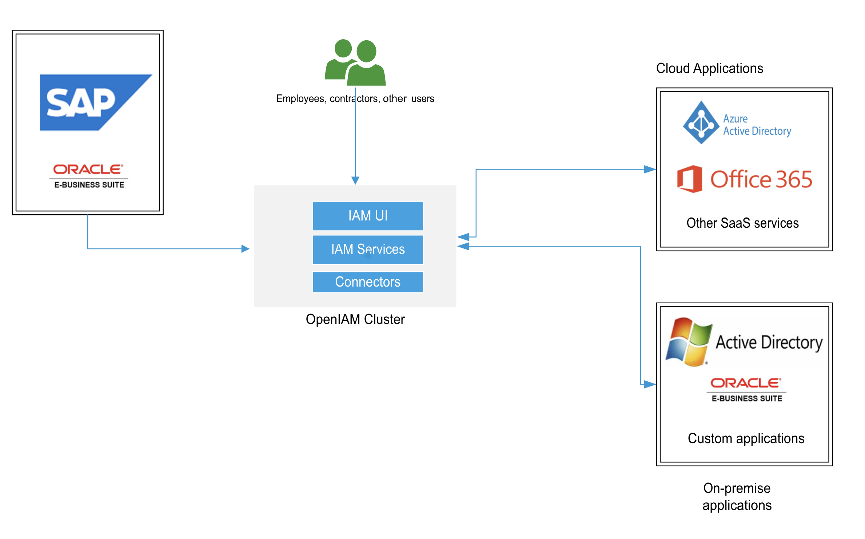
Case study: Enterprise IGA Deployment
Customer Background
Industry: Energy
User population: 45,000 internal employees and contractors
Type of deployment: On-premise in the customers datacenter
Challenge: Provide an Identity Governance platform which will deliver:
Automated user life cycle management for employees and contractors.
  Integrate with workflow for position changes and terminations
Integrate with SAP HR and Oracle EBS as authoritative sources.
Self-service password reset for all users
Service catalog driven request approval to manage all access
Solution
OpenIAM provided the identity governance solution which was deployed at the customer’s datacenter
Configured active synchronization with SAP HR for employee information and Oracle EBS for business specific entitlement which are made available to end users through the Service catalog.
Access model defining job profiles roles and application level entitlements
Configure connector to systems such as Active directory, Oracle EBS, etc
Implement workflows for request/approval, joiners, position changes, terminations
Configure reporting to audit and compliance requirements

Slide 18
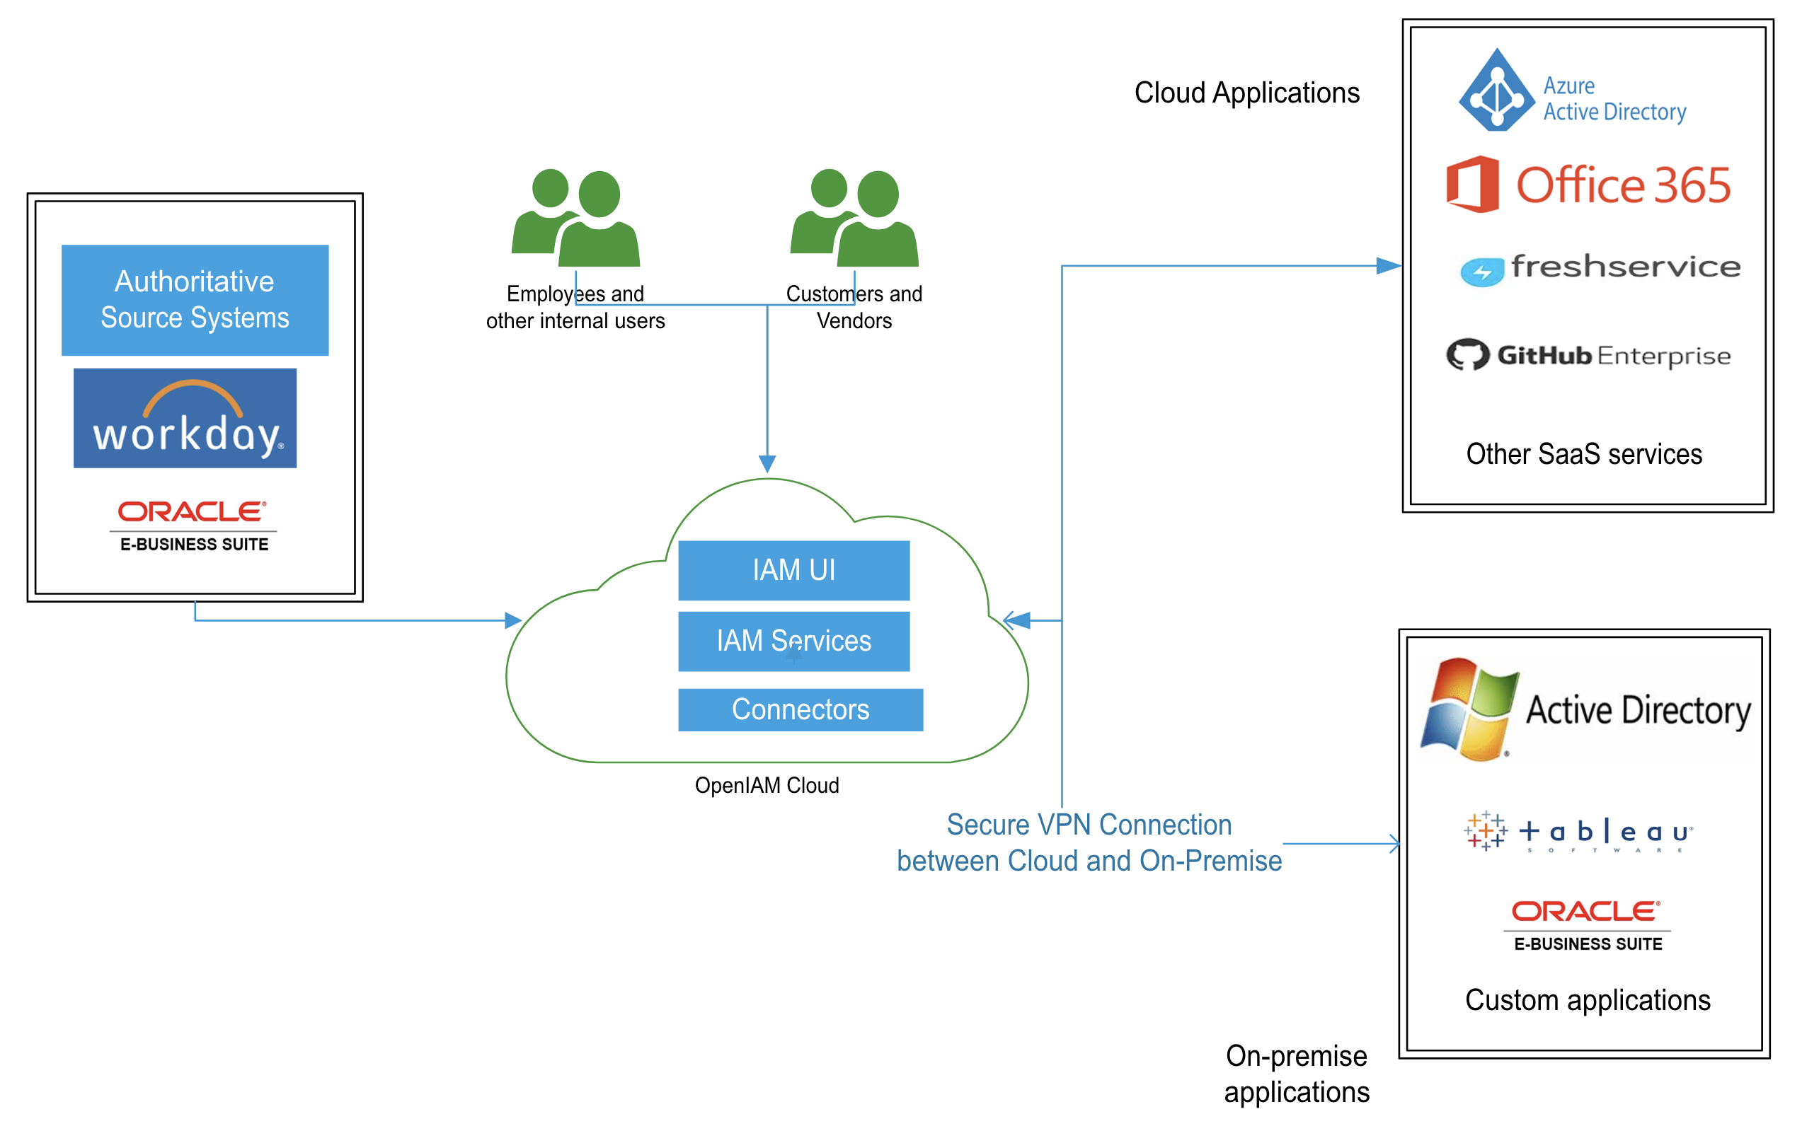
Case Study: IDaaS Deployment
Customer Background
Industry: Manufacturing
User population: 5,000 internal users and 5,000 external users
Type of deployment: IdaaS with integration to on-premise and cloud applications
Challenge: Provide a unified IAM platform which will deliver:
Support both employees, customers and vendors
Automated user life cycle management for employees with Workday integration
Self-registration with validation for Vendors and Customers
Single sign on (SSO) to business applications
MFA for improved security
Self-service password reset for all users
Workflow based request approval functionality for employees
Solution
OpenIAM provided a unified platform consisting of Identity Governance, Web Access Management, Customer IAM and MFA, delivered as an IDaaS.
Integration with Workday allows automated life cycle use cases for joiners, movers, leavers
Access model defining job profiles roles and application level entitlements
VPN from cloud to on-premise with on-premise connector VM to allow communication with on-prem systems.
Enable MFA with Push notification and Adaptive authentication to enforce security rules
Configured SSO to both cloud and on-premise applications
Self-service portal supports password reset, request approval and SSO to business applications

Slide 19
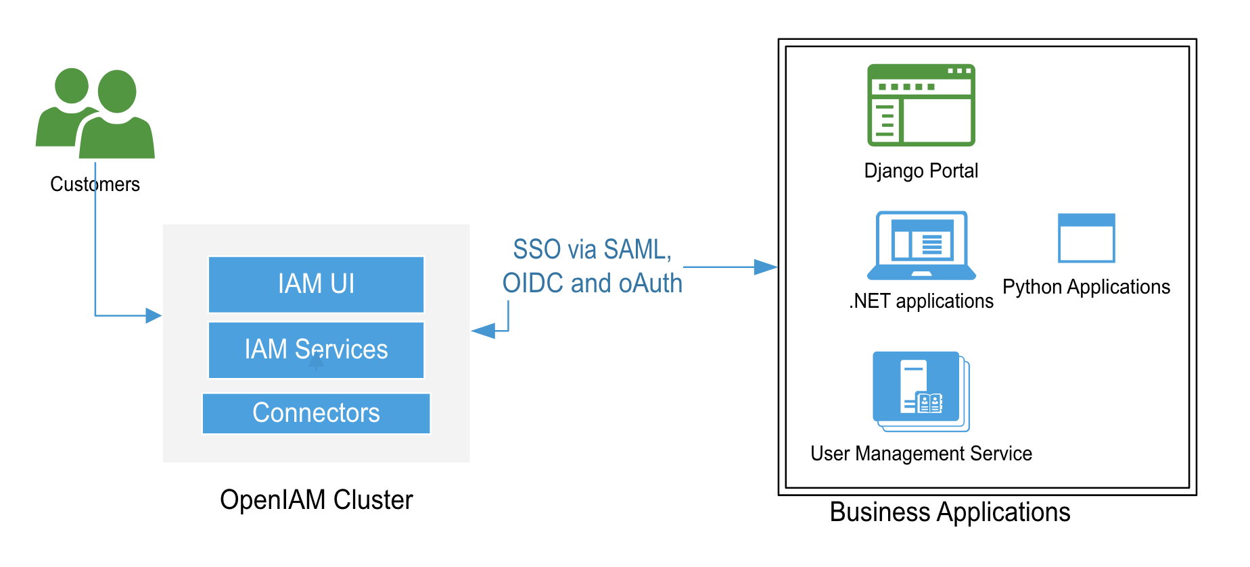
Case Study: Customer IAM (CIAM)
Customer Background
Industry: Financial services
User population: 10,000+ external users
Type of deployment: On-premise in the customers own cloud environment
Challenge: Provide a Customer IAM (CIAM) solution which provides the following:
Supports external customers
Authentication with SMS or e-mail based OTP
Single sign on (SSO) to business applications
Solution
OpenIAM provided the CIAM platform which the customer deployed in their cloud environment.
OpenIAM synchronization functionality was used to migrate existing users and their privileges
Access control model was defined to model business and application level roles
Implemented strong authentication rules to enable multifactor authentication (MFA)
Configured SSO to business applications
Self-service portal provided password reset and SSO to business applications

Slide 20

Thank you!

