Slide 1




Slide 2





We Plus group
We Plus Group, an Italian SME, with about 90 employees and an annual revenue of about 5M€, supports every possible Business solution, among the three sub-companies.
Particle ➔ Consultancy
KITE ➔ Projects
ASC Consulting ➔ SAP ERP
Particle S.r.l.
KITE S.r.l.
ASC Consulting S.r.l.
Consultancy
Outsourcing projects
ERP (SAP)

Slide 3






We Plus functional areas
We Plus is a company that deals with IT Consulting and System Integration, specializing in the design and implementation of solutions and core services for B2C companies (CRM, eCommerce) and B2B (ETL-BI, BPM, CMS).
We Plus combines expertise in the main industrial sectors (Supply-chain, MES), tertiary (Banking, Insurance), R&D (H2020, Industry 4.0).
The offer of We Plus is dedicated to achieving customer success through the introduction of innovation.
Throughout the value chain, thanks to the knowledge of specific solutions and consolidated experience on the main core themes of the various industrial and service sectors.
The essence of a good organization is to join forces to achieve a common goal. Working in a group means following a shared path.
The team's potential is not the sum of the characteristics of the individual components, but rather the union itself, working for a common purpose by building and promoting a shared strategy.
Industry
ETL-BI | BPM | CRM
Services
CMS | ECM | Collaboration

Slide 4
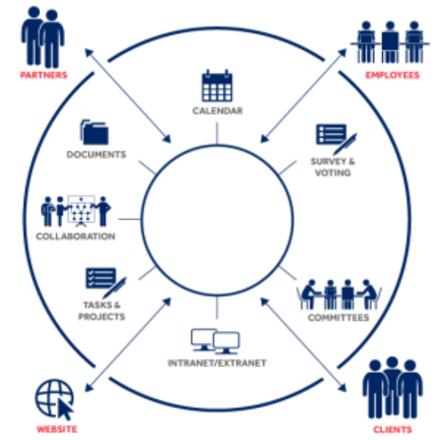



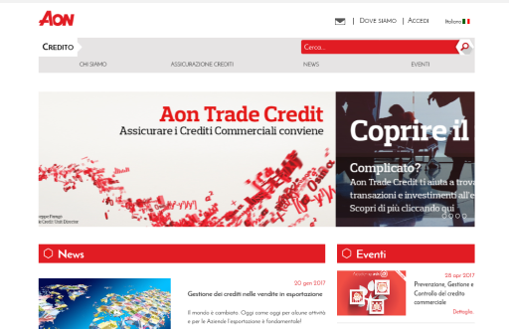
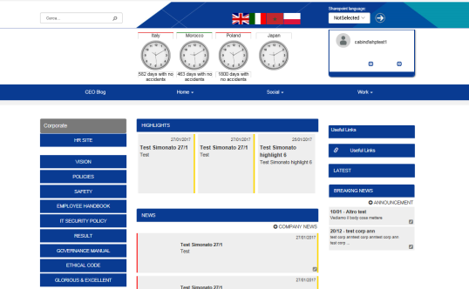
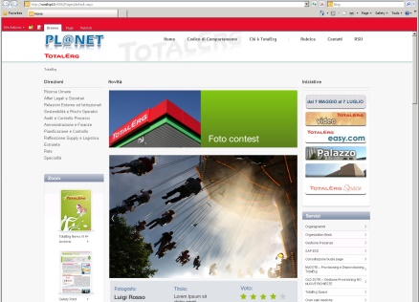
Sharing platforms
We Plus allows companies to manage their internal processes and to share information through dedicated solutions in a simple and effective way.
Furthermore, where employees need to focus on their customers’ needs, We Plus offers common integrated solutions to deal with a single tool for information sharing.
Communication
Intranet
Intranet

Slide 5



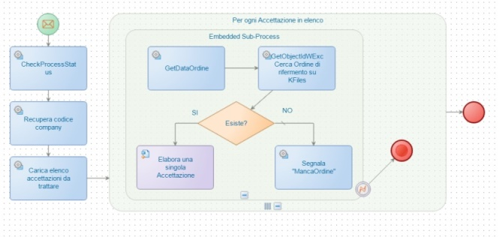
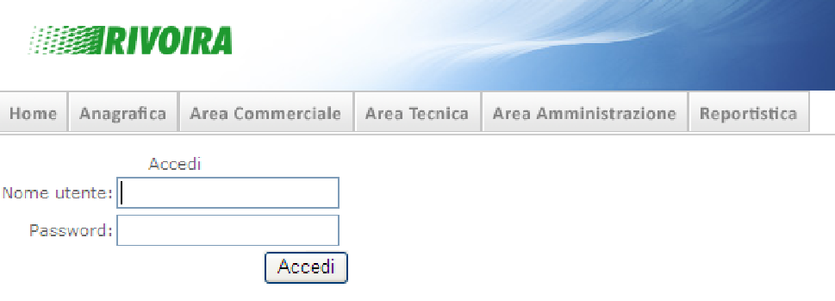
BPM - Business Process Management
Managing business processes means modelling, automating, measuring and improving the processes that people use every day.
We Plus can contribute to the growth of a company thanks to the integration of dedicated Suites (BPMS) that allow the computerization of business process management.
Documental archive (KMS) process-driven
Integrated process management

Slide 6
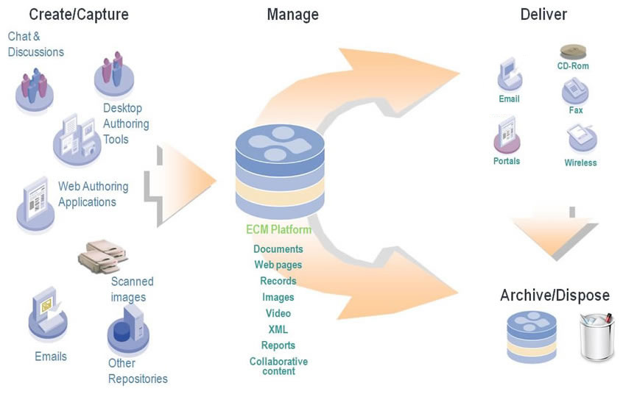

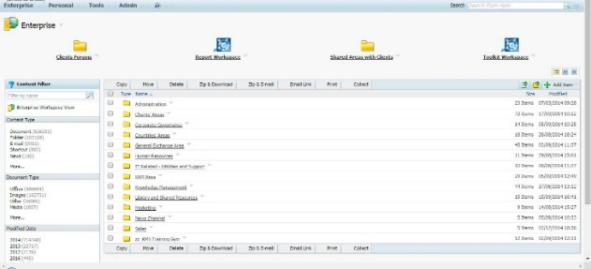
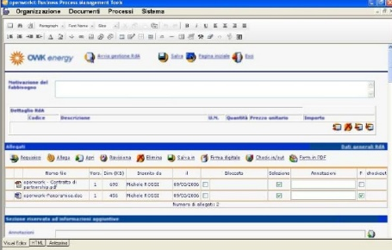
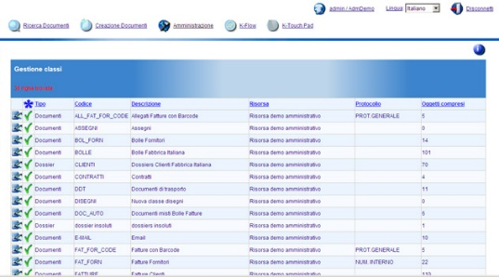
ECM - Enterprise Content Management
We Plus offers methods and tools that allow the management of the documentation produced and received within an organization, regardless of its format.
Document repository
Document repository
Document repository

Slide 7






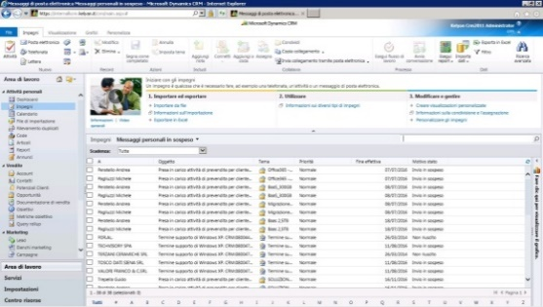
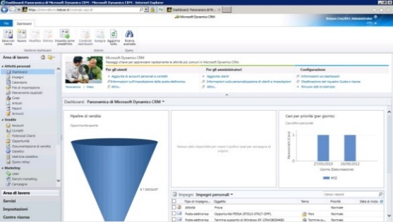
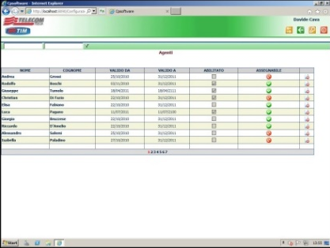
CRM - Customer Relationship Management
CRM makes business processes more efficient, increases customer loyalty, reduces operating costs, increases profits and thus increases and maintains competitive advantage.
to coordinate and automate the various activities, saving time, money, resources and limiting business interruptions.
It also allows to deeply know your clients, share information in all areas of the company, analyze the needs of the consumer and develop targeted strategies, to have an overview of costs,
CRM
CRM
CRM

Slide 8


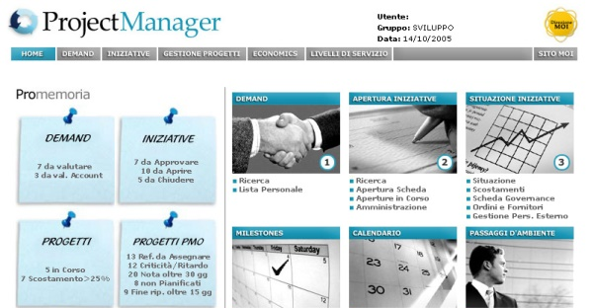
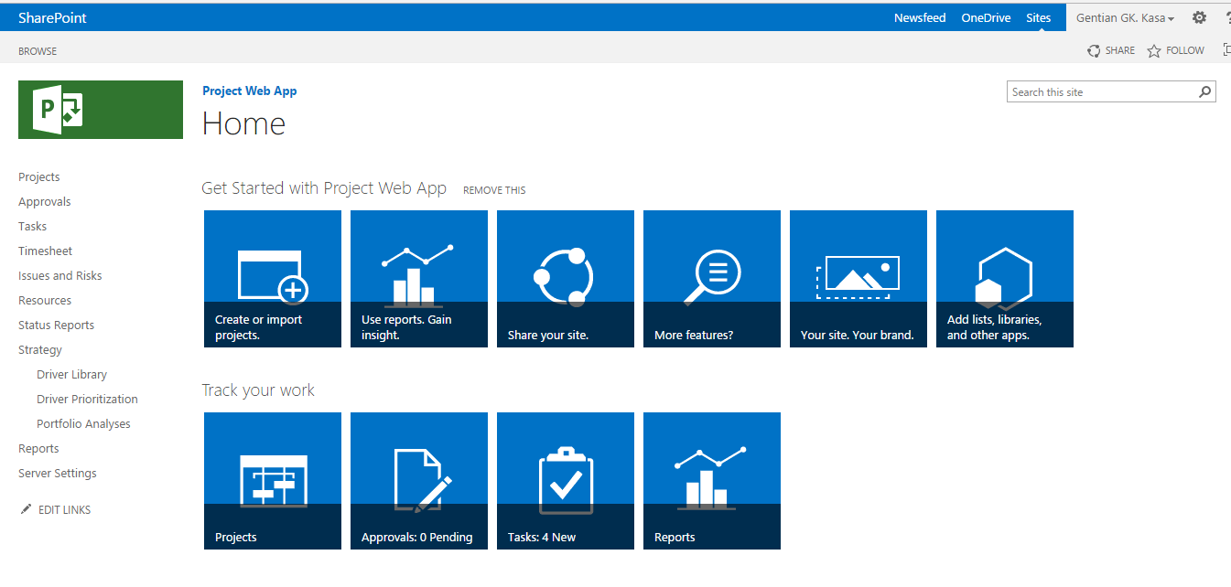
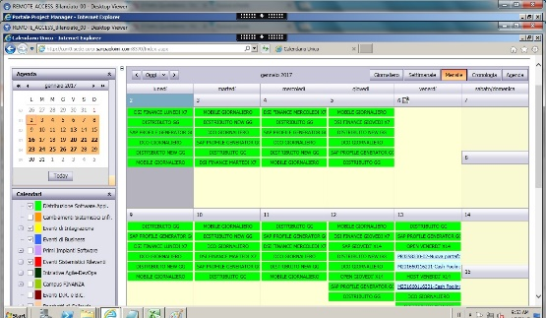
Governance
The need for companies to improve the ICT component has led to the development of process-oriented organizational structures.
Such structures need tools that allow the governance of these processes to equip themselves with an IT Governance - a set of rules and schemes that allow the optimal management of Information Technology systems.
We Plus has contributed to the realization of solutions aimed at the ICT administration in the main aspects that compose it.
VENDORS
Kpi
HUMAN
RESOURCES
Dashboard Monitoring
IT Governance
Economics
PLANNING
Project Manager- Direction of project
activities.
PMS project - Custom Project Server 2013
Supporting Program Management
Master Calendar for activities

Slide 9



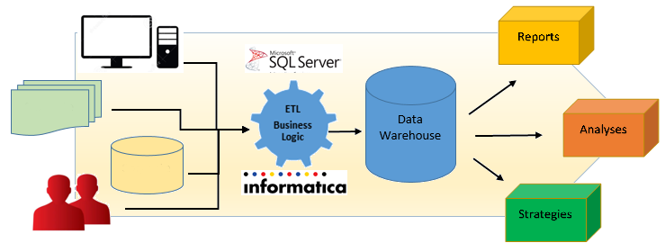


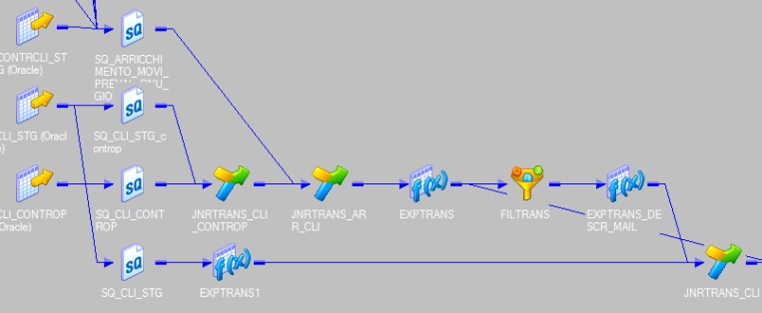
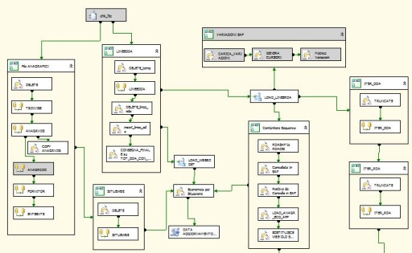
Data Integration
Companies competition is increasing the usability of the data held through unique views integrating and consolidating.
We Plus has contributed to the implementation of Data Integration solutions supporting the customer in the transformation of data into Information.
The ETL processing component is configured as a central element of application to the business data that the actions intend to pursue.
Bank flow management
Bank flow management

Slide 10
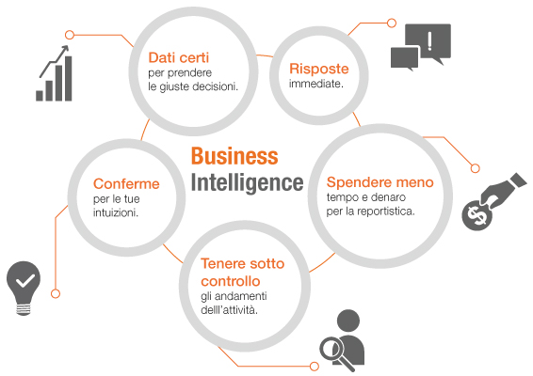


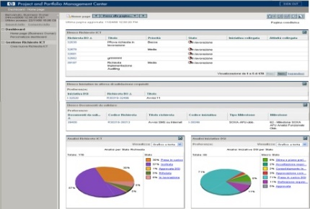
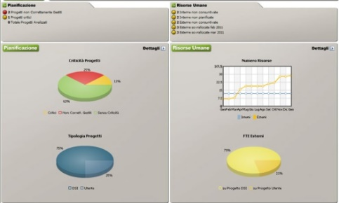
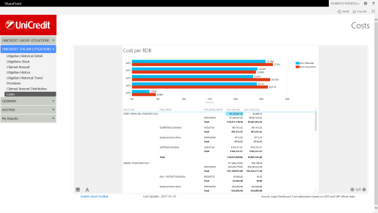
BI - Business Intelligence
BI alludes to a family of business control tools to analyse, process and transform data, share information and reports with your organization.
We Plus uses the information gathered through a business intelligence strategy to increase business performance, hypothesize future scenarios and increase its competitive advantage.
Transparency Portal - Initiative Request Management process from engagement phase to project closure
Directional Dashboard - Operative Dashboard for monitoring project activities
Dashboard

Slide 11
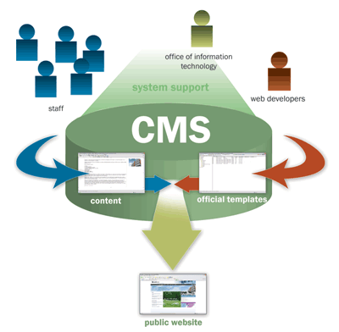



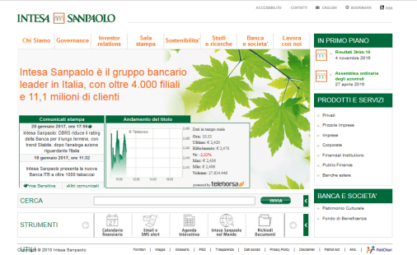
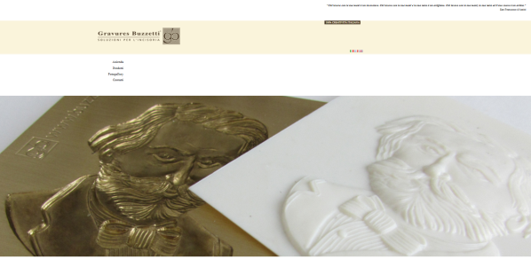
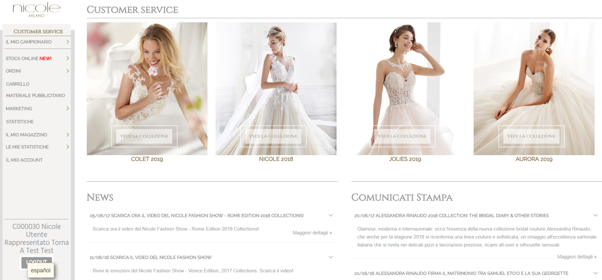
CMS - Content Management System
A Content Management System allows you to create the pages of a site keeping the graphic layout and contents separate, allowing the latter to be created and modified even by users who do not have a technical know-how.
The ten-years experience of We Plus has led us to use different CMS systems able to satisfy every need.
OneTwo CMS
Nicole Spose
Institutional website
Website
E-commerce B2B portal

Slide 12


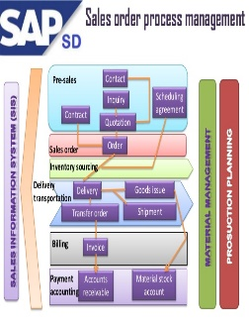

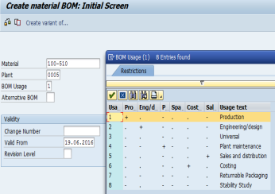

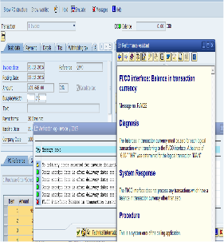
ERP (SAP) - Enterprise Resource Planning
ERP provides an integrated view of core business processes using common DBs maintained by a DBMS. ERP systems track business resources - cash, raw materials, production capacity, and the status of business commitments - orders, purchase, and payroll. The ERP applications share data across company’s departments – purchasing, manufacturing, accounting, sales, etc., facilitating information flow between all business functions and managing connections with stakeholders. ERP integrates organizational systems facilitating error-free transactions and production, thereby enhancing overall efficiency. ERP systems run on a variety of HW and network configurations, typically using a DB as an information repository.
Provided services - Implementation, Customization, remote Application Maintenance and Training for various modules: CO (Controlling), FI (Finance), MM (Material Management), WM (Warehouse Management), SD (Sales and Distribution), PP (Production Planning), HR (Human Resources).
SAP SD (Sales and Distribution)
SAP PP (Production Planning)
SAP FI-CO (Financial and Controlling)

Slide 13
















IT - Infrastructure Technologies and Services
Provision of services on cloud infrastructures to allow customers to focus their efforts on the business.
Extended virtualization of all IT resources (server, storage, applications). TCO reduction.
TCO – Total Cost of Ownership
Nov 7
PDL management via VDI: secure work area on any device, easy updating and cost reduction.
Dec 20
6 days
Today
PDL – Postazione di Lavoro (work terminal); VDI - Virtual Desktop Infrastructure
17 days
24 days
Automation process of releasing applications on heterogeneous infrastructures to reduce risks.
16 days
25 days
Provision of IT security services to guarantee end-to-end protection.
Implementation of data networks to provide fast and reliable access to information.

Slide 14









R&D - Research and Development
We Plus considers innovation, through R&D activities, a strategic lever for the company's business and its customers. The R&D's main objective is the development of innovative methodologies and new IT tools to support its customers in transforming data into useful "Information", and improving the competitiveness and efficiency of their production processes.
We Plus is present in the areas of collaborative research at European and regional/national level, participating in pre-competitive research projects and promoting the development of a network of contacts and partnerships on international level.
Web Services
Jade
Manufacturing
UAV/Services
Energy/Big Data
Open MES
Human-centred
Maintenance
"Open dynamic Manufacturing Operating System for Smart Plug-and-Produce Automation Components“ (FoF11 2015 - 680735)
"Balancing Human and Automation Levels for the Manufacturing Workplaces of the Future“ (FoF04 2016 - 723711)
"Prognostics based Reliability Analysis for Maintenance Scheduling“ (FOF09 2017 - 767287)
“Sensor fusion techniques of data acquired by UAVs during aircraft pre-flight inspection” (MANUNET III 2018 call)
“Big Data for OPen innovation Energy Marketplace” (DT-ICT11 2019 – 872525)

Slide 15

Thank you for your attention!
We Plus S.p.A.
Tel. 011 9063908
www.we-plus.eu
Main Headquarters
Strada Torino 43/95 (c/o Centro Uffici Europalace)
10043 Orbassano (TO), Italy
Milan branch
Via Magnasco, 7
20149 Milano (MI), Italy

