Slide 1

Move down a little bit for better centering and make the font a tiny bit larger.
REAL Leadership
+ REAL Culture
= REAL Results
Could we have the words look like this in white.

Slide 2

Leadership & Culture
Explore. Develop. Strengthen.
REAL Leadership
+ REAL Culture
= REAL Results

Slide 3
Move below Leadership & Culture.
Move above Explore. Develop. Strengthen. Make the font a tiny bit bigger.
REAL Leadership
+ REAL Culture
= REAL Results

Slide 4
Maybe a tiny bit smaller?
Move below Leadership & Culture.
Move above Explore. Develop. Strengthen. Make the font a tiny bit bigger. Just curious, should Leadership & Culture be a different color than green?
Can we reduce the green area a little bit? We really like the people in the background. Love the diversity.
Can the REAL Leadership be moved down a bit, then can it look something like this?
REAL Leadership
+ REAL Culture
= REAL Results
Remove the colon after booth. Should these be on one line?

Slide 5
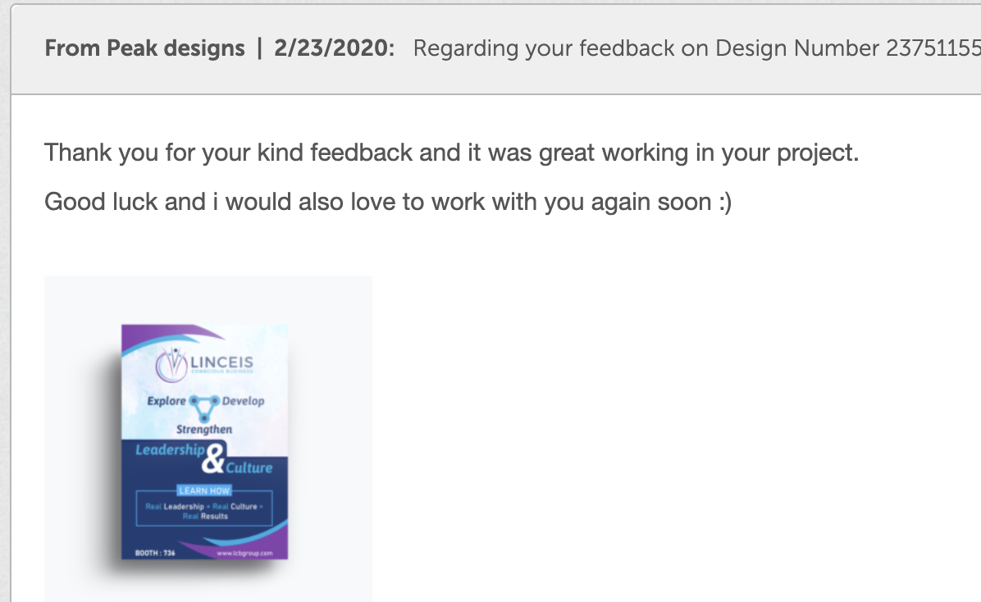


Slide 6



Slide 7



