Slide 1
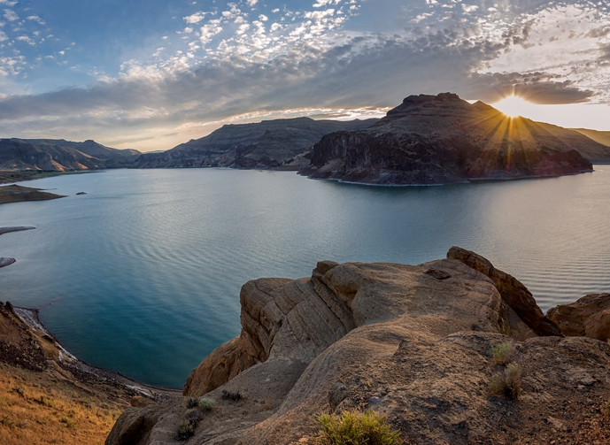
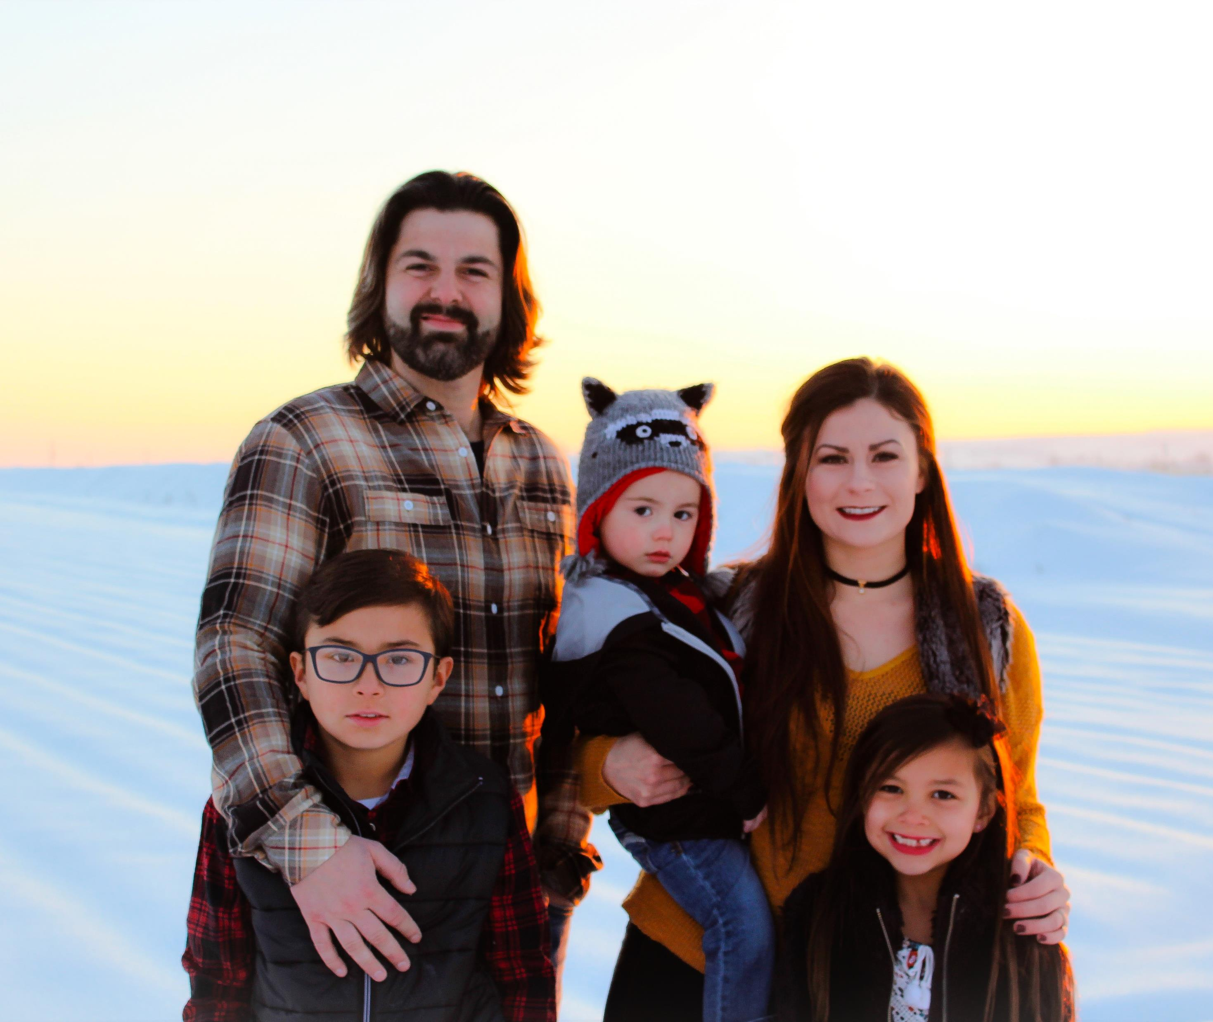
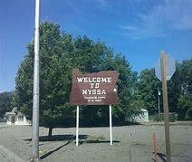
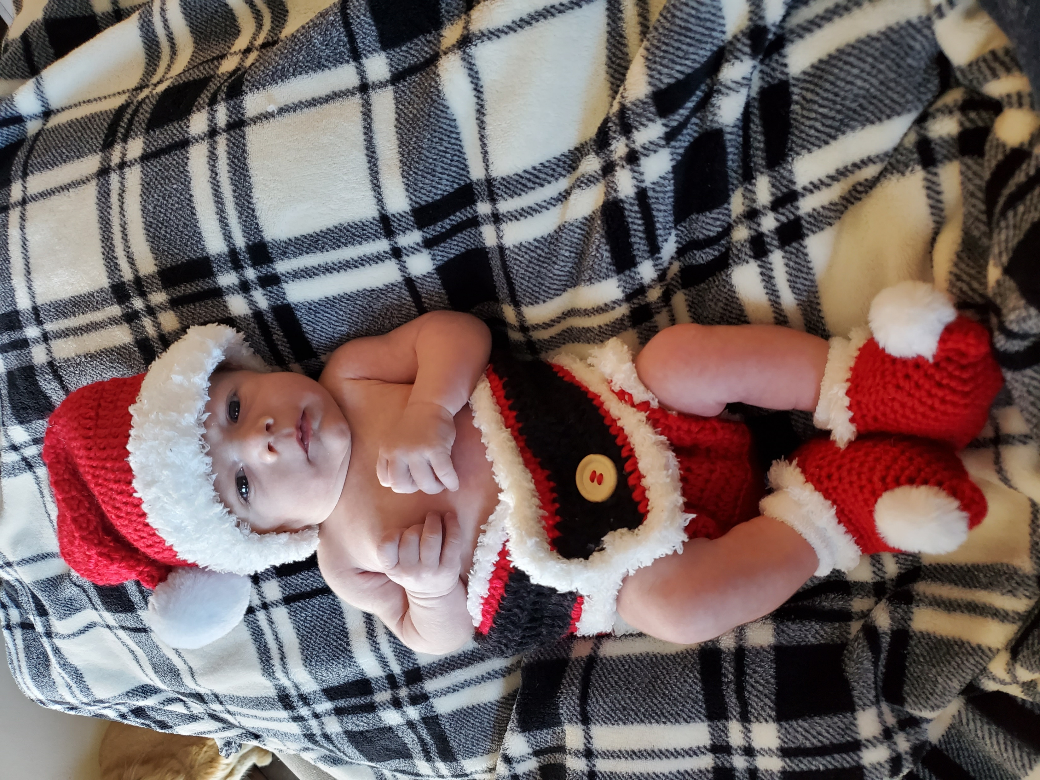

Owyhee T-S & The City of Nyssa
“Community In Action, Control, Transparent and Economic Development”

Slide 2
ethics is knowing the difference between what you have a right to do and what is right to do
COMPANY SUMMARY
Owyhee top shelf will be modeled after my father and grandfather business practices. One of our main goals will be to earn the community of Nyssa's trust through our actions. Community involvement, drug awareness, and becoming a member of the chamber would honor our company and being able to give back to a community that gave me a safe and amazing childhood.
pledge#1; ots cant stress this enough and remains committed to keeping cannabis 100% out of the hands of all youths.
Pledge#2; ots has no interest or would we ever try to change ones believes or core values and is not interested in making this a moral or ethical issue. Marijuana is a drug and it needs to be controlled and we feel that taking control and holding others accountable is the best way to handle this situation.

Slide 3
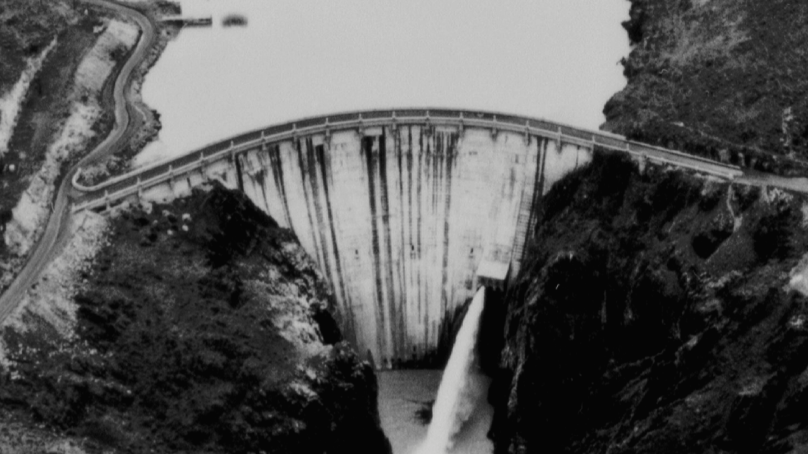
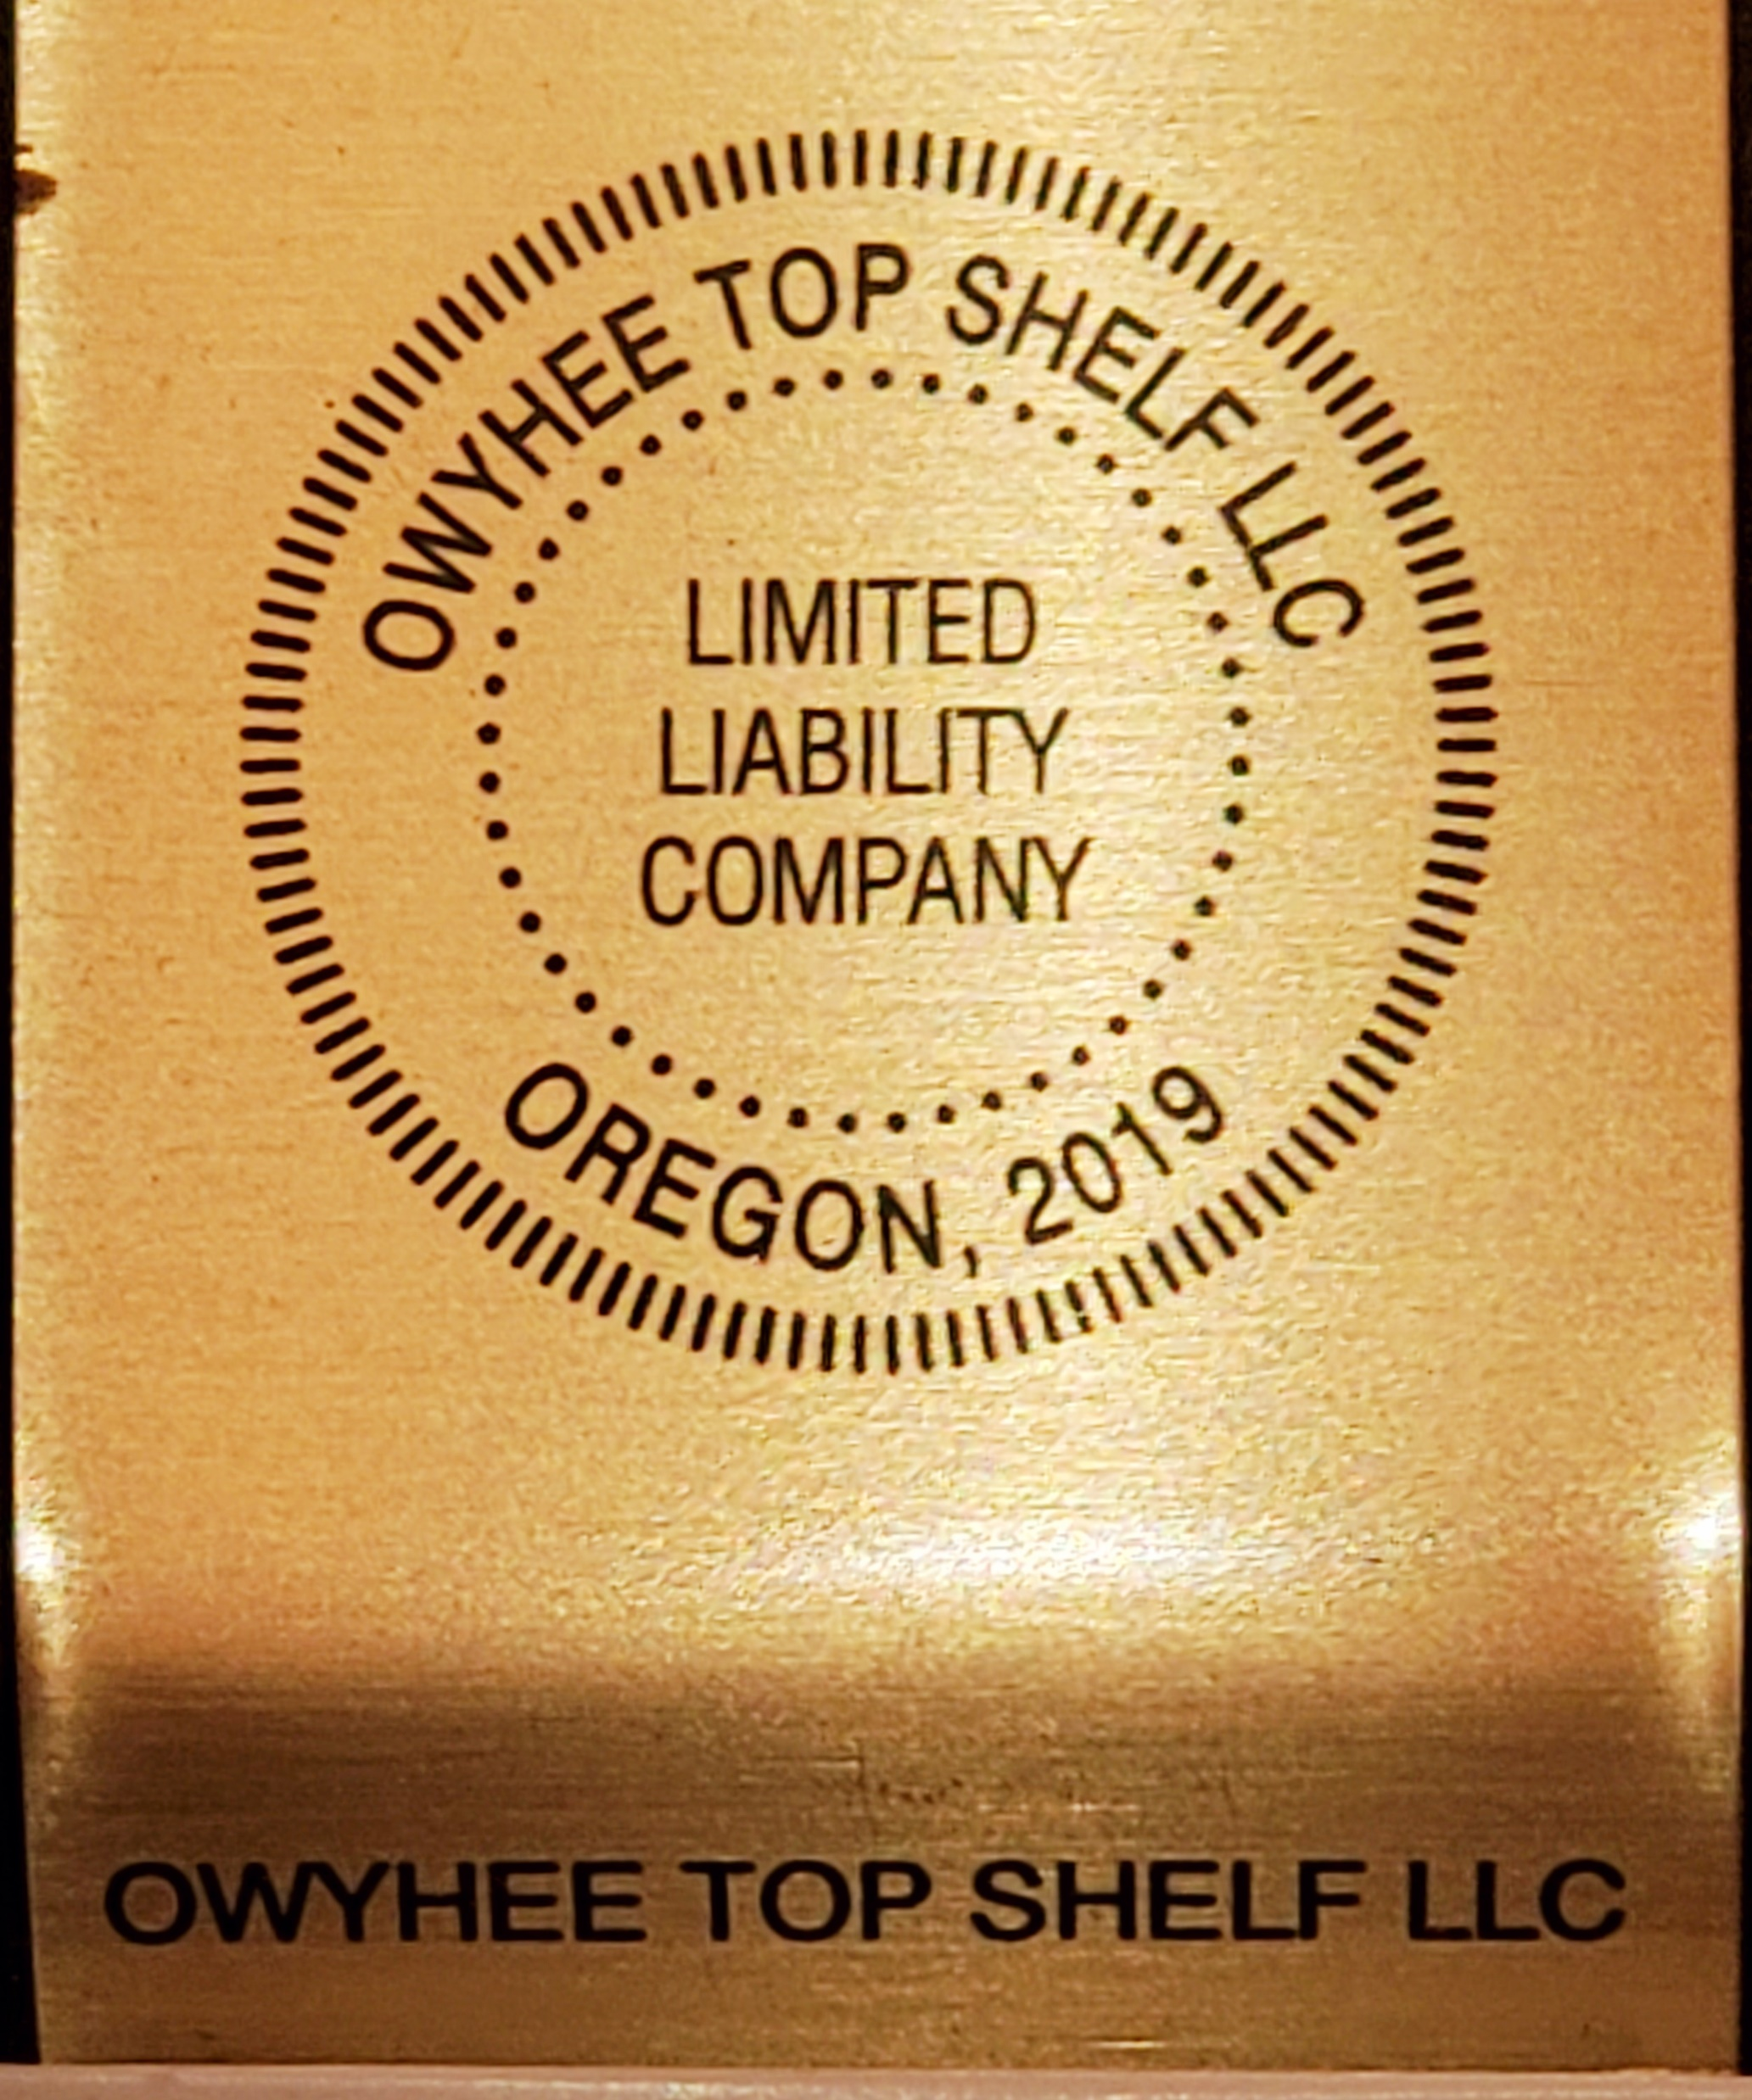
MISSION STATEMENT:
To create a name brand of the highest of quality, with an emphasis on medical applications that holds CONTROL and the strict regulations governed by the city of Nyssa and the OLCC. In doing this; we will bring economic development, growth, family waged jobs and several new tax benefits that can greatly increase the prosperity of Nyssa.

Slide 4
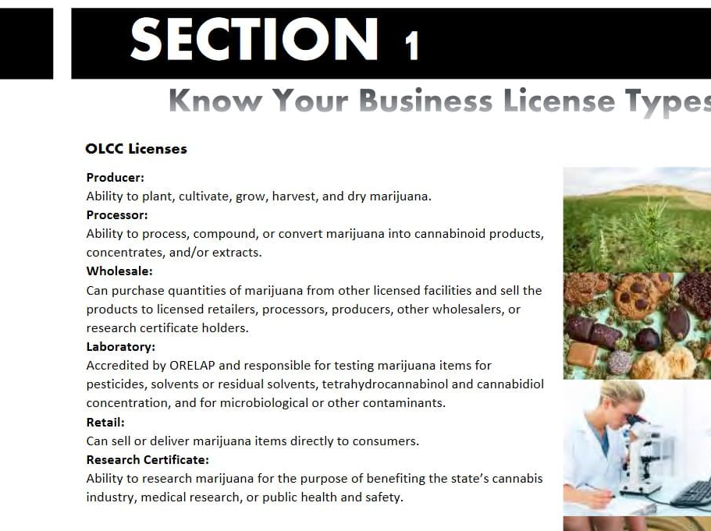
PRODUCTION
TRANSPARENT
FULL CONTROL OF ENVIRONMENT; SMELL AND OTHER NUISANCES
WHOLESALE
SENT OUT OF THE AREA FOR PROFESING INTO PRODUCTS THAT BENFIT THE MEDICAL APPLICATIONS
STRICTLY INDOOR:OUT OF SIGHT-OUT OF MIND
FULLY COMPLIANT W/OLCC &CITY OF NYSSA
MEDICAL APPLICATION
SECERITY
WHOLESALES OUT OF THE AREA TO KLEEP AWAY FROM OUR YOUTHS

Slide 5
TYPE OF LICENSSING:
  Production
WHOLSALE
SHIP, TEST AND WHOLESALE PRODUCT OUT OF THE AREA
PLEDGES TO NOT CREATE PROBLEMS FOR THE CITY OF NYSSA; NO EXTRA TRAFFIC OF ANY KIND
NO ADVERTISING
NEVER GLORIFYING TO OUR YOUTH
WHOLSALE OUT OF THE AREA TO GURANTEE PRODUCT GETS TURNED INTO PROCESSING AND MEDICAL APPLICATIONS
IN SUPPORT OF ABOLISHMENT OF THE BLACKMARKET
INDOOR TIER 1 OR TIER 2 MAX
OUT OF SIGHT OUT OF MIND
NOT INTERESTED IN OUTDOOD PRODUCTION
CONTAIN SMELL
STRONG SECURITY

Slide 6
BUSINESS ASSUMPTIONS & Goals
OPPORTUNITY, CREATING GROWTH AND PROSPERITY TO THE COMMUNITY OF NYSSA

Slide 7
GOALS
  Integral part of the community of Nyssa ( Like my grandfather and father before me ).
  Family waged jobs
  Full employee benefits
  Join Nyssa chamber of commerce
  Increase tax revenue ; City Sales tax & ots Community in action fund
  Generate and raise funds for swimming pool and other activites
  Organizing awareness, fundraisers for drug abuse, and other areas in which the community could use extra funding

Slide 8
Market review and tax benifit
At the request of the council; ( I will have a market analysis done on Nyssa with factual numbers and data of tax benefits that a recreational indoor production facility could create for the community ).
3% city sales tax
Conservative base point around $100,000 a month
Community action fund donating another 3%
Potential grand total of $6,ooo a month to Nyssa

Slide 9
Overview statement
Doing this on a professional manner while following all the state guidelines in which the Oregon Liquor control commission has set forth. Along with the city of Nyssa
Owyhee top shelf is Not asking for a retail license, as we feel this would an abrupt change to Nyssa with to much change to fast with increased traffic and a abundance of people. Pros and cons can be debated and discussed. It is of my opinion that some caution and restrain can still be and should be practiced when introducting the community to these new waters.
Willing to form a pac commitee to help eliminate the black market and create a positive impact on the community while never advertising or glorifying to our youth.

Slide 10

Thank you for giving me your time today, and letting me present the future of Nyssa to you my fellow community, and council members.
My internal gratitude and Deep thoughts w/ Tyler winn:
I know what the community and the council have had to endear in the past with the out of state cards, unwanted traffic, pressure on community/council along with the black-market and all the risks that alone brings to our youths. So, thank you for not grouping me with those individuals and allowing me to give this presentation in which will be taking a very different approach.

