Slide 1
C-Keg 10’ panel art
For 2020 CBC

Slide 2
Elements for trade show panel
Company Logo
Picture of device mounted on keg
Picture and basic description of certification icons
Basic features/benefits list

Slide 3

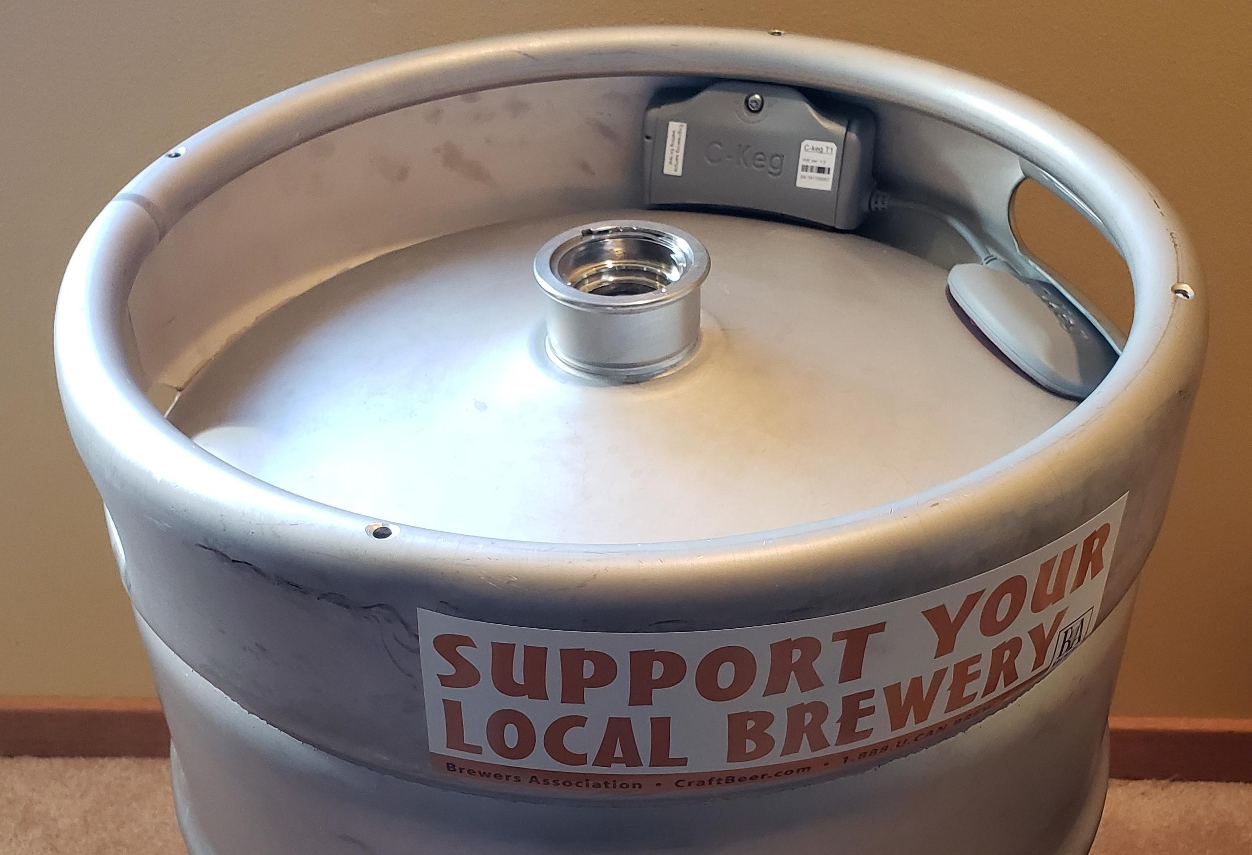

Slide 4
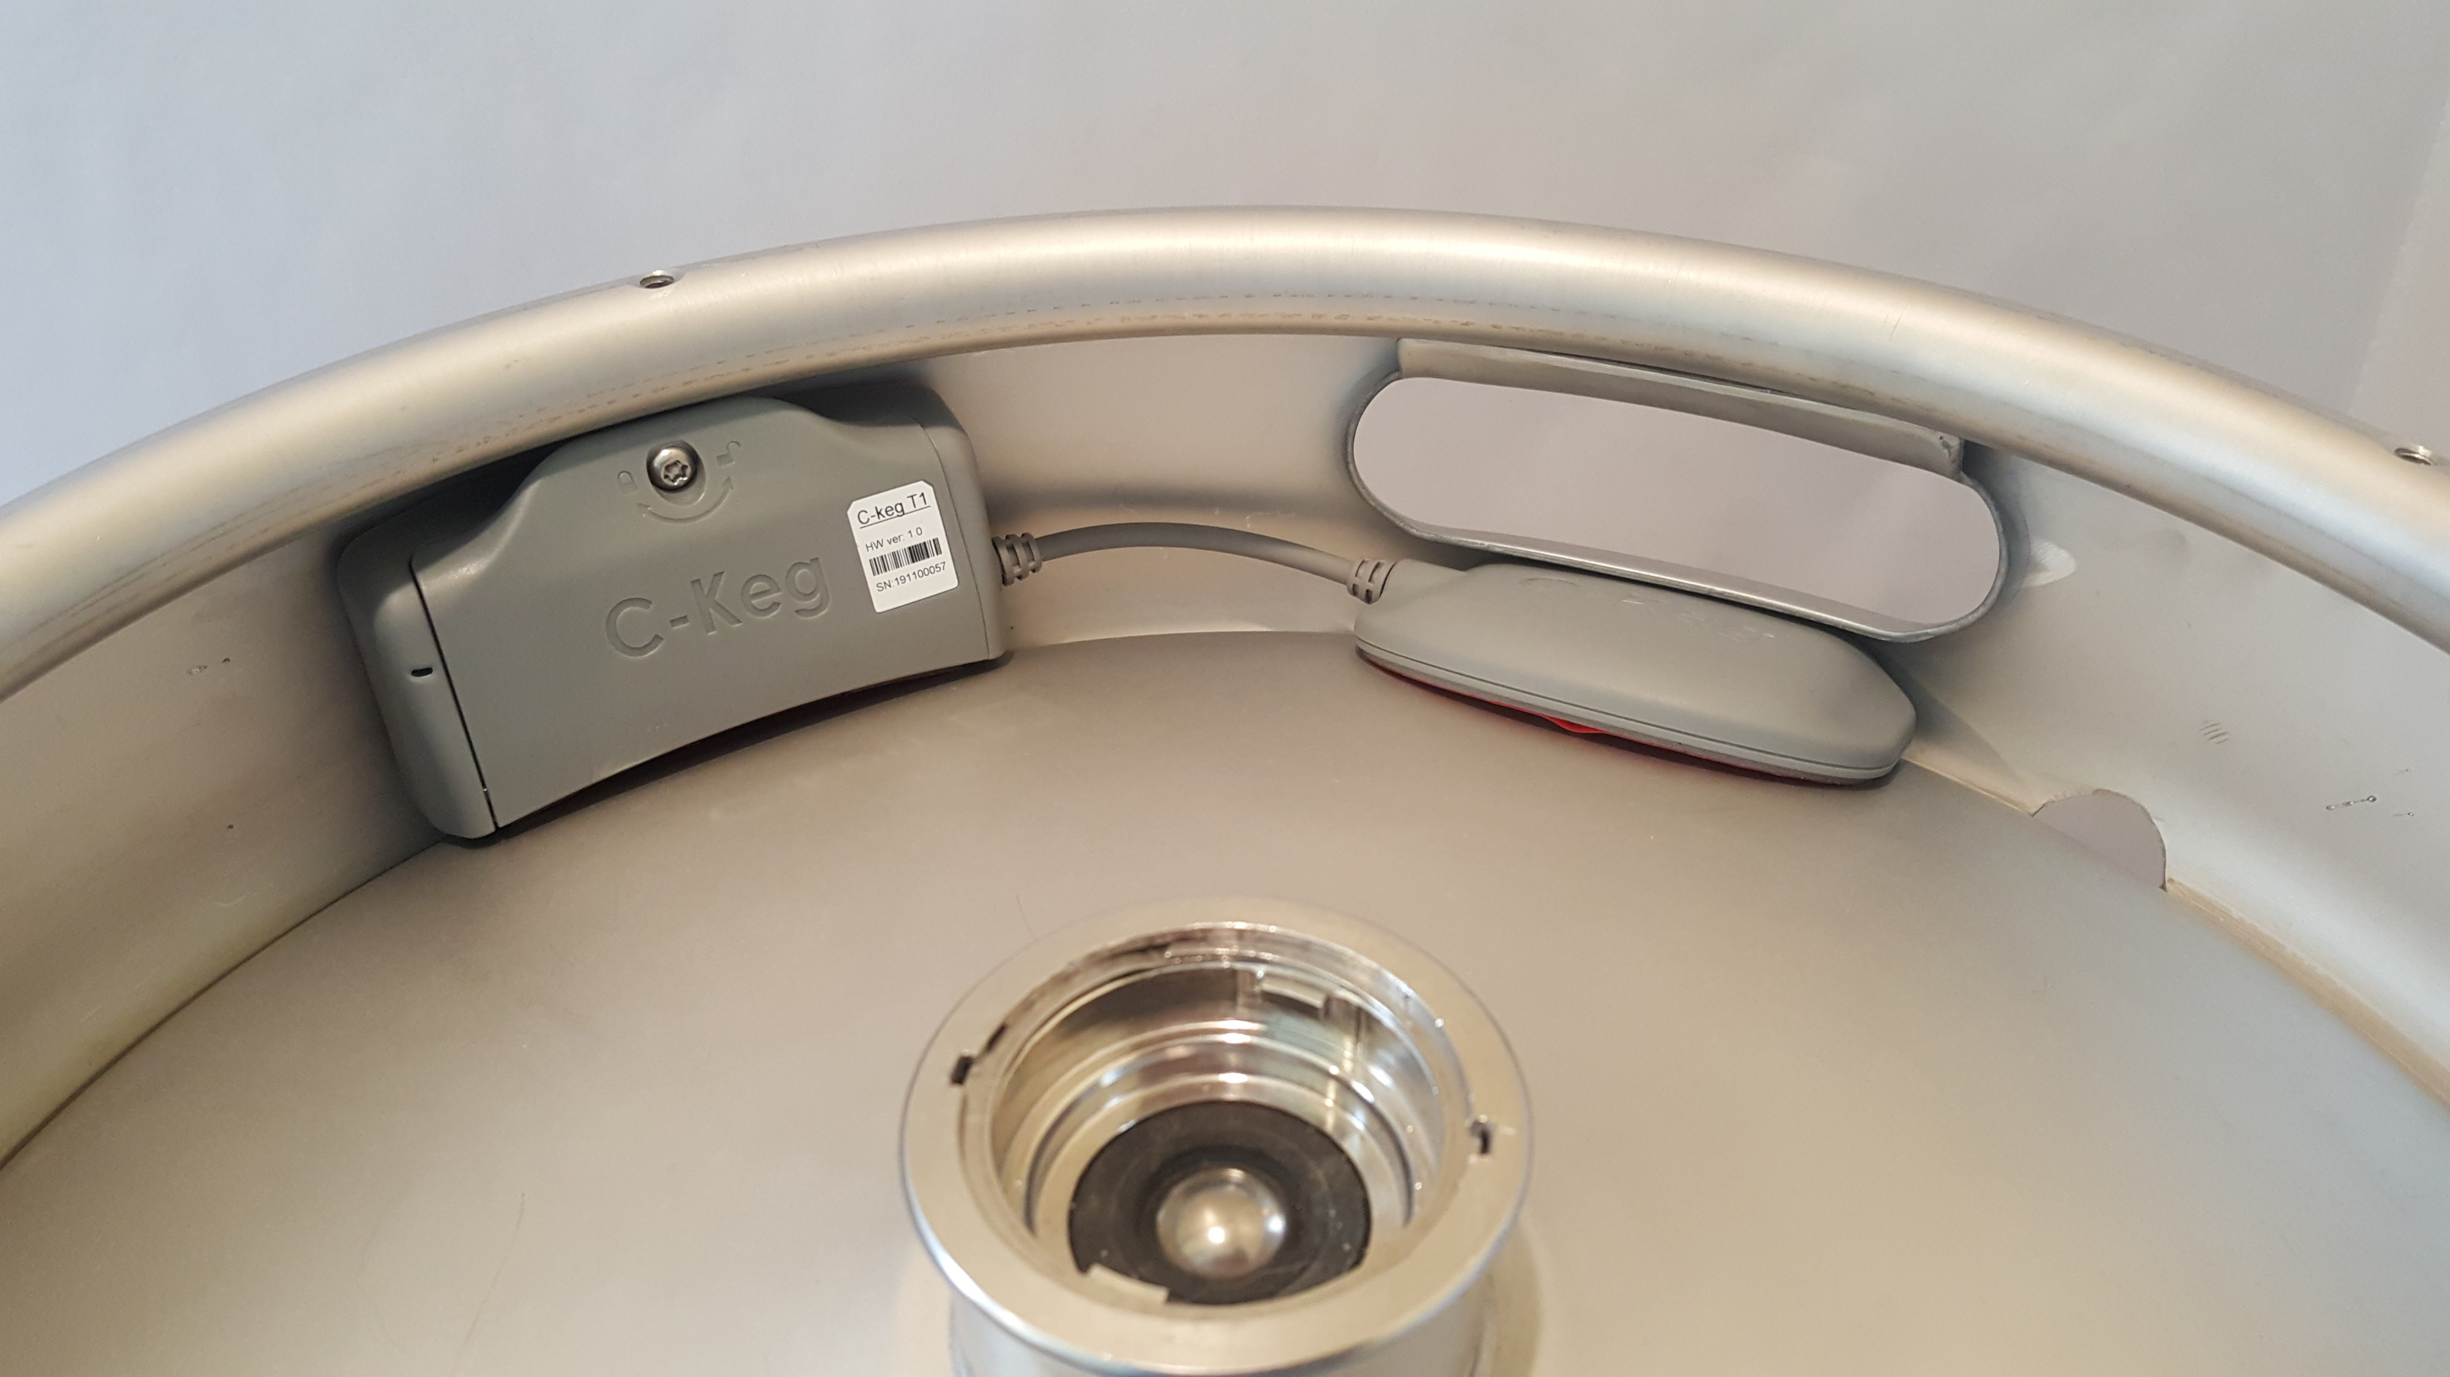

Slide 5
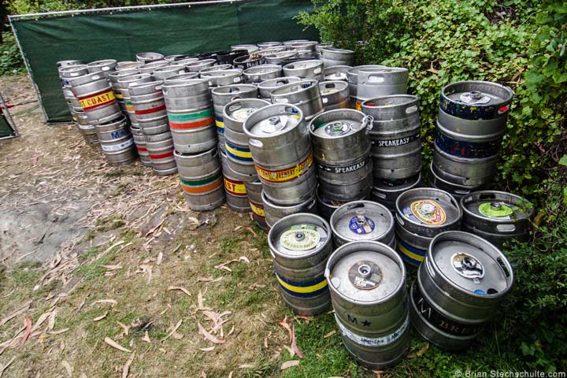

What is C-Keg ?
Asset Tracking+
Quality Control+
Consumer Awareness

Slide 6
Features
24/7 location and temperature monitoring
Automated alerts
IP 67 Ruggedized hardware
No software charges
Kegs and beer descriptions displayed on our public beer map
DIY Cloud management of devices

Slide 7




Icons = C-Keg certifications
Fresh
Certified Independent
Local
Cold Stored

