Slide 1
WELCOME
WELCOME
WELCOME

Slide 2

BECOMING A
CONSTRUCTION LEADER
WORTH FOLLOWING

Slide 3
BECOMING A
CONSTRUCTION LEADER
WORTH FOLLOWING

Slide 4
90-MINUTE
YOUR
INVESTMENT

Slide 5
Starting & Stopping
In light of what you’ve just heard, what are some things you need to either STOP or START doing?
Notes:
TARGET END TIME – 3:30

Slide 6
Leaders Worth Following
T H E L I F T E F F E C T
Size of your organization

Slide 7
Leaders Worth Following
T H E L I F T E F F E C T
Size of your organization
Your Leadership Skills

Slide 8
Leaders Worth Following
T H E L I F T E F F E C T
Size of your organization
Your Leadership Skills

Slide 9
Leaders Worth Following
T H E L I F T E F F E C T
Size of your organization
Your Leadership Skills

Slide 10
Leaders Worth Following
T H E L I F T E F F E C T
Your Leadership Skills
Size of an organization

Slide 11
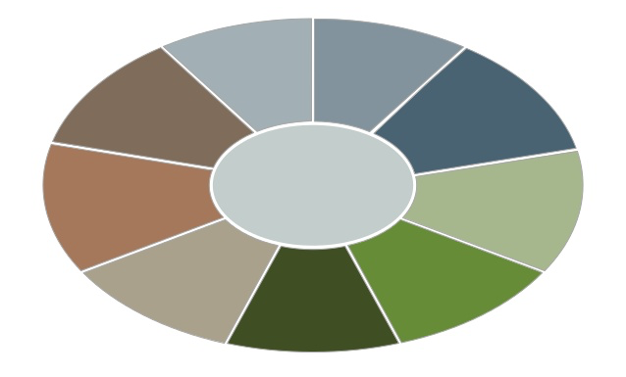
What To Mentor?

Slide 12
What To Mentor?
Employees just doing their job will not get them a pay raise or a promotion.
Doing their job.

Slide 13
What To Mentor?
Employees just doing their job will not get them a pay raise or a promotion.
How they do their job will.
Teamwork
Collaboration
No Whining
Driver
You doing your job.
Actively Engaged
No Rumors
Thinking Ahead
Low Stress
Appreciative

Slide 14
BECOMING A
CONSTRUCTION LEADER
WORTH FOLLOWING
The FOUR Disciplines
INCREASING YOUR CAPACITY
DRIVING THE RIGHT CULTURE
YOUR EMPLOYEES’ LEADERSHIP STYLE
BEING A TRUST DRIVER

Slide 15
BECOMING A
CONSTRUCTION LEADER
WORTH FOLLOWING
The Four Disciplines
1. INCREASING YOUR CAPACITY

Slide 16
Discipline: YOUR CAPACITY
  If you could increase your capacity, what should you use this additional time to do?

Slide 17
Discipline: YOUR CAPACITY
  Increasing your capacity provides you with
  additional time to:
  Be more strategic.
  Serve your boss.
  Serve your peers.
  Do your job.
  Serve EMPLOYEES.

Slide 18
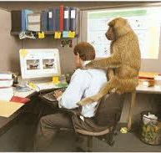
Discipline: YOUR CAPACITY
When your employees talk to you, what do they do?
Leave monkeys on your back?
Add monkeys to your back?
Take monkeys off your back?

Slide 19
Discipline: YOUR CAPACITY
When your employees talk to you, what do they do?
Leave monkeys on your back?
Add monkeys to your back?
Take monkeys off your back?
Their Goal

Slide 20
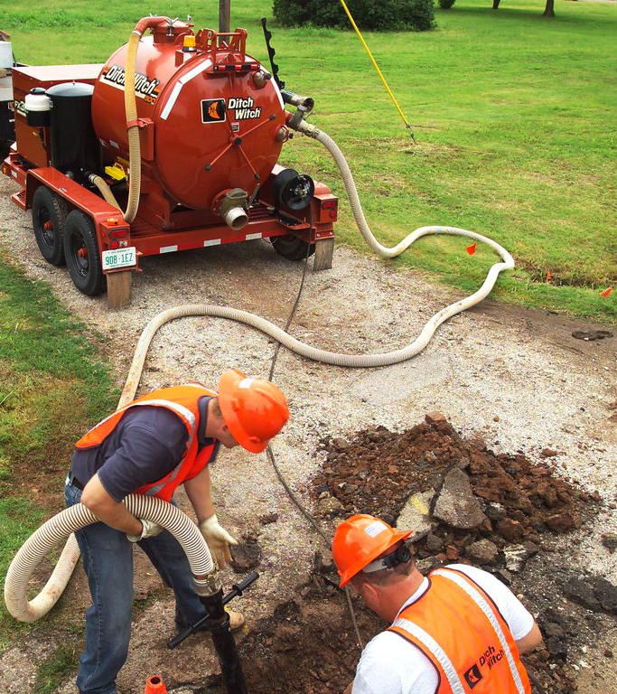
Discipline: YOUR CAPACITY
THE WRENCH

Slide 21
Discipline: YOUR CAPACITY
Think Ahead of your boss.
What are some examples of how you can “think ahead of your boss”?

Slide 22
Discipline: YOUR CAPACITY
Think Ahead of your boss.
What are some examples of how you can “think ahead of your boss”?
“WOW” occurs in the details!

Slide 23
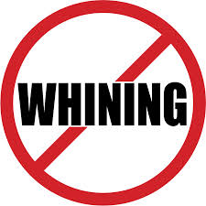
Discipline: YOUR CAPACITY

Slide 24
Discipline: YOUR CAPACITY
How does your boss absorb information?

Slide 25
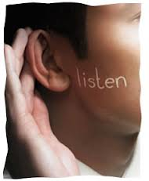
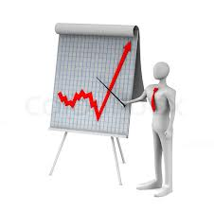
Discipline: YOUR CAPACITY
How does your boss absorb information?
VERSUS
Auditory Learner?
Visual Learner?

Slide 26
EMPLOYEES
Increasing your CAPACITY?
Knowing how to provide
“Management Ready”
information creates additional capacity.

Slide 27
WHAT IS MANAGEMENT READY?
YES OR NO? Will you be able to answer “yes” or “no” to their request?
Or, do you have to ask a lot more questions and/or need more information?

Slide 28
10 ways to make sure your employees’ ideas and requests are:
Management Ready

Slide 29
Management Ready
1. Cost?
Will their request cost money?
If so, they should know if it fits within the budget.
If not, can they justify going over budget, or can they suggest other things within the budget we can scaled back or eliminate in order to offset the cost?

Slide 30
Management Ready
2. Other Departments?
What other departments or people will be affected by this request?
Have they been informed?
Or, better yet, have they pulled them into the brainstorming process so that they can add value to the request?

Slide 31
Management Ready
3. Timing?
Is the timing of their request right?
Are there too many things already going on that are utilizing the organizations resources?
What is the best timing for this request?

Slide 32
Management Ready
4. Others?
Are there people outside of the organization that this will affect?
Customers? Vendors? Shareholders? Community?
If so, in what way?

Slide 33
Management Ready
5. Risk?
Is there risk involved in this request?
If so, what strategies do they have to mitigate the risk?

Slide 34
Management Ready
6. Impact?
What is the financial and business impact of this request?
Will it increase revenues?
Will it decrease expenses?
What is the impact on our customers?
How will we measure its success?

Slide 35
Management Ready
7. Ownership?
Who will be in charge of making this happen?
If the request is for something that will have a “life” to it, who will manage it going forward?

Slide 36
Management Ready
8. Framed Well?
Is this proposal in a format that has been simplified versus over-complicated?
Have you made it obvious that you have considered all aspects and that this request is truly “management ready”?

Slide 37
Management Ready
9. Stategic Fit?
Does this idea fit within our organization’s vision and strategy?
Does it help us achieve our current goals?

Slide 38
Management Ready
10. Anything Else?
If they were you, what other questions need to be answered in order for you to be able to say “yes” or “no” to this request?

Slide 39

OPEN DOOR POLICY

Slide 40
Discipline: YOUR CAPACITY
Throughout the day…

Slide 41
Discipline: YOUR CAPACITY
Throughout the day…
Keep a list of “boss topics”.
Make an appointment.
Be “Management Ready”.
Be succinct.

Slide 42
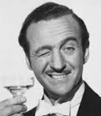
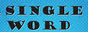




The 6 ways to communicate
Velocity
Capacity
A Look
A Word
A Sentence
A Paragraph
A Chapter
A Book

Slide 43
MENTOR employees to use these words…

Slide 44
I’ve Got It!

Slide 45
Starting & Stopping
In light of what you’ve just heard about CAPACITY, what are some things you need to either STOP or START doing to mentor your team?
Notes:
TARGET END TIME – 3:30

Slide 46
BECOMING A
CONSTRUCTION LEADER
WORTH FOLLOWING
The FOUR Disciplines
2. DRIVING THE RIGHT CULTURE

Slide 47
BECOMING A
CONSTRUCTION LEADER
WORTH FOLLOWING
The FOUR Disciplines
2. DRIVING THE RIGHT CULTURE
WHAT’S YOUR EMPLOYEES ROLE?

Slide 48
DRIVING THE
RIGHT CULTURE
Their role is to be a culture “driver” not a “passenger”.

Slide 49
DRIVING THE
RIGHT CULTURE
Their role is to be a culture “driver” not a “passenger”.
"Owner versus Renter”

Slide 50
RESEARCH:
25%: Actively Engaged
50%: Riding Along
25%: Actively Disengaged
Notes:
THE CHALLENGE OF MOTIVATION 3.0:
HOW TO GENERATE INTRINSIC MOTIVATION

Slide 51
What are the traits for each of the following?
Actively Engaged
Riding Along
Actively Disengaged
Notes:
THE CHALLENGE OF MOTIVATION 3.0:
HOW TO GENERATE INTRINSIC MOTIVATION

Slide 52

HIGH EFFORT
MOTIVATION MATRIX
LOW AGREEMENT
HIGH AGREEMENT
LOW EFFORT

Slide 53
HIGH EFFORT
BUY-IN
HIGHLY ENGAGED
MOTIVATION MATRIX
LOW AGREEMENT
HIGH AGREEMENT
LOW EFFORT

Slide 54
HIGH EFFORT
BUY-IN
HIGHLY ENGAGED
MOTIVATION MATRIX
LOW AGREEMENT
HIGH AGREEMENT
RESENTMENT
HIGHLY DISENGAGED
LOW EFFORT

Slide 55
HIGH EFFORT
CONCESSION
BUY-IN
RIDING ALONG
HIGHLY ENGAGED
MOTIVATION MATRIX
LOW AGREEMENT
HIGH AGREEMENT
RESENTMENT
HIGHLY DISENGAGED
LOW EFFORT

Slide 56
HIGH EFFORT
CONCESSION
BUY-IN
RIDING ALONG
HIGHLY ENGAGED
MOTIVATION MATRIX
LOW AGREEMENT
HIGH AGREEMENT
RESENTMENT
EXEMPT
HIGHLY DISENGAGED
RIDING ALONG
LOW EFFORT

Slide 57
How can your employees
HELP PEOPLE
BECOME HIGHLY ENGAGED?

Slide 58
Being Actively Engaged requires two things:
EXTRINSIC MOTIVATION:
External Encouragement.
INTRINSIC MOTIVATION:
Internally motivated.
Notes:
THE CHALLENGE OF MOTIVATION 3.0:
HOW TO GENERATE INTRINSIC MOTIVATION

Slide 59
What motivates us?
Results
Above
And
Beyond
Intrinsic Motivation
Minimal
Acceptable
Level
Extrinsic Motivation

Slide 60
External Encouragement
Notes:
THE CHALLENGE OF MOTIVATION 3.0:
HOW TO GENERATE INTRINSIC MOTIVATION

Slide 61
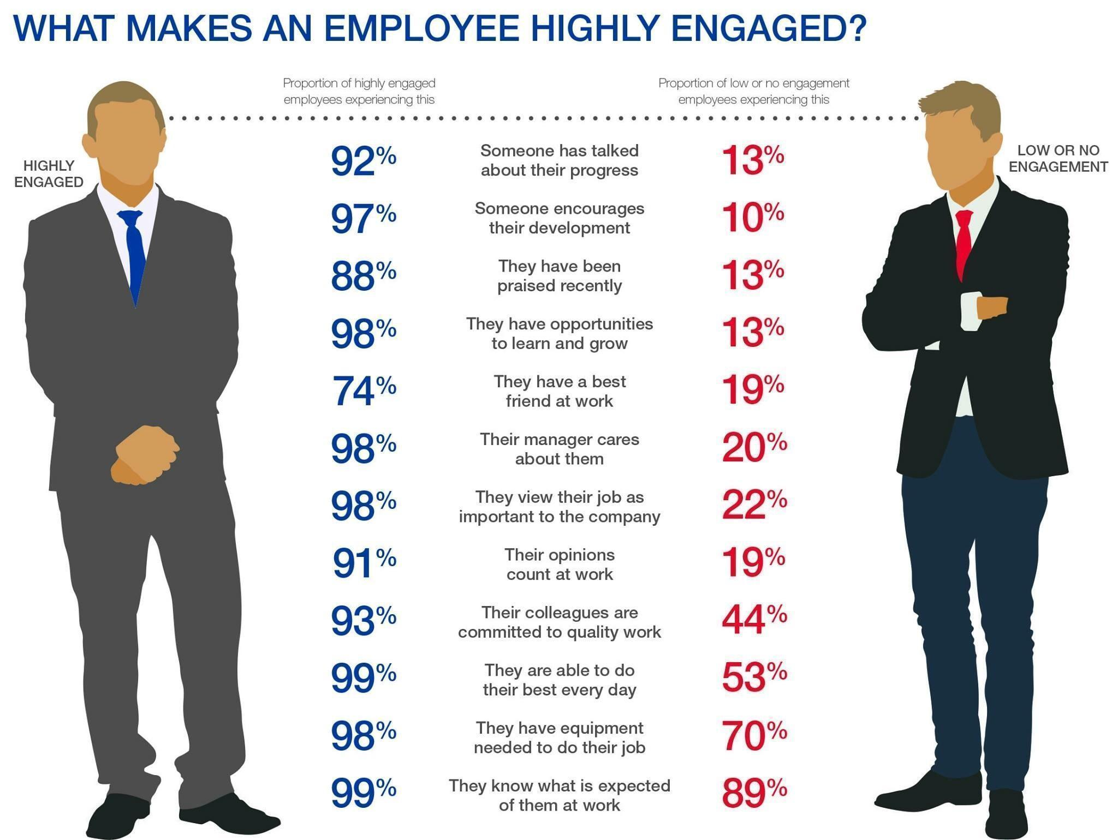
How can you help fellow employees be highly engaged?

Slide 62
How can you help fellow employees be highly engaged?

Slide 63
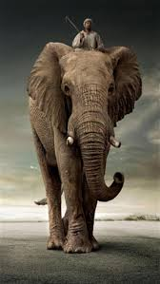
INTRINSIC MOTIVATION
Intrinsic motivation is like an elephant.

Slide 64
The Magic Circle
WHAT
HOW
TRADITIONAL
REMARKABLE
WHY
“Magic Circle” concept courtesy of Simon Senek

Slide 65
BECOMING A
CONSTRUCTION LEADER
WORTH FOLLOWING
DRIVING THE
RIGHT CULTURE

Slide 66

Mentoring your CULTURE
Culture is set by the behaviors that are tolerated.

Slide 67
Starting & Stopping
In light of what you’ve just heard about CULTURE, what are some things you need to either STOP or START doing as a leaer?
Notes:
TARGET END TIME – 3:30

Slide 68
BECOMING A
CONSTRUCTION LEADER
WORTH FOLLOWING
The FOUR Disciplines
3. YOUR EMPLOYEES’ LEADERSHIP STYLE

Slide 69
BECOMING A
CONSTRUCTION LEADER
WORTH FOLLOWING
The FOUR Disciplines
3. YOUR EMPLOYEES’ LEADERSHIP STYLE
WHAT SHOULD IT BE?

Slide 70
Push vs Pull
Push Mindset:
- I’ve worked hard.
- I’ve been here a long time.
- I want that job.
- I deserve that.
- The company owes me that.
- When will I get my next promotion?
- When will I get my next pay raise??
Pull Mindset
- Be a good soldier.
- Don’t ask for an opportunity, be the opportunity.

Slide 71
Leadership Fatigue

Slide 72
What are your employees’
Fatigue Quotients?
EFQ:
Employee Fatigue Quotient

Slide 73
Employees that CREATE FATIGUE, have a HIGH EFQ, and have the following attributes:
Inability to make decisions
Lack of confidence
Negative
An abundance of venting their feelings
Lack of maturity and professionalism
More of a passenger mindset versus driver mindset
Need input on small stuff
High Maintenance
Constantly need high praise for normal stuff
Low Initiative
Never offer solutions
Underlying negativity
Complain a lot
Actively work to do the bare minimum
Hard time prioritizing
Require hovering
More mistakes
Over think things
Don’t meet deadlines
Not punctual
High drama
Bad body language
Highly stressed
Push back on everything
Don’t trust other’s work
Entitlement attitude
----------------------

Slide 74
Employees that ENERGIZE OTHERS, have a Low EFQ, have the following attributes:
Enough competence to take calculated risks
Solutions focused
Problem solver
Own their job
Hold themselves accountable
Calming
Humble
Hard working
Work at being “in-synch” with their manager.
Positive.
Culture driver versus passenger.
Think ahead of their manager.
Take monkeys off their manager’s back.
Can put things into perspective.
Can be trusted with confidential information.

Slide 75
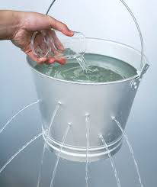
YOUR FATIGUE
& Re-Charging
THE HOLES:
How do you help you plug your holes.
REPLENISH:
What do you do to re-charge?

Slide 76
MENTORING
YOUR
EMPLOYEES
RESULTS

Slide 77
YOUR LEADERSHIP STYLE

Slide 78
YOUR LEADERSHIP STYLE
RESULTS

Slide 79
YOUR LEADERSHIP STYLE
PEOPLE
RESULTS

Slide 80
YOUR LEADERSHIP STYLE
PEOPLE & RESULTS

Slide 81

YOUR EMPLOYEES LEADERSHIP STYLE
WISE OR FOOLISH?
Dr. Henry Cloud
Notes:
TARGET START – 10:45

Slide 82
WHAT’S YOUR WAKE?
STRESS OR CALM?

Slide 83
STRESS VS CALM
40%

Slide 84
YOUR WAKE?
STRESS VS CALM
STRESS OR CALM?

Slide 85
YOUR WAKE?
STRESS VS CALM
CALM IS CONTAGIOUS

Slide 86
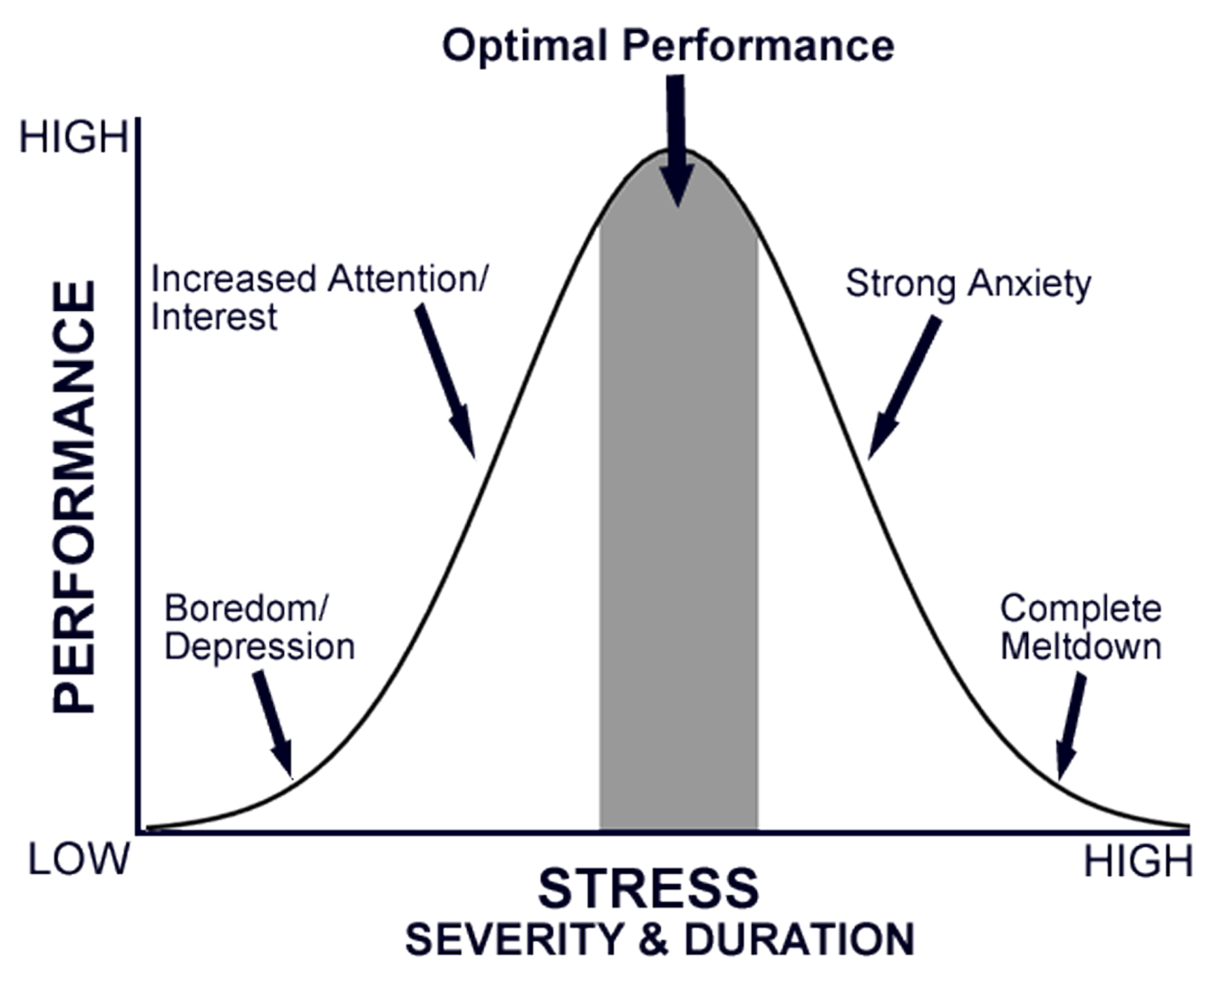
Stress zone versus Energy Zone
Energy Zone
Stress Zone
Stress Zone

Slide 87
The Skill of Reducing Stress
David’s 5-Step Skill of De-stressing:
Recognition that it’s self-inflicted.
Re-frame it.
Catch it early – don’t let concern turn into worry. Take action.
Turn stress into energy.
Serve someone other than yourself.

Slide 88
Critical Conversations
Hurting vs Harming

Slide 89

Critical Conversations

Slide 90


Critical Conversations

Slide 91


Critical Conversations

Slide 92





Critical Conversations

Slide 93

Critical Conversations

Slide 94
Critical Conversations

Slide 95

Critical Conversations

Slide 96
Critical Conversations

Slide 97
Critical Conversations

Slide 98
Critical Conversations
The higher up you go to get a solution…

Slide 99
Critical Conversations
The less likely you are to achieve a win/win solution.
The higher up you go to get a solution…

Slide 100
Your Critical/Coaching Conversations

Slide 101
Your Critical/Coaching Conversations
TRANSACTIONAL Coaching
versus
PROJECTION Coaching

Slide 102
Your Critical/Coaching Conversations
TRANSACTIONAL Coaching

Slide 103
Your Critical/Coaching Conversations
PROJECTION Coaching
What are your goals?
Do you think this behavior will get you there?
Let’s work on improving that.

Slide 104
MULTI-TASKING
REAL OR NOT?
Notes:
TARGET START – 10:45

Slide 105
Helping yourself and your boss
to be a great single-tasker.
Notes:
TARGET START – 10:45

Slide 106
5 ZONES
  5
  4
  3
  2
  1
Page 17 in your
notebook

Slide 107
5 ZONES
  5 DEEP DIVE
  4 MULTI-TASK
  3 SOCIAL
  2 FAMILY
  1 REFRESH AND REPLENISH
Page 17 in your
notebook

Slide 108
Starting & Stopping
In light of what you’ve just heard about YOUR LEADERSHIP STYLE, what are some things you need to either STOP or START doing?
Notes:
TARGET END TIME – 3:30

Slide 109
The FOUR Disciplines
4. BEING A TRUST DRIVER

Slide 110
The FOUR Disciplines
4. BEING A TRUST DRIVER
WHY IS IT IMPORTANT?

Slide 111
Discipline: TRUST
LEARN THE POWER OF BLIND TRUST
WHAT I KNOW
WHAT I HEARD

Slide 112
Discipline: TRUST
LEARN THE POWER OF BLIND TRUST
MISSING KNOWLEDGE
WHAT I KNOW
WHAT I HEARD

Slide 113
Discipline: TRUST
LEARN THE POWER OF BLIND TRUST
BLIND
TRUST
WHAT I KNOW
WHAT I HEARD

Slide 114

Discipline: TRUST
Transparency is a key indicator of trust.

Slide 115
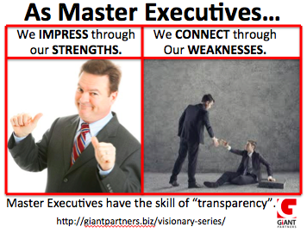
Discipline: TRUST
We impress through our strengths.

Slide 116
Discipline: TRUST
We impress through our strengths.
We connect through our weaknesses

Slide 117
Building Lifelong Trust
RELATIONSHIPS:
Authentic
vs.
Transactional

Slide 118
Building Trust

Slide 119


Building Trust

Slide 120
Building Trust
BEHAVIOR
CHANGE
THE TRUST WALL

Slide 121
Building Trust
TRUST
BEHAVIOR
CHANGE
THE TRUST WALL

Slide 122
Building Trust
TRUST
BEHAVIOR
CHANGE
THE TRUST WALL

Slide 123
Building Trust
TRUST
BEHAVIOR
CHANGE
THE TRUST WALL

Slide 124
Building Trust
TRUST
BEHAVIOR
CHANGE
CHARACTER
COMPETENCE
CONSISTENCY
THE TRUST WALL

Slide 125
Building Trust
TRUST
BEHAVIOR
CHANGE
CHARACTER
COMPETENCE
CONSISTENCY
THE TRUST WALL

Slide 126
CONSTRUCTION LEADER
WORTH FOLLOWING
The FOUR Disciplines
INCREASING YOUR CAPACITY
DRIVING THE RIGHT CULTURE
YOUR EMPLOYEES’ LEADERSHIP STYLE
BEING A TRUST DRIVER

Slide 127
CONSTRUCTION LEADER
WORTH FOLLOWING
THE GOAL

Slide 128
The Accountability Index
THE GOAL OF YOUR MENTORING
  Level 1 – Waiter Do exactly what I’ve asked you to do.
  Level 2 – Researcher Research the topic and report back.
  Level 3 – Recommender Research the topic, outline the options and make a recommendation.
  Level 4 – Decider Make a decision and then tell me what you did.
  Level 5 – Owner Make whatever decision you think is best.

