Slide 1

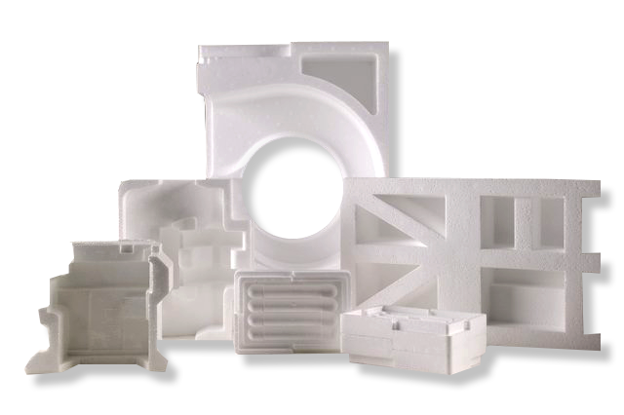
EPS Life Cycle – Global Warming
EPS has a very low global warming impact compared to other packaging materials. The carbon footprint for manufacturing 1 ton of EPS is the equivalent of driving your car 31 miles.
1 km
115.5 kg CO2
50 km
5,775 kg C02
100 km
11,550 kg CO2
Driving Distance
1 ton of EPS
5,360 kg CO2
https://co2.myclimate.org/en/car_calculators

Slide 2

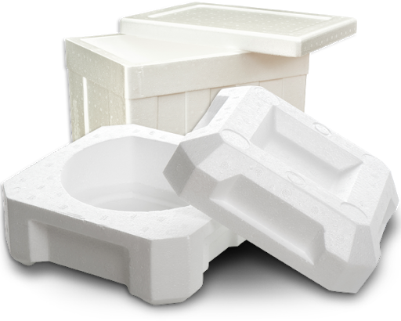
Life Cycle – Non-Renewable Energy Use
100 Watt
EPS energy consumption for the manufacture of 1 ton of packaging material is equivalent to 300 hours of light for a single lightbulb.
One 100 watt lightbulb = 360 MJ
1 ton of EPS = 108,000 MJ
https://www.energy.gov/articles/how-much-do-you-consume

Slide 3
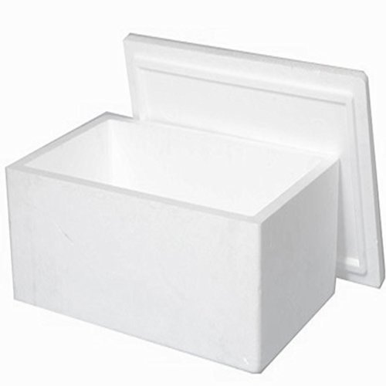
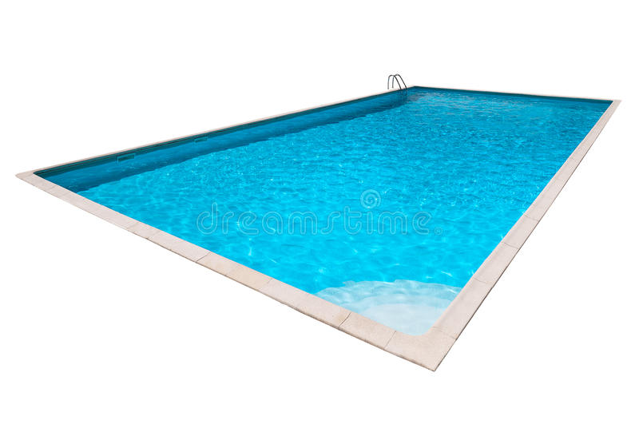

Life Cycle – Water Consumption
The amount of water used to manufacture 1,000 EPS shipping containers is the equivalent of xx swimming pools.
24,000 gallons
One 40x20 foot swimming pool (avg 4 ft depth)
of EPS foam uses xxx gallons water to manufacture.
A typical EPS shipping container 15x13x12 inches weighs 2 lbs.

Slide 4
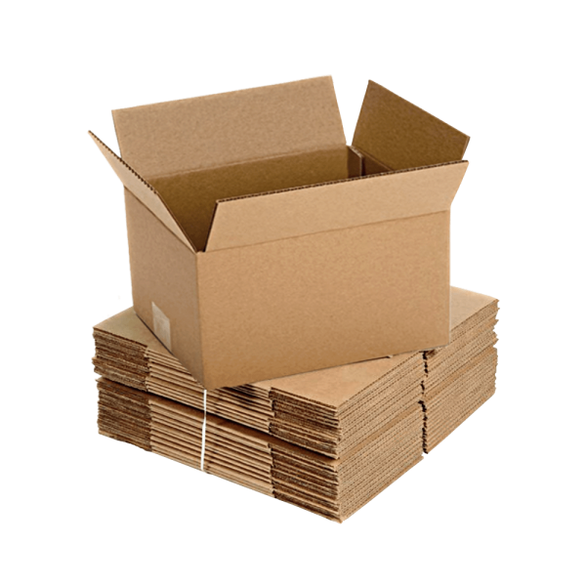
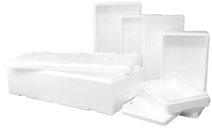
Life Cycle Water Consumption
The amount of water used to manufacture 1,000 EPS shipping containers is a miniscule amount compared to corrugated paper.
uses xxx gallons of water
uses xxx gallons of water

