Slide 1
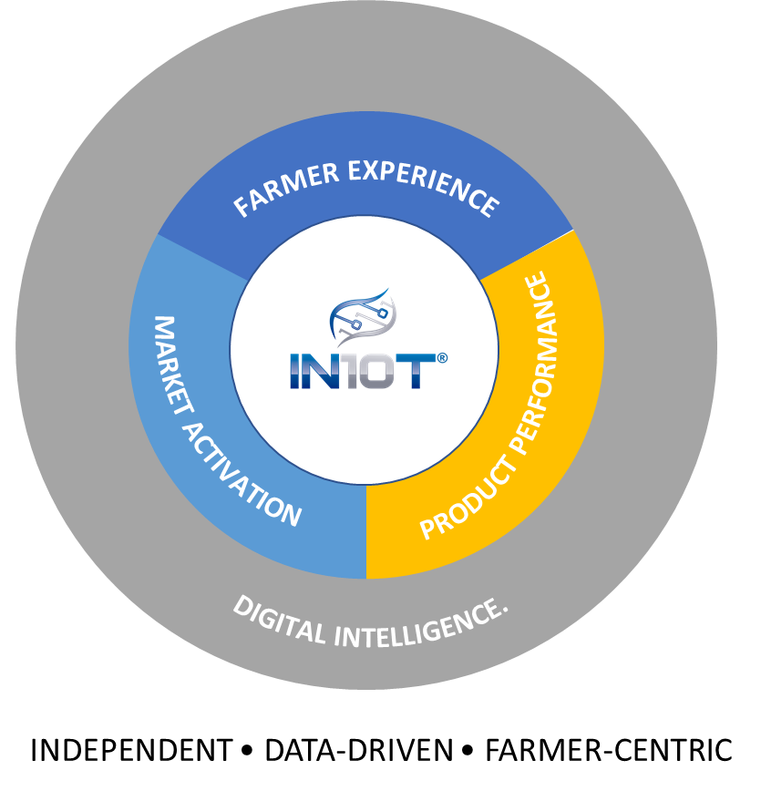
ACCELERATE ADOPTION.
At IN10T,
IN10T is an independent, farmer-centric, data-driven company focused on helping farmers realize the benefits of new agriculture products and solutions by helping clients accelerate the time from scientific discovery to successful farmer adoption.
PRODUCT PERFORMANCE.
FARMER EXPERIENCE.
MARKET ACTIVATION.
DIGITAL INTELLIGENCE.

Slide 2
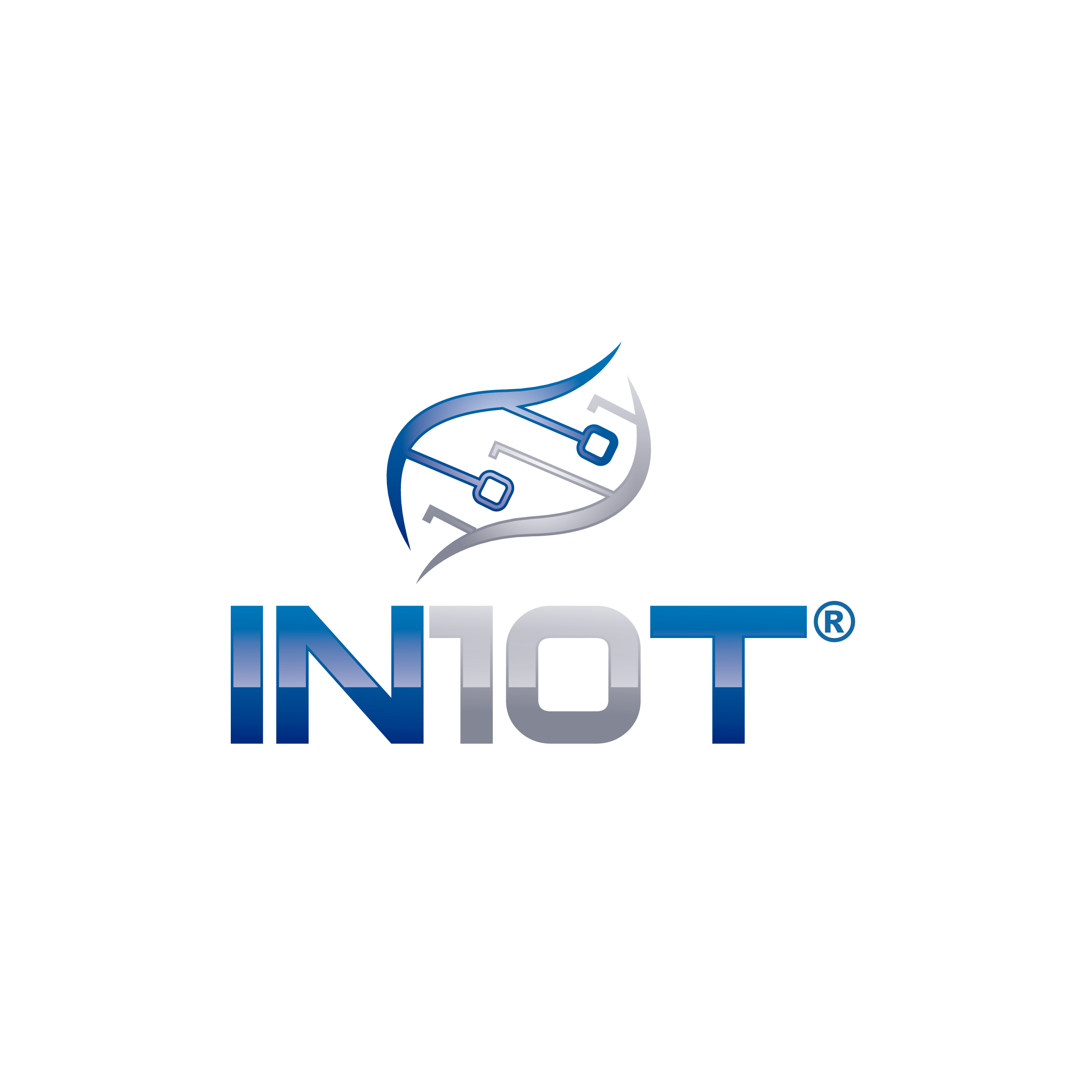
FARMER EXPERIENCE
MARKET ACTIVATION
PRODUCT PERFORMANCE
DIGITAL INTELLIGENCE.
INDEPENDENT • DATA-DRIVEN • FARMER-CENTRIC

