Slide 1

Bluemind
Solutions
Get your large complex Enterprise data transformed into value driven
structured information to supercharge your business.
Know More
Notes:
Flip the background image (mirror the current image) to make it a “Right handshake”. The current image shows “Left handshake”
Edited the text under “Bluemind Solutions”

Slide 2



BETTER DATA BETTER DECISIONS BETTER ROI
Our value added services help companies realize the full potential of ERP and e-Commerce implementations.
MASTER DATA MANAGEMENT
E-COMMERCE DATA CONFIGURATION
SUPPORT SERVICES
Notes:
Edited the Title
Edited the text under title

Slide 3






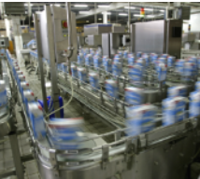


Industries Served
AEROSPACE
DEFENSE
OIL & GAS
INDUSTRIAL MANUFACTURING
FOOD &
BEVERAGE
ELECTRONIC
COMPONENTS
LIFE SCIENCES
TEXTILE
WHY US?

Slide 4


Bluemind Solutions specializes in extracting business centric information from large, complex and disparate sources to realize full potential of Enterprise and E-Commerce implementations.
Our services help organizations to recognize significant business value hidden in the large data set through effective relationship mapping, highlighting category trends, identifying patterns and anomalies for improving ROI
Our services are product agnostic, covering a wide array of EAM, PLM, PIM, MDM platforms.
Our value driven services focus on information management and data quality improvement for BOMs, part-drawings, specification sheets and legacy data. Our ability to bring over 4 decades of domain and functional specialization to delivering our services sets us apart from the rest.
Our complete spectrum of services include data discovery, data cleansing, data enrichment, de-duplication and metadata management with specialization in Manufacturing, Retail, Wholesale, Distribution, Supply Chain and e-Commerce domains.
Notes:
Edited the text

Slide 5


Operating with a bad data is more expensive than the cost of improving data quality
5major impacts of bad MRO data:
Unreasonable high inventory
Excessive procurement cost
Unplanned maintenance downtime
Design failures
Inappropriateness of storage location
Notes:
Edited the title text
Removed periods from the bullets

Slide 6

Notes:
Add an option to “Attach Samples File” along with “Name” and “Email” fileds
Change to the title to “How good is my Data?”
Second Line: “Share your sample data for a Free Data Value Analysis!”

Slide 7
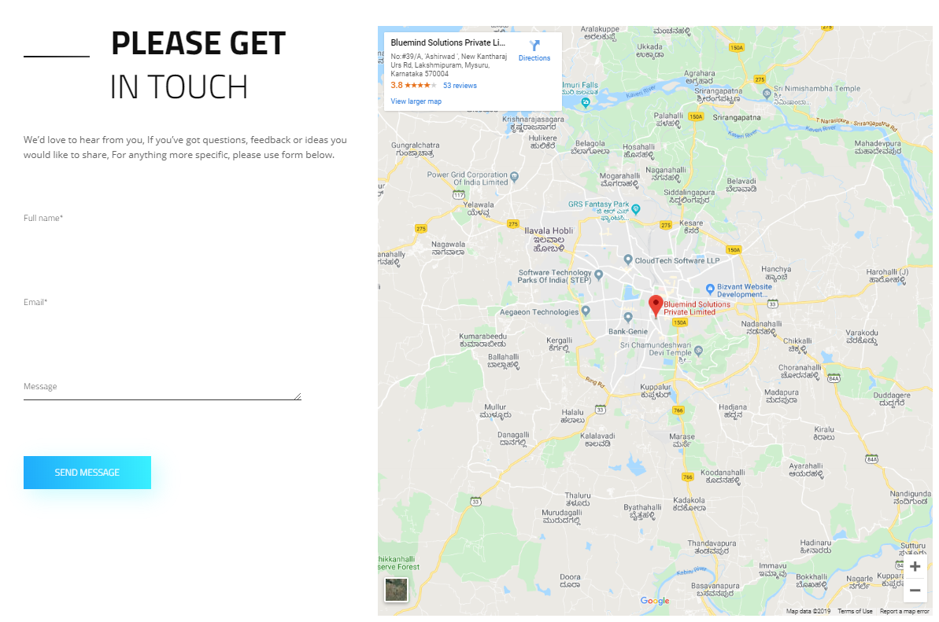
Notes:
Change “PLEASE GET IN TOUCH” to “Schedule a Data Value Discovery session with Bluemind”

