Slide 1
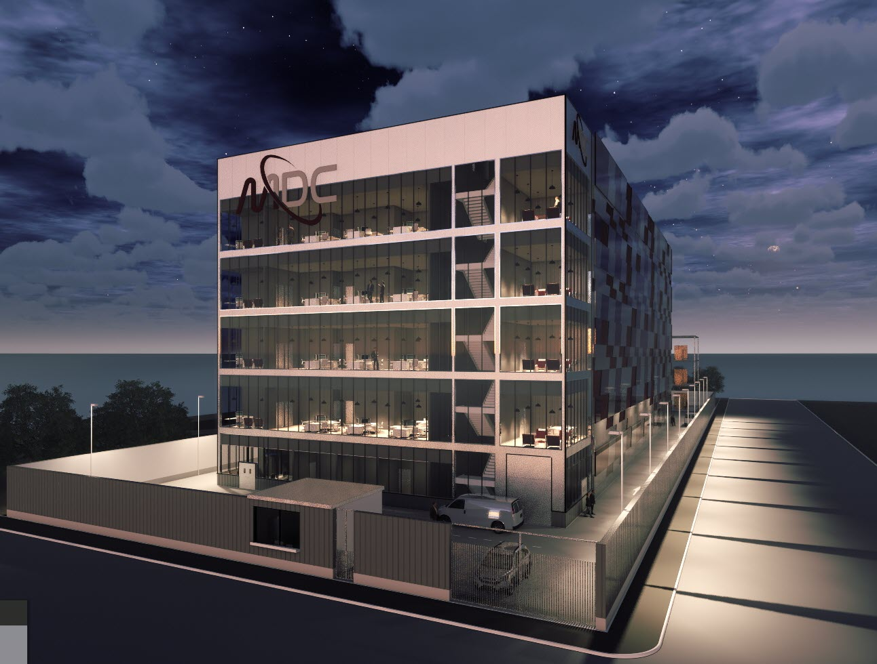
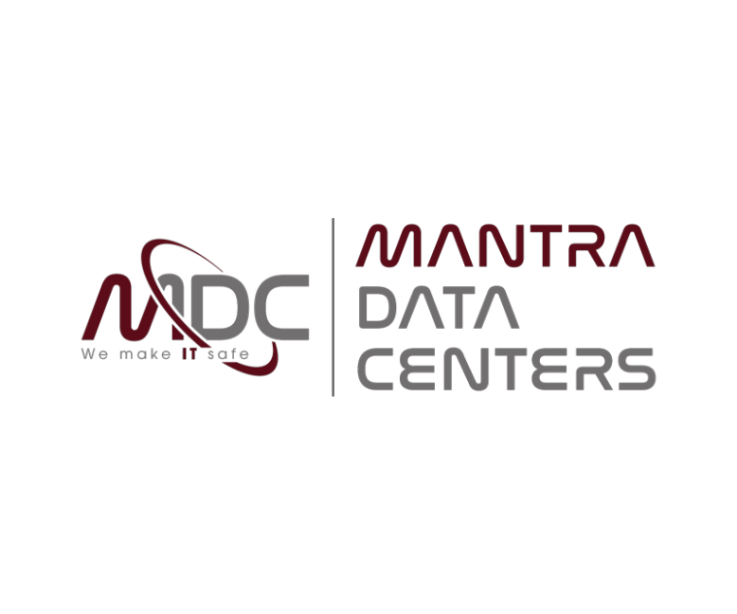
Introduction:
Mantra Data Centers
February, 2020
STRICTLY CONFIDENTIAL

Slide 2
Disclaimer
IMPORTANT: This presentation was prepared by Mantra Data Centers (“Mantra Data Centers” or “MDC”) and the content herein is of a strictly confidential nature. This presentation cannot be reproduced, distributed or published by the recipient or used for any purpose whatsoever without the prior written consent of MDC. Although the information contained in this presentation was obtained from sources considered reliable, MDC cannot guarantee the accuracy and truth of the same. The opinions presented herein represent those of MDC at the present time, and are, therefore, subject to amendment and alteration. MDC is not responsible for any direct losses or reduced profits that may result from the use of the information contained herein.
2

Slide 3
Index
1 | Executive Summary
2 | Why India?
3 | Why MDC?
4 | Let’s Build your Data Center together
3

Slide 4

Introduction
One Of India’s First Dedicated Wholesale Colocation Service Providers
Network of 7 Data Centers to be built in 6 Cities across PAN INDIA
Totaling 11,500 racks or 640,000 sq ft. Built Space
Purpose-Built Data Centers
European Class Design and Infrastructure
Tier III Uptime Institute Design & Constructed Facility Certified
LEED Gold Certified with Low Carbon Footprint
Energy Efficient & Environmentally Sustainable: Design PUE of 1.5
Modular & Scalable Design Philosophy
Carrier Neutral (with incoming fiber from multiple carriers)
DELHI
(NCR)
AHMEDABAD
MUMBAI: 2 DCs
HYDERABAD
BANGALORE
CHENNAI
4

Slide 5
Service Offerings
Tailor Made Solutions for an Evolving Market
Wholesale Colocation Services
- State of the art infrastructure offering reliable, flexible colocation services to large clients
- Custom built white space
Caged Colocation Services
- Lease of entire data center / large suites / substantial blocks of caged technical floor space
- Dedicated space for each client ensuring no sharing of floor space or caged blocks
- Unparalleled security with advanced features like electronic and biometric systems, cage level control, CCTV, 24x7 security and more
Data Center Physical Infrastructure Management
- On-site amenities & services, with customizable Class A office space
- A holistic view of the DC’s performance for energy, equipment and floor space for efficient usage
- CCTV video storage services
IT Managed Services (as an addition to the colocation services)
- Public Cloud Services
- Monitoring Services
- Administration & Operation Services
- Cybersecurity Services
- Hand & Eyes Support Services
- Business Continuity-Disaster Recovery Services
- NOC Services
5

Slide 6
Technical Specifications
Inside our Data Center
Area: - 2,000 racks, expandible up to 4,000 racks - 60,000 sqft rack space, expandable up to 120,000 sqft. rack space - 100,000 sqft. gross built area, expandable up to 200,000 sqft. gross built area Ancillary Facilities: Fully Equipped Office Space Conference Rooms Meet-me Rooms NOC Room Staging Area Work Lounge, Cafeteria & Vending Machines Power: - 6 kW/rack on Day 1, expandable as per Client’s needs - Total IT Power 12 MW on Day 1, 18 MW total, expandable as per Client’s needs - N+1 Emergency Generators, with 48 hours fuel tanks guaranteed supply - N+1 Uninterrupted Power Supply (UPS) units BMS (Building Management System) & DCIM (Data Center Infrastructure Management) | Fire Protection: - VESDA System for early smoke detection - Fire supression with Novec inert gas in white space rooms, and sprinklers in ancillary areas - Compliant with NFPA requirements Access Control and Physical Security: - 5 Layer Access Control - Biometric/Proximity Card Access Control - 24x7 Security Staff - Compliant with TIA-942 & ISO 27000 requirements Cooling: - N+1 Air-Cooled chillers - N+1 Precision Air Conditioning CRAH units - Cold Aisle strategy - Leak detection Building: - Multistory G+4+Technical Roof - 150kg /srft /1,500 kg/sqm load bearing slabs - 16.4ft (5m) Clearance Height Floor to Slab - 31.5 inches (80 cm) raised access floor - Steel Reinforced Concrete Structure and Façade Panels
6

Slide 7

PAN India Presence
7 Data Centers to be deployed strategically across India to give an edge to our Clients
  Large, Young Populations
  Widespread Internet usage and availability
  Extensive use of IoT
  Reliable access to terrestial and/or submarine network
  Active Government presence
  Potential to service large international clients (OTT’s, Hyperscalers)
 | Mumbai | Delhi (NCR) | Bangalore | Chennai | Hyderabad | Ahmedabad
Population | 20.41 Million | 30.29 Million | 12.32 Million | 10.97 Million | 10.00 Million | 8.05 Million
Ranking (Population) | 2nd | 1st | 4th | 5th | 6th | 7th
Economical Focus | Finance Commerce Entertainment | Manufacturing Finance Transportation | IT | IT Automotive Services | Pharma IT | Commerce Telecom Construction
Power Infrastructure | ● | ◑ | ◑ | ◕ | ◕ | ◑
Network Connectivity | ● | ◕ | ◕ | ● | ◕ | ◕
Disaster Proofing | ◑ | ◔ | ◕ | ◑ | ◕ | ●
Land Availability | ◔ | ◑ | ◑ | ◕ | ◕ | ◕
Attractiveness | ● Very High | ◕ High | ◑ Moderate | ◔ Low | ○ Very Low
7

Slide 8
Why India? (i)
The largest democracy in the world
#1. One of the world’s fastest growing economies
India to remain one of the fastest growing economies in the world
Structural reforms to take India to its potential GDP growth of 8%-10% in the future
#2. Largest Youth Population in the world
  India to have world’s largest youth population by 2020
  India to be the largest supplier of university graduates in the world by 2020
  India has the third largest group of scientists and technicians in the world
#3. Huge Domestic Market
  Rising affluence is the biggest driver of increasing consumption in India
  India’s consumer story will be led by its 129 mn urban mass consumers
  Private consumption to be four times by 2025
#4. Rising economic influence
  Centre of global maritime trade to move from the Pacific to the Indian Ocean Region. India and China will be the largest manufacturing hubs of the world by 2030
  Connectivity to Central Asia and Europe via the International North-South Transport Corridor (INSTC)
  In the next five years, India to have greater economic influence across the Asia-Pacific Region
#5. Indian Infrastructure story
  Over the next three decades, more than 350 mn Indians will move into cities
  Over the next two decades, more than $ 1.5 tn investments have been planned for infrastructure
8

Slide 9


Why India? (ii)
Growth in mobile data consumptions, digital and e-commerce transactions is expected to drive explosive growth in internet traffic
Average mobile data consumption per user to grow five fold over FY18-23
Digital transactions in BFSI sector growing at a rapid pace:
Average monthly mobile data consumption per user (GB/month)
Growth in number of mobile payment transactions per annum (bn)
18.0
460
3.5
7
0
-1
FY18
FY23
FY18 FY23
E-commerce transactions to grow driven by increasing penetration Growth in number of e-commerce transactions per annum (bn)
Growth in number of smartphone users (mn)
Current smart phone penetration in India is
~30% compared to
~70% in US
1,626
438
400
800
0
FY18
FY23
FY18
FY23
Data consumption / user through video streaming to increase from 2 GB / month in FY18 to ~13.5 GB / month in FY23 at a CAGR ~45%
Social media users to reach ~370 million by FY23 (~30% penetration)
Increase in number of connected devices: 1.7 bn in FY18 expected to grow to 2.4 bn by FY23
E-governance
~3.5 bn documents processed digitally by government in last 4 year
1.22 bn Aadhaar issued – a unique identification number for citizens
9

Slide 10
Why India? (iii)
Why is India so attractive to Hyperscalers & OTT’s?
#1. Personal Data Protection Bill
  India’s first attempt to domestically legislate the mechanisms for the protection of personal data and aims to set up a Data Protection Authority in the country. The Bill regulates the processing of citizens’ personal data by government, companies incorporated in India, and foreign companies that are dealing with personal data of customers in India. Through the proposed law, the Government of India is rooting for data sovereignty by mandating certain class of data to be stored within Indian borders.
#2. Multiple Submarine Cable Landing Stations
  India has 15 submarine cable landing stations compared to 8 in China
  India has 5 more submarine cables in the pipeline to be from/to Mumbai, Chennai and Puducherry
#3. Digitalization Trend
  Strong demand for data centers due to digitization trend; digital economy expected to contribute ~20% to GDP by FY21
#4. High Scalability Potential
  Availability of large land parcels at relatively lower costs compared to other APAC countries
#5. Hubs
  Multiple IT / Financial Hubs in seismic 2 & 3 zones (ex: Bangalore, Hyderabad, Mumbai), making it safe and attractive for building Data Centers
#6. Mobile Phone Users
  By 2023 India will have 800 million Smartphone Users
10

Slide 11
Why MDC? (i)
Key Value Propositions to our Clients
PAN India Presence - Mumbai, Bangalore, Chennai, Hyderabad, Delhi (NCR) & Ahmedabad - To be located in vicinity of other Data Centers - Proximity to international fiber routes for latency sensitive and network edge deployments Rigorous Quality & Standards to be met, all DC’s will be - Uptime Institute Tier III Certified - Indian Green Building Council (IGBC) LEED Gold Certified Carrier Neutral - Independence from any network, hardware or software vendor - Full range of connectivity providers into MDC Facilities High Security - 24 x 7 x 365 security using electronic & biometric systems; cage level controls, motion detection, CCTV monitoring Dedicated power delivery infrastructure - Agreements in place with electricity distributors / renewable IPP’s for uninterrupted power supply in the DC sites Dedicated cooling delivery infrastructure - Robust cooling systems to maintain ideal temperatures for servers & communication devices | Service Offerings - Wholesale Colocation - Caged and/or Dedicated Spaces - IT Managed Services Highly Experienced Management Team - The MDC team provides a scarce combination of critical local contacts, local development and operational know-how, technical experience and financial track record First-Class Stakeholders - Partnership with leading players to achieve project success Tailor Made Solutions - Bespoke solutions tailored to the Client’s needs - Secure and resilient solutions with scalable capacity - Private Suites: Self-contained areas including 24x7 NOC services - Cages: secure, flexible, private areas large-scale resilience - Flexible power configurations Scalable Modular Capacity - Delivery of power and cooling infrastructure quickly, efficiently and without impacting the existing operating system’s reliability - Critical power solutions deployed in a modular fashion - Pay-as-you-grow
11

Slide 12
Why MDC? (ii)
INSERT PHOTO
XXX XXX
Founding Partner, Chairman,
Board Member
Proven track record in real estate and private equity investments through [Insert Company], including the freehold for [Company]’s Madrid (MAD2) Data Center
Very well-connected to key parties in India through his roles as Co-Founder of the Spain-India Council Foundation, Co-Founder & Executive Chairman of the Chamber of Commerce & Tourism of India in Spain, and Special Adviser for Business Promotion between Spain and India by the Ministry of Industry, Commerce and Tourism of Spain
Highly engaged participant of the Annual General Meetings: WEF, IMF, WB, ADC, G-30, OECD, Club of Madrid, etc.
The MDC Management Brings the Right Skillset Required for a Successful Data Centre Roll-Out
Significant operational and strategic experience through 30 years of experience with PwC
Deep understanding of business development and internationalization through his role as a Strategic Business Adviser for various companies (Independent Board Member of: Mahindra CIE Automotive Limited)
Fellow Chartered Accountant from the Institute of England and Wales and a member of the Spanish Institute of Chartered Accountants
INSERT PHOTO
XXX XXX
Founding Partner, COO,
Board Member
Deep and specialist knowledge in data centre design, with over 25 years of data center industry experience
Proven track record in growing and operating a data center business as Co-Founder of Quark, a Spanish Data Center Company that was sold to KKR in 2014
Owner of an international consultancy firm focused on architectural, design and engineering services for Data Center Clients (Completed projects in: Saudi Arabia, Brazil, Spain, Bahrain, Qatar, UAE, Morocco & Holland)
INSERT PHOTO
XXX XXX
Founding Partner, CTO,
Board Member
Proven track record in Finance, Real Estate and Private Equity investments
As MD of the [Company] Group of Companies, [XXX] oversees the family office across multiple sectors, including Real Estate, Trading, Consulting & Private Equity; through investing alongside potential investors
Highly relevant industry experience through previous roles at Banco Santander’s Leveraged Finance NY Team. Jaan had actively been involved in closing 14 transactions, representing a combined value of ~USD 12 Billion total project debt
INSERT PHOTO
XXX XXX
Founding Partner,
Investor Relations,
Board Member
12

Slide 13













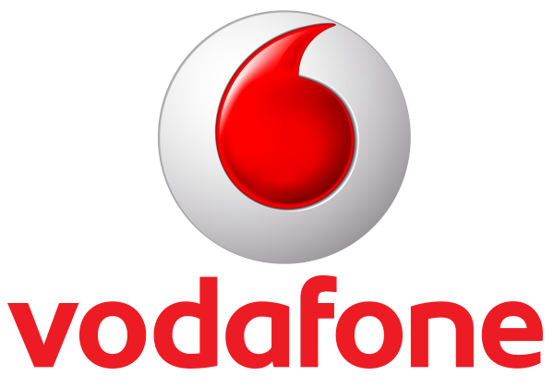





















Why MDC? (iii)
MDC plans to partner with Leading Global and Domestic Institutions
Potential Suppliers:
Potential Advisors:
1
Power Equipment
8
Market Advisors
2
HVAC Equipment
9
Legal Advisors
10
Tax Advisors
3
Network Connectivity
Potential Collaborators:
4
Design
11
Government Agencies
12
Business Networks
5
Facility Management
6
Real Estate
7
EPC
13
Foundations
13

Slide 14
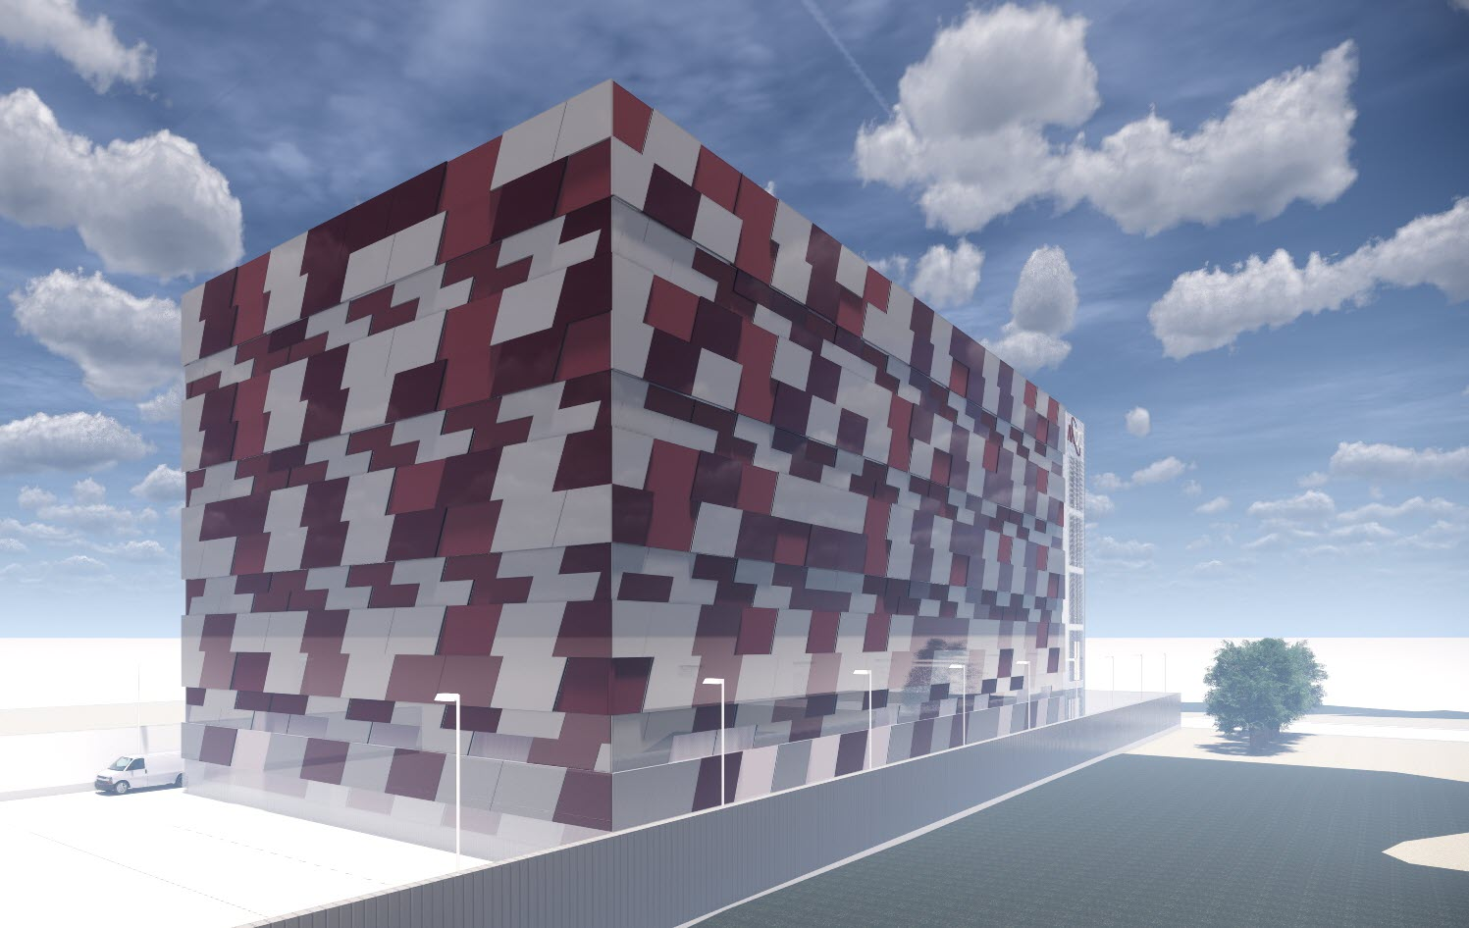
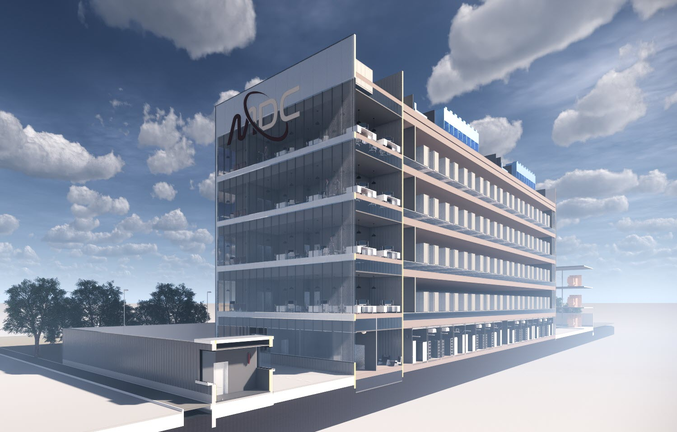
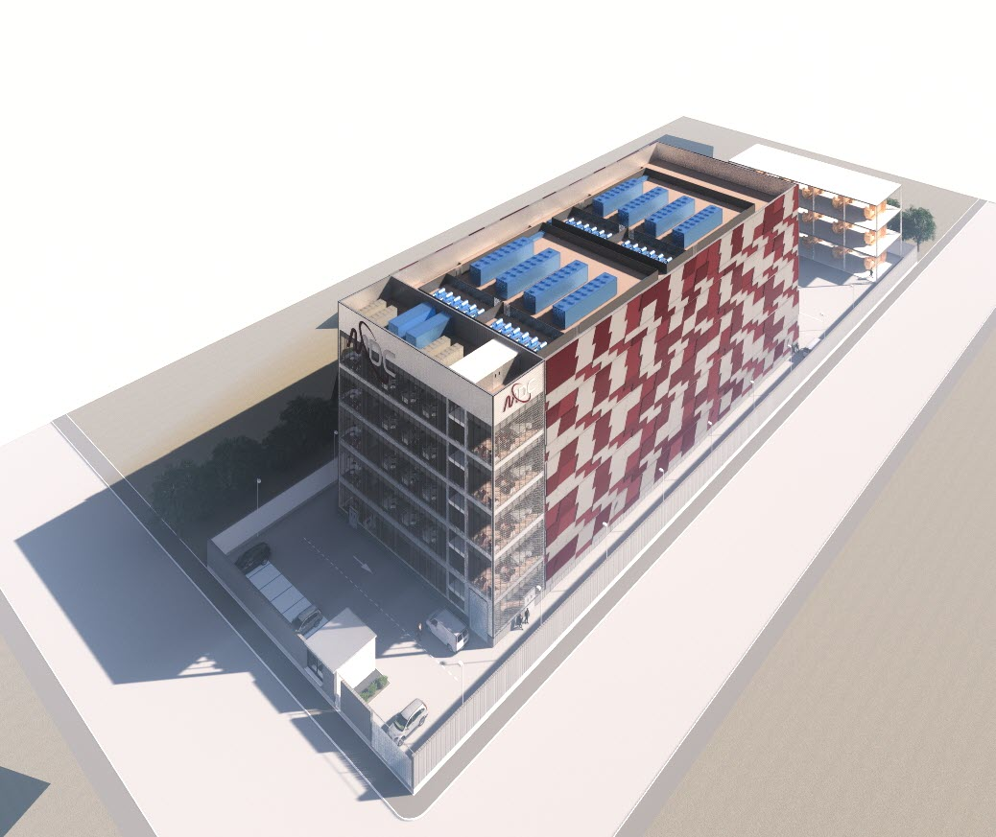
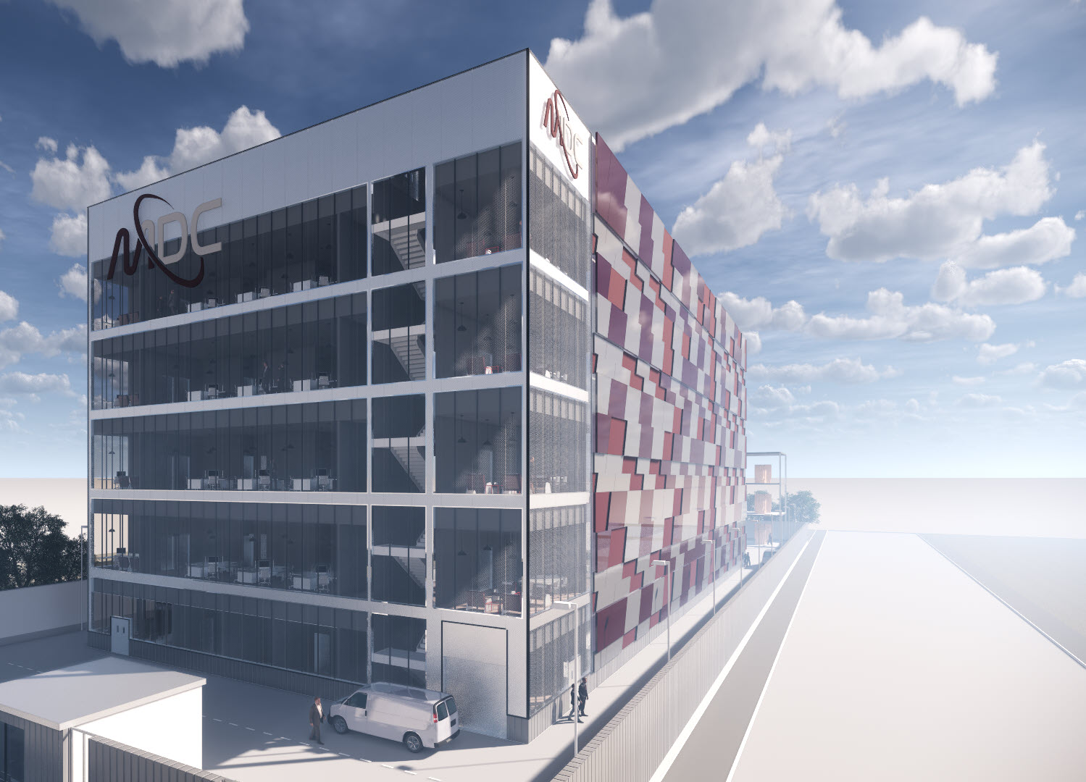
Let’s Build your Data Center Together
"Alone we can do so little, together we can do so much." - Helen Keller
14

Slide 15
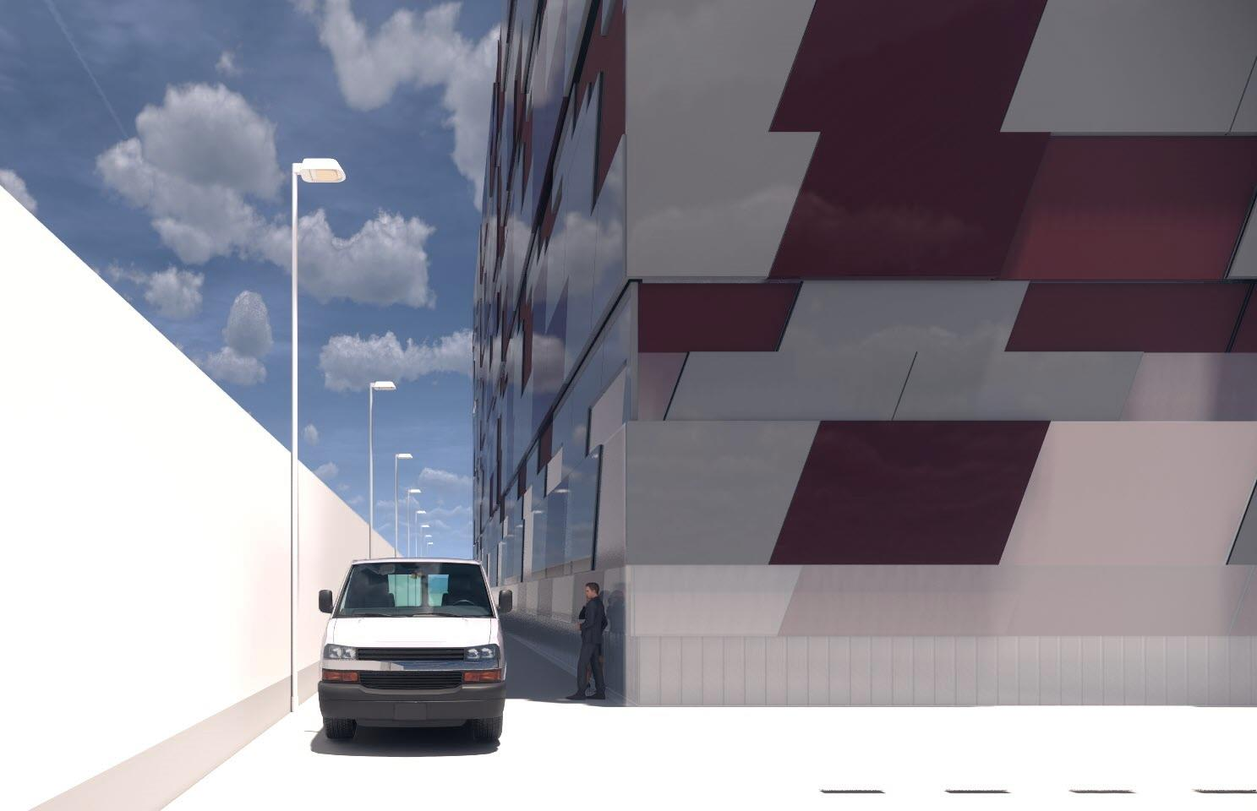
Mantra Data Centers
[Address]
[Address]
[Address]
Telephone: +34 XX XXX XX XX
Email: xxx@xxx.com
Thank you for reading.
STRICTLY CONFIDENTIAL

