Slide 1


Slide 2
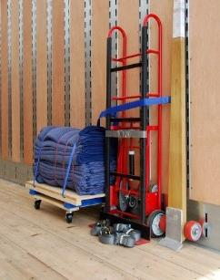

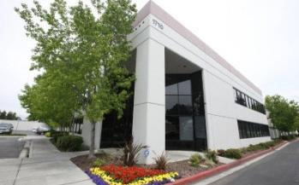

CRST Specialized Transportation (STI)
1
Asset based, specialized carrier with $250 million annual revenues
2
Operating 900 power units
3
55 Distribution Centers
4
LTL Padded Van Network
5
Servicing clients’ products that require:
6
Specialized equipment
7
Specialized handling & services
8
Unique, integrated solutions
9
Owned by CRST International
10
More than $2.0 billion in revenue

Slide 3










Dry Van
Team Expedited
Specialized High
Value Products
Flatbed
National/Regional
Operating Fleet/Support
Customized Fleet
Operations
PEGASUS
Temp Controlled
Regional
Flatbed
West Coast
Regional

Slide 4
Dry Van
Team Expedited
Specialized High
Value Products
Flatbed
National/Regional
Operating Fleet/Support
Customized Fleet
Operations
PEGASUS
Temp Controlled
Regional
Flatbed
West Coast
Regional

Slide 5












Industries
Served
Computer/Office Equipment
Data Center Infrastructure
Asset Recovery
Industrial Machinery
Retail
Telecommunications
Healthcare
Events & Exhibits
Motorcycles/ATVs
Entertainment Equipment
shipments in
Museum & Fine Art

Slide 6


Environmental Stewardship
For our Customers
  Pad wrap services for over 50 years
  Recycle packaging from deliveries
  Monitor fuel consumption
  Help customers sustainability metrics
For STI
  Smart Way certification
  Corporate recycle electronic equipment

Slide 7
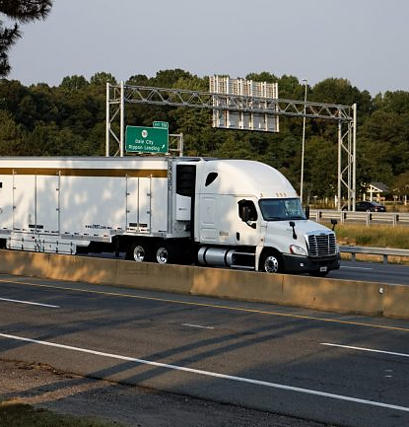


TRANSPORTATION SOLUTIONS
Standard asset based services include: inside pick-up & delivery, experienced drivers, air ride, lift-gates, decking, pads, straps, double slot logistics, & handling equipment
LTL Network
LTL Padded Van (Daily/Weekly Scheduled Departures
DIRECT SERVICES
Truckload Large LTL Expedited Blanket wrap TL Climatic Tradeshows & Events

Slide 8
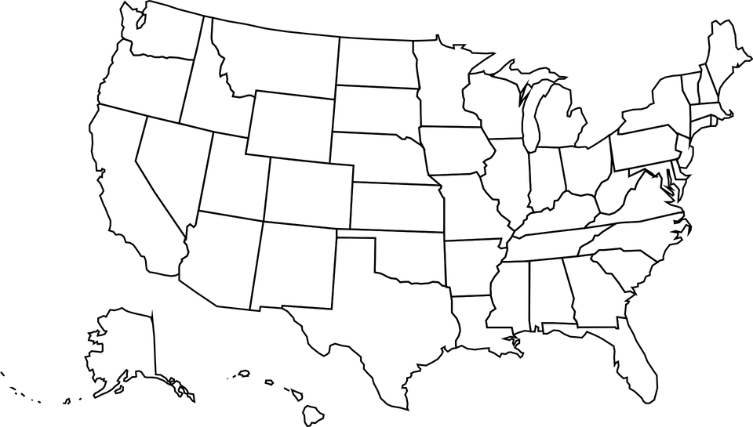
STI Network
55 Distribution Centers (DCs)
Saskatoon
Edmonton
Regina
Vancouver
Calgary
Quebec
Winnipeg
Montreal
Seattle
Spokane
Billings
Ottawa
Portland
Minneapolis
Toronto
Boise
Sacramento
Milwaukee
Rochester
Boston
Detroit
Omaha
Iowa City
Pittsburgh
Hartford, CT
All DCs Integrated by:
STI Systems (TM. Scanning)
STI Qualified Drivers, Authority
STI Processes
STI Communication Protocols
STI Administrative Elements
San Jose
Las Vegas
Slat Lake City
Chicago
Columbus
Denver
New York
Kansas City
St Louis
Philadelphia
Baltimore
Los Angeles
Nashville
Richmond
San Diego
Phoenix
Little Rock
Albuquerque
Raleigh
Dallas
Atlanta
Jacksonville
Houston
Orlando
San Ontario
Tampa
Pompano Beach

Slide 9
Sti Network
Provides LTL Padded Van Services
Saskatoon
Edmonton
Regina
Vancouver
Calgary
Quebec
Winnipeg
Montreal
Seattle
Spokane
Billings
Ottawa
Monodon
Portland
Minneapolis
Toronto
Halifax
Boise
360 scheduled departures weekly
Real-time shipment tracking
Less than 1% claim frequency
SOP includes 24 hour/pre-call
Providing value added services
  Warehousing
  Merge in transit
  Vendor Managed Inventory
Sacramento
Milwaukee
Rochester
Boston
Detroit
Omaha
Iowa City
Pittsburgh
Hartford, CT
San Jose
Las Vegas
Slat Lake City
Chicago
Columbus
Denver
New York
Kansas City
St Louis
Philadelphia
Baltimore
Los Angeles
Nashville
Phoenix
Albuquerque
Little Rock
Richmond
San Diego
Raleigh
Dallas
Atlanta
Jacksonville
Houston
Orlando
San Ontario
Tampa
Pompano Beach

Slide 10

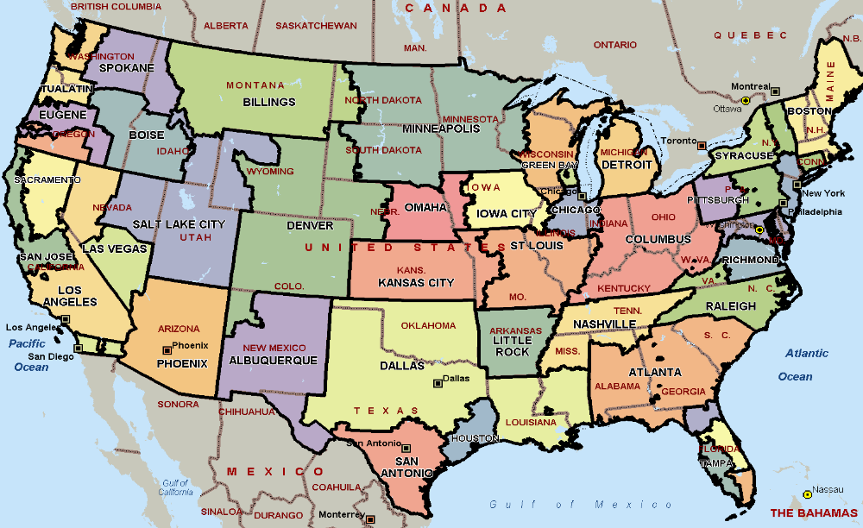
STI Network
DC Service Areas

Slide 11
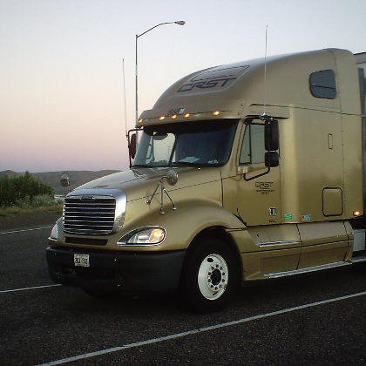
STI Direct Fleets
Truckloads & Large LTL - direct pick up & delivery
Direct Fleet types include:
Inside pick-up/delivery
Climatic, Tradeshow, Dock to dock Blanketwrap TL
Experienced drivers
Load, unload, pack/unpack, secure
General Service, Medical Fleet
Trailers equipped
Air-ride suspension, lift gates, interior
decking, pads, straps, and double
slot logistics
Appropriate handling equipment on board

Slide 12


STI Express
A complementary service to what we do today
Faster Transit
Nationwide
White Glove Service
Flexible First/Final Mile/Linehaul
Adaptive to Customers’ Needs
Dock-to-Dock and Door-to-Door
Product must be Packaged/Skidded

Slide 13
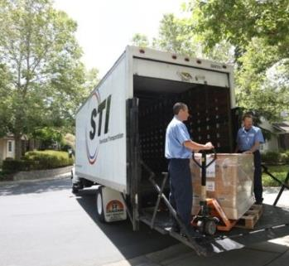
Other Specialized Solutions
Final/First Mile
Residential & commercial delivery
Supply Chain: Inventory Management, Business Solutions & Project Logistics:
  National inventory management solutions
  National warehousing programs
  Project Logistics solutions

Slide 14
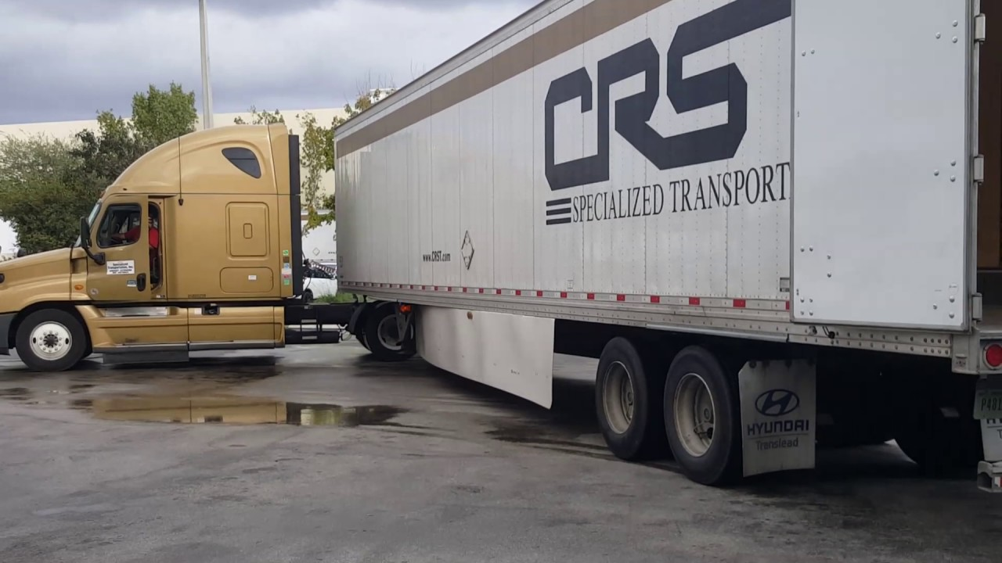
First/Final Mile
135 Service Providers covering the US and Canada
Door to door, drop ship and Final Mile only capabilities
Flexible delivery options
  Threshold – garage or through first door
  Standard – room of choice (up to 2 flights of stairs)
  Premier – room of choice with set-up and debris removal

Slide 15

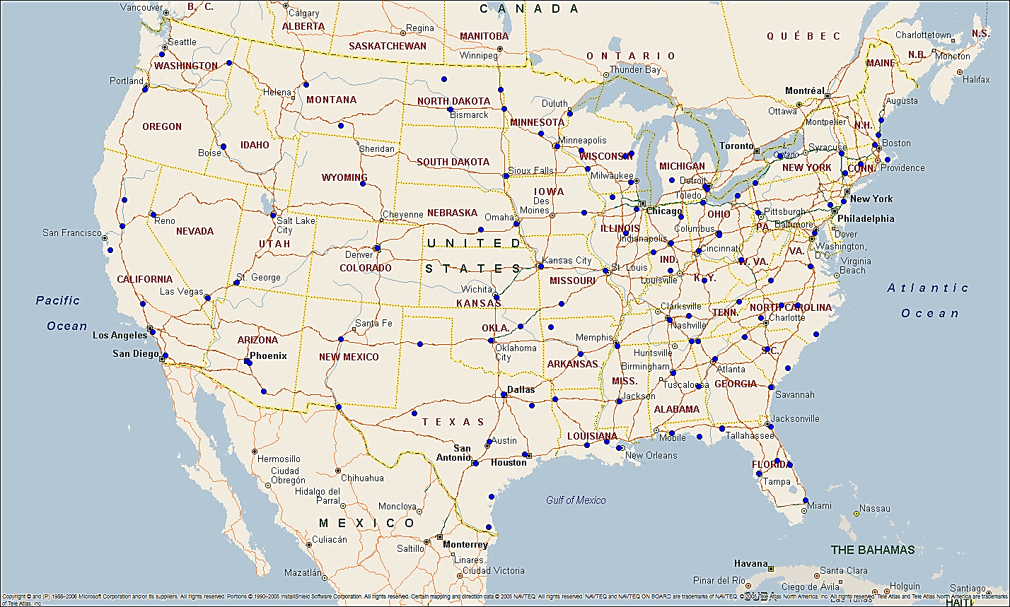
140 Home Express Service Providers

Slide 16

Other Specialized Solutions
Final/First Mile
Supply Chain: Inventory Management & Project Logistics:
Residential & commercial delivery
  National inventory management solutions
  National warehousing programs
  Project Logistics solutions

Slide 17



STI “Solutions”
Capabilities & “Service Bundles”
“CPM” – STI’s Inventory Management System
Vendor managed inventory; Order fulfillment
Merge In-Transit; Forward deployment
End of lease management; Reverse logistics; Loan management
Raw material management; Supplier management
Centralized Customer Control Tower
Web Centric application providing visibility across all locations
Table driven for quick system changes
Web based online reporting. Examples include:
  Shipments Not Received/Received; Dock to Stock; Material aging
  Current On-Hand Inventory; Historical On-Hand Inventory

Slide 18

STI Customer Service
“How we make it Happen”
Dedicated, Experienced Customer Service persons knowledgeable to the account
Work directly with the Client & Client’s customer
Develop Scope of Work and associated SOP’s
Provide Daily, Weekly, Monthly, Quarterly Reports
Coordinate services such as location surveys, after hour deliveries, rigging, extra labor, place inside, unpack & remove packing material, & driver crew assist installers with set up
Results: more control, lower risk shipping &
deliveries per customer expectations

Slide 19


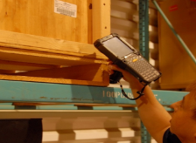


STI Technologies
END TO END VISIBILITY
INTEGRATED SYSTEMS
BUSINESS ANALYTICS
ELECTRONIC CONNECTIVITY
Satellite updates
Mobile App updates
Track & Trace options
Smartphone Access
MySTI
Status updates pushed
Daily status reporting
Real time POD capture
Transportation operations
Cross dock scanning
Shipment processing
Automated routing
Document creation
Transportation optimization
Document Imaging
Operations Report series daily, weekly
Customized reporting
Ad hoc reporting
On-time performance reporting
Activity & performance dashboards
Electronic shipment registration
Electronic shipment status
Electronic invoicing
Electronic payment
Billing summaries
Interface Options
ANSI X.12 , EDIFACT,
XML, Web Services, FTP, AS2, Electronic mail

Slide 20

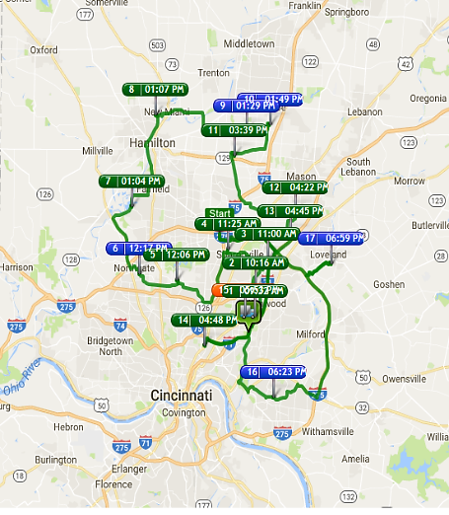
STI – Newest Technology
DISPATCH TRACK
Route optimization – minimize miles and cost subject to delivery windows and other constraints
Visibility to trucks in route
Automatic customer updates based on current schedule (text, e-mail, call)
Ability to take photos and attached directly to order
Works on android devices and iPhone/pads
Roll out first half of 2018

Slide 21

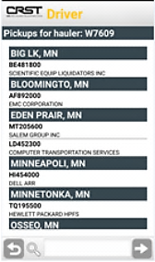
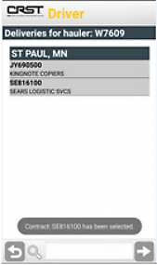
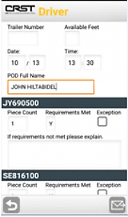
STI Technologies - STI Mobile App
Provides real time information allowing:
Tracks drivers’ shipment load and unload
Captures POD & gives real time upload to STI system
Document capture to STI Imaging system
Picture capture to STI Imaging system
Standard Operating Procedures Retrieval

Slide 22

Key Differentiators
Customized, asset-based solutions
Products that are unique, require driver expertise due to potentially precarious delivery situations with clients’ customers
Accommodate truckload, partial TL, & LTL shipments alike
High touch customer service knowledgeable & experienced with personnel & processes
Safety focused for product, delivery crews, & the public
Quality focus for damage prevention, on time, fulfilling each unique set of delivery requirements

Slide 23


