Slide 1



Slide 2



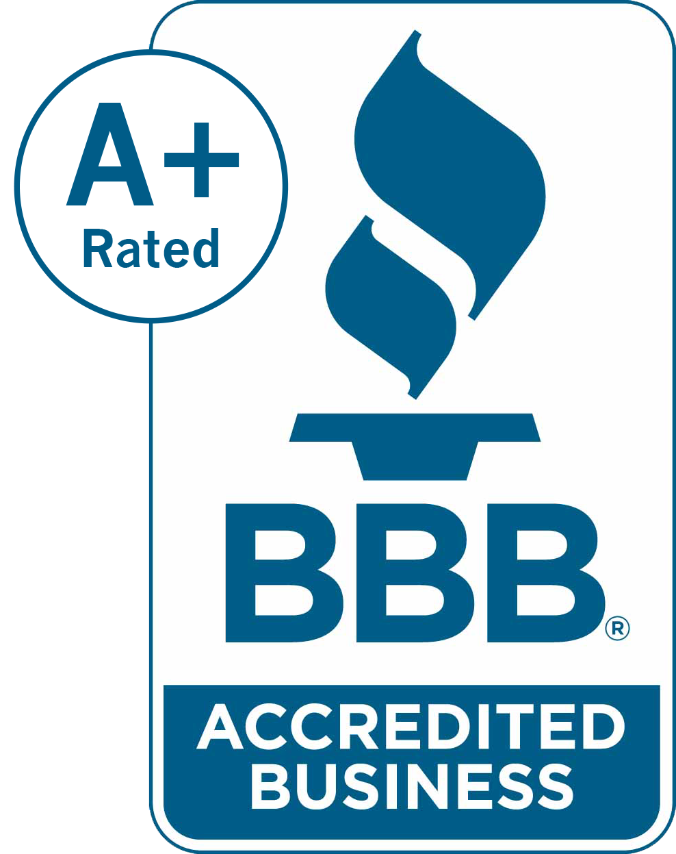


at a Glance
acn.com • whoisacn.com
RVPs and SVPs (including Circle of Champions members) earn annual income achieved by fewer than 1% of ACN IBOs. Their success stories and earnings are extraordinary and not typical. Earnings as an ACN IBO are based solely upon the successful sale of products to customers and their usage of those products. Individuals will incur expenses in operating their ACN business, such as the sign-up fee and renewal fee, as well as other possible operating expenses. As with any business, earnings and success at ACN are not guaranteed but depend primarily on the individual’s commitment, persistence and effort.

Slide 3


Company
Customer Acquisition Company
Started in the U.S. in January 1993
27 Countries on 5 Continents
Revenue of $4 Billion over the last 5 years & Growing
Millions of Customers Acquired
World’s Largest
Direct Seller of Telecommunications, Energy & Other Essential Services

Slide 4












Residential and Business Services
Wireless
Energy
High Speed Internet
Security & Automation
Television
Payment Processing
ID Theft Protection
Notes:
Remove boxes around all logos

Slide 5

Our Business Model
Service Providers
Internet
Marketing
Media
Advertising
Mass
Mailing
YOU!
Customers
Relationship Marketing!

Slide 6

Online Business
COST: $199 + $25 Monthly Support Fee
ACN PROVIDES:
Personalized Online Store
Hosted & Updated Daily
Product Info & Ordering
U.S. Based Customer Care & Billing
IBO Support Call Center
Customer Trackinge
YOU Acquire Customers and ACN Does the Rest!

Slide 7

5
YOU
YOU
Your Team’s Customers
Overriding Residual Income
Your Customers
3 to 20%
Personal Residual Income
Level 1) 4%
Level 2) 4%
Level 3) 4%
Level 4) 4%
Level 5) 4%
Residual Income
Refer to the ACN Compensation Plan for Complete Details

Slide 8
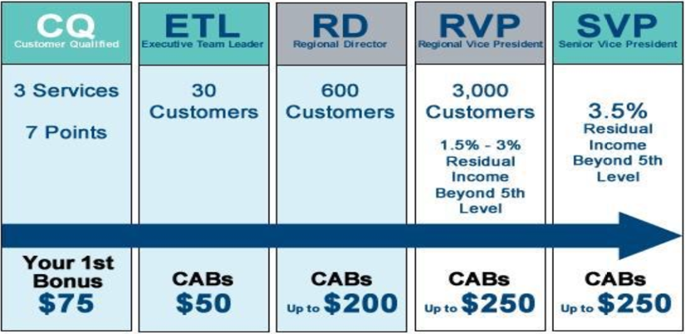
EARNED POSITIONS &
CUSTOMER ACQUISITION BONUSES (CABs)
Incentives Trips

Slide 9




Who Invited YOU
1
2
3
4
5
6
7
8
Become an Independent Business Owner TODAY!!!!

Slide 10

Celebration of Human Potential

Slide 11
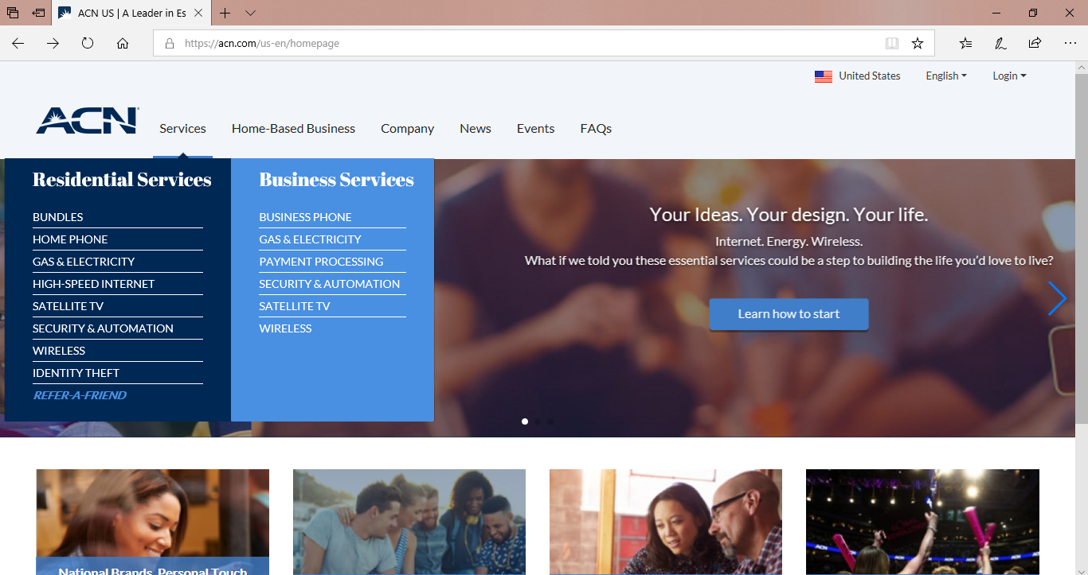
With ACN you get your very own online business!

Slide 12
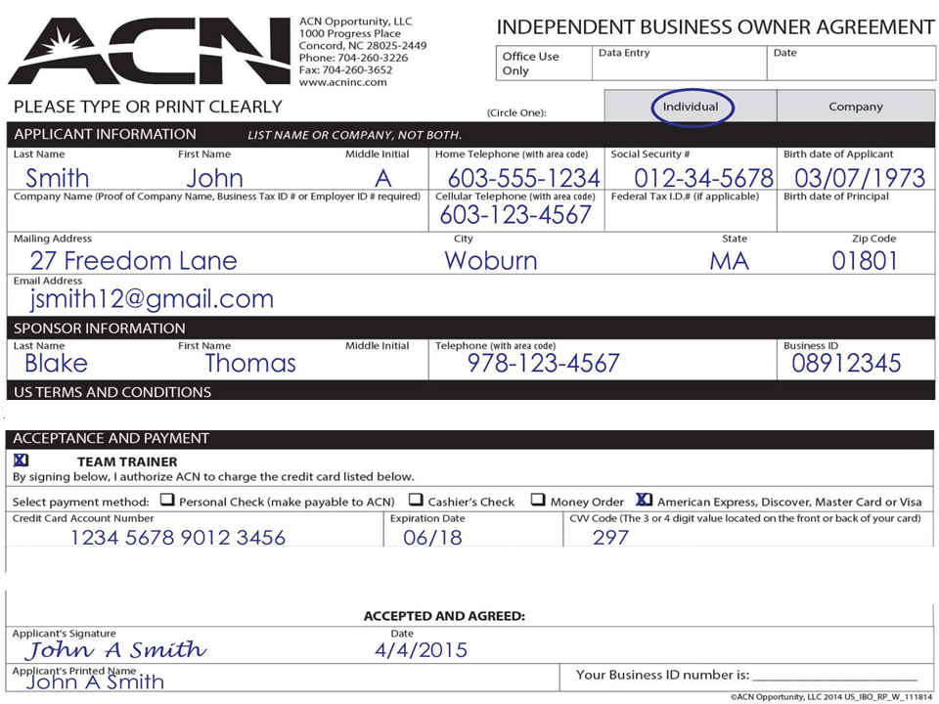

Notes:
With an opportunity that offers so much and appears so simple, it’s important to understand no matter how good an opportunity is you have to do the right things to get the right results, and that is why ACN believes so strongly in providing the very best training and support possible.
We offer comprehensive online training on exactly how to build your business from "A to Z”… In addition we also offer local, regional, and international training events… with ACN, you may be in business for yourself, but never by yourself. If you're a success, we're a success.
The information that I just went over was meant to be a brief overview of the ACN opportunity. It was designed to give you enough information so you can decide whether the timing is right for you to pursue it.
Please get with the person who shared this information with you and let them know if:
A. You would like to try one or more of our services
B. If you'd like to learn more about the ACN opportunity, or
C. You are ready to get started right now.
Thank you so much for your time, and take care.

Slide 13

Let’s Start Making Money
TODAY

Slide 14
Monthly Personal Customer Acquisition Bonuses
(YOUR Customers)
3 Services & 7 Points = $75
5 Services & 10 Points = $200
PLUS $200 for every additional
3 Services & 6 Points
8 Services & 16 Points = $400
11 Services & 22 points = $600

Slide 15
Personal Residual Income
3% - 20%
1 – 39 Customer Points = 3%
40 – 59 Customer Points = 5%
60 – 99 Customer Points = 10%
100 – 149 Customer Points = 14%
150 – 199 Customer Points = 17%
200+ Customer Points = 20%

Slide 16
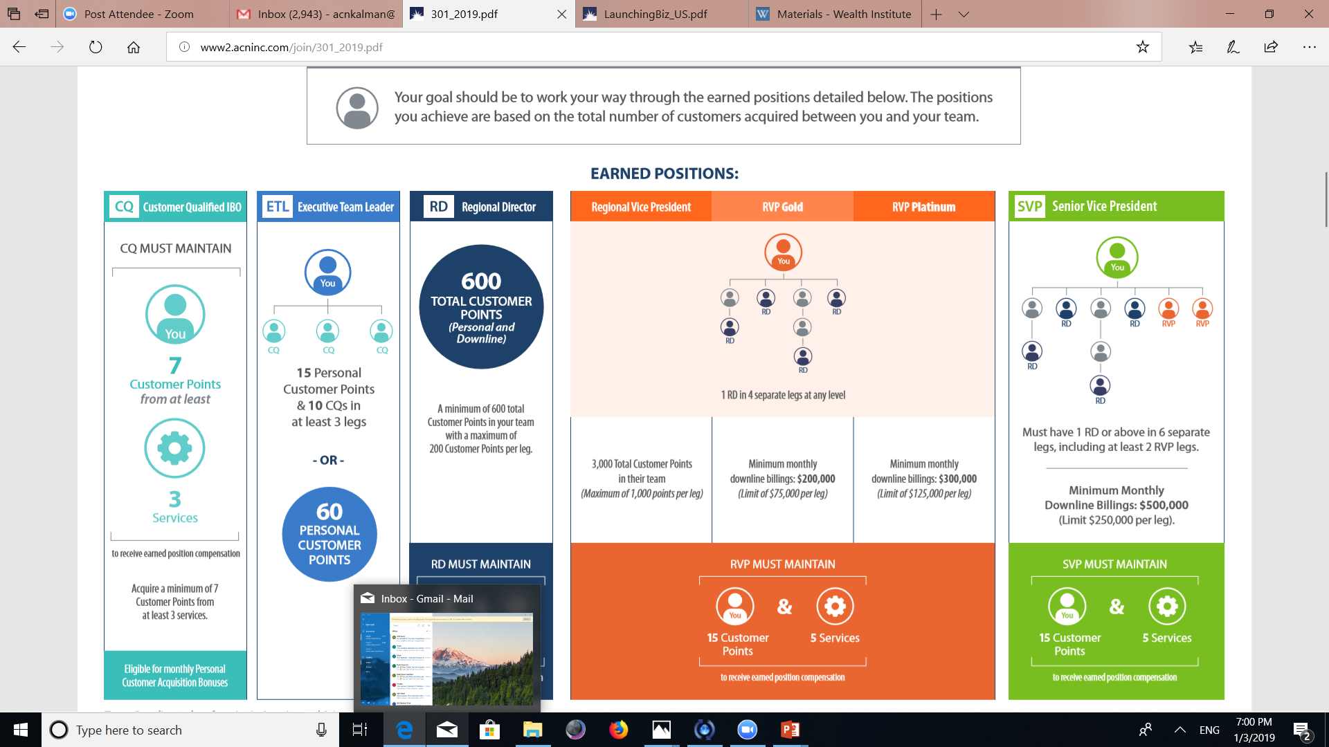

7 Day Goal
Become Customer Qualified
Leadership
Training
AND
Your FIRST Check !!!
Home
Meeting

Slide 17








Essential Residential & Business Services
3
ID Theft Protection
Xoom Energy
Internet
Television
Home Security
2 Points
2-5 Points
8 Points
4 points for monthly plan or 8 Points for annual
1-2 Points
Wireless
Merchant
Services
CQ Example:
2 IDSeal accounts is 8pts
+ Your Electric is 1 point
= 9 points
1-10 Points
Become Customer Qualified today!
3 or more services
totaling a minimum of 7 points
3 Points

Slide 18
Electricity & Gas
Residential 1 point
Business 2 points
NY, MD, PA, CA, NH, TX, MA, NJ, GA, OH, IL, CT, IN, DE, ME, RI, MI, KY, VA
Become Accredited Today
Residential / Small Business / Medium Business
Customers must sign up themselves
Utility still bills the customer
Utility still services the customer
Xoom provides the energy
XoomXtras.com – Customer Rewards Program
FAVOR,HELP,TRY acquire customers on www.acn.com

Slide 19

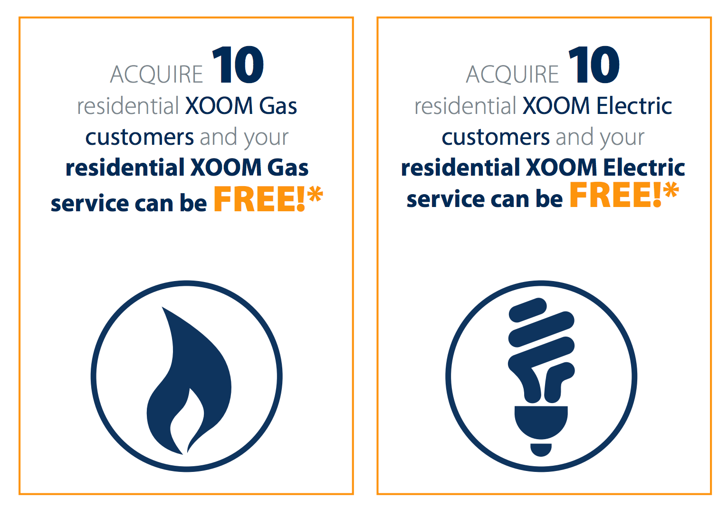

Slide 20

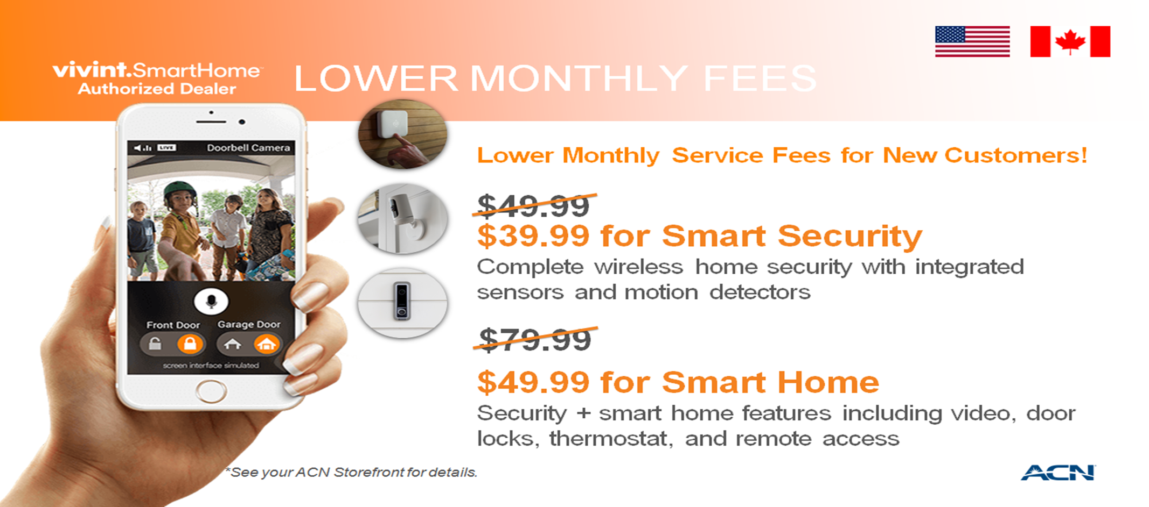
8 points
ACN’s Direct Vivint Sales 877-479-1668

Slide 21



IDENTITY PROTECTION
Up to 8 pts
Notes:
Flagship product. Spouse or children over 18, 2 points each adult. Great service bcuz growing epidemic. Lets watch this video so we can learn more about the need for this service.

Slide 22

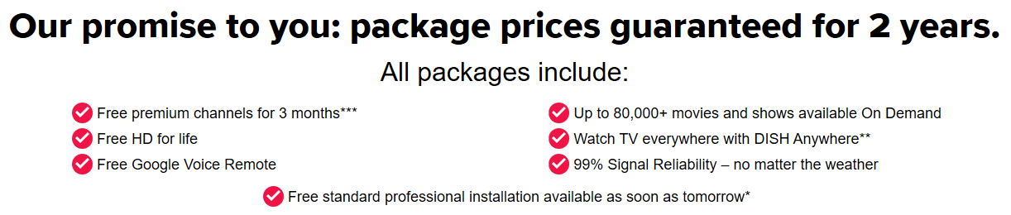
5 Points
Order Online from your ACN storefront or Call to Order!
For residential customers : 800-222-5368
For commercial customers : 888-320-3558

Slide 23
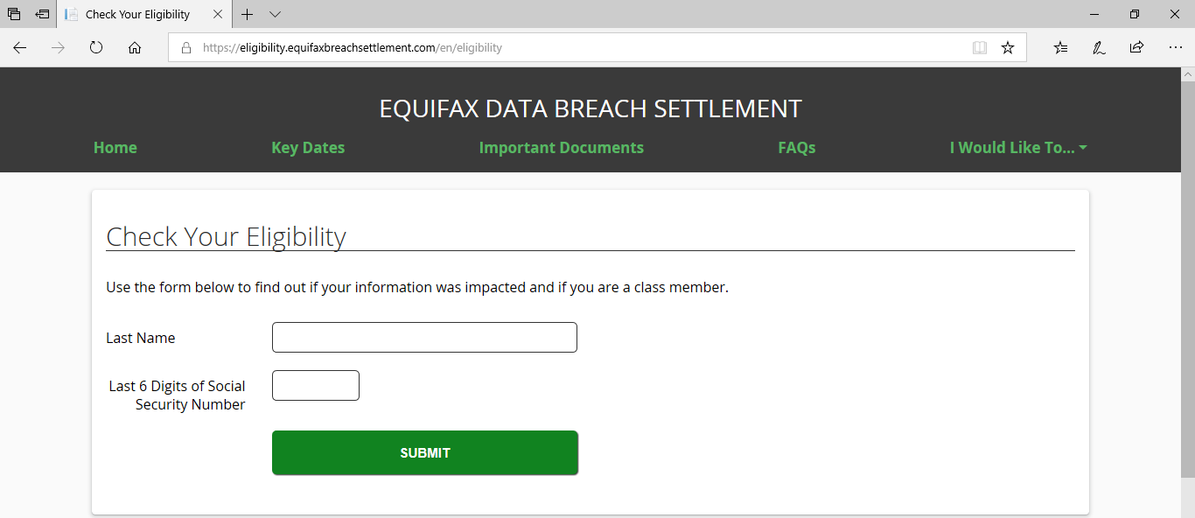
Equifax breach affected over 140 million Americans.
Are YOU one of them?
myidseal.com

Slide 24
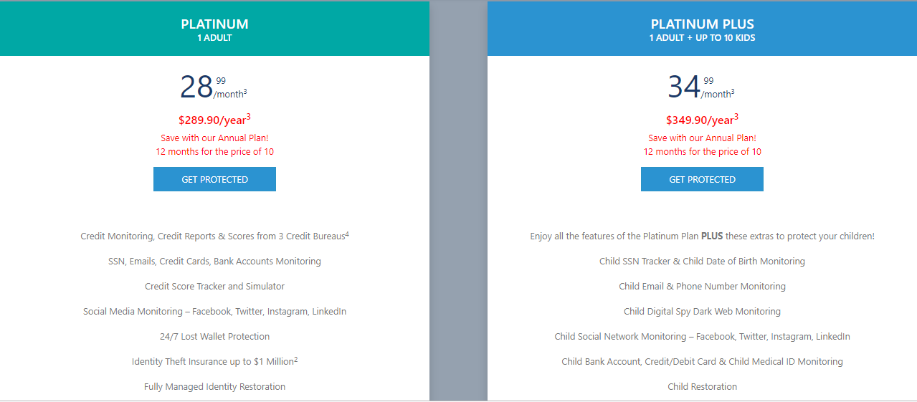
New Year point promotion : 4 points/month or 8 points/annual

Slide 25
Create Your Story Today!
5 services with a minimum of 10 points
= $200
+ $50 for directly sponsored CQs

Slide 26


LAUNCHING YOUR BUSINESS
Private Business Reception (PBR)
OVERIDING RESIDUAL INCOME

Slide 27
Overriding Residual Income
4%
4%
4%
4%
4%
40 Personal Customer Points
60 Personal Customer Points
75 Personal Customer Points
RVP and Higher get paid below Level 5

Slide 28

Home Meeting (PBR)
1. Set A Date - Have Your Meeting at YOUR HOME
- 4:30, 6:30pm and 8:30pm Weekdays / Weekends on the Hour
2. Make A List. 100 names and numbers. Do Not Prejudge!
- Your “A” List is Your Top 10
- Business Owners
- Network Marketing Experience
- Already Successful
3. Invite, Invite, Invite...
- 50% Will Not Show
- The Size of Your PBR will Duplicate, good or bad
- Your goal is to pack your living room!

Slide 29
invitation script
Start by asking “Do you look at other ways of making money”?
Share your “WHY”
Edify the speaker
Handling questions
Talk about the person, not the thing. “That’s a great question, but I don’t have all the details. I know it deals with technology and cyber security. And that’s why this speaker is coming. I can’t wait to learn from them based on their success.”
Set up the friendly reminder call (confirmation call)
Do not present,
just invite!
Enthusiasm & Urgency = Great Results
Practice the Script

Slide 30
“Are You Ready To Get Started?”
Yes
Questions
No
Schedule Your PBR TODAY!
Sign up as a
IBO
Questions About Becoming
IBO or Customer?
Thank
Them!
Pencil In Home
Meeting Date
If IBO: Draw out
ETL Road Map
Sign Up As A
Customer
Promote local
Training!!
Promote local Training!!
ACN Compass App & Magazine
ACN Compass App
& Magazine
Ask for
Referrals!

Slide 31


&

Slide 32
Professionals SORT Amateurs SELL and CONVINCE Sorting is fun! Convincing is draining! Be a professional listen, sort and move on …and remember a NO may NOT be a NO FOREVER SW, SW, SW, SW, NEXT !!

Slide 33




Emotional Rollercoaster
KEEP THE BAR DOWN ! ! !
This is Normal
Focus on your WHY

Slide 34
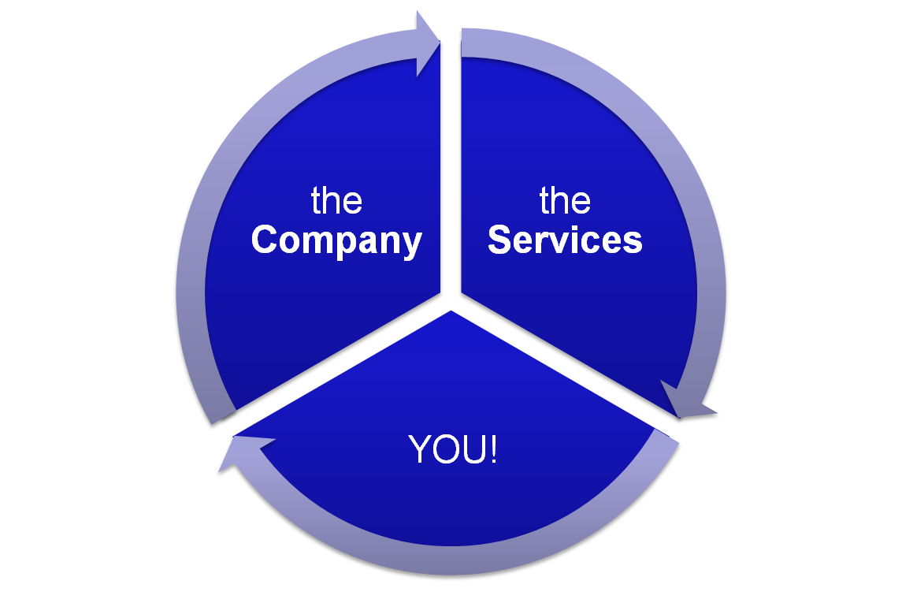
ACN is the same for everyone
Invest
in
You

Slide 35
We are in the “promoting” business
International Event
Leadership Class
Weekly Training
Home Meetings
Events Build Your Business
Events Build Your Belief
YOU!
Events Build

Slide 36






Slide 37
Notes:
Convention video – experience the excitement

Slide 38

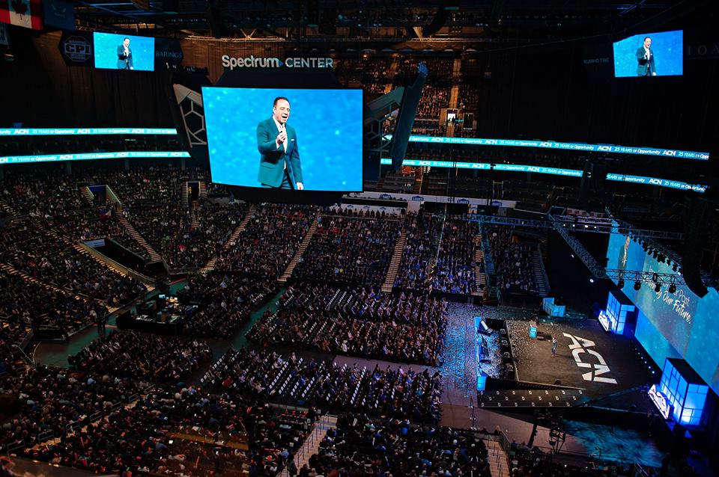

Slide 39

Call to Action
CREATE SUCCESS TODAY:
Qualify your position for income by getting Promoted to CQ Today*
Schedule Your PBR before leaving.
3. Get Registered for Charlotte, NC
(acnreg.com)

