Slide 1
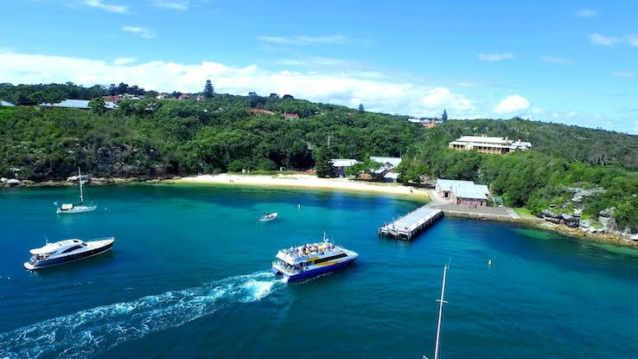

Human Factors IN TRAFFIC CRASHES, Analysis of Drivers’ Responses –
OPEN CLASS: MANLEY NSW
Presented by: Jeffery Muttart Ph.D.
World renowned Human Factors expert
Location:
Qstation – Sydney Harbor National Park
1 North Head Scenic Drive, Manley NSW
Course Fee: $1,730 AU
$1,200 USD
It has been 3 years since Dr. Muttart has come to AU to teach, don’t miss out on this year’s class.
Register on our website:
www.crashsafetysolutions.com or Contact:
Lynn@crashsafetysolutions.com
860-861-1418
Course Topics
Perception-Response Time
Response to slow moving or stopped vehicles on multilane high speed roads
Nighttime recognition
Headlight mapping demonstration and instruction
Driver decision making
Research in IDRR
Gap acceptance for left turns, right turns, and through movements for drivers, riders, and pedestrians
Pedestrian walking speeds
Acceleration
Lateral acceleration (swerving) for cars, motorcycles, and commercial vehicles
Forward and backward acceleration of cars, motorcycles and commercial vehicles
Drivers’ responses to green and yellow traffic signals, deceleration choice, reaction time and probability of stopping
Visit www.CrashSafetyResearch.com/about/ to learn more about Dr. Muttart

