Slide 1

Satellite Equipment & Services Overview

Slide 2
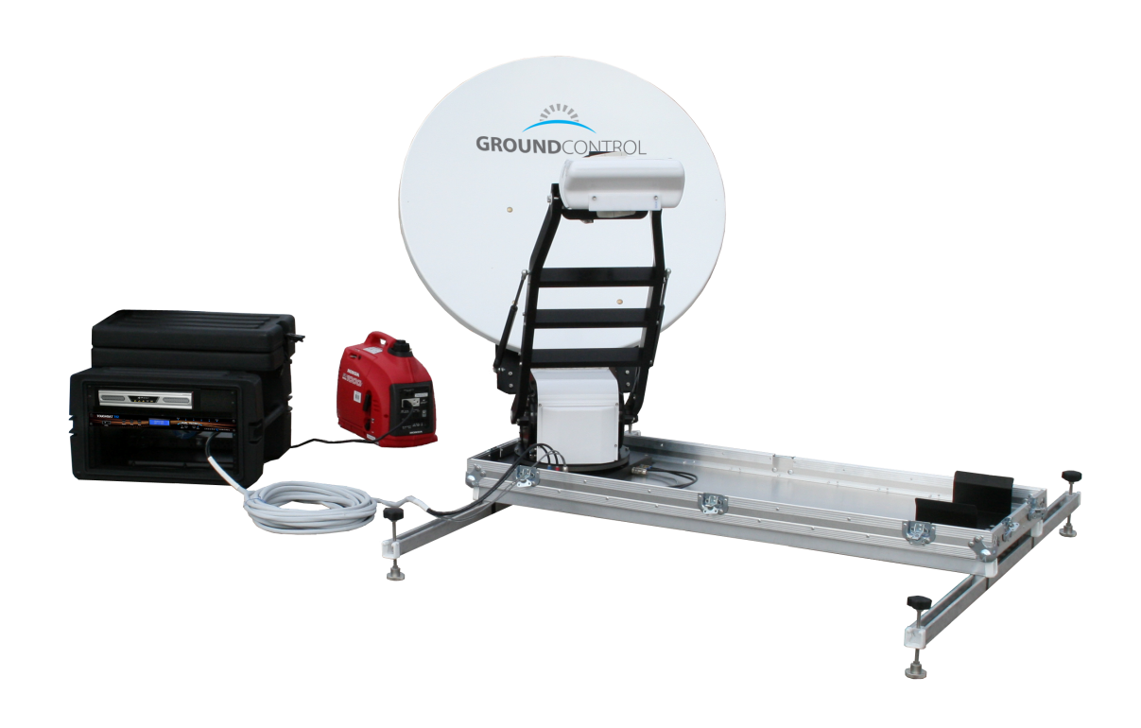
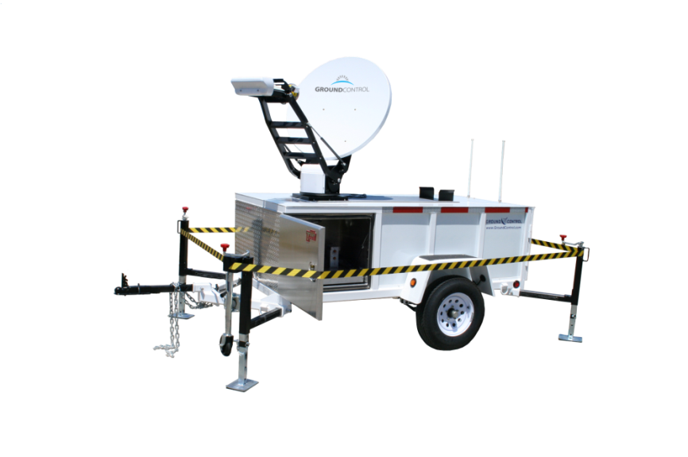

DRRECOMMENDED HARDWARE
Ground Control Toughsat Auto Deploy
Flyaway Configuration
T-100 Trailer configuration
iDirect Evolution Modem Technology with TS2 Dual Matrix ACU
Manufactured and supported by Ground Control

Slide 3
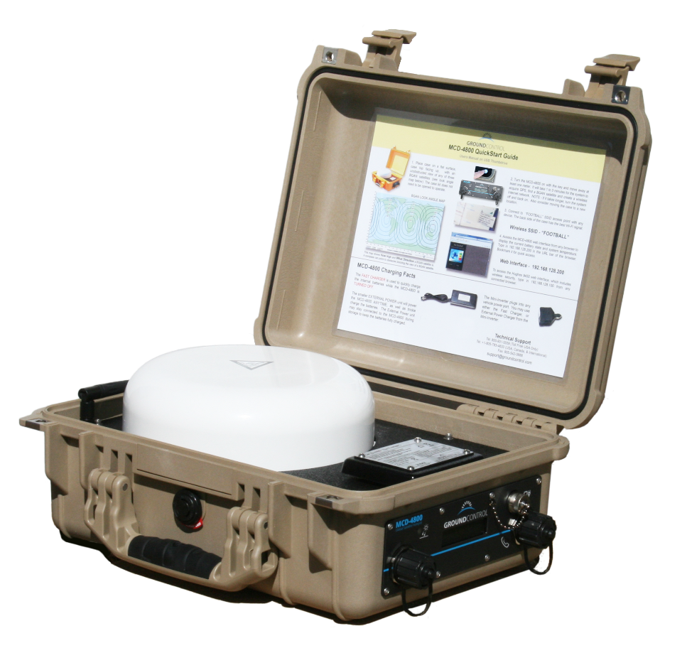
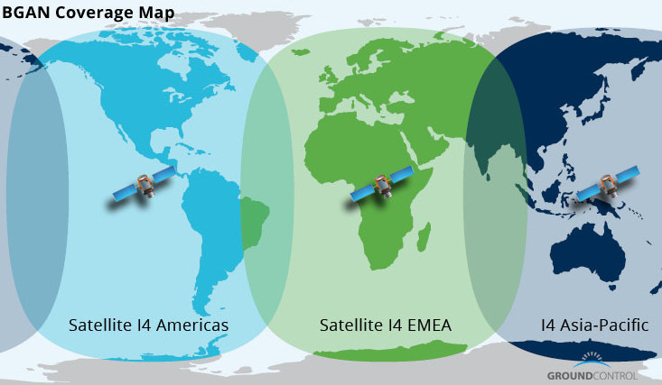
DRRECOMMENDED HARDWARE
MCD-4800 – Portable Satellite Hotspot
Auto pointing satellite terminal – functions globally
On board power – up to five hours on single charge
Offers access to critical communications such as email, video and voice
Enclosed in watertight Pelican case and can be operated with the unit closed.

Slide 4

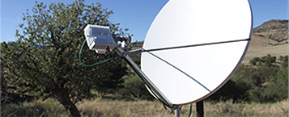
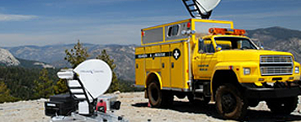


GROUND CONTROL COMPANY PROFILE
We are a single source provider of Professional Grade Satellite Internet Services & VoIP as well as a Satellite System Manufacturer headquartered in the United States.
In business since 2002, we have handled thousands of installations around the world with fixed, mobile and portable equipment. We specialize in Ku band services in North America utilizing the Dual Matrix Network. With fully staffed Technical Support, Engineering and Assembly departments, we are able to be single source for hardware and services.
FIXED
MOBILE
PORTABLE
Complete fixed systems are tested, provisioned and shipped directly onsite where our technicians will install and support the VSAT connectivity.
Our Flagship product, the Toughsat, is used in the Oil & Gas industry for both primary connectivity and disaster recovery. The Toughsat is available in vehicle mount, portable flyaway cases and trailer options.
Satellite phones and L-Band portable terminals are a compliment to standard Ku VSAT services. Equipment is extremely portable and can be utilized for exploratory missions where VSAT installation is not required.

Slide 5
SATELLITE APPLICATIONS
Ground Control provides connectivity anywhere in the United States. Just like your home or office, we provide you with a wireless environment or a standard Ethernet port. All of your applications can be run over satellite such as:
Web Browsing
Voice over IP
Email
Video Conferencing
VPN
Simple Voice over IP phones can be connected to allow standard phone communications anywhere in the world.
Cellular Network extenders can be connected to allow users to user their Verizon or AT&T cellular phones even when there are no active cell towers available. Ground Control currently provides our Flyaway hardware to AT&T for this very service to their remote customers.

Slide 6
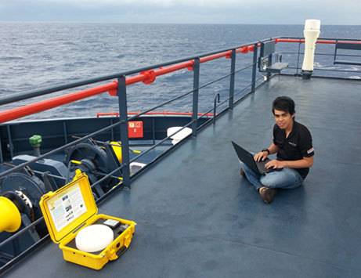
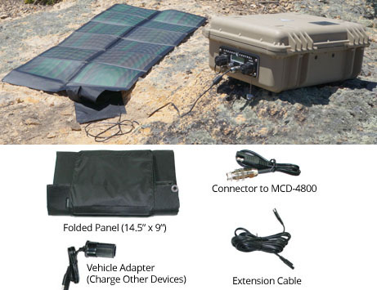

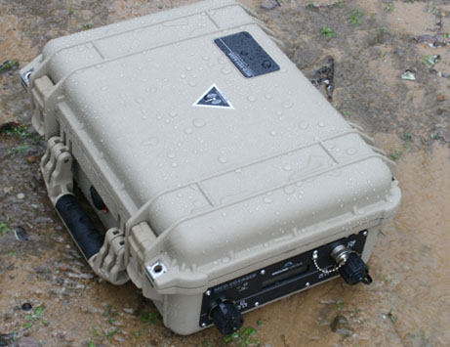
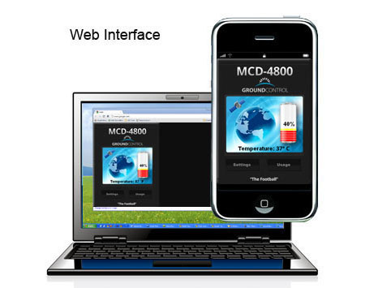
COMMUNICATIONFLEXIBILITY
Voice
Video
Data
Email

