Slide 1
Rebranding/ upgrade
Logo + packaging brief
myAir
Stressless Routine

Slide 2
Who we are:
myAir is a personalized functional food company, specializing in stress-management
The company's product line is based on a clinically proven Super herbs & terpenes IP protected formula.
myAir produces nutrition bars with stress relieve formulations.
Our unique technology enables us to personalize the best solution for each of our customers, and adjust the solution over time, to fit their needs best.

Slide 3
myAir - Brand Attributes:
Delicious > Taste is the gate to every food product
Nutritious > We are in the wellbeing business
Personalized > We adjust the optimal solution for each of our clients, with a learning personalization mechanism
Trustful > Pharma grade quality assurance, full compliance, top data privacy assurance
Clinically proven > Our products were clinically tested in renowned scientific labs, with the provision of the best professionals in the fields of both stress management and medical cannabis
Effectively stress relieving > Our research shows that our product is effective as promised, and we give our clients tools to monitor their stress levels over time, and see the impact of our products in a measurable way

Slide 4
Our purpose:
Enable people to successfully manage their stress levels, as part of their healthy daily dietary routine.
Manage your stress to be at your best
Stressless routine

Slide 5
Our Values:
Bullet proof trust > We are determined to earn our customers trust. From quality assurance, to data protection, full compliance and more, we are committed to do all that it takes to be trustworthy.
Empowerment > stress management is about power not weakness. We empower people who understand that stress should be managed as part of a healthy lifestyle, to do so as part of their daily dietary routine
One size does not fit all > stress is different for different people, and so should be stress management solutions. We need to understand our clients and monitor their stress levels over time in order to match them the ideal stress management for them.
If you can't measure it, you can't manage it > We believe that in order for people to manage stress they need to have measurement tools. So, monitoring and measuring stress levels over time is an inherent part of our value proposition
Learning never ends > Science never stops discovering, and we never stop investigating and learning. We are committed to always be in the forefront of stress management science.

Slide 6
Differentiating Advantages:
Our business model: We acquire customers, rather than selling products.
As stress experts we understand that stress needs to be managed on an ongoing basis, and not as an ad-hoc "pain killer". This is why we build stress management programs rather than selling products on occasional basis.
Our proprietary formula: We formulated an IP botanic extracts & terpenes formula, that is research based and clinically proven.
Our Technology: Our science-based technology enables us to personalize the optimal dietary routine to each of our customers, and create a personalization mechanism to better fit our solutions to our customers

Slide 7
Target Audiences Analysis

Slide 8



We identified 3 major segments represented by 3 personas
Julia, The super juggler
David, The career builder
Debra, The stay at home mom

Slide 9
Meet Julia, the super juggler
Julia is 48 years old, married with 3 children.
A partner in a very successful law firm.
she wakes up very early in the morning,
and starts running from the moment she opens her eyes. Between orchestrating her job, taking care for her children, managing house chores and visiting her aging parents at least once a week – she also squeezes Pilates at least twice a week, and tries to jog from time to time.
Her life is very satisfying, yet very stressful.

Slide 10
Meet David, the career builder
David is 29. He’s a software developer in a Silicon Valley company.
He is very ambitious and dreams of climbing the ladder and becoming a part of the company’s executive management.
His work is extremely demanding. Deadlines are tough an his boss keeps piling more and more tasks on his desk. His newly wed wife finds it hard to accept his long working hours.
Although he is highly appreciated by his team, he is in a constant fear of falling off track.

Slide 11
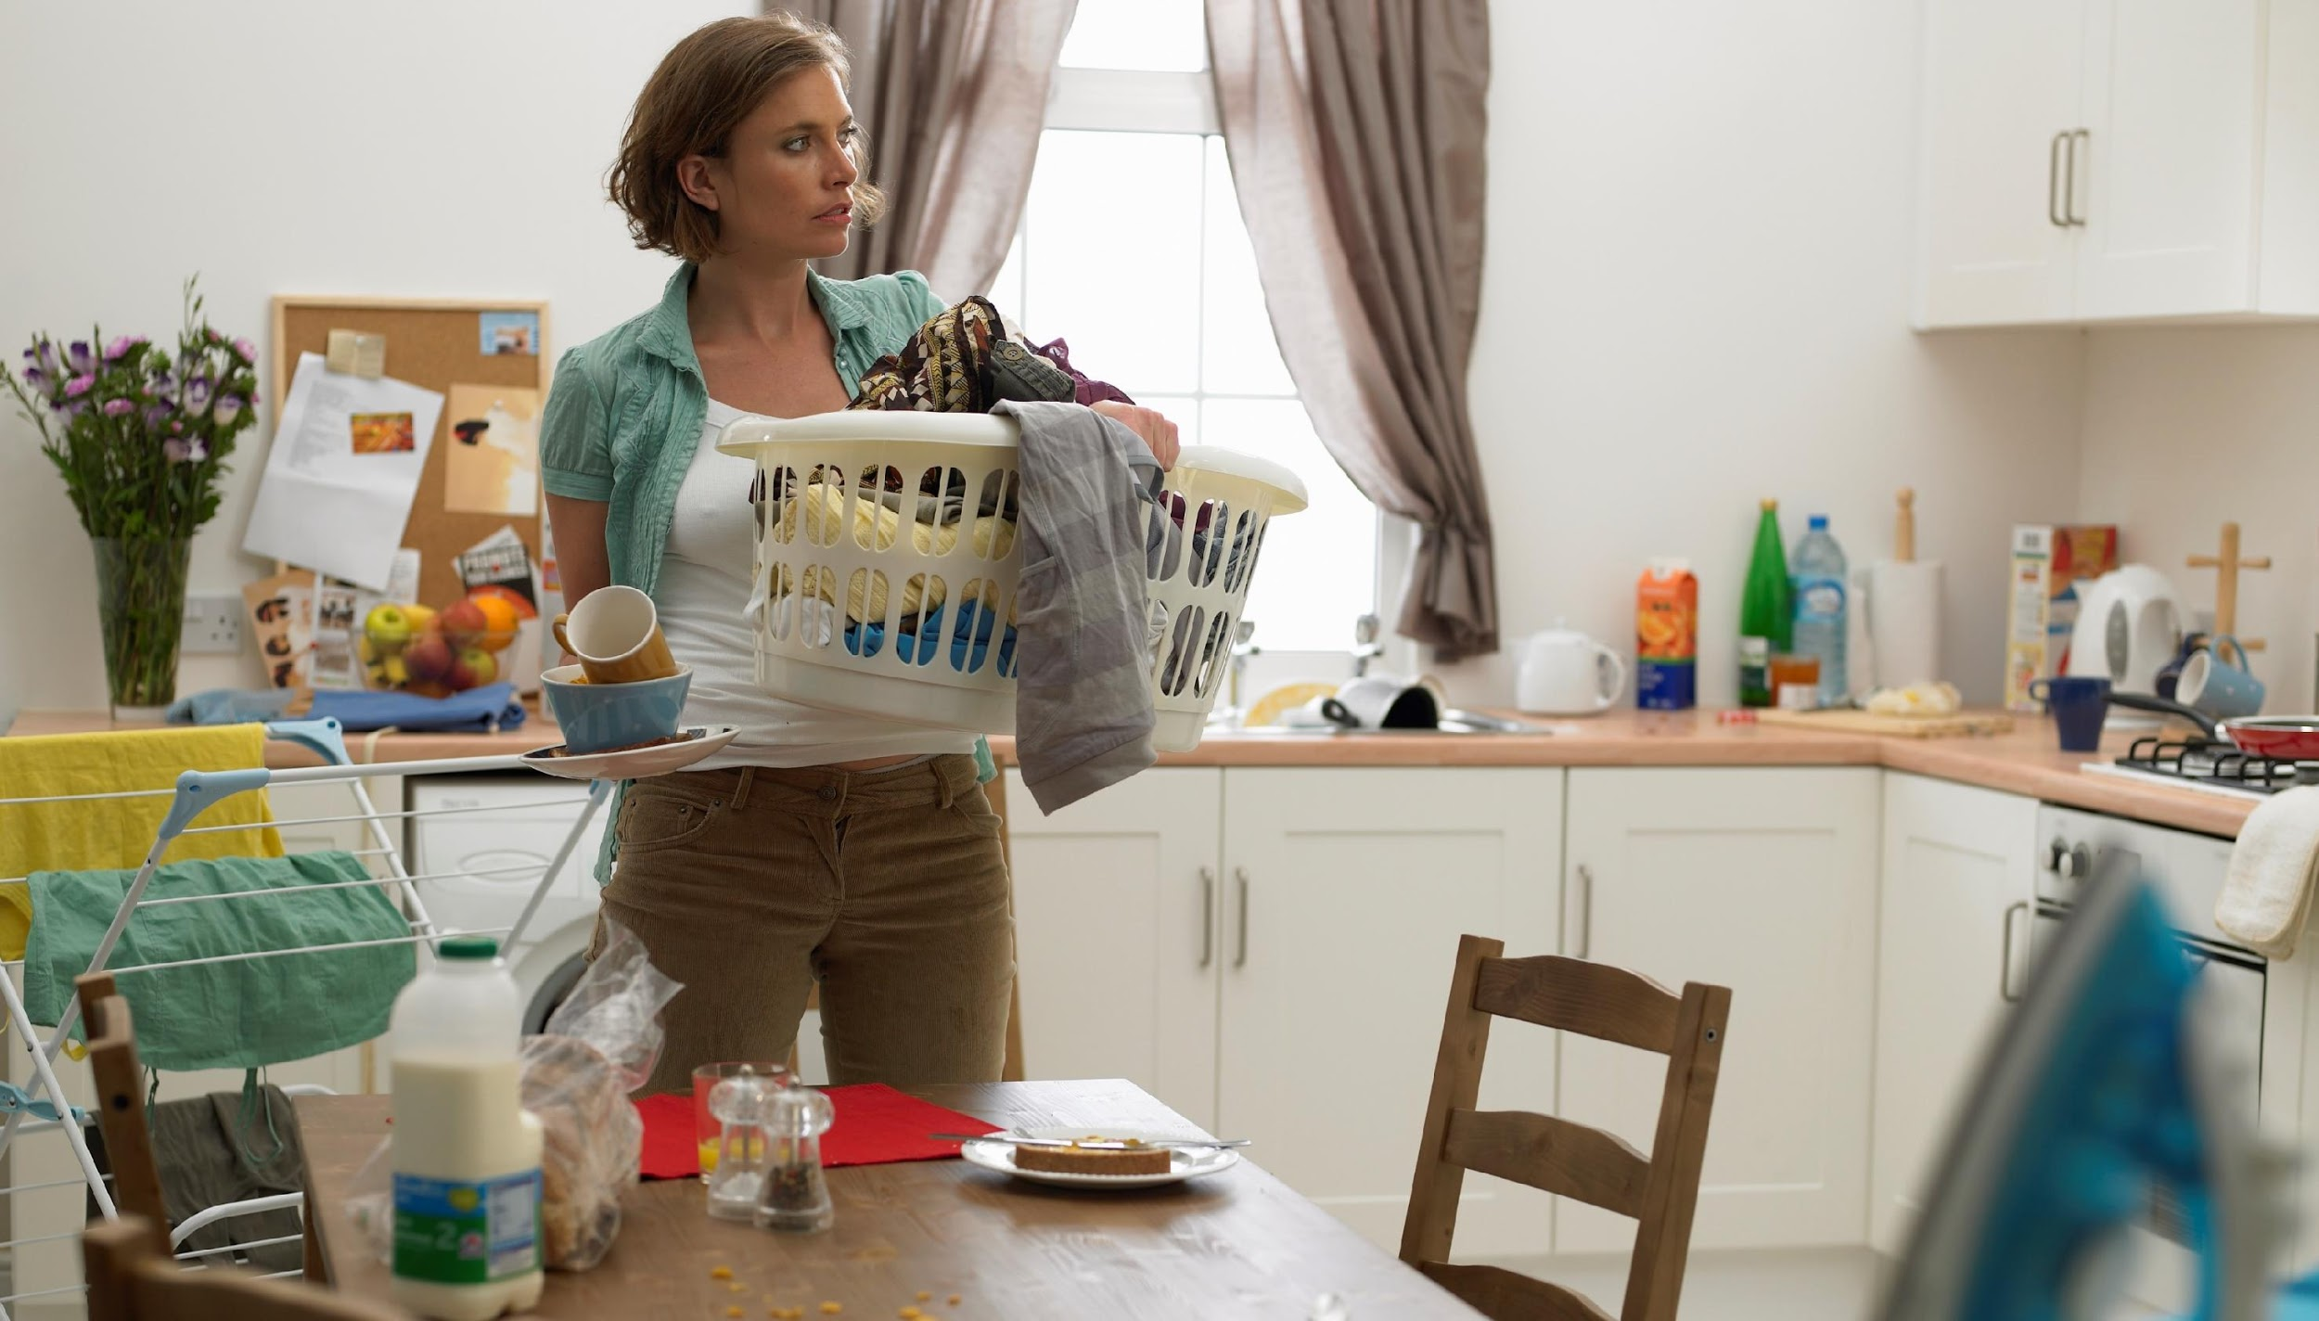
This is Debra, the stay at home mom
Debra is 37 years old. She is married with 4 kids.
In her 20s she was a very promising young professional.
However, when her children were born, she decided that raising them was the most important thing for her.
So she took all her energy and skills and invested them in being the best mom she can. She invests a lot in her kids and their education. She sits for hours with each of them, making sure they realize their full potential. She takes them everywhere, having to keep a tight schedule in order to do so. She is also very active in community affairs. As part of her perfectionism, she makes sure every member in her family eats well, exercise regularly and embrace an overall healthy lifestyle.
Not many acknowledge it, but Debra has the hardest job on earth…

Slide 12
Julia, David & Debra are very different, yet they have a lot in common
They all run a very active, even hectic, lifestyles
They are all achievers: ambitious and committed to their goals
They are successful, intelligent and tech savvy
However, their life is very stressful…
Their task list never shortens, and they are always short of time
They demand a lot from themselves, and they are in a constant fear to lose control
They feel that if they’ll slow down even a bit, they will fall off track
They are looking for ways to keep up their pace,
without any stress holding them back

Slide 13
User Image:
Urban > Our target audiences live in cities, and manage an urban lifestyle. They are in a constant search for better solutions to live a healthier lifestyle in the demanding environment of urban life.
Smart > We all understand that nutrition and sports are crucial for health, but most people ignore stress and its devastating impact on health. Smart people realize that stress management is just like nutrition and sports: an inherent part of living a healthier life.
Progressive > Our customers are tech savvy, early adaptors and trendy.
On top of things > Our customers are strong people, that manage a successful and fulfilling lives. They are achievers: ambitious and committed to their goals. Their motto in life is "When there is a will, there is a way".

Slide 14
Reference for bars

Slide 15
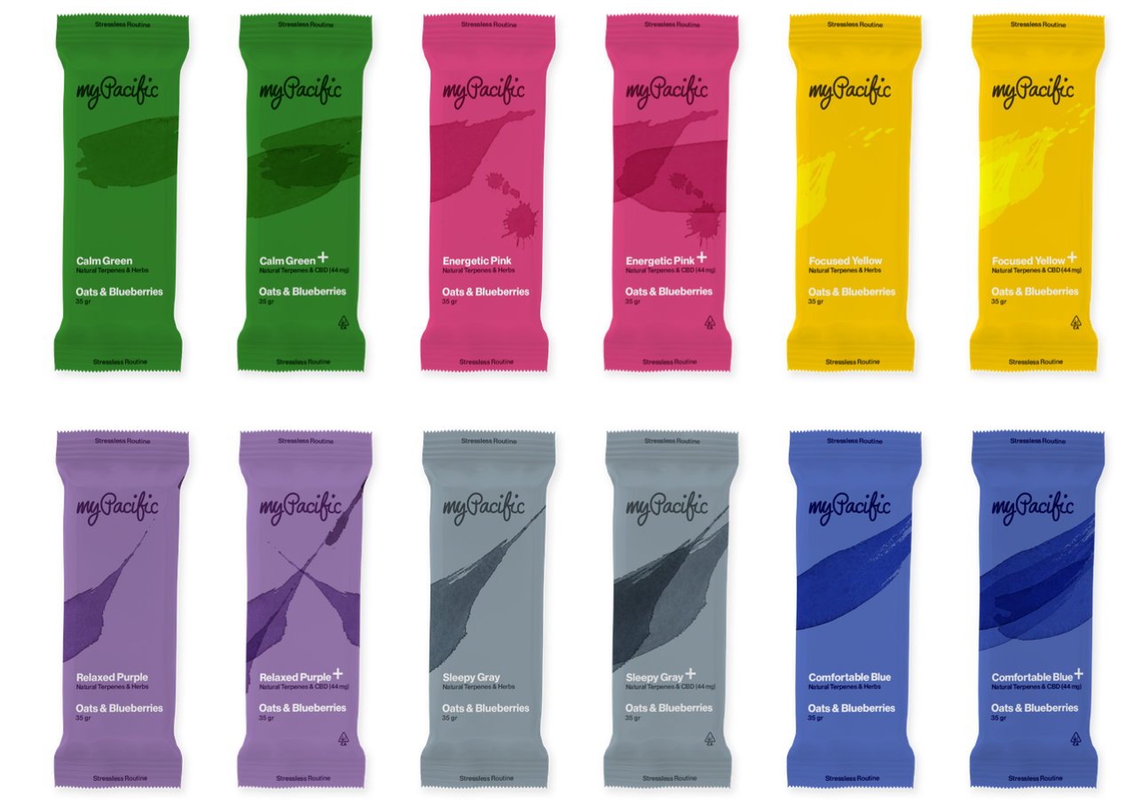
This is our current design.
We would like to rebrand ourselves-
1. New name (myAir)
2. Upgraded element on the package
3. More “passion for food) – to help consumers understand the 3 different flavors we have

Slide 16
Project deliveries

Slide 17
Project deliveries - LOGO
Logo for myAir -
white background + transparent
black background + transparent
favicon
landscape shaped
rectangular shaped

Slide 18
Project deliveries - Nutrition bar Packaging
1. Packaging design - 12 packages: 6 formulation designs X 2 strengths
Regular strength = Natural terpenes
Strong strength = Natural terpenes & functional herbs
2. We have 3 different flavors and we need to add a “food appeal” design to demonstrate the different flavors
Dates, apples & nuts
Oats, cranberries & chocolate
Oats, banana & pecan
please design ONLY Dates apples & Nuts, and give 1 example of each of the 2 other flavors
3. small simbol / icon for the Indication to day/night formulation:
 | regular Natural terpenes infused | Extra - terpenes AND functional herbs infused
Day nutrition bars | Calm Yellow Energetic Pink Focused Green | Calm Yellow Energetic Pink Focused Green
Night nutrition bars | Sleepy Gray Relaxed Purple Comfortable Blue | Sleepy Gray Relaxed Purple Comfortable Blue

Slide 19
myAir Stressless Routine | myAir Stressless Routine | myAir Stressless Routine | myAir Stressless Routine | myAir Stressless Routine | myAir Stressless routine
Design element Demonstrates the plant based functional terpenes and herbs | Design element Demonstrates the plant based functional terpenes and herbs | Design element Demonstrates the plant based functional terpenes and herbs | Design element Demonstrates the plant based functional terpenes and herbs | Design element Demonstrates the plant based functional terpenes and herbs | Design element Demonstrates the plant based functional terpenes and herbs
Comfortable blue (night icon) Natural terpenes & herbs | Sleepy Gray (night icon) Natural terpenes & herbs | Relaxed purple (night icon) Natural terpenes & herbs | Calm Yellow (day icon) Natural terpenes & herbs | Energetic Pink (day icon) Natural terpenes & herbs | Focused Green (day icon) Natural terpenes & herbs
Dates, nuts & apples | Dates, nuts & apples | Dates, nuts & apples | Dates, nuts & apples | Dates, nuts & apples | Dates, nuts & apples
A symbol/design element to demonstrate the flavor | A symbol/design element to demonstrate the flavor | A symbol/design element to demonstrate the flavor | A symbol/design element to demonstrate the flavor | A symbol/design element to demonstrate the flavor | A symbol/design element to demonstrate the flavor
30 gr | 30 gr | 30 gr | 30 gr | 30 gr | 30 gr

Slide 20
Design the new logo
day formulations
Design new element –
Based on this idea
Based on new idea that demonstrate our natural terpenes/ functional herbs / Plant based solution
night formulations
Design 2 strength versions for each formulation (Terpenes / Terpenes & herbs)
Based on that idea-same package colors, double element

Slide 21
Reference - designs of brands we loved (not the logos- the full brand and its feeling)

Slide 22
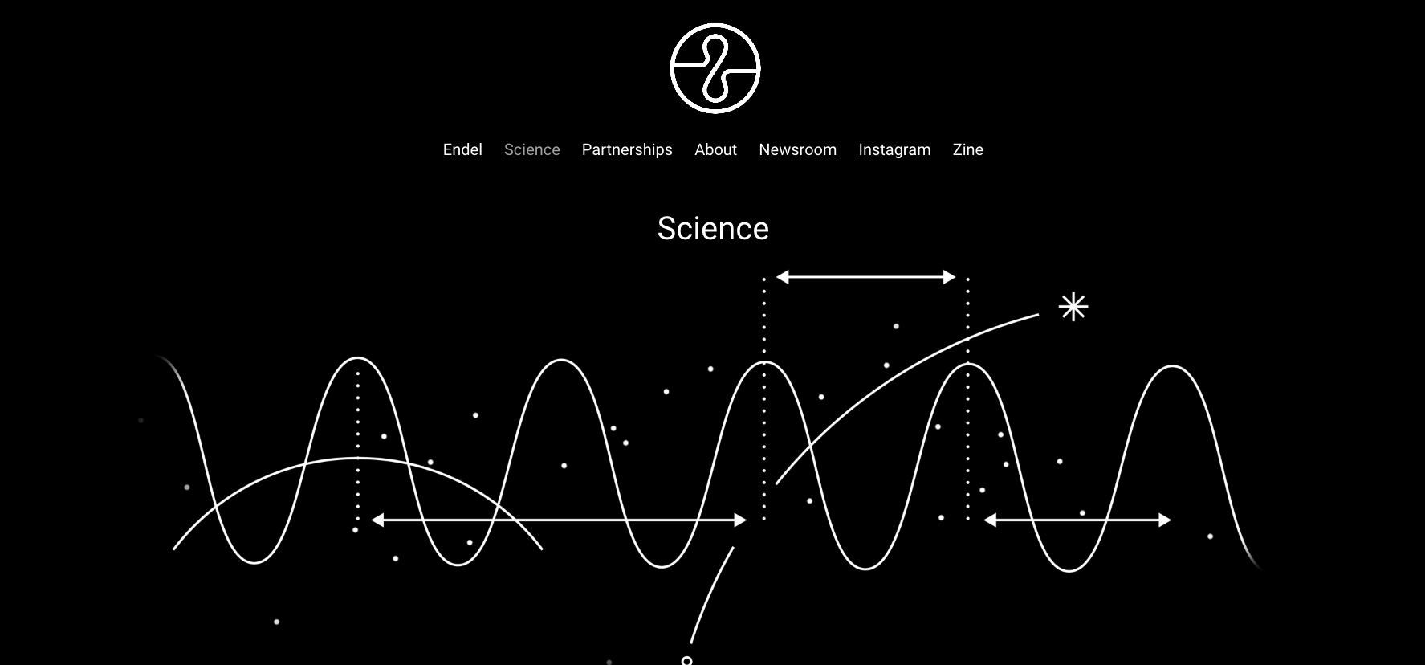
https://endel.io/

Slide 23
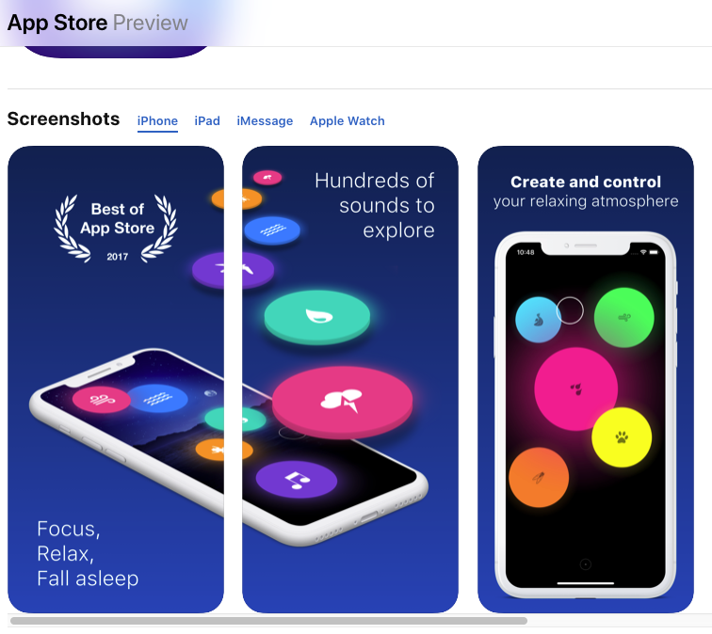
https://apps.apple.com/us/app/taomix-2-sleep-sounds-focus/id1032493819#?platform=iphone

Slide 24
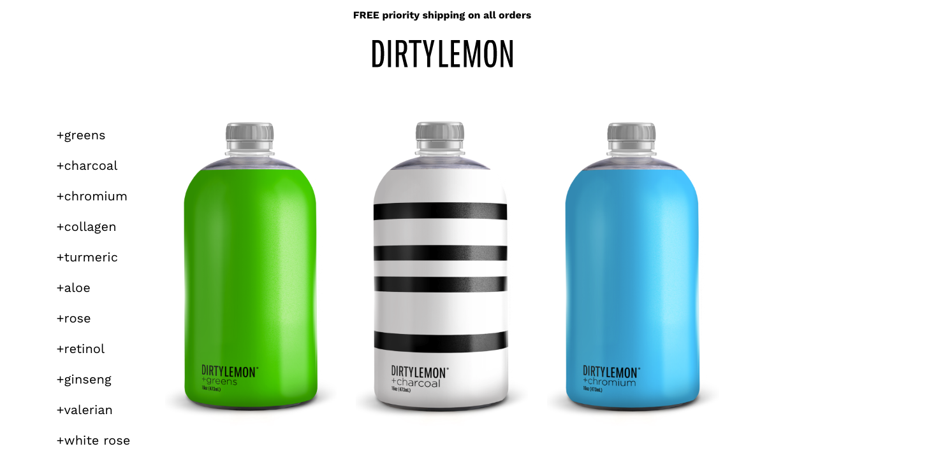
https://dirtylemon.com/

Slide 25
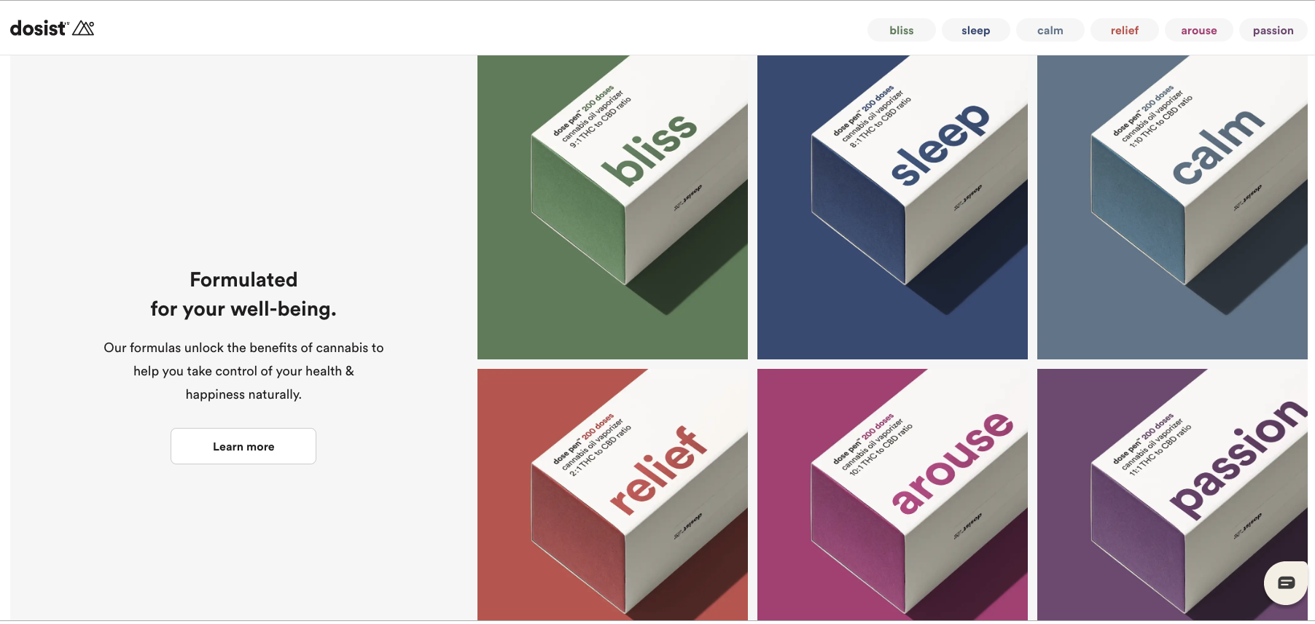
https://dosist.com/

Slide 26
