Slide 1
Brief Logo P2P Benchmarking Lab

Slide 2
Who we are
Losam Agency, marketing agency specializing in the creation and animation of communities.
Losam Agency created P2P Benchamrking Lab for the company Tradshift, a think tank dedicated to the Head of P2P (Responsible for accounts payable in companies).
The P2P Benchmarking Lab, what is it :
5 meetings a year (1 dinner + 5 breakfasts meeting)
1 founding committee composed of 8 leaders which will define the themes of the different meetings

Slide 3
Who are
Tradeshift
Tradeshift
Tradeshift is the business commerce company . They offer solutions for businesses to buy and sell goods and services, and a flexible platform for customers to tailor solutions to meet their needs .
They provide commerce for all.
Their mission
We are fighting for an open, connected, democratic way of doing business; for innovation that includes and empowers everyone in the trade process.

Slide 4
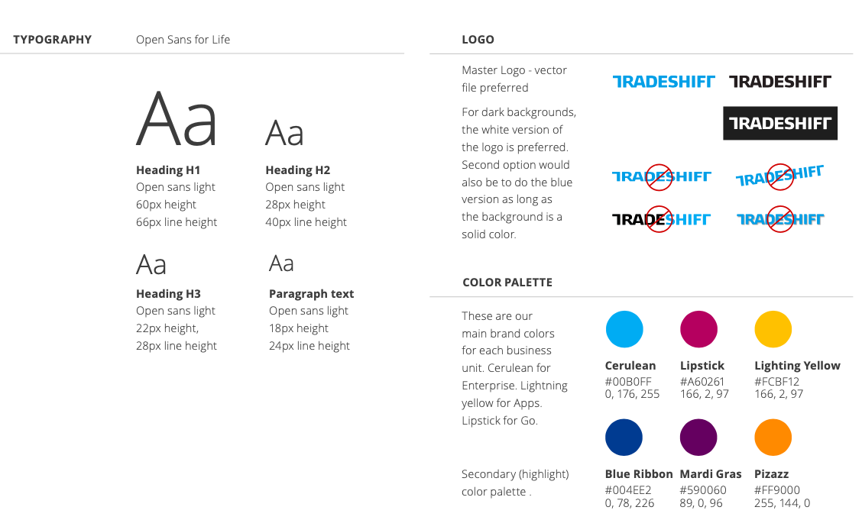
Tradshift - Brand Guidelines

Slide 5
P2P Benchmarking Lab
Target:
Head of P2P
In charge of accounts payable in companies
Positioning :
High-end, we address a target of corporate decision makers
Finance – the theme of the think tank
Professional, we address companies exclusively

Slide 6
Brief
What: Creating a logo
Sector: Marketing
Logo text: P2P Benchamarking Lab
Elégant
Amusant
Traditionnel
Personnel
Féminin
Coloré
Bas de gamme
Audacieux
Sérieux
Moderne
Professionnel
Masculin
Noir et Blanc
Haut de Gamme
v
v
v
v
v

Slide 7


Inspiration
Keep the DNA of the client Tradshift

