Slide 1

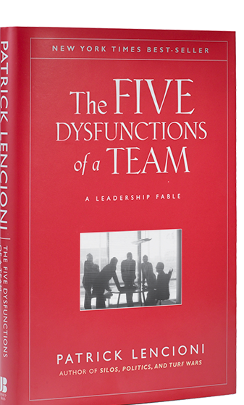



To do:
add department rollout
list separate objectives of key leader vs department
list the qualifications fo the transition eval

Slide 2

.
Objectives
Team cohesion
      Solid trust
  Aligned expectations
Playbook 1.0
Aligned vision, values, strategy, priorities & roles
Productive meetings
Consistent communication with greater org
Stage 1
Executive launch
meeting audits
Quarterly offsites
Transition readiness
Cohesion validation (CTAR)
Playbook complete
Meeting momentum
leader coaching
2 day
Objectives
  Key leaders
  Finish Playbook 2.0
  Become Ambassadors of Org Health
  Cross functional cooperation
Department teams
Cohesion, Clarity, productive meetings
Department rollouts
Break down silos
Dept priorities align to org priorities
.
Stage 2
Next level rollout
Key leader conferences
Key leader kickoff
meeting audits
Transition readiness
Department CTARs
  core values detailed and implemented
meeting mastery
Department teams
Department rollouts
leader coaching
Stage 3
Organizational rollout
Objectives
  All employees
  Understand and utilize the Playbook
  Are equipped & motivated to create a healthy culture
  The consultation is completed when the leaders are ready to assume responsibility for maintaining a healthy culture.
workshops
Legend
Transition readiness
Live off site
Playbook rollout
video-conference
Internal training
Legend
Train the trainers
Transition evaluation
Train the leaders
Training

