Slide 1
Thanks for choosing us!

Slide 2

This presentation shows what we currently have. But we want to give it a more modern style.
Feel free to change designs, images, icons. Surprise us! This document is just a guide to get an idea of the company web, content and what we want to show.
If the document is not clear enough, we attach links to each of the pages. Some links are public and others private.
If you want to see all the links, we need to create an account in our wordpress, which requires an email. If you are interested, send us your email to p.pradas@decidesoluciones.es and we will create your account.
OUR CORPORATE COLOUR:
OUR LOGO:
#e74e1d
R: 231
G: 78
B: 29

Slide 3
MAIN MENU

Slide 4
Search
Social networks
HOME (LOGO)
INDUSTRIES
TECHNOLOGIES
ABOUT US
RESOURCES
PARTNERS
Field Services
Machine Learning
Who we are
Transportation & logistics
How we work
Rule-based systems
Success Stories
Workforce planning
Mathematical Optimization
Carrers
Manufacturing
Contact us

Slide 5
HOME PAGE
https://decidesoluciones.es/en/?page_id=19849&preview=true

Slide 6
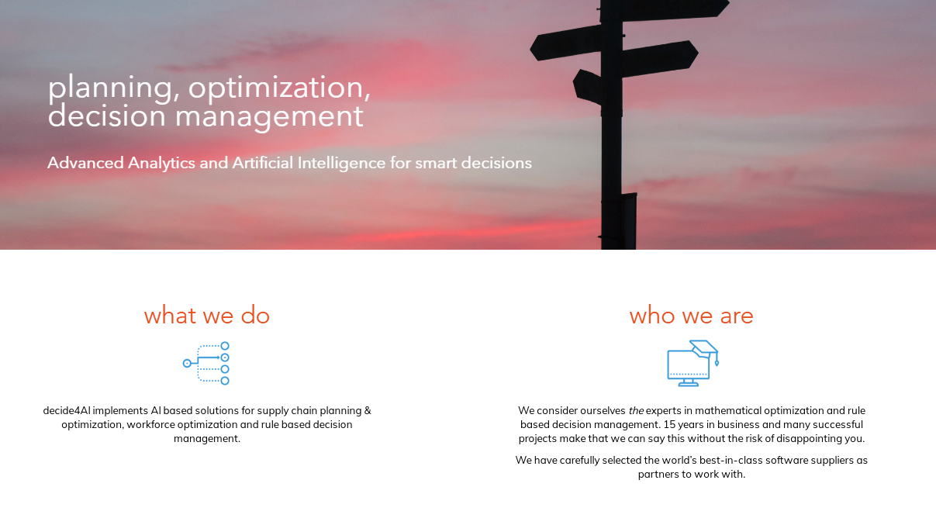
Interested to join us?
Click here and go through the 20 second test to find out if we are the right place to work for you.
(This button goes to an intermediate page (pop up?) detailed on slide 56.

Slide 7


Slide 8
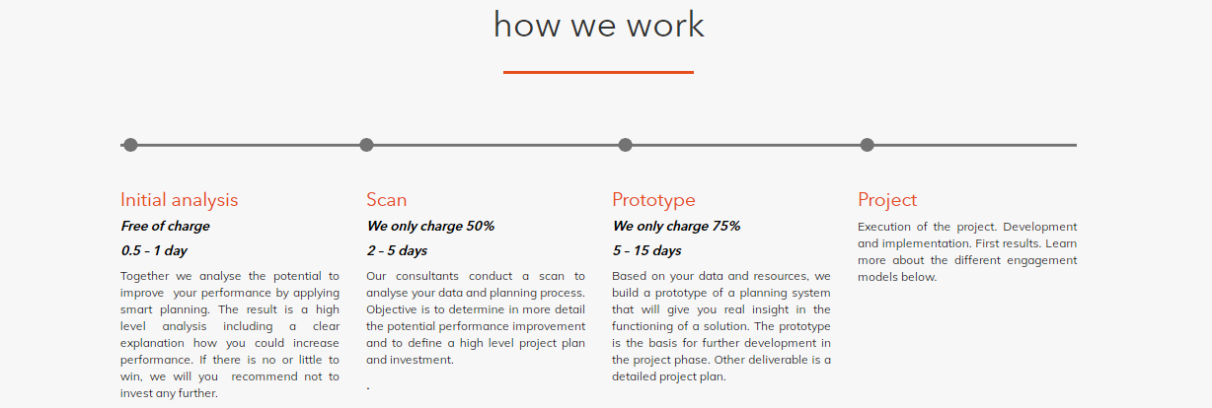


Slide 9
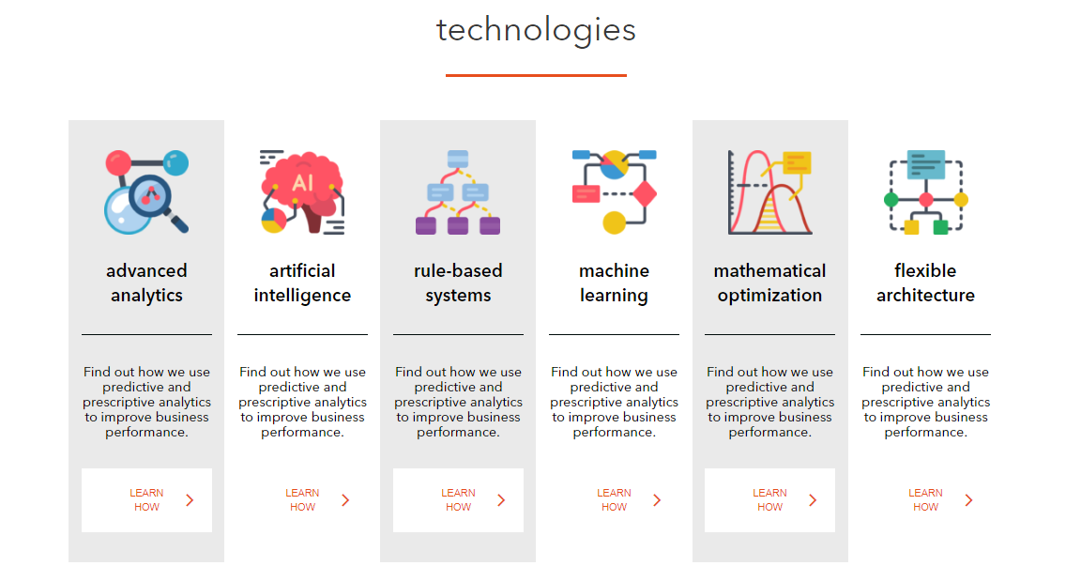

Slide 10



Slide 11
FIELD SERVICES PAGE
https://decidesoluciones.es/en/?page_id=20979&preview=true

Slide 12

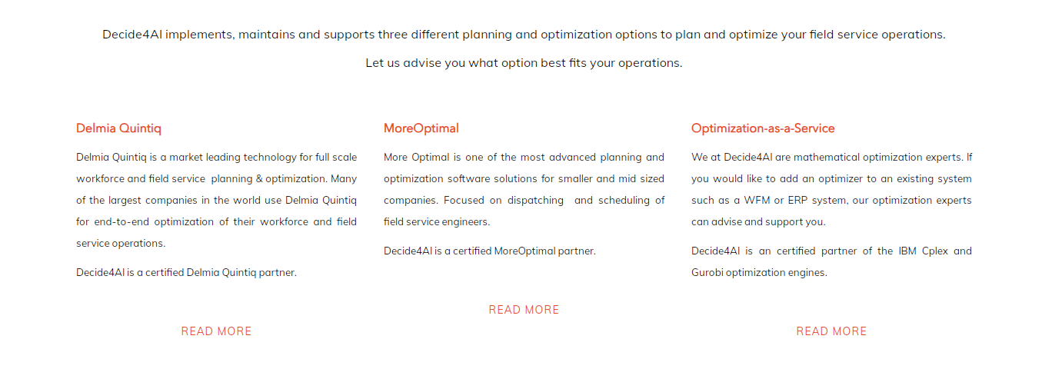

Slide 13
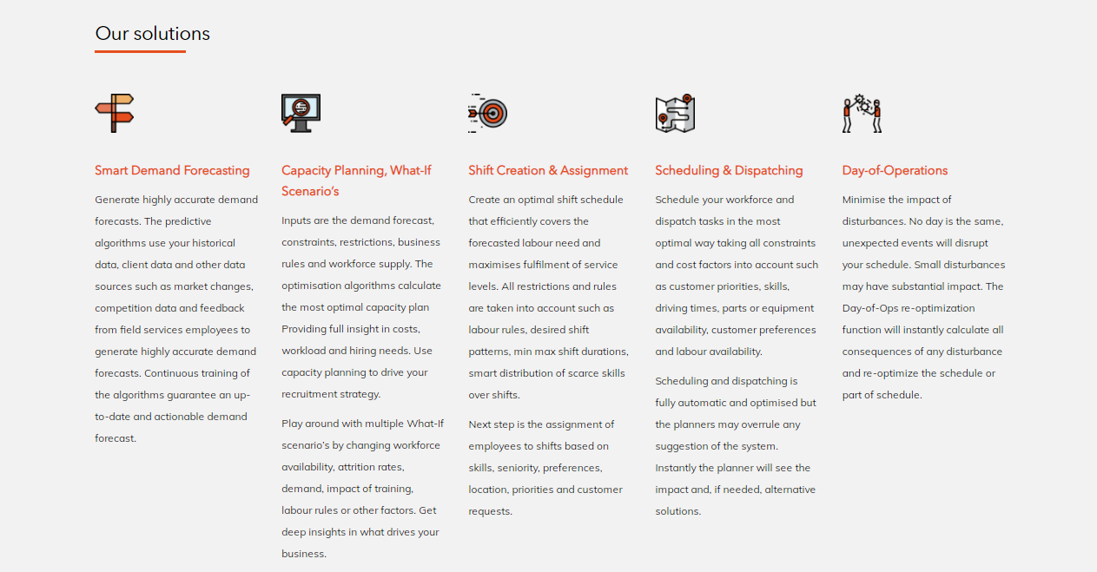

Slide 14


Slide 15
TRANSPORTATION & LOGISTICS PAGE
https://decidesoluciones.es/en/?page_id=22065&preview=true

Slide 16
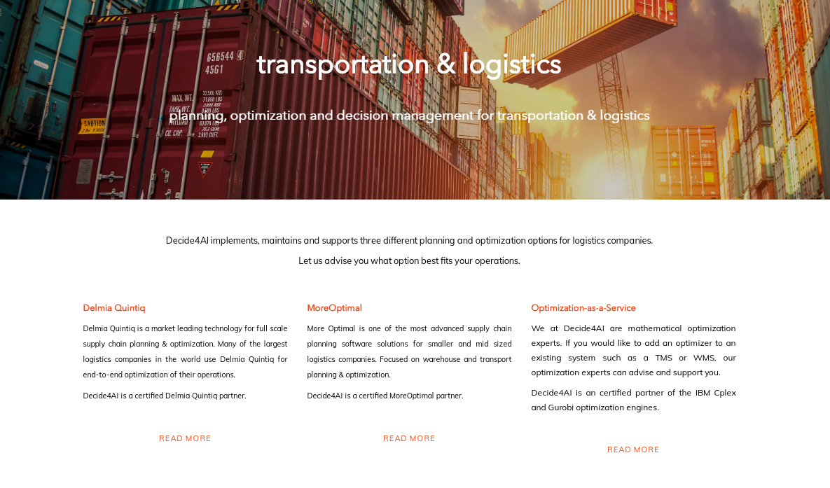

Slide 17
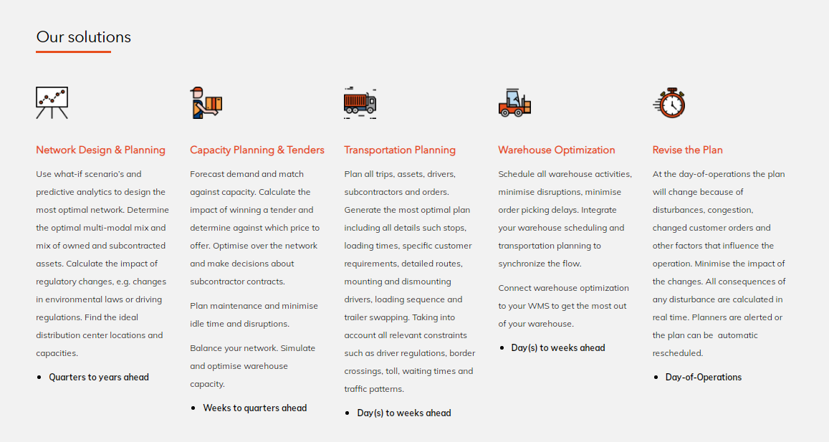

Slide 19
WORKFORCE PLANNING PAGE
https://decidesoluciones.es/en/?page_id=22086&preview=true

Slide 20


Slide 21
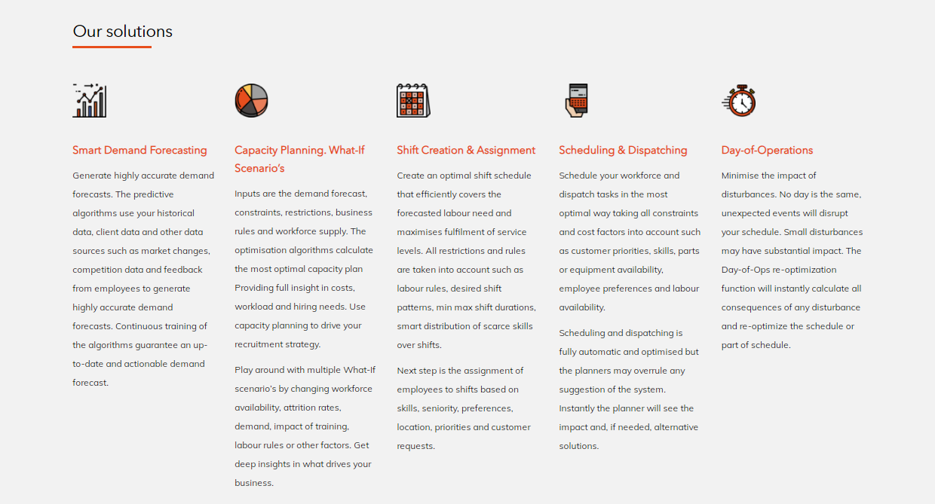

Slide 22


Slide 23
MANUFACTURING PAGE
https://decidesoluciones.es/en/?page_id=22100&preview=true

Slide 24


Slide 25
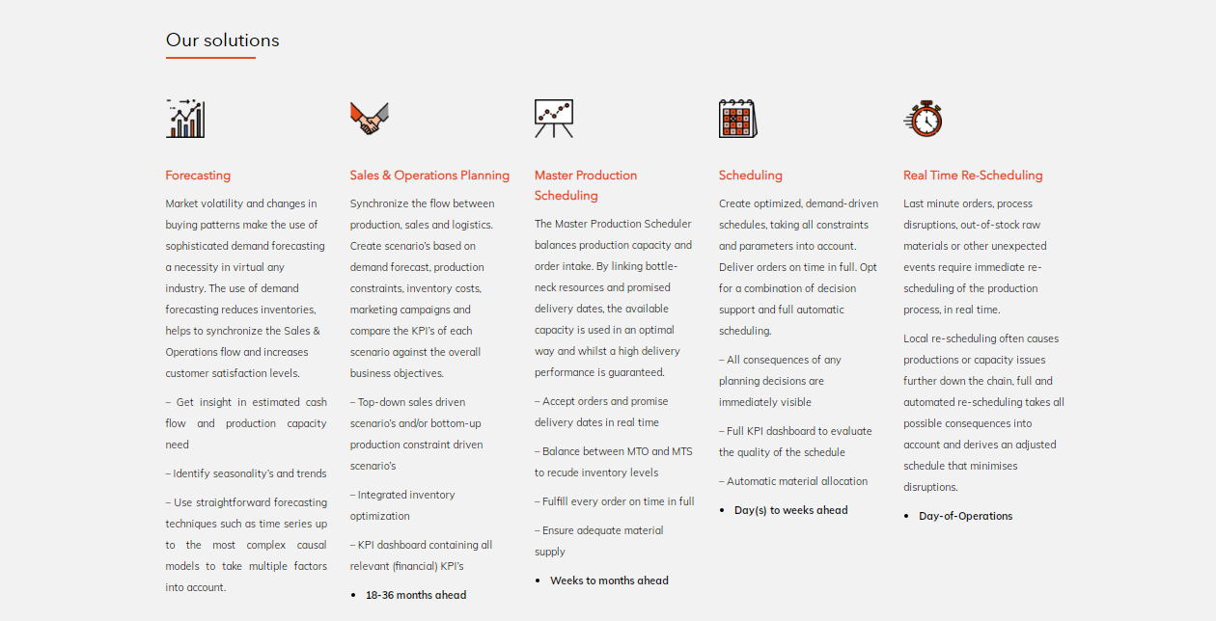

Slide 26
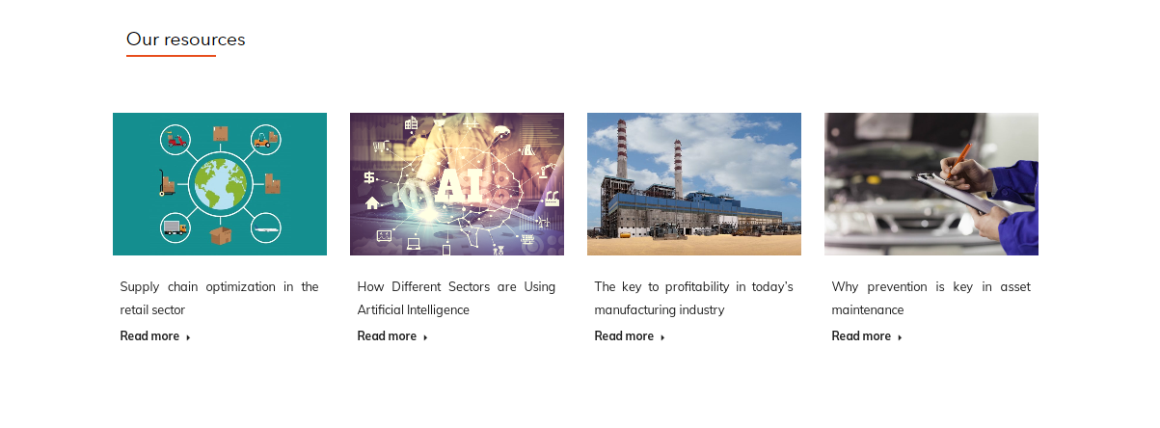

Slide 27
MACHINE LEARNING PAGE
https://decidesoluciones.es/en/technological-solutions/machine-learning/

Slide 28
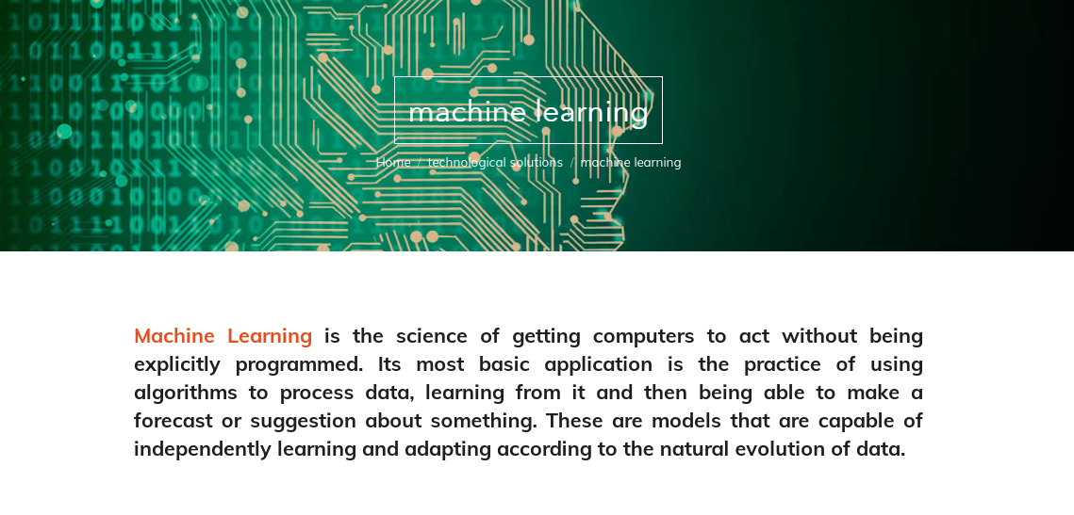

Slide 29
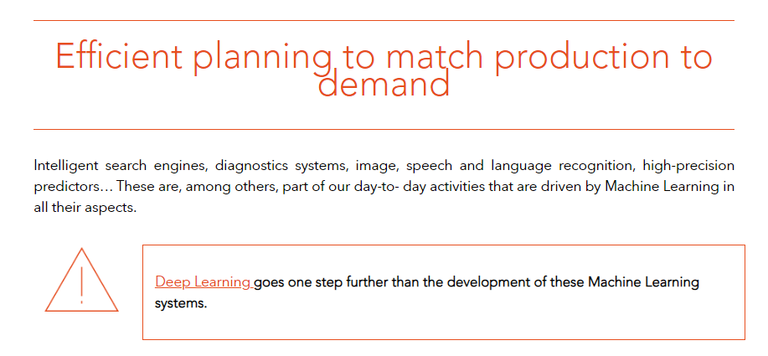

Slide 30
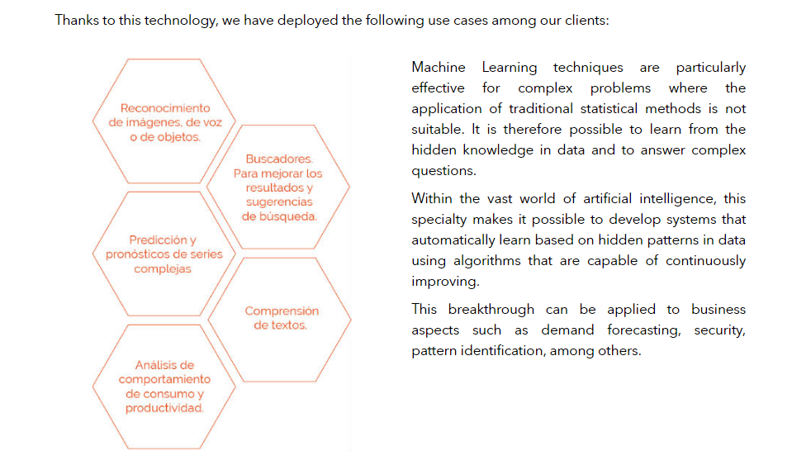

Slide 31

Industries in which we apply Machine Learning
Field Services
Transportation & logistics
Workforce Planning
Manufacturing

Slide 32
RULE-BASED SYSTEMS PAGE
https://decidesoluciones.es/en/technological-solutions/rule-based-systems/

Slide 33
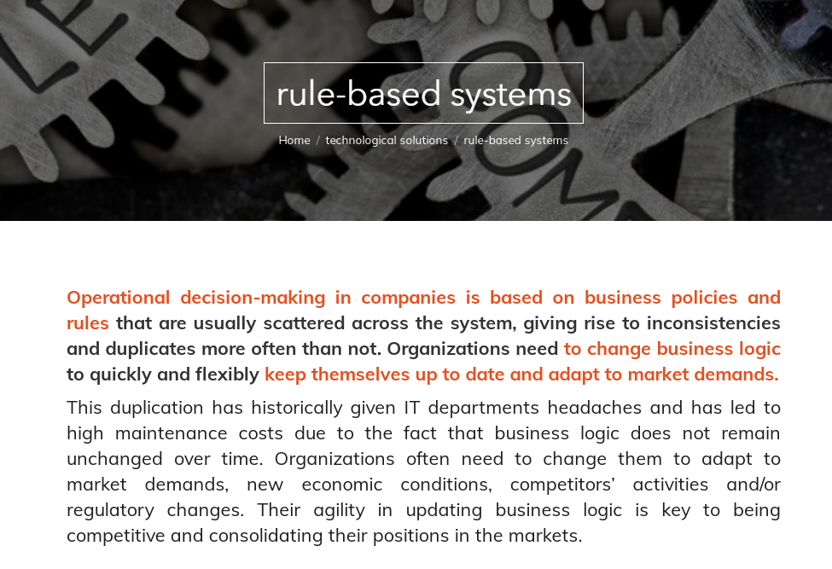

Slide 34

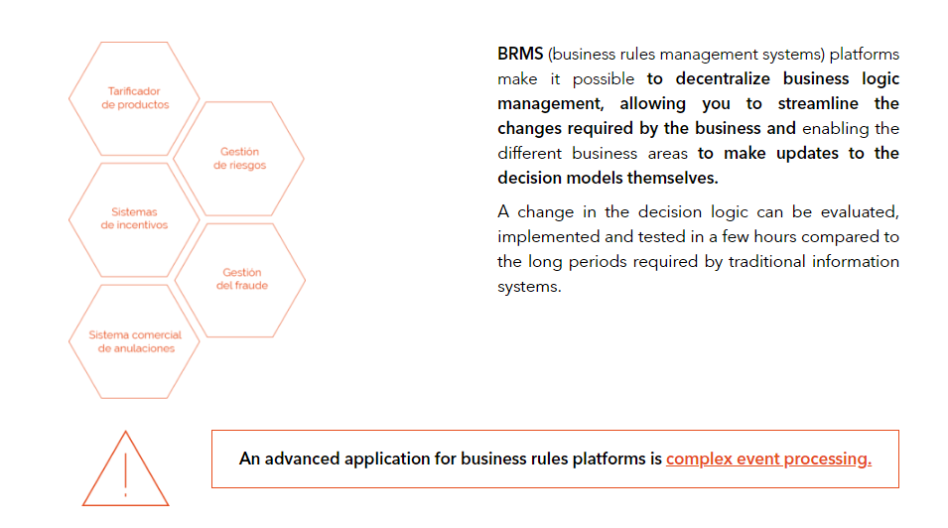

Slide 35
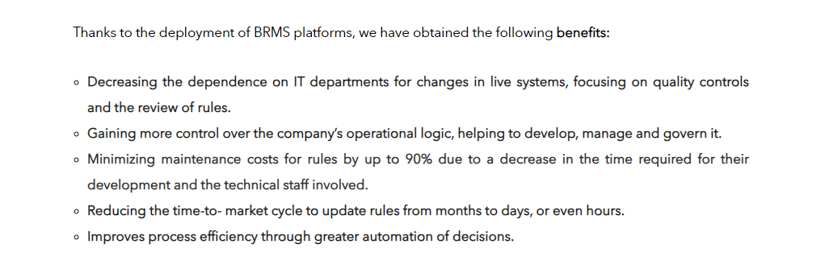
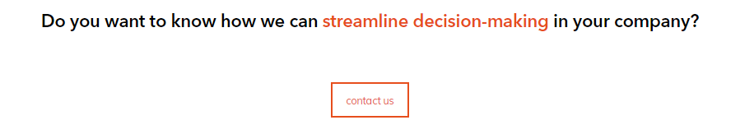
Industries in which we apply BRMS
Field Services
Transportation & logistics
Workforce Planning
Manufacturing

Slide 36
MATHEMATICAL OPTIMIZATION PAGE
https://decidesoluciones.es/en/technological-solutions/mathematical-optimization/

Slide 37



Slide 38
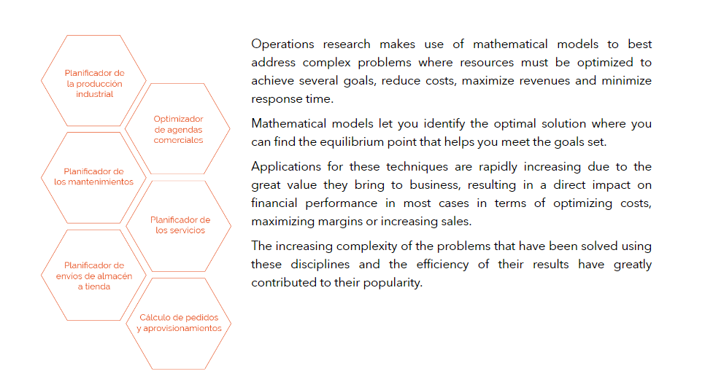
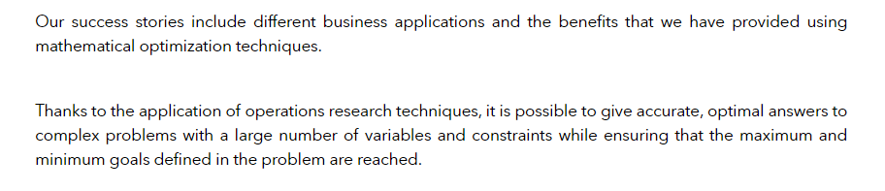

Slide 39

Industries in which we apply mathematical optimization
Field Services
Transportation & logistics
Workforce Planning
Manufacturing

Slide 40
WHO WE ARE PAGE
https://decidesoluciones.es/en/who-we-are/

Slide 41
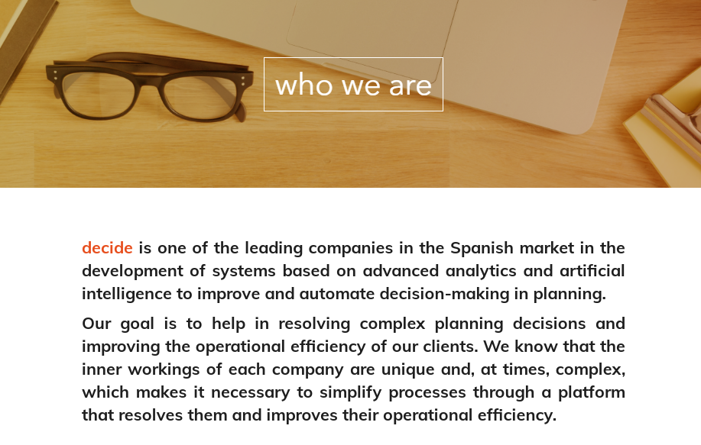

Slide 42
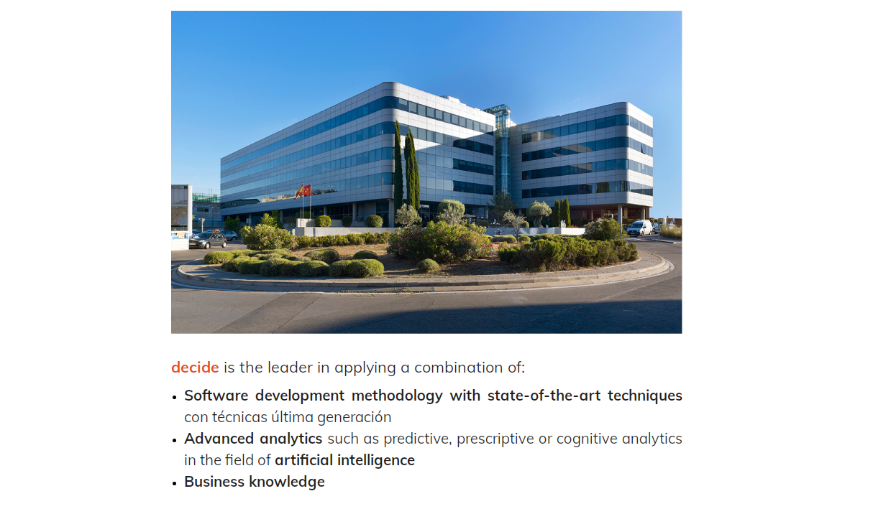

Slide 43
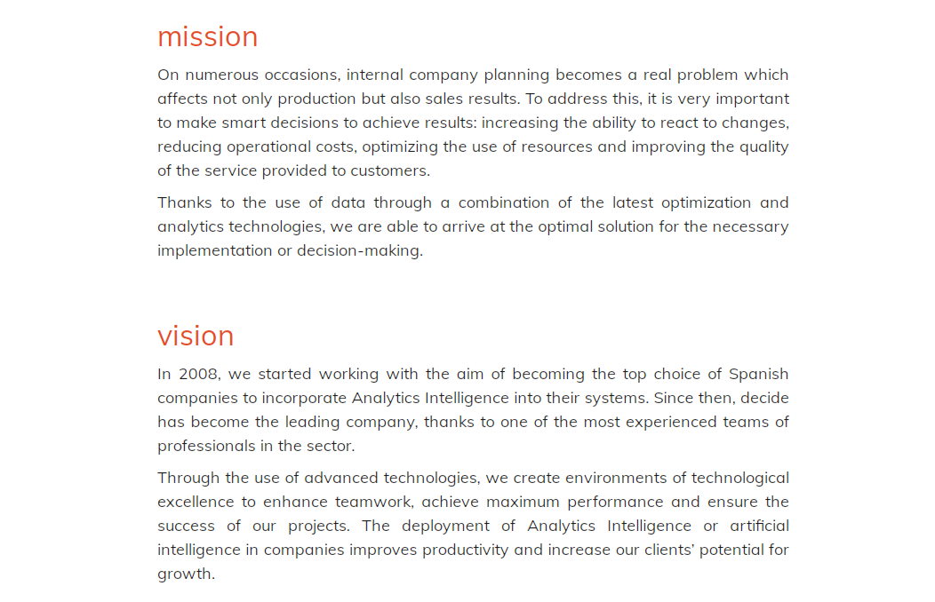

Slide 44
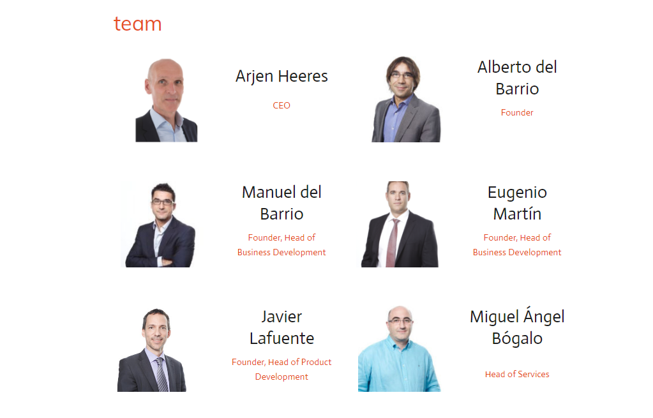

Slide 45
HOW WE WORK PAGE

Slide 46
THE LOW RISK, LOW COST APPROACH TO IDENTIFY WHAT SMART PLANNING COULD MEAN FOR YOU
Investment: free of charge
Time: 0.5 – 1 day
Investment: We only charge 50%
Time: 2-5 days
Investment: We only charge 75%
Time: 5-15 days
1
2
3
4
Initial analysis
Together we analyse the potential to improve your performance by applying smart planning. The result is a high level analysis including a clear explanation how you could increase performance. If there is no or little to win, we will you recommend not to invest any further.
Scan
Our consultants conduct a scan to analyse your data and planning process. Objective is to determine in more detail the potential performance improvement and to define a high level project plan and investment.
Prototype
Based on your data and resources, we build a prototype of a planning system that will give you real insight in the functioning of a solution. The prototype is the basis for further development in the project phase. Other deliverable is a detailed project plan.
Project
Execution of the project.
Learn more about the different engagement models.

Slide 47
ENGAGEMENT MODEL
Before entering into a project we will evaluate the engagement model, Fixed Price or Time & Material and the project methodology, Agile or Waterfall. As customer you may select your preferred model.
Fixed Price project
Especially recommendable in cases of a well defined scope and for smaller projects where the specifications are unlikely to frequently change.
Clear project plan with milestones
Payment schedule based on milestones
Responsibilities are clearly defined in project plan
No surprise project
Time & Material project
T&M projects are ideal in case of expected frequent changes in the project or if you would like to manage the project and use a team of our specialist consultants.
Full transparency and grip on project
Lower hourly costs
Changes are easily manageable
Hybrid
Per phase or sprint a fixed price with clear deliverables. Recommended for larger projects where in the course of the project insights may change.

Slide 48
PROJECT METHODOLOGY
Agile / Scrum
An agile development process and more particular the Scrum methodology, is recommend for projects where the end goal is not specified in detail. The customer is able steer the process based on intermediate deliverables and new insights can quickly be applied. In small steps, sprints, new intermediate products are delivered that can be evaluated.
Possible disadvantage is the higher level of customer effort
Waterfall
Well defined process with one big deliverable at the end of the process. In case specifications are clearly defined and no or little change is expected, this project methodology is more efficient and less customer interaction is needed.
Disadvantages are the limited possibilities to include new insights and to cater for changes.

Slide 49
SUCCESS STORIES PAGE
https://decidesoluciones.es/en/success-stories-decide/

Slide 50
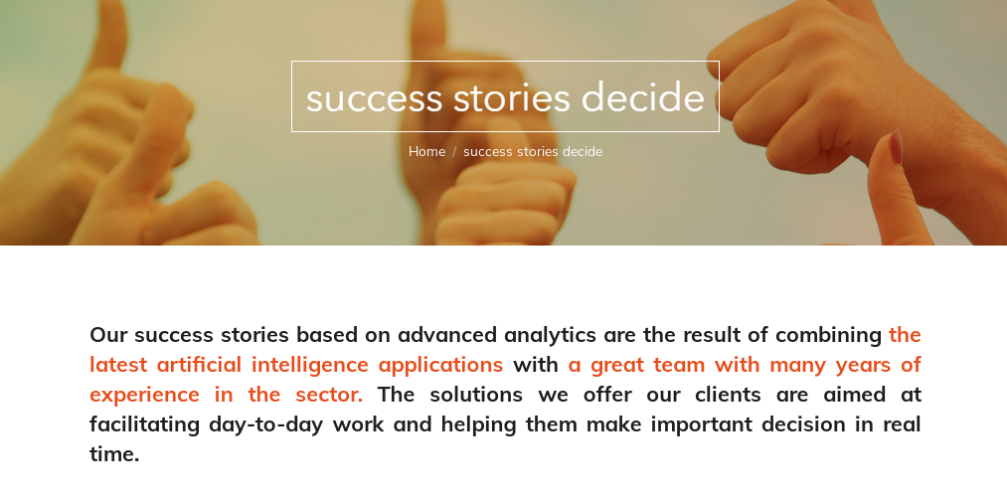

Slide 51
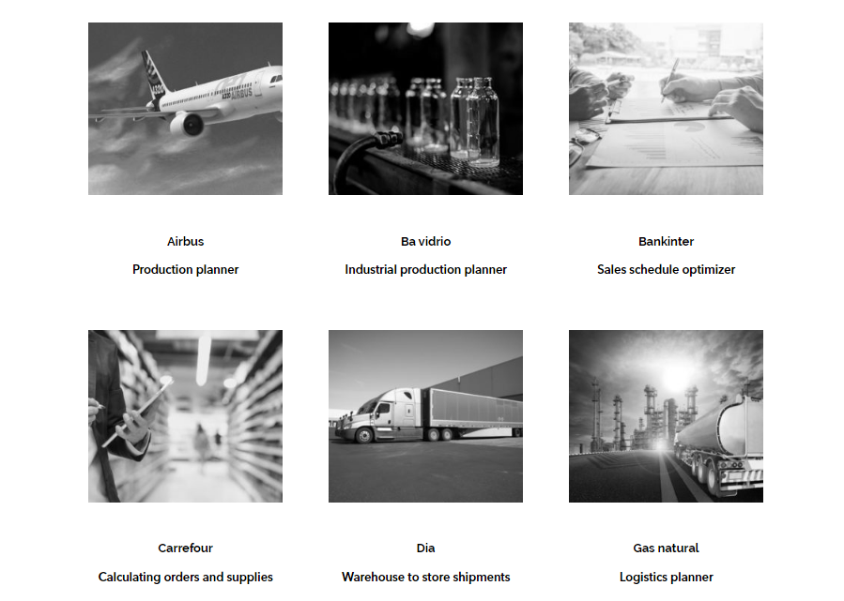

Slide 52
EXAMPLE OF A SUCCESS STORY PAGE
https://decidesoluciones.es/en/casos-de-exito/airbus/

Slide 53

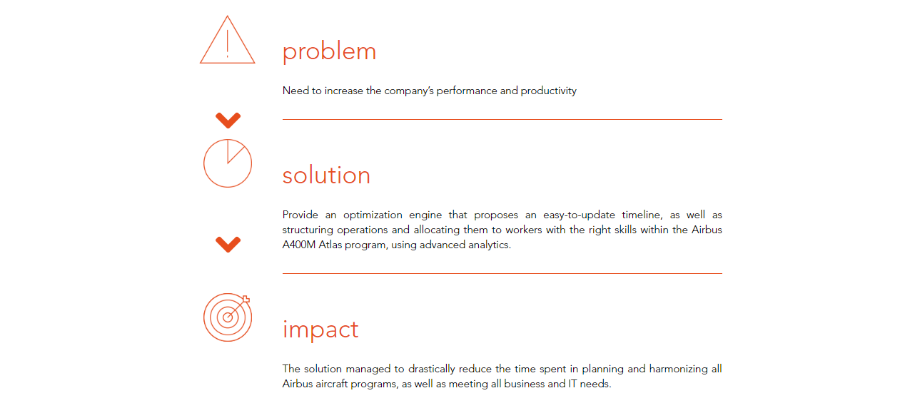

Slide 54
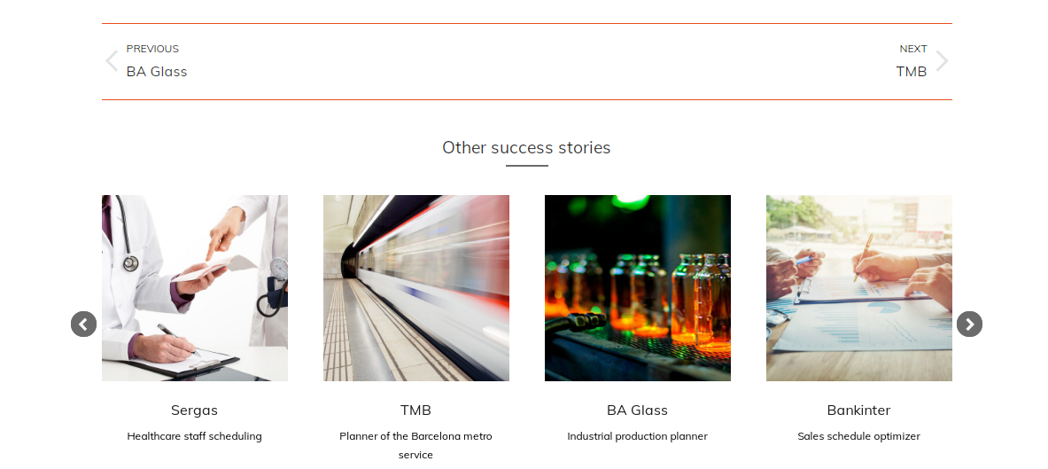

Slide 55
INTERMEDIATE PAGE (POP UP?) BETWEEN HOME PAGE AND CARRERS PAGE

Slide 56

Here is the test to find out if Decide is a good fit for you:
1. I love cracking tough programming or optimization problems
2. It’s great to work in a team with the brightest minds
I love flexible working hours
Three times Yes? Great!! Click here to find out more
BUTTOM

Slide 57
CARRERS PAGE

Slide 58

Decide for Decide!
Join us and work with the brightest minds cracking the toughest problems.
At Decide we are group of AI and optimization technology driven people. We have different back grounds and interests but we have one thing in common, we are excited about applying the latest AI and optimization technology to make things better.

Slide 59






Our values
Teamwork
We have formed teams that jointly are responsible for good results. We believe that working in a team will help you to accelerate the learning process and, perhaps even more important, it is more fun to work in a team.
Craftmanship
Our aim is to deliver the best, to make ourselves feel proud on what our customers can achieve with our technology.
Your talent
We believe that your talent is the starting point. We will not try to push you into a role description. It’s the opposite, we organize work that fits your talent and ambition. (If none of the open vacancies exactly fit, don’t worry just drop us a mail and we’ll talk).
Flexibility
Working hours are flexible and whenever possible it is up to you where you like to work. Do you prefer to work from home or in the office? Or a combination. We believe that what counts are the results.
Growth
Being a technology frontrunner means that we need people who love to follow and learn the latest advancements in AI. That is why we will help you discover and grow your talents. Your growth is our growth.
How we are
We respect differences, actually, we love differences. We believe variety and inclusion propels creativity. We treat others the way we want to be treated.

Slide 60
Find out more about our vacancies.
No exact fit? Don’t worry simply send us your CV so we can find out how to make it work.
Full stack python developer
2 – 5 years experience
Optimization / Algorithm expert
Cplex, Gurobi or similar
Junior Sales, enterprise experience
Front end developer
…………..

Slide 61
CONTACT US PAGE
https://decidesoluciones.es/en/contact/

Slide 62

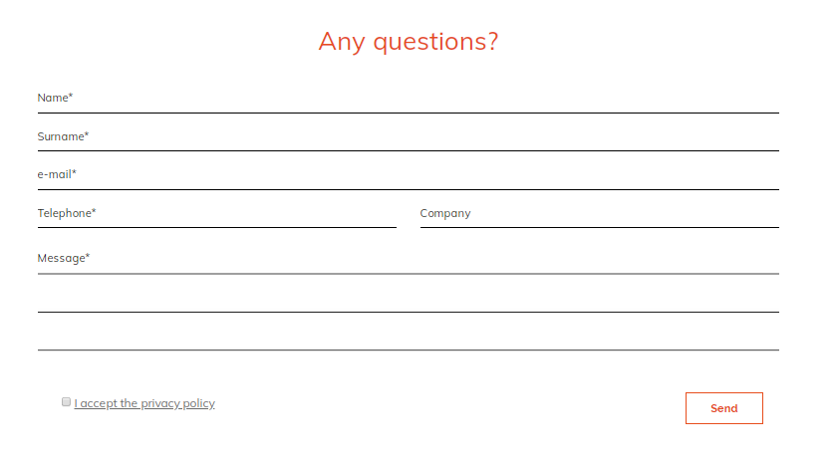

Slide 63
RESOURCES PAGE
https://decidesoluciones.es/en/blog/
We currently have a simple blog page. But we have more types of content, and we would like to be able to show: articles, infographics, whitepapers, videos and press publications.

Slide 64
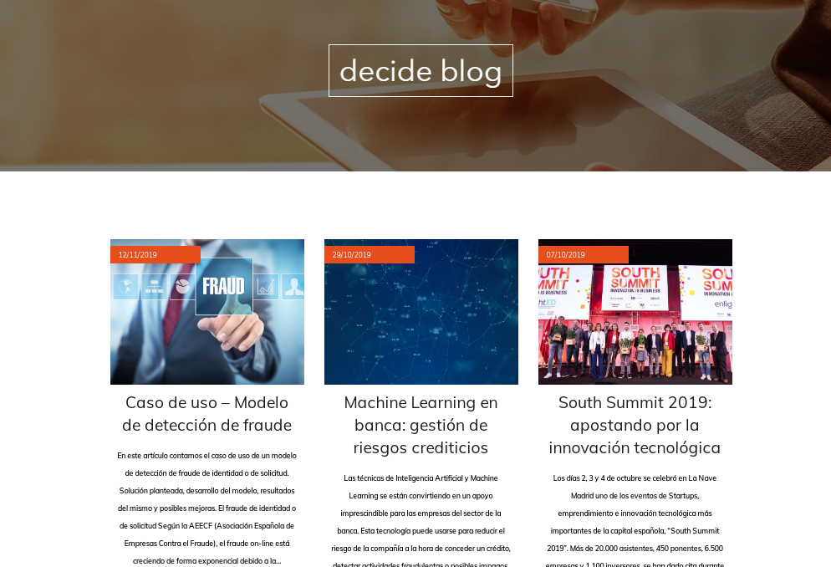

Slide 65
PARTNERS PAGE
https://decidesoluciones.es/en/partners-area/

Slide 66
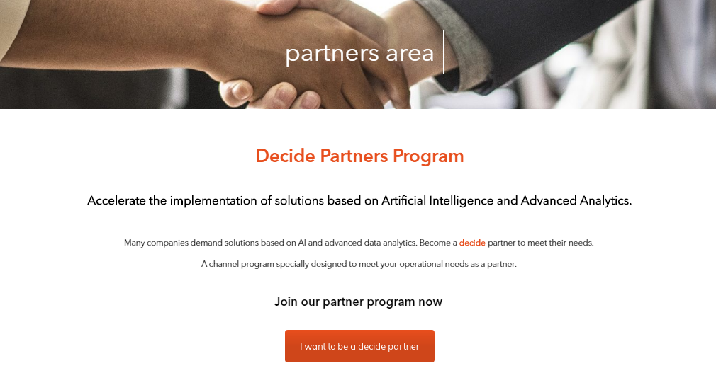

Slide 67
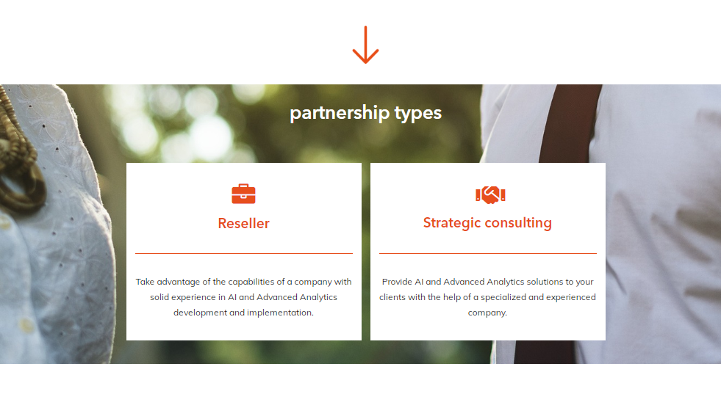

Slide 68
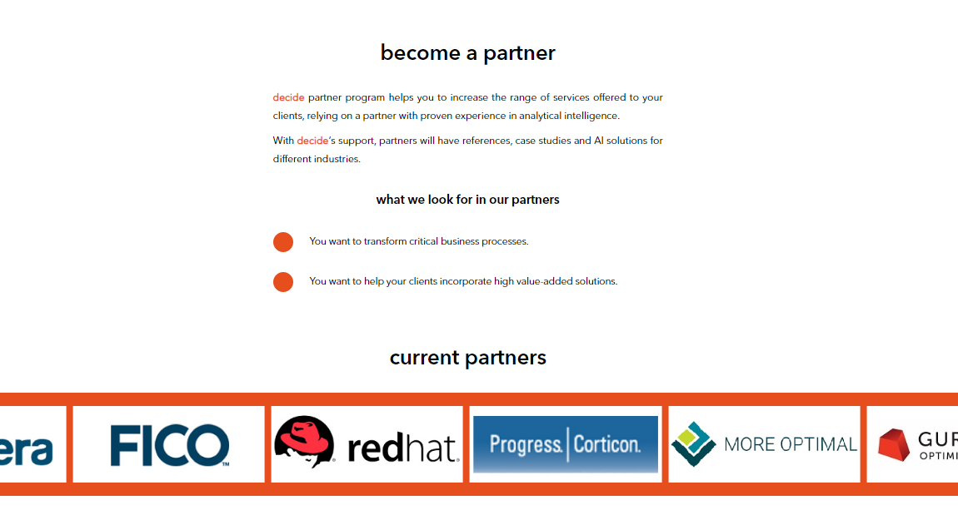

Slide 69
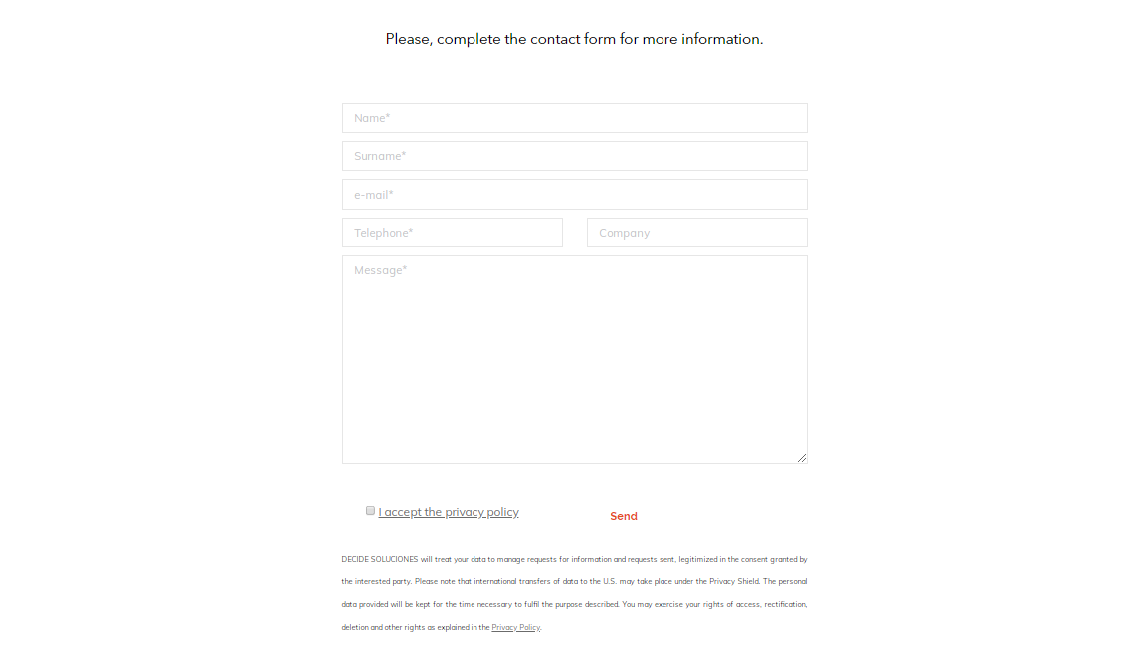

Slide 70
We can't wait to see your work!

